Slide 1
EIC Detector(s)
Consensus within the EIC community:
  A least 1 general purpose detector
  Needs for a second detector - majority favors a second general purpose detector instead of more specialized detector
  Arguments for 2 detectors similar as for every collider
  The 2 detectors should be complementary
  Both machine designs include at least 2 IRs
Backward
Forward

Slide 2
Unique Requirements
Challenges
  Hermeticity
  Precision + compactness ⇒ large fields (~ 3 T)
  Low mass precision tracking
  Broad PID range (e and π/K/p)
    250 MeV/c - 50 GeV/c
  Good calorimetry
    HCAL: extreme req. in forward region (<50%/√E)
    EMCAL: extreme req. backwards region (<2%/√E)
Moderate Requirements
  Modest radiation hardness requirements, low pile-up, low multiplicity
p (GeV/c)

Slide 3

R&D Efforts
  Laboratory Directed Research & Development Programs (LDRDs) at National Labs in the US (BNL, JLAB, ANL)
  R&D at Belle-II and Panda has some overlap with EIC
  CERN/LHC
    No R&D on key EIC challenges (PID, ECal)
    R&D for phase-I upgrades ended, phase-II focus on radiation hardness and rate
  Generic EIC Detector R&D Program
    Started in 2011 by BNL, in association with JLab and DOE NP
    Funded by DOE NP, through RHIC operations
    Program explicitly open to international participation
    Standing EIC Detector Advisory Committee with internationally recognized detector experts
Current: Marcel Demarteau (ANL, Chair), Carl Haber (LBNL), Peter Krizan (Ljubljana), Ian Shipsey (Oxford), Rick Van Berg (UPenn), Jerry Va’vra (SLAC), Glenn Young (JLab)

Slide 4
Generic EIC Detector R&D Program
  Typical 10-11 projects supported at any time
  Attempt to merge projects in larger consortia when related (calorimetry, tracking, PID, Si-Vertex)
  Participation:
    46 institutions (13 non-US), 6 Natl. Labs
    187 participants
    Important seed for formation of EIC collaborations
    Since 2016 budget flat at $1M/year
  Requested funds exceed available funds by factor 2.5 (FY18)
  Despite being underfunded projects make steady and excellent progress.
  Need for increased R&D to meet challenges as recommended in 2015 LRP
    Funding is spread too thin
    Funding fewer would discourage many & excludes groups with expertise that want to get involved
N.B.: Generic RHIC detector funding was ~$4M in 2018$

Slide 5
Supporting Slides

Slide 7
FY19 Projects
11 Projects approved for FY19
  eRD1 - Calorimeter consortium
  eRD6 - Tracking/PID consortium
  eRD14 - PID consortium
  eRD22 - GEM Transition Radiation Detector (TRD)
  eRD16 - Fwd Silicon tracking
  eRD18 - Central Si tracking/Si sensors
  eRD15 - Compton spectrometer
  eRD17 - e+A Simulations/Nuclear Breakup (BEAGLE)
  eRD20 - Software consortium
  eRD21 - Background studies
  New - DAQ/Streaming Readout
Green = consortia

Slide 8
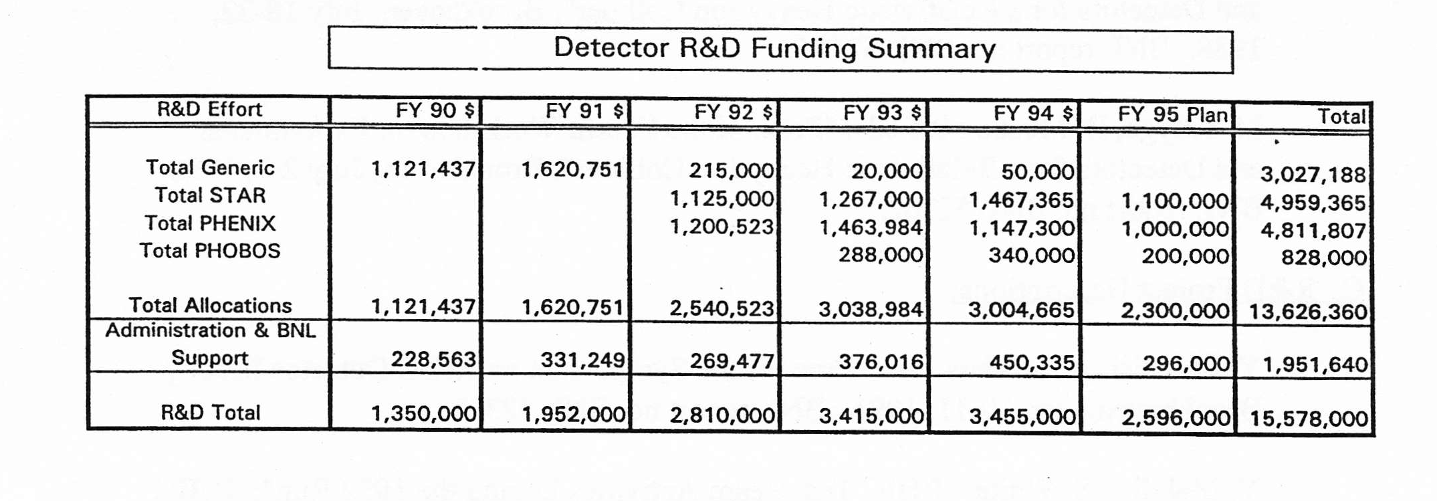

Look back at RHIC Detector R&D
2018 $
$2,598,651.87
https://www.usinflationcalculator.com
$3,605,725.23
$5,038,932.86
$5,945,834.05
$5,865,293.79
$4,285,580.37
Current generic R&D level for EIC: $1M
EIC detector has 2-3 more subsystems than RHIC detector

Slide 9
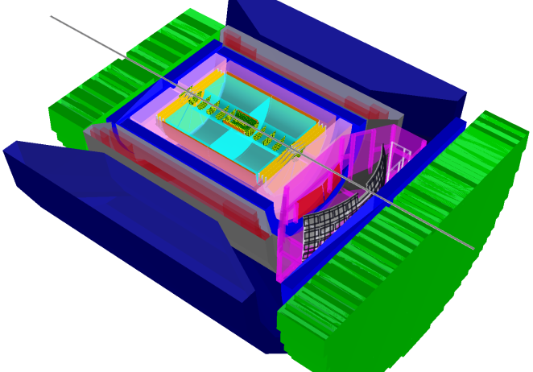
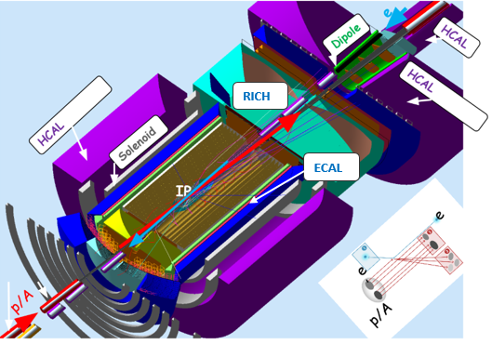
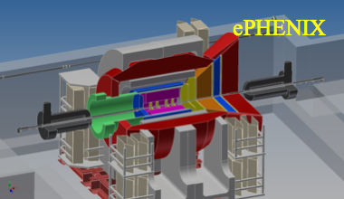
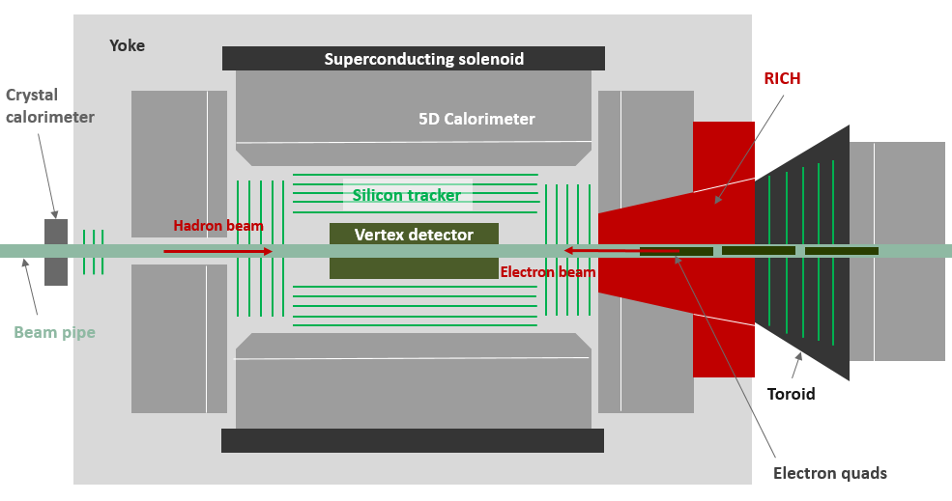
Current EIC Detector Concepts
Brookhaven concept: BEAST
Jefferson lab concept: JLEIC
Current Concepts
  Important as test bed for detector R&D
  Each attempt to match requirements
  Nothing is cast in stone
  Will evolve as new concepts are developed
sPhenix → ePhenix
Argonne concept: TOPSiDE

