Slide 1
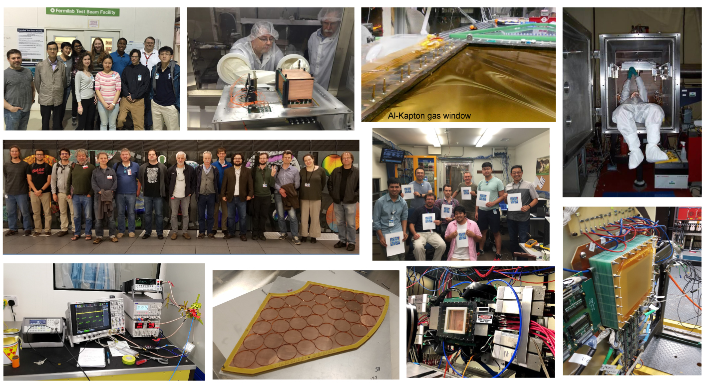
Detector R&D
Photos in part from talks at EIC Detector R&D Committee Meeting: July 26/27, 2018, CUA
Thomas Ullrich, EIC User Meeting
CUA, Washington DC, July 29, 2018

Slide 2
Setting the Stage: EIC Detector(s)
Consensus within the EIC community:
A least 1 general purpose detector
Needs for a second detector - majority favors a second general purpose detector instead of more specialized detector
Arguments for 2 detectors similar as for every collider
The 2 detectors should be complementary (different strengths) - success of combined HERA data is good example
Both machine designs include at least 2 IRs

Slide 3
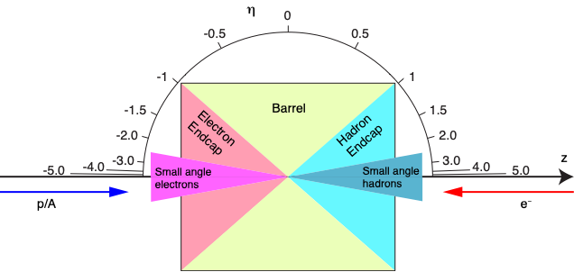
General Purpose EIC Detectors
Backward
Forward

Slide 4
General Purpose EIC Detectors
Backward
Forward
Magnet
Originally many solutions discussed (Dipole, Toroid, …)
Focus now on Solenoidal Magnet
Compact EIC detector requires large fields: B ~ 3T
Available magnet: BaBar B = 1.5 T
No ongoing R&D

Slide 5
General Purpose EIC Detectors
Backward
Forward
blue = ongoing R&D
Polarization/Luminosity
Electron Polarization: Compton Process (need 1% or better)
Proton/Light Ion Polarization: experience from RHIC but tighter requirements at EIC
Luminosity Measurements

Slide 6
General Purpose EIC Detectors
Backward
Forward
blue = ongoing R&D
Barrel
Si-Vertex tracker: low X/X0, resolve charm vertices ⇒ MAPS, ….
Main tracker: p, dE/dx ⇒ TPC, Si-Tracker, GEM, MMG, μRWELL, …
Particle ID (PID): p < 10 GeV ⇒ DIRC, EMCal, …
EM Calorimetry: e/h, γ, π⁰, …
Hadron Calorimetry: jets (neutral component) ⇒ optional
Muon Detector: vector mesons ⇒ optional

Slide 7
General Purpose EIC Detectors
Backward
Forward
Forward
Si-Vertex tracker: resolve charm vertices ⇒ MAPS, ….
Tracker: p ⇒ GEM, MMG, μRwell, …
Particle ID (PID): p < 50 GeV ⇒ RICH, TRD, …
EM Calorimetry: E, e/h, γ, π0, …
Hadron Calorimetry: E, e/h, jets ⇒ high resolution needed

Slide 8
General Purpose EIC Detectors
Backward
Forward
Very Forward
Nuclear Breakup/Fragments: ZDC, Roman Pots, Forward proton detector
Proton pT, t measurement: Roman Pots

Slide 9
General Purpose EIC Detectors
Backward
Forward
Backward
Si-Vertex tracker
Tracker: p ⇒ GEM, MMG, μRwell, …
Particle ID (PID): ⇒ RICH, EMCal
EM Calorimetry: E, e/h ⇒ high resolution needed

Slide 10
General Purpose EIC Detectors
Backward
Forward
Very Backward
Access to low Q² region: Low Q2 tracker

Slide 11
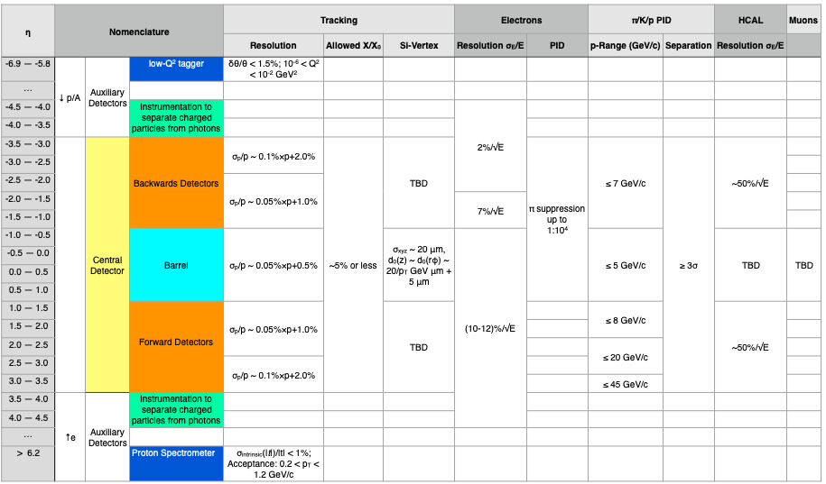
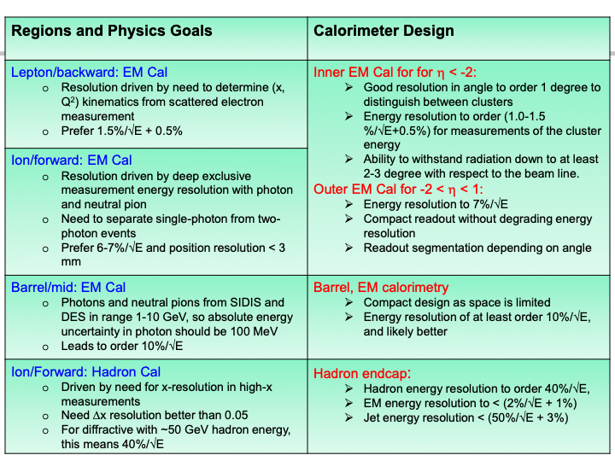
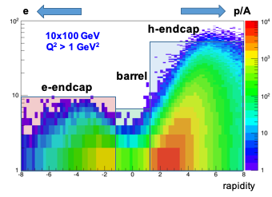
R&D Driver: Requirements
Big View:
Hermetic detector, low mass inner tracking
good PID (e and π/K/p)
extreme requirements in forward region
Good calorimetry
HCAL: extreme req. in forward region
EMCAL: extreme req. backwards region
Moderate radiation hardness requirements, low pile-up, low multiplicity
Hard Numbers:
General consensus on many fronts but need more refinement
Identify physics driver and specify/verify needs
Also need to take into account correlation between subsystems
p (GeV/c)
Within the next year we need to refine detector requirements from detailed simulations focusing on main physics driver
From R&D Handbook (later more)
eRD1: Tanja Horn
From WP

Slide 12
Generic EIC Detector R&D Efforts
Generic EIC Detector R&D Program (covered here)
Other substantial efforts with impact on EIC
Laboratory Directed Research & Development Programs (LDRDs) at National Labs in the US (BNL, JLAB, ANL)
CERN
R&D program with partial match with EIC needs (e.g. RD51 Micro-Pattern Gas Detectors Technologies)
LHC Experiments R&D for phase-I upgrades, especially ALICE (TPC, ITS, SAMPA) and LHCb (RICH, trigger less DAQ). Now in production, R&D finished.
R&D at Belle-II and Panda (crystals, DIRC, …)
ILC related R&D
Notes:
DIRC = Detection of Internally Reflected Cherenkov light

Slide 13
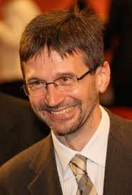
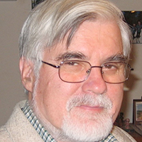
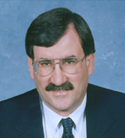
Generic EIC Detector R&D Program
Started 2011 BNL, in association with JLab and the DOE Office of NP
Funded by DOE through RHIC operations funds
Program explicitly open to international participation
Standing EIC Detector Advisory Committee consisting of internationally recognized experts in detector technology
Meets twice a year, funding limited to one year (FY)
~January: Review of ongoing projects
~July: Review and new proposals
Current: Marcel Demarteau** (ANL), Carl Haber (LBNL), Peter Krizan (Ljubljana),
Ian Shipsey (Oxford), Rick Van Berg (UPenn), Jerry Va’vra (SLAC), Glenn Young (JLab)
Retired:
Robert Klanner (Hamburg),
Howard Wieman (LBL)
**Chair
URL: https://wiki.bnl.gov/conferences/index.php/EIC_R%25D

Slide 14
R&D Program In Numbers
Typical 10-11 projects supported
Attempt to merge projects in consortia when related
Participation:
46 institutions (13 non-US)
6 Natl. Labs
187 participants
Since 2016 budget flat ~$1M
Requested funds exceed available funds by factor 1.5-2.5
LRP
N.B.: Generic RHIC detector funding was $4M in 2018$

Slide 15
FY19 Projects
11 Projects are considered in FY19
eRD1 - Calorimeter consortium
eRD6 - Tracking/PID consortium
eRD14 - PID consortium
eRD22 - GEM Transition Radiation Detector (TRD)
eRD16 - Fwd Silicon tracking
eRD18 - Central Si tracking/Si sensors
eRD15 - Compton spectrometer
eRD17 - e+A Simulations/Nuclear Breakup (BEAGLE)
eRD20 - Software consortium
eRD21 - Background studies
New - DAQ/Streaming Readout
Green = consortia
Notes:
Project Engineering and Design

Slide 16
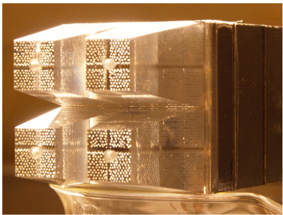
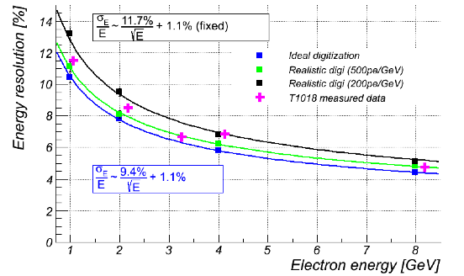
W-SciFi Calorimetry (eRD1)
UCLA/BNL/IU/PSU/TAMU
Scintillating fibers embedded in W-powder composite absorber
Development led to working prototypes with good energy & position resolutions, choice of readout technology, all coupled with levels of radiation hardness that would result in a capable EM calorimeter for the barrel and hadron-going directions at an EIC.
Technology is used for EMCal in sPHENIX
Issue: In RHIC beam in 2017, η=3.75, ~10¹¹ n/cm² SiPM show non-homogeneous degradations ⇒ need for a good monitoring system for a W-SciFi calorimeter (future project?)

Slide 17
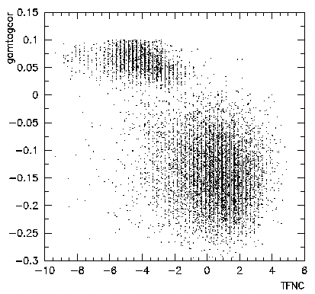
Hadron Calorimetry (eRD1)
UCLA/BNL/IU/PSU/TAMU
New effort: examine timing of signals from a hadronic calorimeter to possibly dramatically (factor 2) improve energy resolution
Utilization of observable correlated with the total number of neutrons in the shower to make correction to the observed total energy on the event-by-event basis.
Ratio of Cherenkov to Scintillation light in DREAM
Timing information of shower development may be used in a similar fashion.
In addition: ZEUS FNC Tile/WLS method to use timing for e/h separation
FY19: proof of principle using a small, 3x3 prototype (iron and lead absorber and scintillation tiles) in FNAL test beam
EM
Had
Notes:
Figure 5 shows scatter plot showing ratios of Cherenkov-to-Scintillation for 50 GeV
pions, and ratio of energy deposited in the first 1.25 ns to the total energy deposited in
the calorimeter, as predicted by MC (IEEE Transaction on Nuclear Science, Vol.63,,
No2, April 2016, A. Benaglia et al.). In both cases, a reliable correction to the total
energy is possible on event-by-event basis.

Slide 18
Scintillating Glasses (eRD1)
IPN-Orsay, CUA,
VSL, Caltech
e-going direction needs high precision calorimetry (≲ 2%/√E)
Requires Lead Tungstate (PbWO4) crystals
Despite progress still a struggle to work with vendors (SICCAS & CRYTUR) to get high quality PbWO4 crystals
New effort: Study various scintillating glasses
Similar to lead glass in many properties but exhibit up to 100x the light yield per GeV.
Path to inexpensive high resolution EM calorimeters
Past: Limited to small samples due to difficulties with scaling up the production while maintaining the needed purity.
The VSL at CUA offers the facilities and expertise
Samples made at CUA/VSL with new method. 35 times lighoutput of PbWO4
Notes:
Vitreous State Laboratory (VSL).

Slide 19
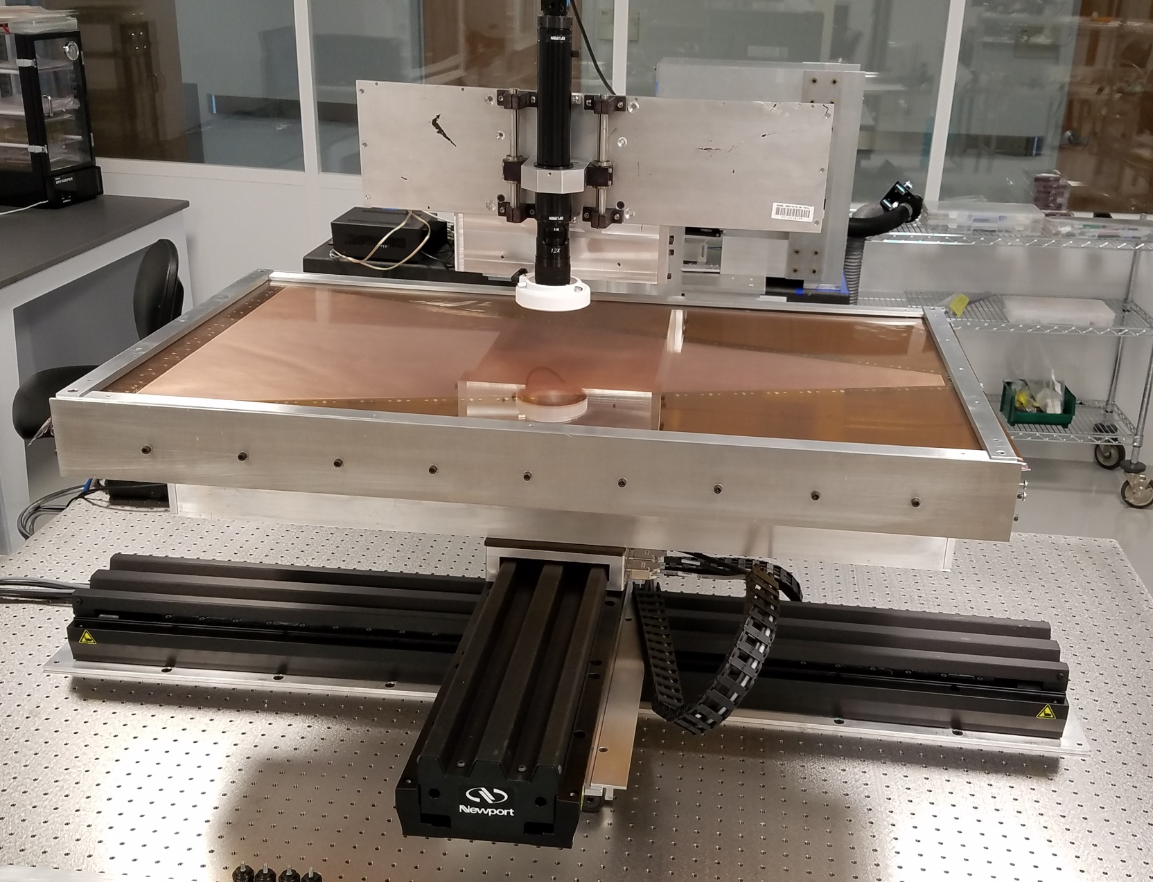
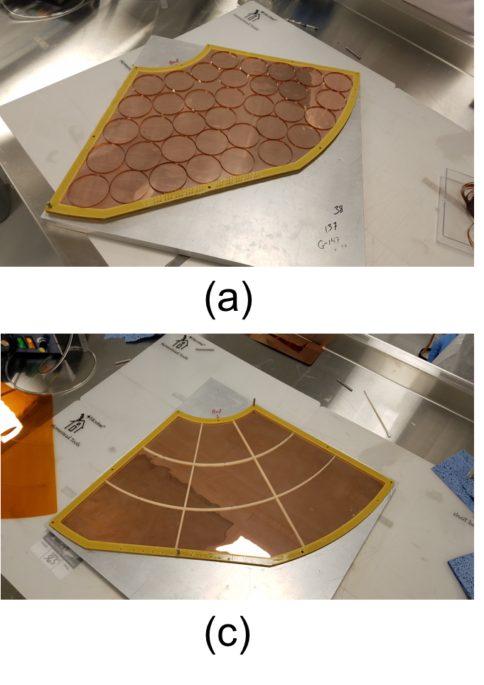
GEM R&D Program (eRD3)
Temple, Saclay
Effort concentrated on forward GEM and barrel MMG tracking solutions
Large, well equipped, laboratory has been created at Temple University partly from this program but with significant help from the University.
The laboratory now includes optical CCD-based scanners for large GEM foils, ultrasonic baths, and an X-ray characterization station
Real resource for the MPGD community
Analyzed foils for BONUS experiment and Mecaro (Korean company).
Characterization with cosmics and x-rays of triple-GEM detector with Kapton spacer rings and G10 spacer grids closes out the eRD3 program.

Slide 20
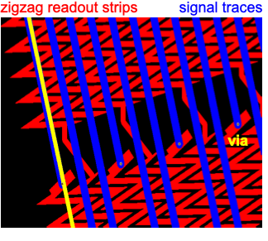
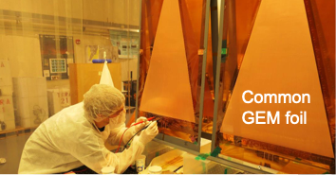
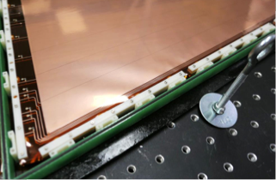
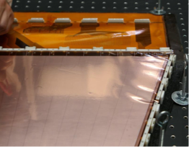
Large, Low-Mass Prototype GEMs (eRD6)
Initial assembly of carbon-fiber frame prototype and test
Encouraging:
CF frame doesn’t show any large deformation when stack is tensioned
No issues with conductivity of CF
Total chamber mass below 3 kg (w/ HV filter but w/o FE electronics)
First data: Readout uses long zigzag strips, find low noise
Problematic:
Detector did not hold full voltage (HV trips) probably caused by on parts by insufficient stretching of the 5 foils in the stack
Remedies:
Redesign and improvement of inner frames and pull outs
FY19: pull-outs with a more solid design (PolyEther Ether Ketone)
FIT
Notes:
PEEK Polyether ether ketone

Slide 21
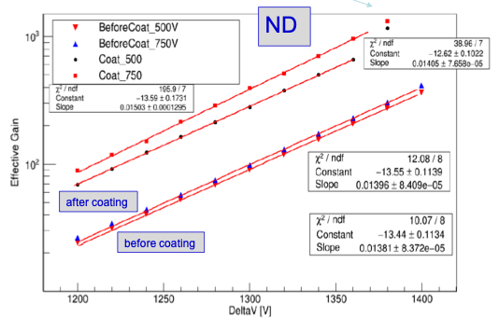
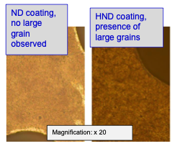
R&D on MPGDs for RICH Detectors
INFN
Trieste
Gaseous single-photon detection with MPGDs for high-momentum RICH
Development of resistive MMG prototype with miniaturized pad-size
Use of innovative photocathode based on NanoDiamond (ND) particles coupled to MMG
Near future:
Beam test with MMG + ND
Production of a new set of small-size THGEM coated with ND and hydrogenated ND (HND)
Notes:
High pt -> gas RICH

Slide 22
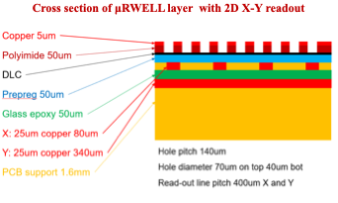
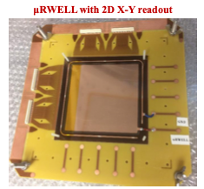
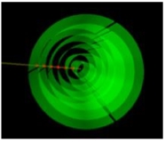
μRWELL Detectors (eRD6)
FIT, UVA, Temple
Resistive micro-well detector (μRWELL) detector
HV drift cathode, a drift gap, and a micro-well layer (similar to a single GEM foil) which is mounted on a resistive readout board
Combines the advantages of both GEM and Micromega MMGs, needs no stretching
Goal: cylindrical μRWELL layers (possible part of main tracker)
Acquired and assembled one small 10 cm × 10 cm prototype with 2D X-Y strips readout
X-Y strips signal are shared through capacitive coupling
Analysis of the data just started and is ongoing

Slide 23
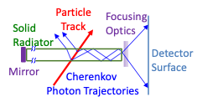
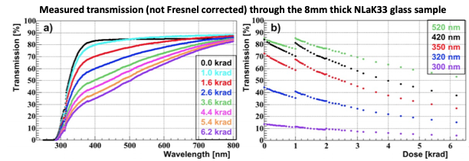
Particle ID with RICH Detectors (eRD14)
Developing a suite systems covering the full angular- and momentum range required Imaging Cherenkov detectors are the primary technology
Current Projects
DIRC: 10 GeV/c for p/K, 6 GeV/c for π/K, and 1.8 GeV/c for e/π
Focus on lens: radiation hardness test & realization of 3-layer lenses with improved radiation hardness using PbF2 and sapphire.
Preparation for transfer of PANDA DIRC prototype to the US.
Notes:
In a DIRC (Detection of Internally Reflected Cherenkov light), another design of a RICH detector, light that is captured by total internal reflection inside the solid radiator reaches the light sensors at the detector perimeter, the precise rectangular cross section of the radiator preserving the angular information of the Cherenkov light cone.

Slide 24
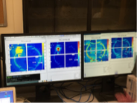
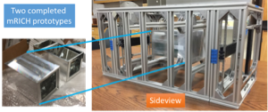
Particle ID with RICH Detectors (eRD14)
dRICH: RICH with two radiators (gas + aerogel) to cover the full momentum range: more than 3 s.d. separation for π/K/p over 3-50 GeV/c in forward region (up to 15 GeV for e/π)
Focus on simulations
FY19: Build small prototype (with INFN support)
mRHIC: Compact aerogel RICH covering up to 10 GeV/c (π/K/p)
First RICH with (Fresnel) lens focusing
Test beam data taken in June/July 2018
FY19: Use mRICH to work on integrated readout sensor electronics solution for all Cherenkov systems
Beam test at Fermilab 6/2018
Institutes: ACU, ANL, BNL, CUA, William & Mary, Duke, GSU, GSI, Howard, INFN Ferrara, INFN Roma, ISS Rome, JLAB, LANL, ODU, USM, UIC, UNM, SC, Yale
Notes:
In a DIRC (Detection of Internally Reflected Cherenkov light), another design of a RICH detector, light that is captured by total internal reflection inside the solid radiator reaches the light sensors at the detector perimeter, the precise rectangular cross section of the radiator preserving the angular information of the Cherenkov light cone.

Slide 25
Something to Worry About
Photon Detectors: The most important challenge is to provide a reliable highly-pixilated photodetector working at 2-3 Tesla. This problem is not yet solved.
SiPMTs: in the past rejected for RICH detectors because of the neutron damage. This needs dedicated studies.
MCP-PMTs: As far as MCP-PMTs, we do not know if the present MCPs are even designed right for the 2-3 Tesla operation. Needs studies.
Large-Area Picosecond PhotoDetector (LAPPD)
Commercialized by INCOM after initial development by LAPPD collaboration
Promising but still not fully applicable for EIC needs. Work is needed on improving LAPPD’s in strong fields while maintaining QE and resolution. This is a major action item.
See also talk by S.Dalla Torro on Sunday
Notes:
Large-Area Picosecond PhotoDetector (LAPPD)

Slide 26
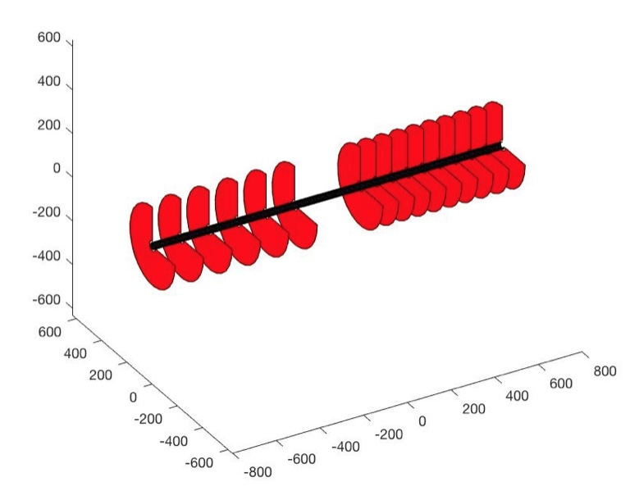
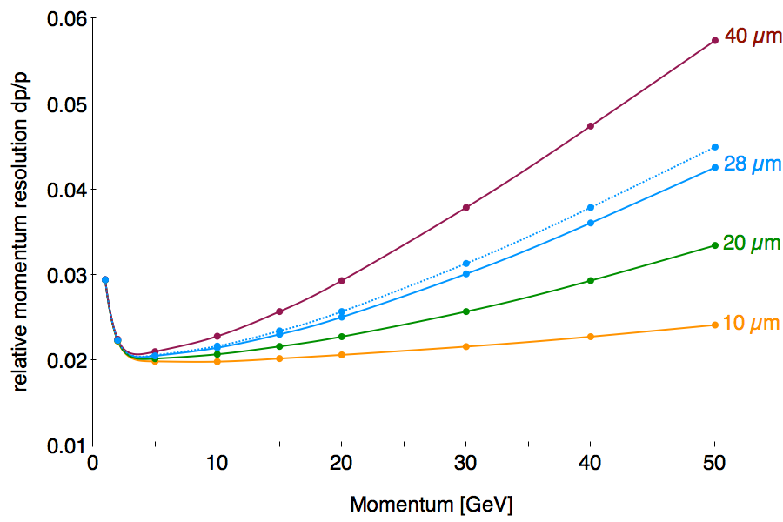
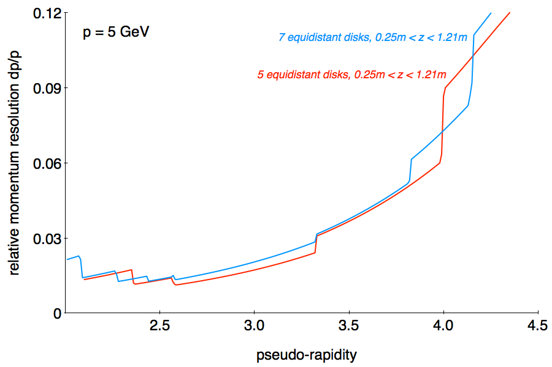
Forward/backward Silicon Tracking (eRD16)
Aim: Conceptual design of Si-tracker for forward/backward scattering angles
Science-driven sensor specifications
Optimized disk geometry and layout
Conceptual arrangement of services,
Optimized integration with inner Si-tracker,
Close collaboration with eRD18 (barrel Si-tracker)
LBL

Slide 27
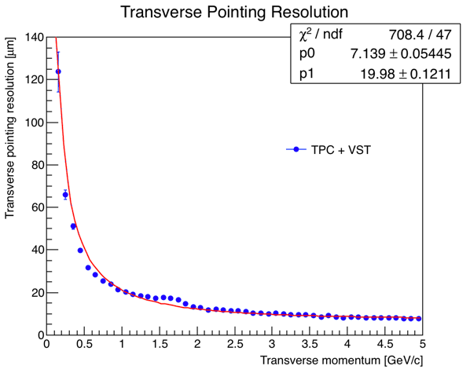
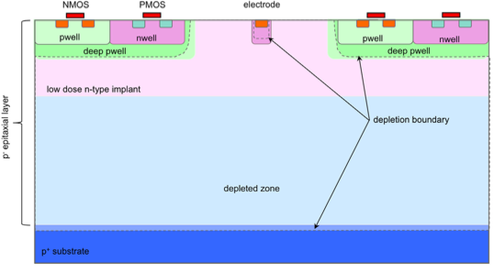
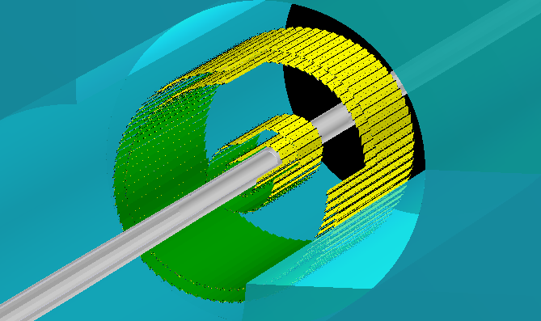
Central Si Tracking and Vertexing (eRD18)
Birmingham
Aim: Conceptual design based on depleted MAPS
Sensor development
Selected technology: TowerJazz 180 nm modified process
Fully depleted with small collection electrode
Prototype test structures evaluated
Drafted preliminary EIC DMAPS specifications
Considering a timing layer with faster readout to tag bunch crossings
Layout simulations / detector performance
20 x 20 μm² pixels
m @ 1 GeV/c
W. Snoeys, NIMA 871 (2017) 90–96

Slide 28
FY19: Si Tracker Efforts (eRD16&18)
Sensor development
CERN-TJ Investigator 2 chip
ATLAS MALTA chip
Additional designs will be available in fall
Work with chip designer at RAL
Simulate possible readout architectures
Explore tradeoff between power and pixel size
Explore interface of barrel with forward/backward disks
Study trade-offs between barrel lengths and disk radii
Explore low-mass mechanical support concept(s) and cooling
Perform initial set of fast and slow simulations towards an all-Si tracker

Slide 29
Background Studies (eRD21)
Background Studies and the impact on the IR and Detector design/operation, electronics, beamline components
Synchrotron radiation, beam-gas interactions, beam halo effects and beam losses, neutron flux, …
Substantial progress in FY18 created and benchmarked realistic simulation tools and techniques with a validation procedure using the HERA configuration
Applied this work to current JLEIC configuration (realistic machine configuration, vacuum pipe geometry and materials) to produce the first results of background due to synchrotron radiation.
Developed tools and procedures of general applicability to any EIC design
BNL team have now joined eRD21.
JLAB, SLAC, UCONN, ODU, BNL

Slide 30
Take Away Message
Despite not having a concrete detector design created by established collaborations the subsystems needed are rather well defined although choice of technology is still open in many places
Requirements are approximately known but need to be refined further
The EIC R&D program is a vital part of the EIC efforts with many active participants
Despite being underfunded the projects make steady and excellent progress. Publication record is very good.
For the first time in 4 years the number of proposals is dropping
Big challenges in PID (see next talk by Elke) that need our full attention. LAPPDs are of great importance.

Slide 31
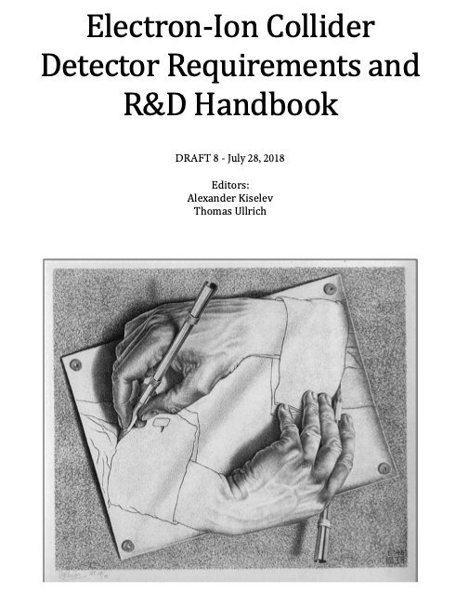
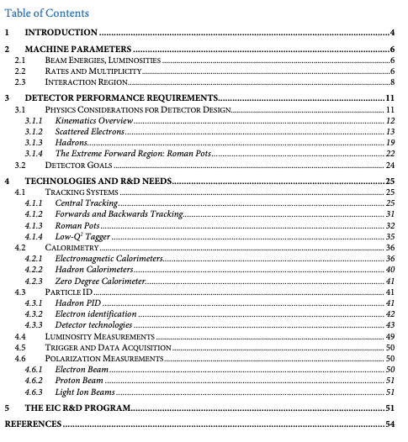
Project: EIC Detector Handbook
“Living” document on detector requirements, R&D needs, available technologies, EIC kinematics and more
Should be (once released) regularly updated as requirement get refined
Needs user input - don’t complain, write and add to it or change and improve
Received lots of input from members of eRD1, eRD6, eRD14, eRD18, eRD22
Editors (A. Kiselev, TU) now integrating text, ref., figures, iterating with authors
Currently 53 pages and growing
Missing: Trigger and DAQ, parts of pol. measurement, hadronic calorimeter
Plan first release in August (yes 2018)

Slide 32
Backup Slides

Slide 33
Definitions
Generic EIC Detector R&D
R&D that focuses on the need for any EIC detector
Independent of any specific design that might or might not features a subsystem with that technology
Needs clear motivation that it is targeted on EIC needs
Performed by anyone in and outside US
Little/No Preconstruction Engineering & Design (PED) supported
Targeted EIC Detector R&D
R&D that focuses on the need for a specific EIC detector
Collaboration in place and mature detector design exist
R&D is mostly conducted by collaboration members
PED is included at some level

Slide 34
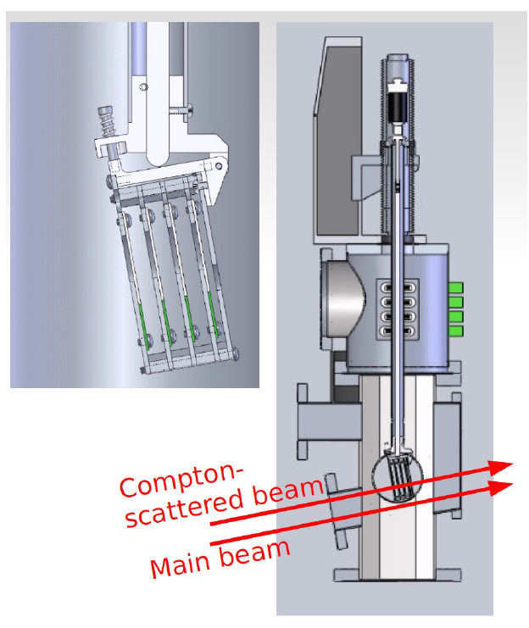
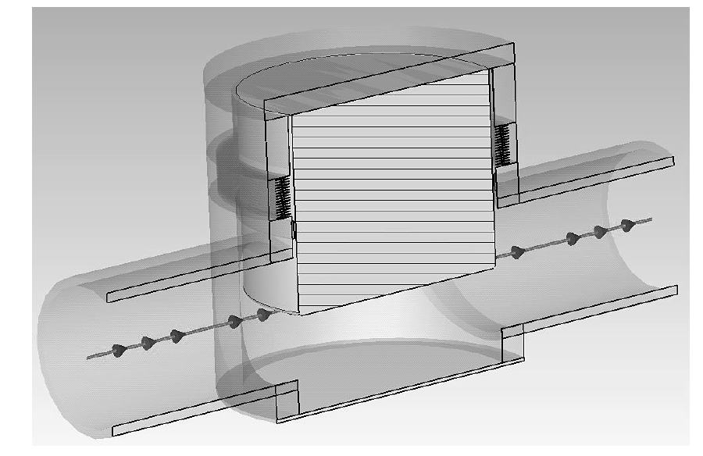
eRD15 Compton electron detector R&D
Compton photon
calorimeter
g_{c}
Green laser
Electron detector not in direct view of synchrotron fan
Compton electron
tracking detector
e⁻ beam to spin rotator
e⁻ beam from IP
Photons from IP
Hall C Compton
diamond detector
Compton polarization through Compton backscattering, study of electron detection
few planes of strips to determine electron momentum from magnet deflection
1% or better electron polarization measurement
Best measurement Compton electron detector at SLD ( ~0.5%)
looking at Roman Pot option on electron side for detector protection, cooling and access
Status
Event generator and polarization analysis code package done
Background from Brehmstrahlung, Interaction Point and halo under control : 10 W laser power CW seems adequate
Preliminary Wakefield study shows detector can be operated with JLEIC beam structure at 3A
Roman pot windows still allows measurement at 1% level
TOTEM Roman Pot

Slide 35
R&D plans
incorporate TOTEM Roman Pot design into EIC detector lattice
preliminary pipe, chamber and vacuum design and beam induced background using Molflow
optimization of shielding and geometry to minimize Wakefield
beam test to validate simulation
optimization of electronics and detector for potential bunch by bunch measurement ( if needed )
study and improvement of systematics of measurement for better than 1% measurent

Slide 36
EIC Software Consortium (ESC)
ANL, BNL, FNAL, JLAB, SLAC, Trieste, W&M
ESC goals and focus
reach out to the EIC community
communicate present status of EIC software
bring existing EIC software to the end users
produce publicly available consensus-based documents on critical subjects
provide vision for the future
continue work on common interfaces (e.g., geometry, file formats, tracking)
explore new avenues of software development (e.g., machine learning)

Slide 37
ESC status and plans
Considerable progress in FY18
Reach out to the EIC community
Bring existing EIC software to the end users
Play active role in software-related workshop organization
Gain missing knowledge and apply it to practical tasks
Arrange expert discussions and come to a consensus-based decisions
Take measures to prevent future EIC software divergence
Try to establish forward looking vision of EIC software
Work closely with EICUG Software Working Group
FY19 goals
Development of Detector Simulations
Geant4 Simulations physics list, validation
Interfaces and integration “software sandbox”, event data model (ProIO)
ESC Initiatives Containers, Machine learning, Monte Carlo Event Generators

Slide 38
eRD22: GEM based Transition radiation detector/tracker for EIC
Yulia Furletova(JLAB)
on behalf of GEM-TRD/T working group
Notes:
Title Page

Slide 39
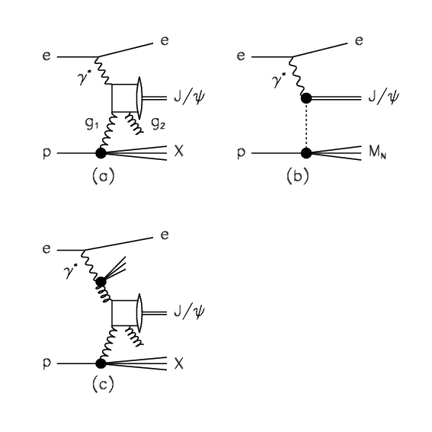
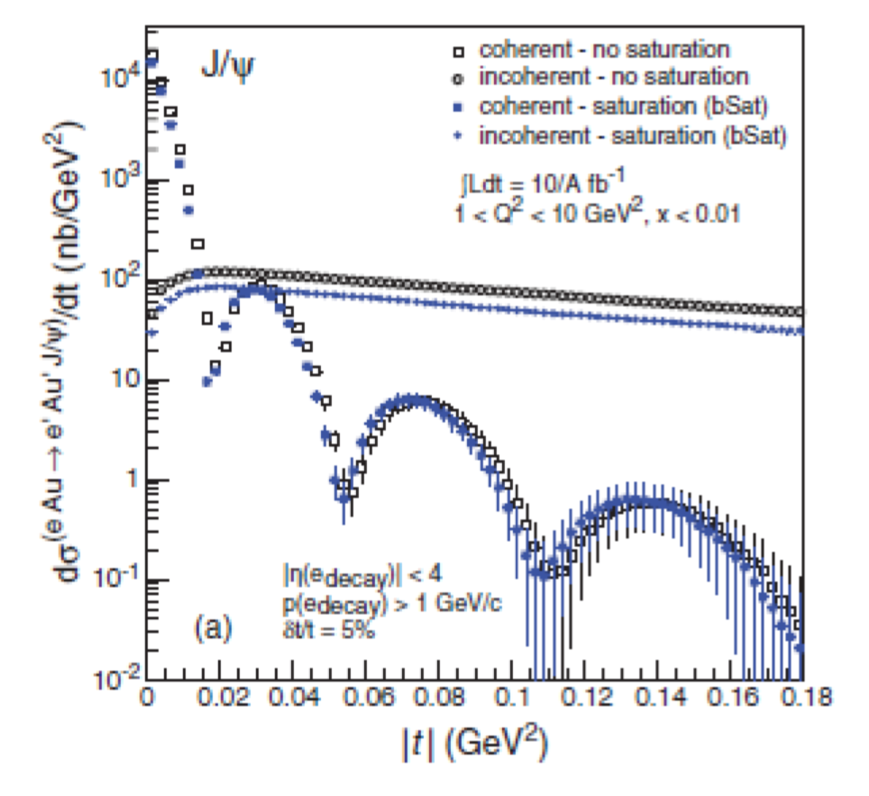
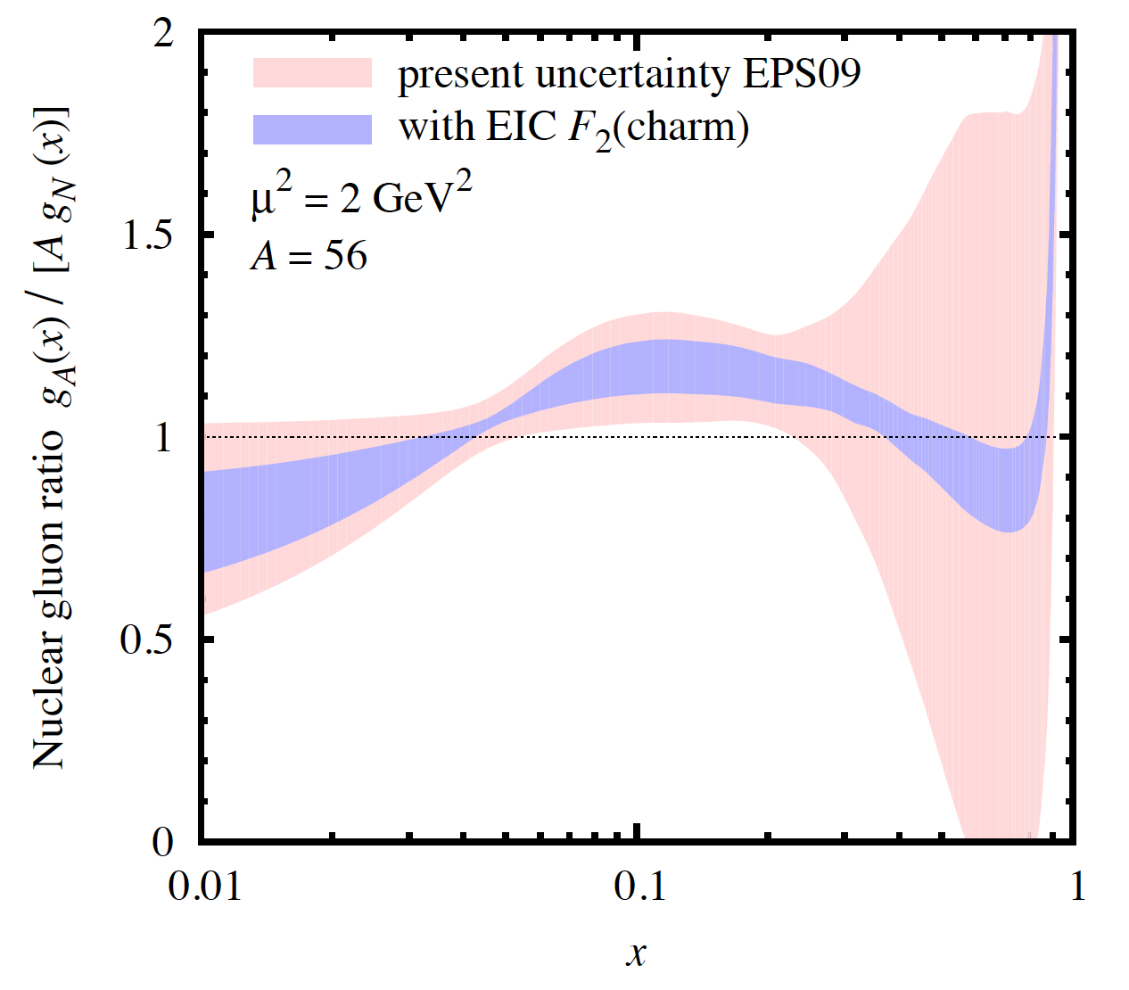
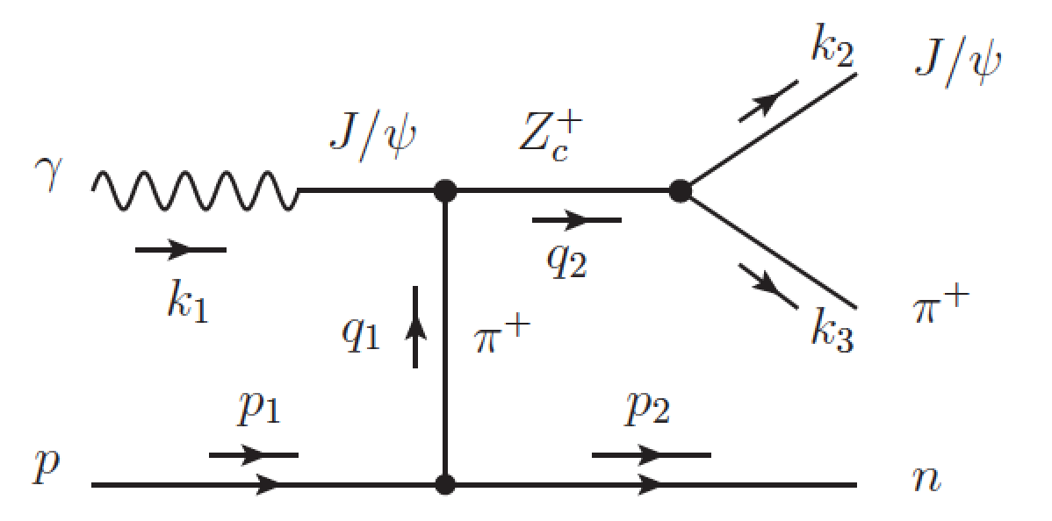
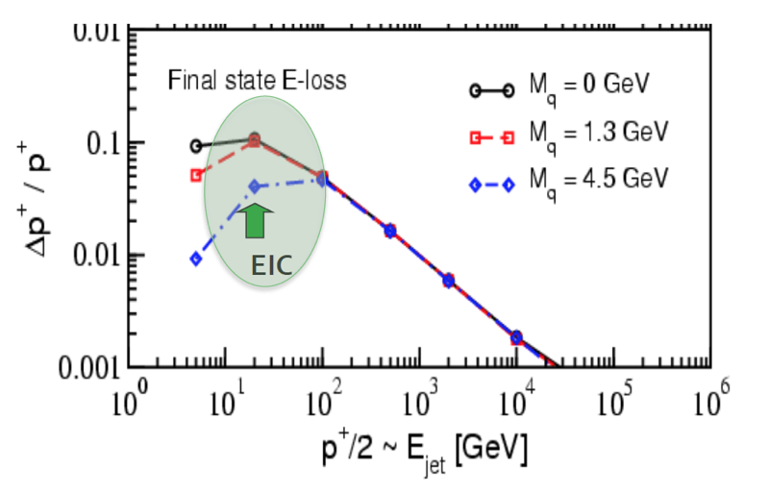
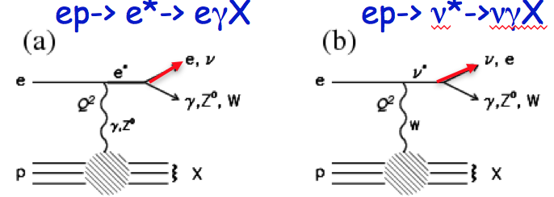
Electron identification (e/hadron separation)
GPD and
Coherent Exclusive Diffraction
(saturation)
Saturation
Coherent Exclusive Diffraction
J/Ψ, φ
Br (J/->e+e- ) ~6%
Br (J/->+- ) ~6%
Heavy quark tagging
e
$$ν$$
Br (D->e+X ) ~16%
W
b
c
Br (B->e++X_{C} ) ~10%
Exotic spectroscopy (pentaquarks, tetraquarks, XYZ)
Other BSM physics
Ivan Vitev
e
е’’
b
Notes:
Interior Page Design 2

Slide 40
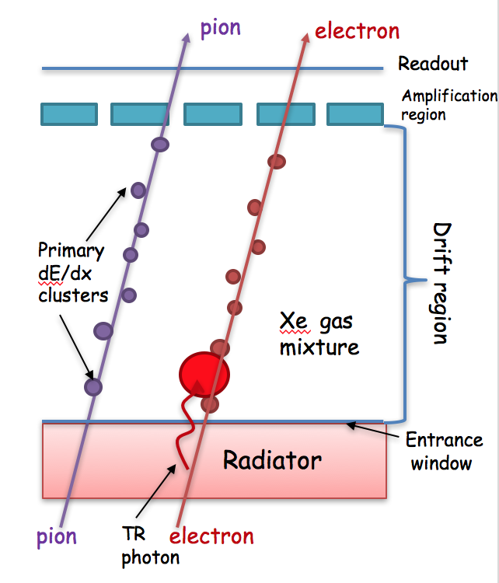
eRD22 GEM-TRD/T
Goal:
To develop a next generation of transition radiation detectors to improve electron identification (e/hadron separation) at EIC
TEAM:
Jefferson Lab: Howard Fenker, Yulia Furletova, Sergey Furletov, Lubomir Pentchev, Beni Zihlmann , Chris Stanislav, Fernando Barbosa
University of Virginia: Kondo Gnanvo , Nilanga K. Liyanage
Temple University: Matt Posik , Bernd Surrow
Critical issues/solutions of TRD operation:
High occupancy in Forward region -> need to find a replacement for straw or wire chamber => use a high granularity offered by GEM technology
Wire Chambers: Space charge suppress late signals => use GEM technology
need cluster separation in time =>
Use GEM technology combined with fADCs
- Optimization of entrance window (and for multi-layered TRD also an exit window) for TR-photon
Notes:
Interior Page Design 2

Slide 41
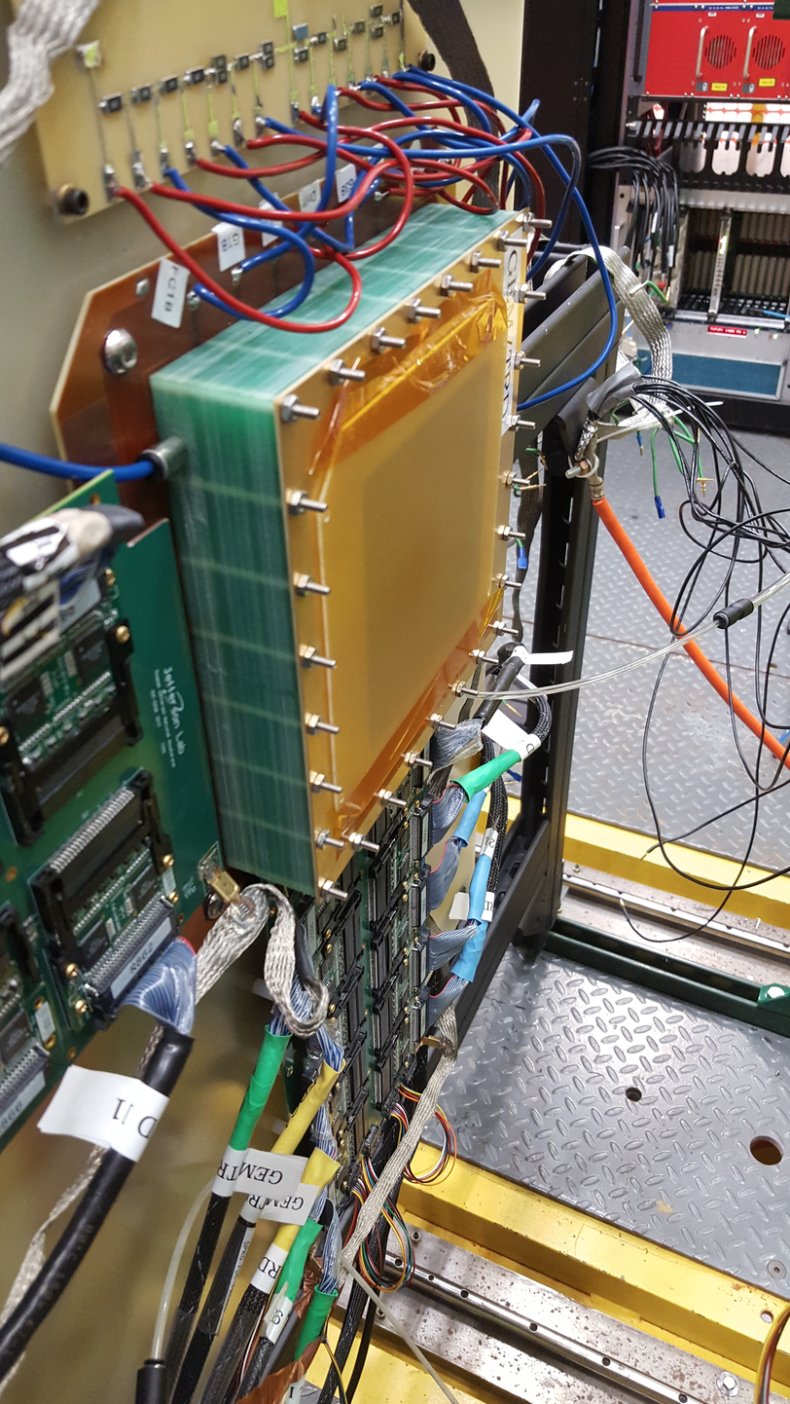
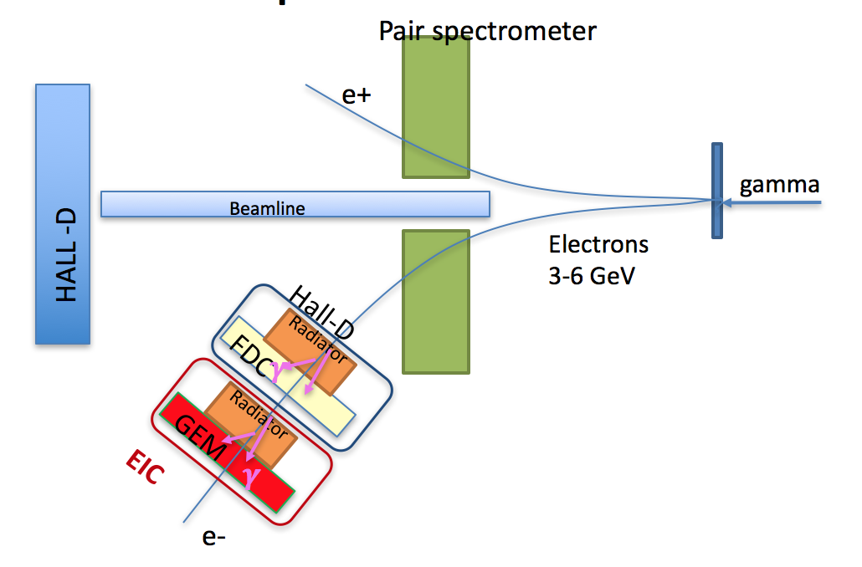
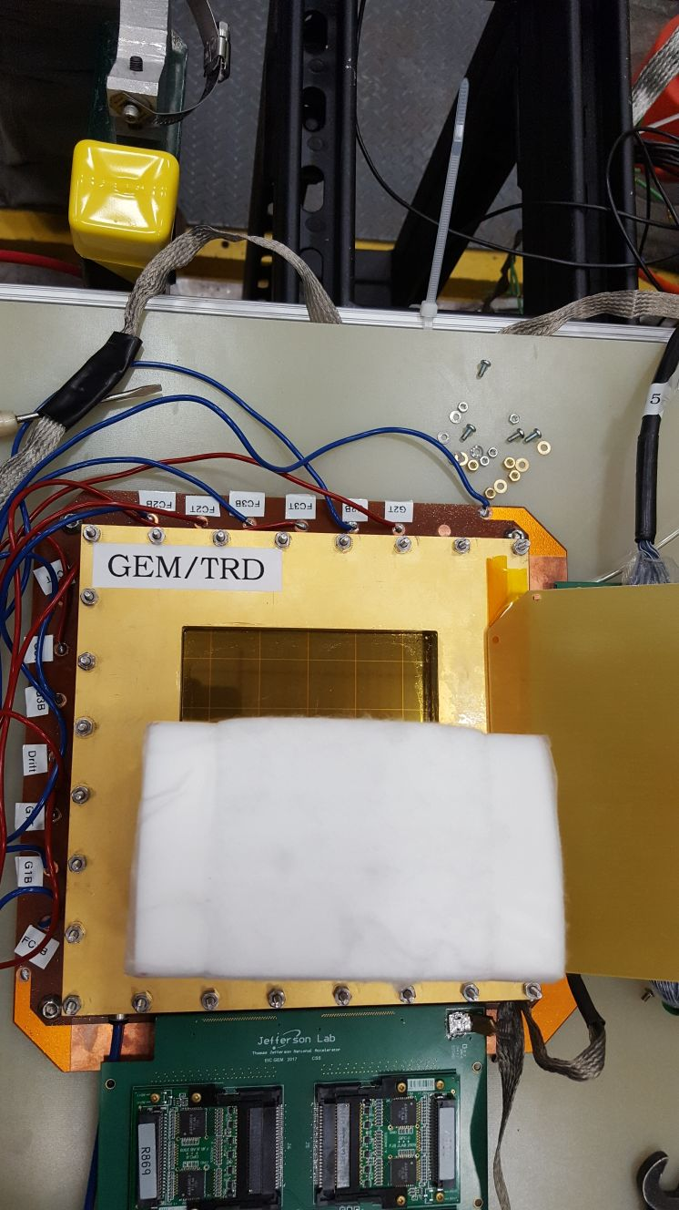
Test Setup at JLAB HALL-D
3-6 GeV electrons in Hall-D from pair spectrometer
Electron beam only => cover ½ of the sensitive area with radiator to “mimic” pion response
We performed a GEANT4 simulation of TRD setup with GEM detector (gas and radiator volumes) for a single layer operation and estimated e/pi rejection factor.
We built and tested a new GEM based TRD prototype and optimized its performance (new HV divider, different drift filed voltages, gas gain, etc)
Front-end electronic / DAQ :
Test new DAQ with Flash ADCs
We performed a test beam measurements using the existing facility at JLAB Hall-D
Test of different TR-radiators
New gas-mixing system is ready to use.
Yulia Furletova
Notes:
Interior Page Design 2

Slide 42
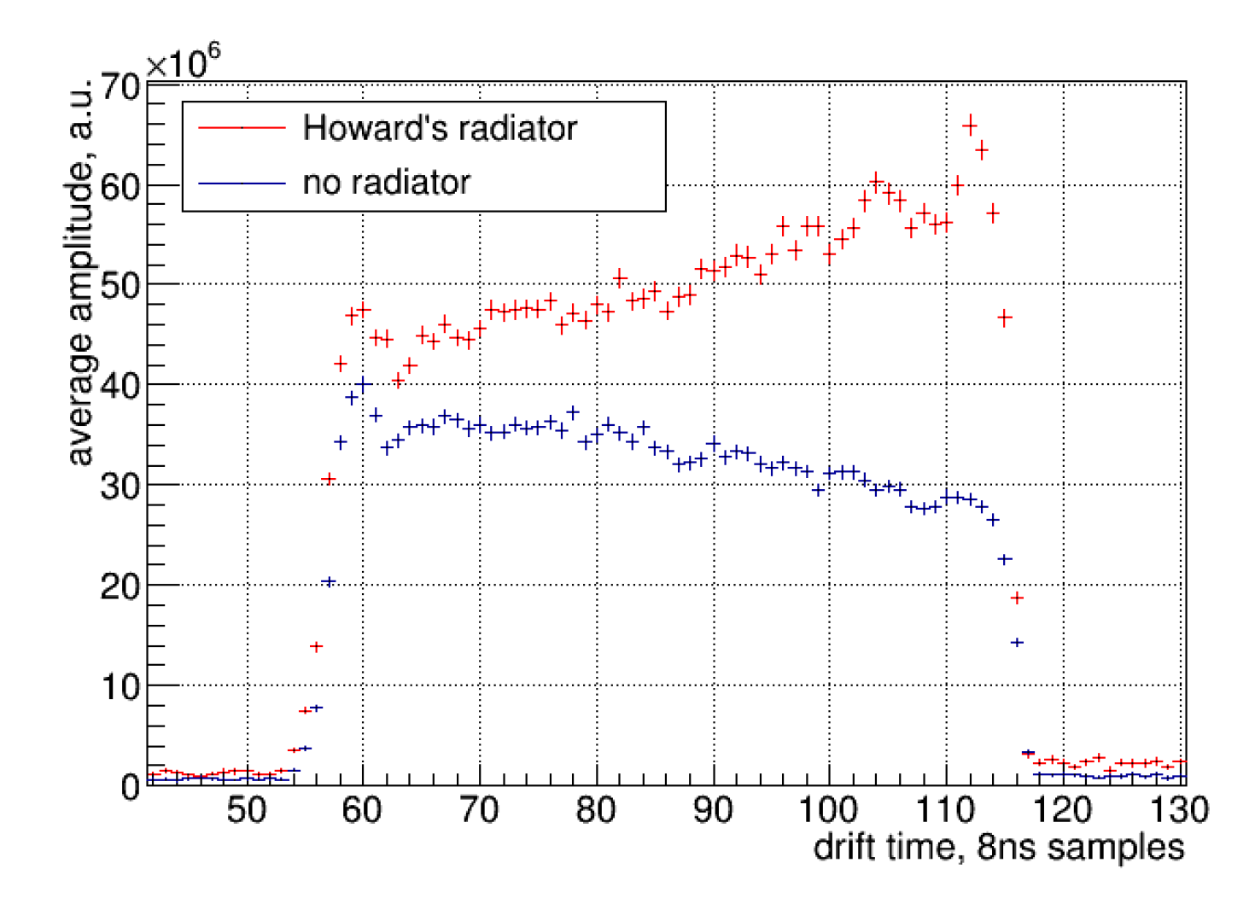
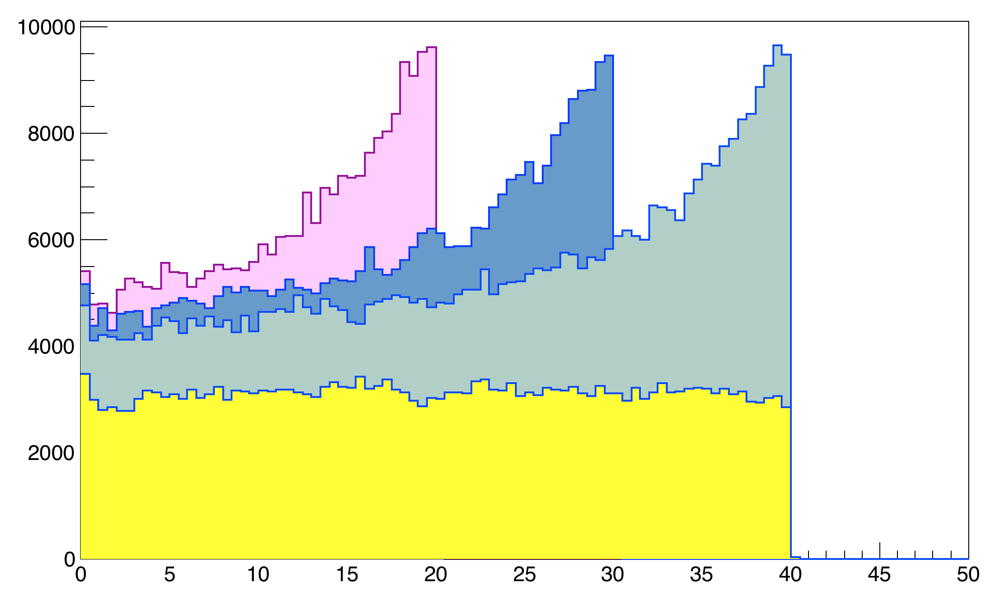
GEM TRD/T Energy deposition (dE/dx + TR) vs distance
GEANT4 simulation
Measured data
dE/dx + TR for electrons
Clearly see TR-photons
R:5cm,
D: 2,3,4cm
Xe/CO₂ (80/20)
Reg. follies radiator
e,
~3 GeV
dE/dx for Pions
Distance in gas [mm]
MC simulation: Very preliminary rejection, single module (likelihood method)
Slope in dE/dx, possible problems:
Bad gas mixture
Wrong HV settings
Diffusion
Space charge
 | 90% eff | 70% eff
2cm Xe | 2.5 | 12
4cm Xe | 4.5 | 17
Yulia Furletova
Notes:
Interior Page Design 2

Slide 43
Proposal for FY19
In addition (budget request fro FY19)
We have identified a several issues and studies which should be pursued in addition to those in our original plans as important steps towards the realization of a new generation of transition radiation detectors as a part of the EIC project.
Gas system: gas analyzer to begin quantifying and monitoring contaminations and to measure the concentrations of the Xe and CO2 gasses
( split a cost with Hall-D) ca. $7k (40%)
In collaboration with readout consortium:
On-line particle identification: to move a part of an off-line reconstruction software into on-line (FPGA evaluation board ~$7k)
Readout hardware: find a cheaper solution/replacement of FlashADC125 ($50/channel -> 5-7$/channel)
Detector prototype: following the EIC R&D (tracking consortium eRD6) effort on new technology such as RWELL detectors, we are planning to work in parallel with the consortium toward an optimization of the detector for TRD/Tracking application. ($15k)
Tracking: evaluate the performance of our prototype as a tracker (no cost)
Radiator optimization: we need to identify and test promising new radiator materials to optimize the yield of TR-photons.
CEA-Saclay has an interest in ASIC developments for EIC and in particular for GEM-TRD/T. We are looking forward to collaborate!
6
Yulia Furletova
Notes:
Interior Page Design 2

Slide 46
Summary and Future Plans for eRD1
Status of current projects
W/SciFi calorimeter R&D
Early R&D lead to full implementation into sPHENIX detector
Now investigating alternative readout with WLS bars
Radiation damage studies of SiPMs is ongoing
W/Shashlik calorimetry
Investigating as a possible alternative to W/SciFi calorimetry
Hadron Calorimetry
Investigating dual readout HCAL measuring time development of hadronic shower
Crystal Calorimetry
Study of PWO crystals is ongoing; continuing to investigate crystals from two possible vendors
New investigation of scintillating glass materials is beginning
Investigating other forms of calorimetry
Particle flow, radiation hard, luminosity monitors, …

Slide 47
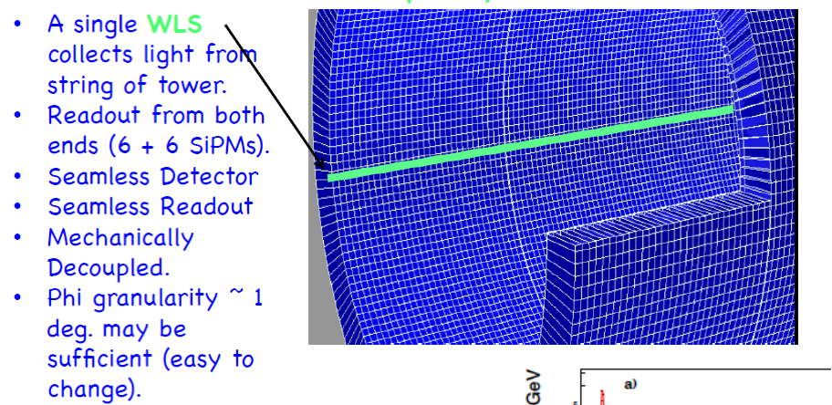
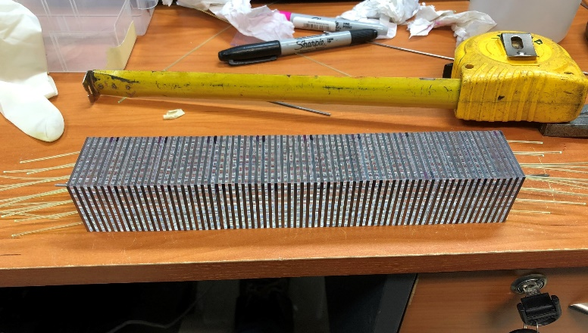
Future Plans
Dual Readout Hadronic Calorimetry
Measuring time development of hadronic showers
W/SciFi readout with WLS bars
W/Shashlik Calorimetry with SiPM readout of individual fibers
Radiation Damage Studies with SiPMs
Hamamatsu
Bubbles
CUA/VSL scintillating glass
KETEK
PWO crystals from SICCAS
Material/ Parameter | PbWO₄ | CUA/VSL glass
Luminescence (nm) | 420 | 440
Relative light output (compared to PbWO₄) | 1 | 11-35
New SiPMs may perform better under irradiation

Slide 48
eRD14 – overview
Dual-radiator RICH (dRICH).
First dRICH for solenoid detector
Aerogel & C₂F₆ gas provide continuous coverage up to:
60 GeV (π/K); 15 GeV (e/π)
Compact modular aerogel RICH (mRICH)
First RICH with (Fresnel) lens focusing
Small, sharp ring improves performance and reduces photosensor area (cost)
Covers up to 8 GeV (π/K) and 2 GeV (e/π)
1
6 GeV
Photosensors and electronics
Large area low-cost LAPPD (MCP-PMT) photosensors
Sampling electronics (GHz) for small-pixel detectors
Next-generation barrel DIRC
First DIRC with high-resolution in x,y, and t
3D reconstruction allows leap in performance
Radiation-hard optics being developed
Covers up to 6 GeV (π/K) and 2 GeV (e/π)

