Slide 1
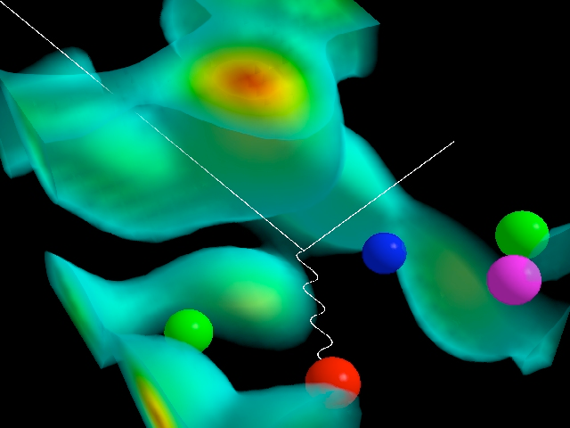
The Glue That Binds Us
Probing Gluonic Matter With the World's First Electron-Ion Collider
Thomas Ullrich (BNL/Yale)
Old Dominion University
October 18, 2016
D. Leinweber (Three quarks localized by the gluon field & e scatter)

Slide 2
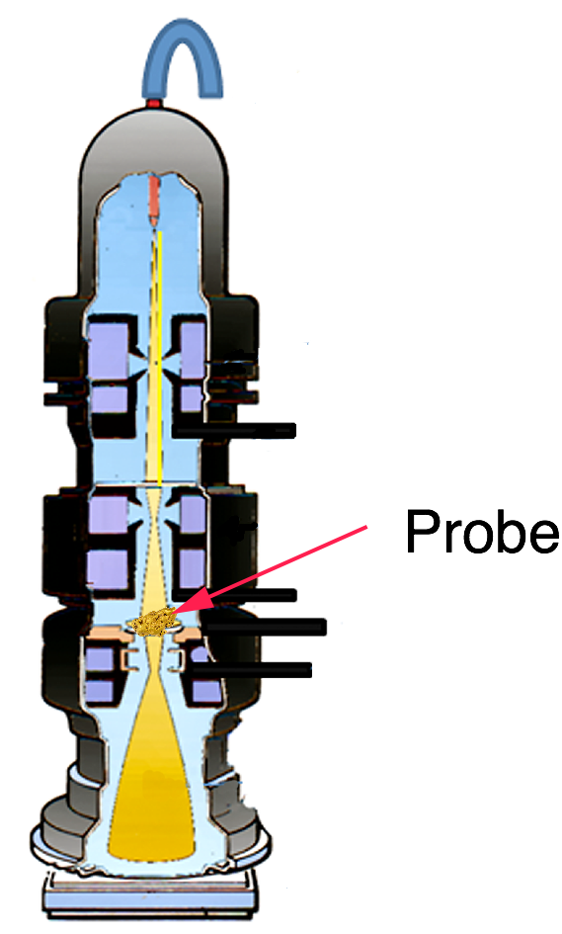
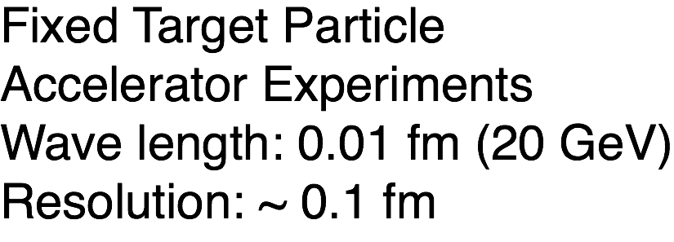
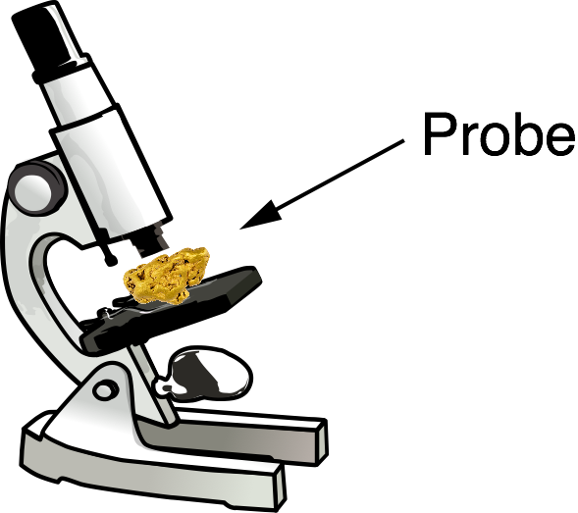
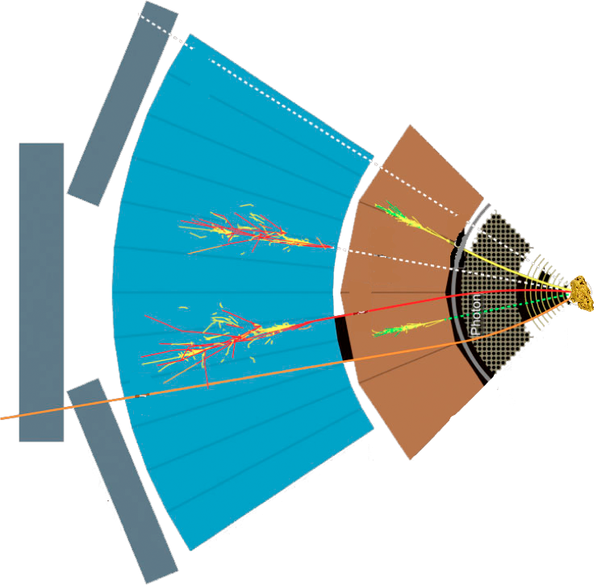
Studying Matter at Small Scales
Target
SLAC, EMC, NMC, E665, BCDMS,
HERMES, JLab, COMPASS, …
Detector

Slide 3
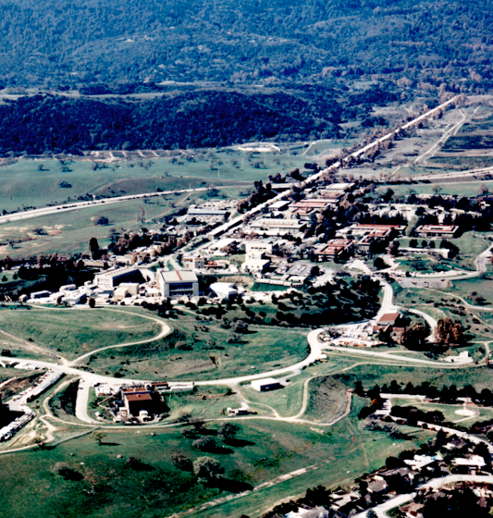
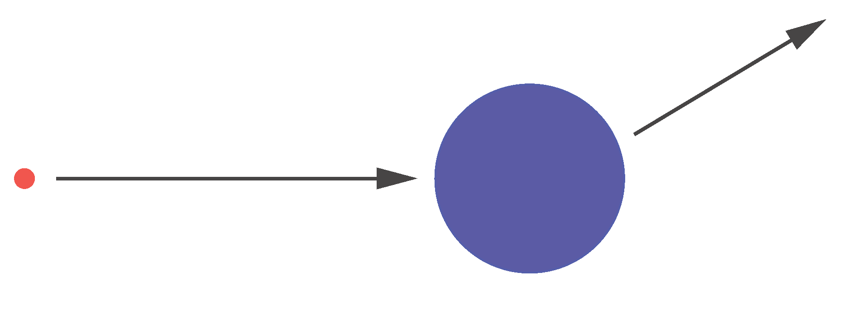
Probing Matter with Hard Probes
The SLAC experiments in the 1960s established the
quark model and our modern view of particle physics.
proton
Constant F(q²):
⇒ scattering on point-like constituent of the nucleon
quarks
Mott = Rutherford + Spin
electron
p₂
?
p₁
inelastic
elastic
Formfactor: F(q²)
Fourier transform
of charge distributions
Notes:
Parton Model (Feynman & Bjorken): nucleons as made up of point-like constituents
provides a very simple framework for calculating scattering cross-sections
as well as structure functions.
Parton Model: every object with a finite size has a formfactor and therefore experiences a dependence of
the 4-momentum transfer (Q2 dependence) from the scattered particle.
\frac{d\sigma}{d\Omega} = \left( \frac{d\sigma}{d\Omega} \right)_\mathrm{Mott} |F(q^2)|^2
q^2 = (\mathbf{p}_1 - \mathbf{p}_2)^2
Friedmann, Kendall, Taylor

Slide 4
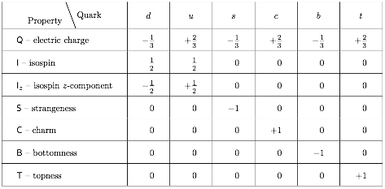
“Static” Quark Model
Quarks: spin 1/2 fermions, color charge
M. Gell-Mann,
K. Nishijima (> 1964)
Baryons:
q
Mesons:
q
q
q
q
Eight-fold Way: Account for every hadron we found so far
Where’s the Dynamics?
Notes:
In physics, the Eightfold Way is a term coined by American physicist Murray Gell-Mann for a theory organizing subatomic baryons and mesons into octets (alluding to the Noble Eightfold Path of Buddhism). The theory was independently proposed by Israeli physicist Yuval Ne'eman and led to the subsequent development of the quark model.
Particles along the same horizontal line share the same strangeness, s, while those on the same diagonals share the same charge, q.
In addition to organizing the mesons and spin-1/2 baryons into octets, the principles of the Eightfold Way also applied to the spin-3/2 baryons, forming a decuplet. However, one of the particles of this decuplet had never been previously observed. Gell-Mann called this particle the Ω⁻ and predicted in 1962 that it would have a strangeness −3, electric charge −1 and a mass near 1,680 MeV/c². In 1964 a particle closely matching these predictions was discovered[1] by a particle accelerator group at Brookhaven, making the Eightfold Way a triumphant success. Gell-Mann received the 1969 Nobel Prize in physics for his work on the theory of elementary particles.
The baryon octet
The Eightfold Way may be understood in modern terms as a consequence of flavor symmetries between various kinds of quarks. Since the strong nuclear force is the same for quarks of any flavor, replacing one flavor of quark with another in a hadron should not alter its mass very much. Mathematically, this replacement may be described by elements of the group SU(3). The octets and other arrangements are representations of this group; for a more detailed explanation of this fact, see the article Particle physics and representation theory.

Slide 5
Quantum Chromodynamics (QCD)
Quantum Chromo Dynamics is the “nearly perfect” fundamental theory of the strong interactions
F. Wilczek, hep-ph/9907340
Three color charges: red, green and blue
q
q
Exchange particles (gluons) carry color charge and can self-interact
Self-interaction: QCD significantly harder to analyze than QED
Rich in symmetries:
Evolution: DGLAB (Q²), BFKL (x) - later more
Notes:
QCD is a type of quantum field theory called a non-abelian gauge theory with symmetry group SU(3).
Gauge “color” symmetry: unbroken but confined
Global “chiral” symmetry: exact for massless quarks
Baryon number and axial charge (m=0) are conserved
also:
Scale invariance of quark (m=0) and gluon fields
Discrete C,P & T symmetries

Slide 6
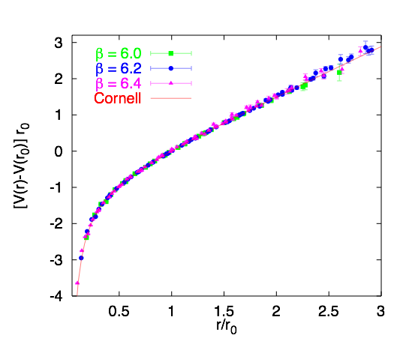
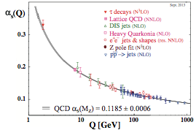
The Role of Gluons
Confinement:
Asymptotic freedom:
“Gluon” potential between
heavy quark-antiquark pair
Phys. Rept. 343, 1 (2001)
The self-interaction of gluons is fundamentally responsible for the asymptotic freedom of quarks and gluons in QCD
~1/r at short range
long range ~ r
Quarks experience force of 16 tons at distances of ~ 1 Fermi (10⁻¹⁵ m)
2004, Gross, Politzer, Wilczek
Notes:
screening corrections (g->qq->g) and anti-screening corrections )g->gg->g

Slide 7
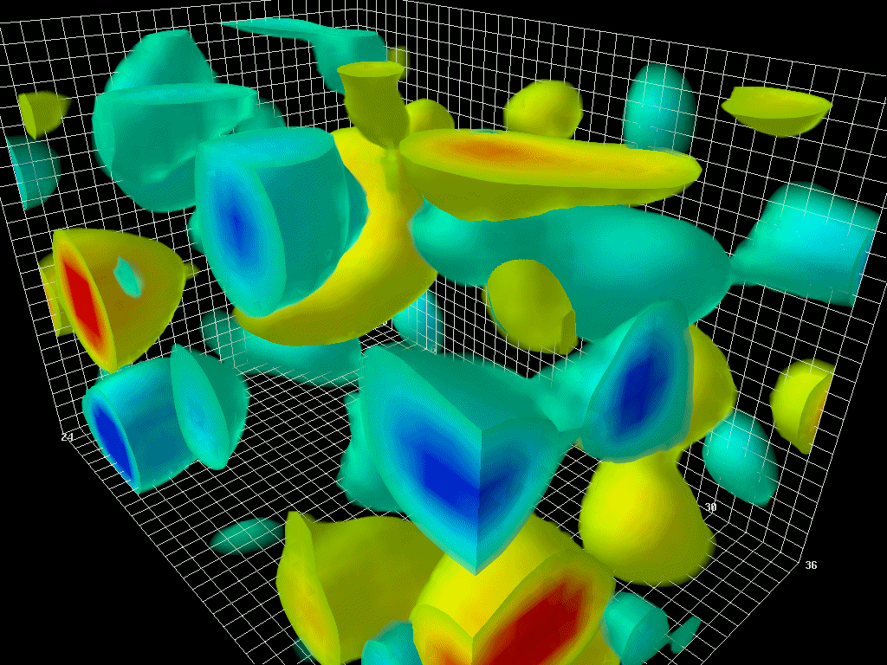
The Essential Mystery
There is an elegance and simplicity to nature’s strongest force we do not understand
(Nearly) all visible matter is made up of quarks and gluons
But quarks and gluons are not visible
All strongly interacting matter is an emergent consequence of many-body quark-gluon dynamics.
Understanding the origins of matter demands we develop a deep and varied knowledge of this emergent dynamics
Notes:
The animations to the right and above illustrate the typical four-dimensional structure of gluon-field configurations averaged over in describing the vacuum properties of QCD. The volume of the box is 2.4 by 2.4 by 3.6 fm, big enough to hold a couple of protons. Contrary to the concept of an empty vacuum, QCD induces chromo-electric and chromo-magnetic fields throughout space-time in its lowest energy state. After a few sweeps of smoothing the gluon field (50 sweeps of APE smearing), a lumpy structure reminiscent of a lava lamp is revealed. This is the QCD Lava Lamp. The action density (top) and the topological charge density (right) are displayed. The former is similar to an energy density while the latter is a measure of the winding of the gluon field lines in the QCD vacuum.

Slide 8
Studying Matter at the Smallest Scales
ep/eA Collider Experiments
Wave Length: 0.0001 fm (10 GeV + 100 GeV)
Resolution: ~ 0.01-0.001 fm
Past: HERA,
Future: EIC, LHeC, …

Slide 9
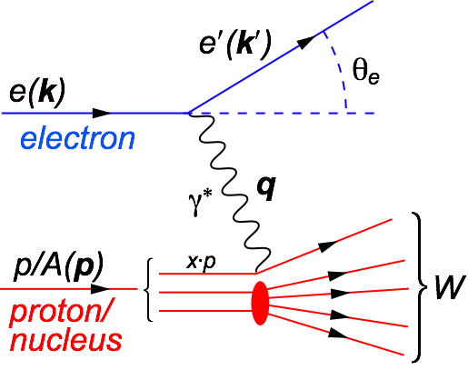
Deep Inelastic Scattering (DIS)
DIS:
As a probe, electron beams provide unmatched precision of the electromagnetic interaction
Direct, model independent, determination of kinematics of physics processes
x:
y:
s:
Q²:
square of center-of-mass energy of electron-hadron system
Bjorken-x
x is fraction of the nucleon’s momentum carried by the struck quark
0 < x < 1
squared momentum transfer from scattered electron
Virtuality
“Resolution” power
Inelasticity
Fraction of electron’s energy lost in nucleon restframe
0 < y < 1
s: center-of-mass energy squared
Q²: resolution power
x: momentum fraction of parton
y: inelasticity
quark+anti-quark
momentum distributions
gluon momentum distribution
Notes:
W2 can also be interpreted as the center-of-mass energy of the gauge boson nucleon system.
Q2 max = s
Q2: negative square of the momentum transfer q, denotes virtuality
x: make Remark that for e+p 0 < x < 1 while for e+A scattering 0 < x < A.
y: is the fraction of the lepton’s energy lost in the nucleon rest frame. It it thus also the fraction of the incoming electron energy (also known as inelasticity) carried by the exchange boson (photon) in the rest frame of the nucleon
Q^2 &=& -q^2 = - (k-k^\prime)^2 \\
&\approx& 4 E E^\prime \sin^2\left(\frac{\theta}{2}\right)

Slide 10
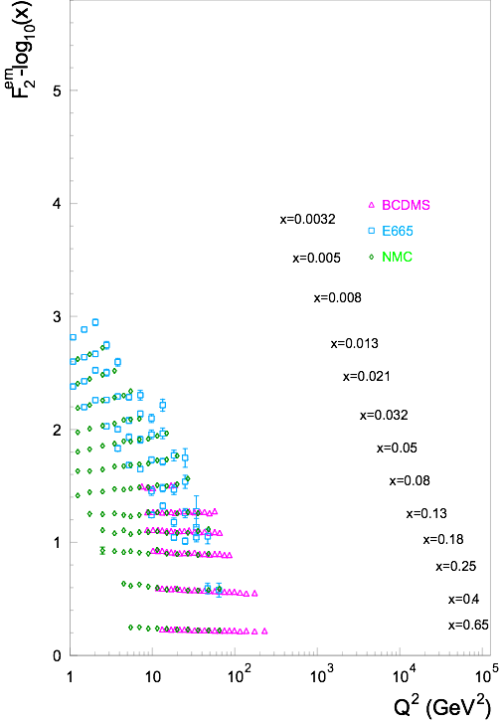
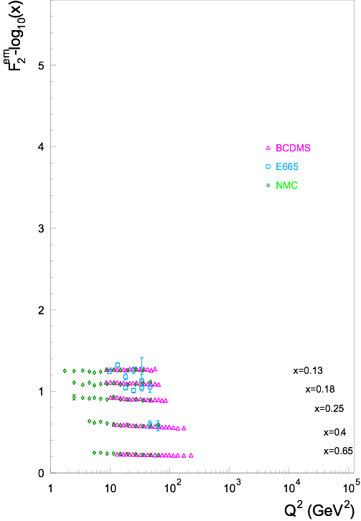
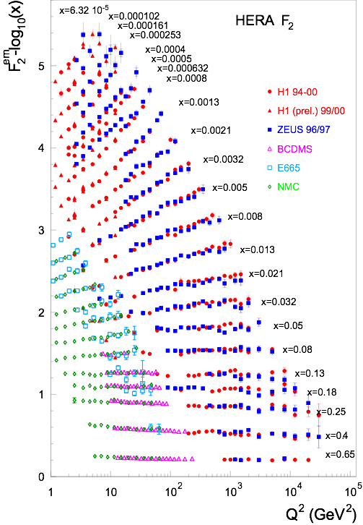
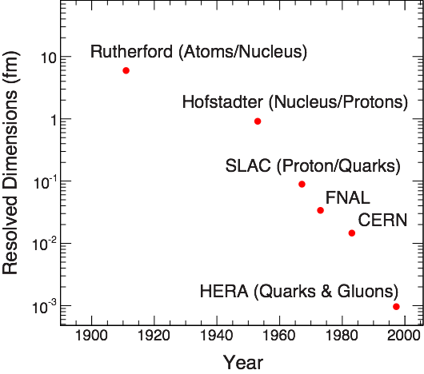
F2: The Key Structure Function
λ ~ ℏc/Q
Q² ≈ s⋅x
Bjorken Scaling: F2(x, Q²) → F2(x)
virtual photon interacts with a
single essentially free quark
Bjorken Scaling: F2(x, Q²) ≠ F2(x)
Broken - Big Time
It’s the Glue !!!
Notes:
Bjorken Scaling: virtual photon interacts with a single essentially free quark

Slide 11
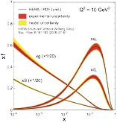
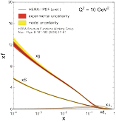
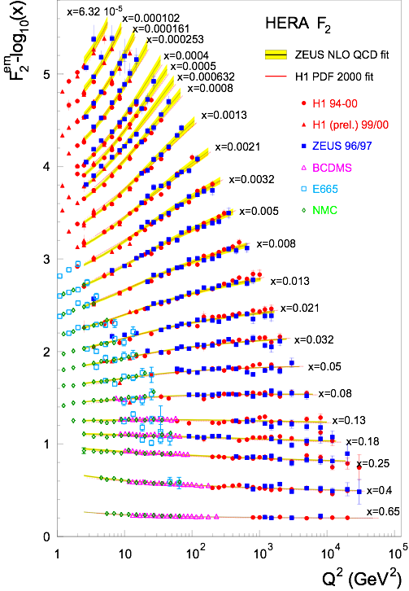
Quark and Gluon Distributions
Structure functions allows us to extract the quark q(x,Q²) and gluon g(x,Q²) distributions.
In LO: Probability to find parton with x, Q² in proton
F₂
dF₂ /dlnQ²
pQCD+
DGLAP Evolution
⇒
+
Proton is almost entirely glue by x<0.1
(for Q² = 10 GeV²)
Notes:
integro-differential equations

Slide 12
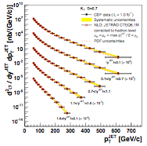
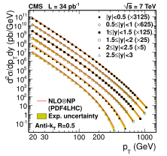
Perturbative QCD: Benchmark for New Physics
Structure functions measured at HERA ep collider
Jet cross-sections: pp collisions at LHC andpp collisions at Fermilab
At large momenta, the weak QCD coupling (asymptotic freedom!) enables systematic computations
Are we done?
Notes:
Perturbative QCD describes only a small part of the total cross-section
Lattice QCD is of very limited utility in describing scattering

Slide 13
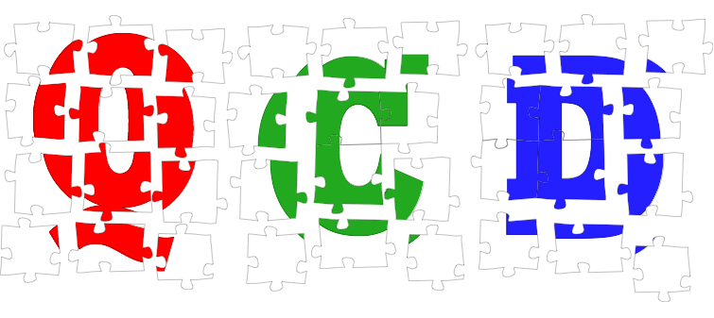
The Frontiers of Our Ignorance
... that motivate an Electron-Ion Collider

Slide 14
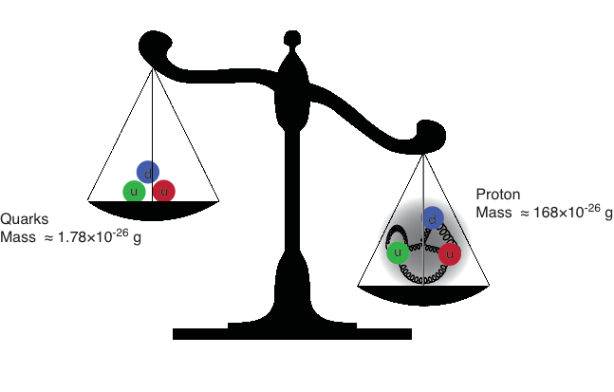
The Mass Puzzle
The Higgs is responsible for quark masses
~ 2% of the proton mass.
Gluons are massless…yet their dynamics are responsible for
(nearly all) the mass of visible matter. We do not know how?
Notes:
Mass from binding energy
Binding through gluons

Slide 15
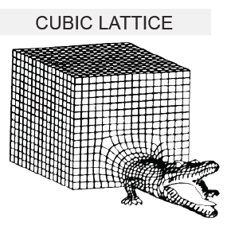
Scattering in the Strong Interactions
Perturbative QCD:
Describes only a small part of the total cross-section
Lattice QCD:
First principles treatment of static properties of QCD: masses, moments, thermodynamics
Very challenging for dynamical processes and very limited utility in describing scattering
Instead ⇒ Effective theories:
How do quark and gluon degrees organize themselves to describe the bulk of the cross-section?

Slide 16
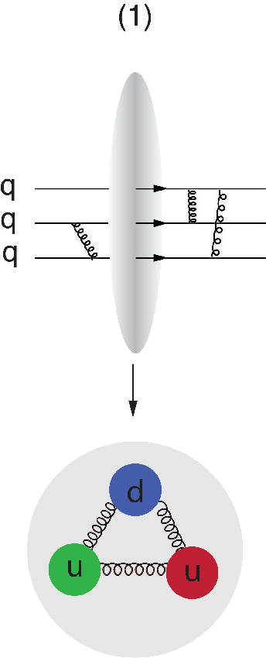
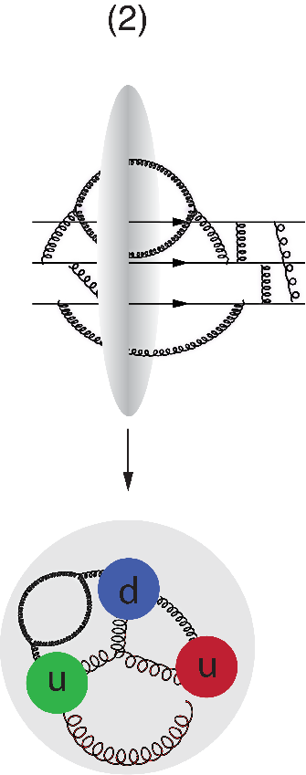
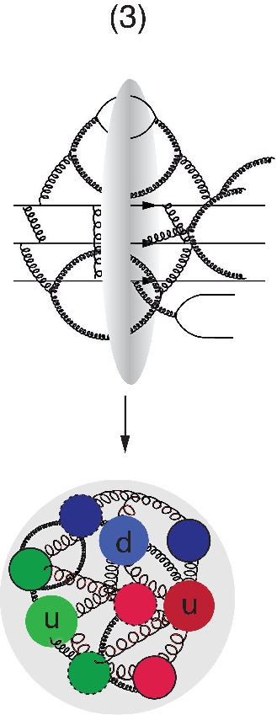
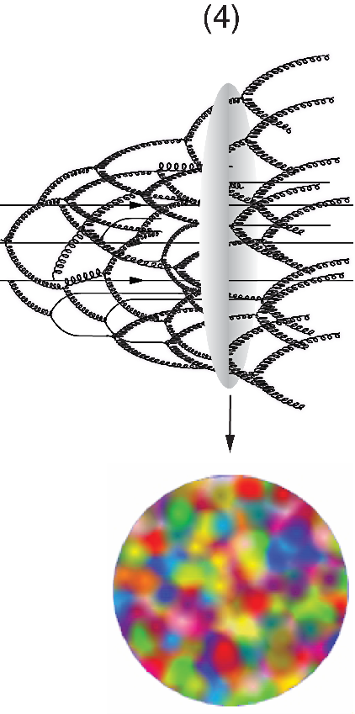
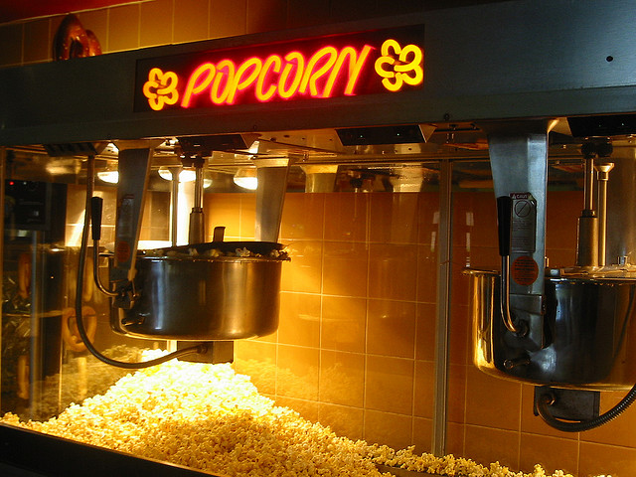
A Look Inside the Boosted Proton
In QCD, the proton is made up of quanta that fluctuate in and out of existence
Boosted proton:
Fluctuations time dilated on strong interaction time scales
Long lived gluons can radiate further small x gluons…
Explosion of gluon density
Δt ∝1/ΔE
momentum

Slide 17
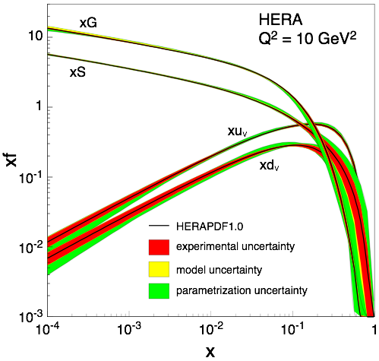
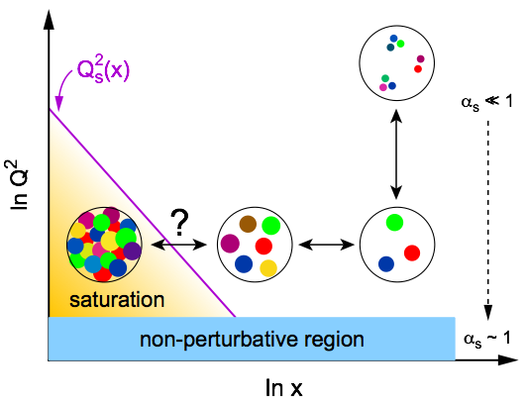
Gluon Saturation
Is the proton a runaway popcorn machine at high energies ?
Explosion of gluon density violates unitarity!
Cross-sections must be finite
pQCD
evolution
equation
New Approach: Non-Linear Evolution
Recombination compensates gluon splitting
New evolution equations at low-x & low to moderate Q²
Saturation of gluon densities characterized by scale Q_{s}(x)
Saturation ⇒ New Effective Field Theory:
Color-Glass-Condensate (CGC)
Dramatic consequences: Q² < Q²S ⇒ αs(Q²S)

Slide 18
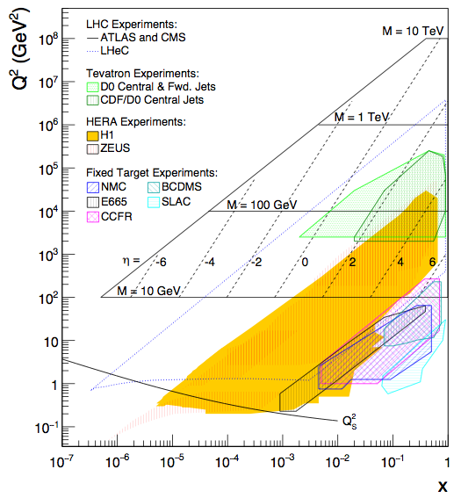
Gluon Saturation: Reach of Past Experiments
HERA (ep)
Marginal overlap
Only at low Q2 making comparison with perturbative QCD hard

Slide 19
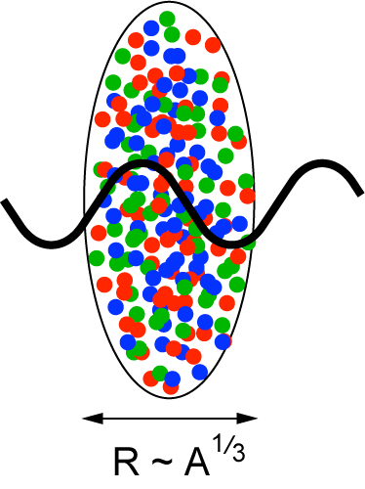
Gluon Saturation in Nuclei: The Oomph
Probes interact over distances L ~ (2m_{N} x)⁻¹
Probe interacts coherently with all nucleons for L > 2 R_{A} ∼ A^{1/3}
Enhancement of Q_{S} with A: saturation regime reached at significantly lower energy in nuclei (and lower cost)
Nucleus serves as amplifier of the saturation scale

Slide 20
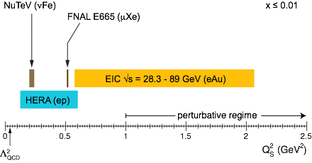
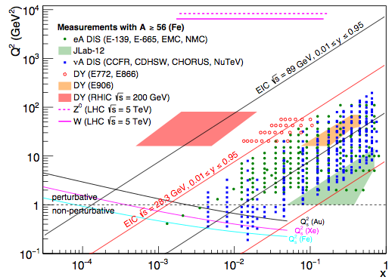
Gluon Saturation: Reach of Past Experiments
Fixed Target DIS Experiment (eA, μA, νA)
Same marginal overlap
Only at low Q² (Q² < 1 GeV²) making comparison with perturbative QCD impossible
Future:
Pushes into regime where comparison with our current understanding can be made
Need to push for highest energy and heaviest ions

Slide 21
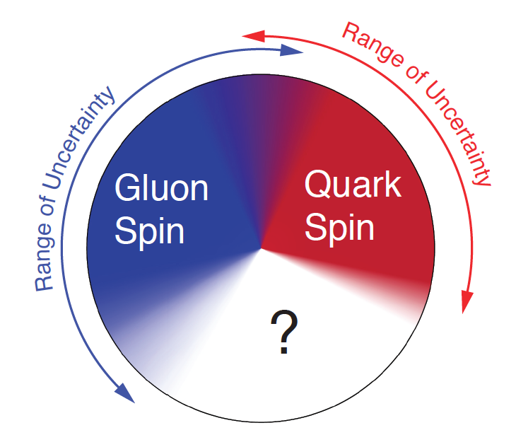
Key Topic in ep: Proton Spin Puzzle
What are the appropriate degrees of freedom in QCD that would explain the “spin” of a proton?
After 20 years effort
Quarks (valence and sea): ~30% of proton spin in limited range
Gluons (latest RHIC data): ~20% of proton spin in limited range
Where is the rest?
It is more than the number ½! It is the interplay between the intrinsic properties and interactions of quarks and gluons
Notes:
If we do not understand the proton spin, we don’t understand QCD

Slide 22
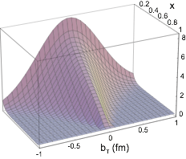
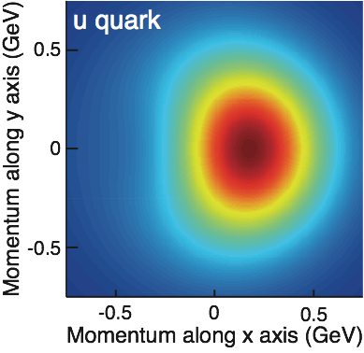
What Does a Proton Look Like?
In transverse momentum?
In transverse space?
How are these distributions correlated with overall nucleon properties, such as spin direction?
Transverse Momentum Distributions (TMDs):
2D+1 picture in momentum space (kT)
Generalized Parton Distributions (GPDs):
2D+1 picture in coordinate space (bT)
3D Imaging with EIC
Study through azimuthal asymmetries in semi-inclusive DIS
Requires π/K/p PID
Study through exclusive processes (DVCS, diffraction, VM production)
Luminosity hungry
S
⊕
z

Slide 23
Electron-Ion Collider
Investigate with precision universal dynamics of gluons
Central themes:
Probing the momentum-dependence of gluon densities and the onset of saturation in nucleons and nuclei
Mapping the transverse spatial and spin distributions of partons in the gluon-dominated regime
Provide novel insight into propagation, attenuation and hadronization of colored probes
Ultimate QCD machine:
The world’s first polarized electron-polarized proton collider
The world’s first electron-heavy ion collider
Luminosities: a hundred to up to a thousand times HERA
Fine resolution inside proton down to 10⁻¹⁸ meters

Slide 24
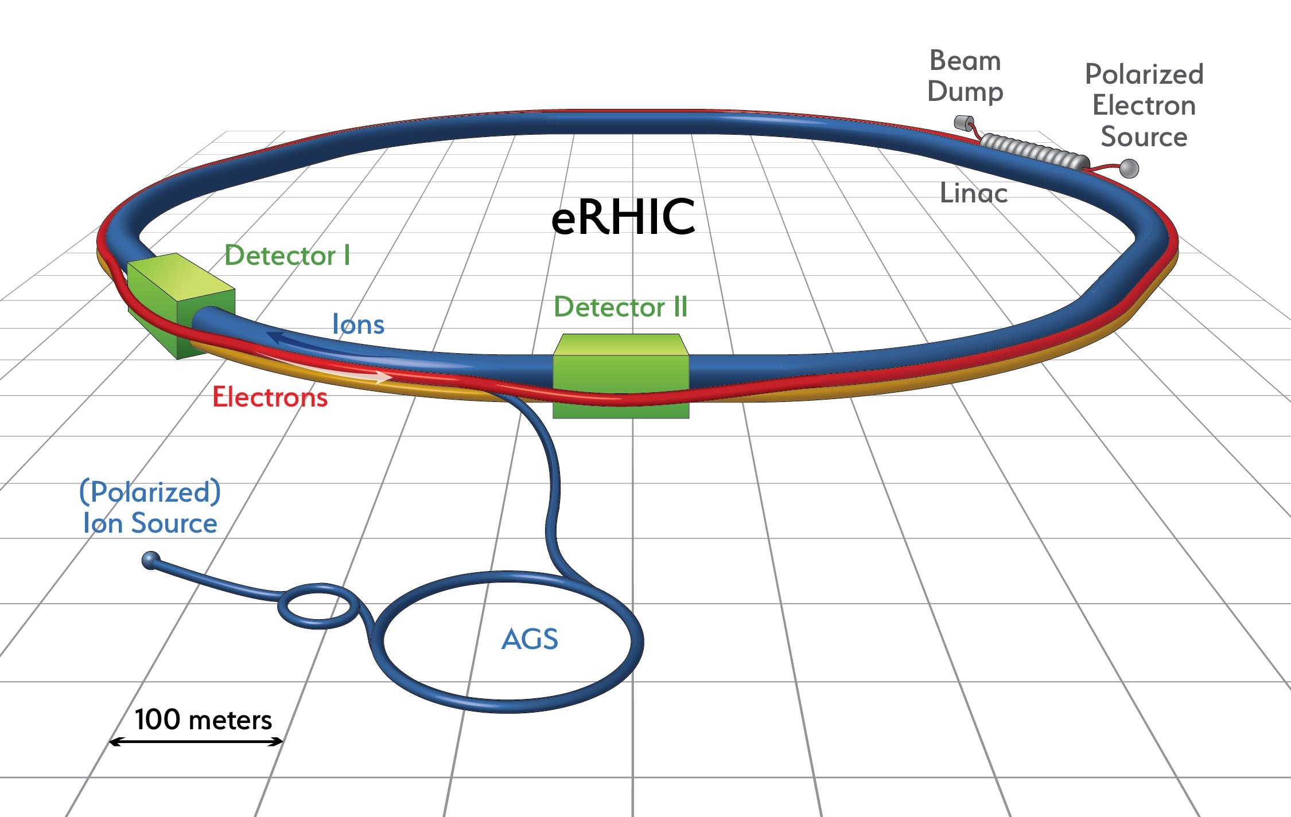
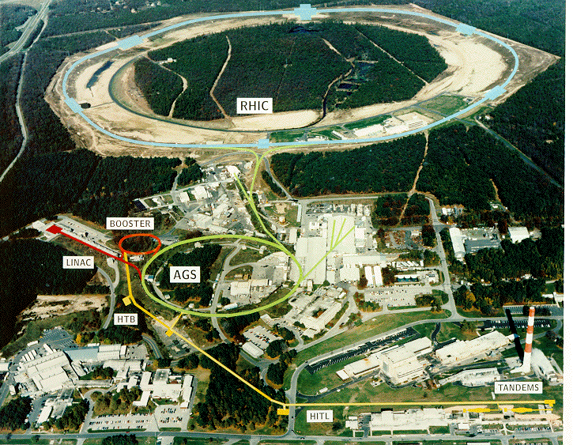
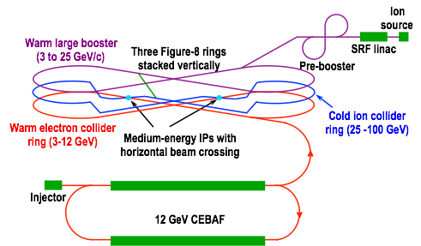
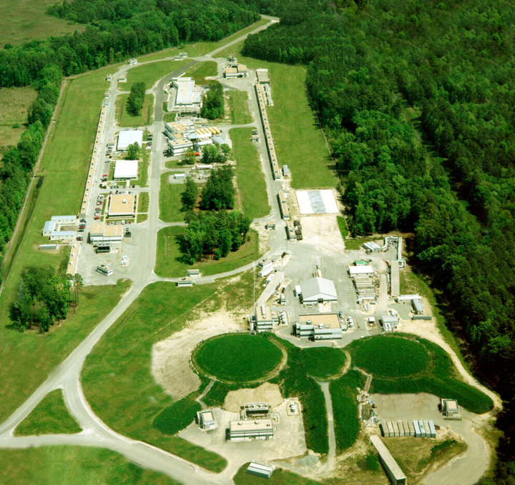
US Electron Collider: Accelerator Designs
eRHIC (BNL)
Add ERL+FFAG Recirculating e Rings to RHIC facility
Electrons up to 18 GeV
Protons up to 275 GeV
Ions (Au) up to 110 GeV/u
L ≈ 1.2×10³³ cm⁻² s⁻¹ at √s=120 GeV
JLEIC (JLab)
Figure-8 Ring-Ring Collider, use of CEBAF
Electrons 3-10 GeV
Protons 20-100 GeV
Ions up to 40 GeV/u
L ≈ 10³⁴ cm⁻² s⁻¹/A at √s=22 GeV)
eRHIC: arXiv:1409.1633, JLEIC: arXiv:1209.0757
Notes:
The designed frequency matching scheme allows operation with hadron energies down to 40 GeV/u, but the energies between 46 and 98 GeV/u cannot be used.

Slide 25
Examples of Key Measurements at an EIC

Slide 26
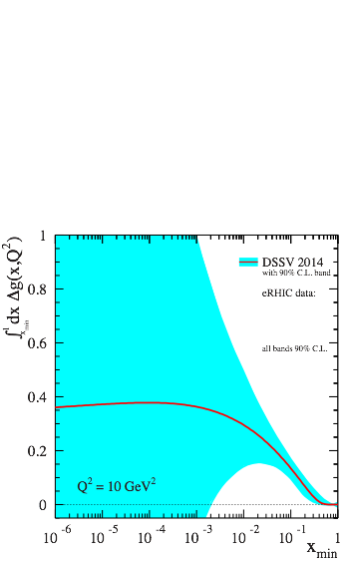
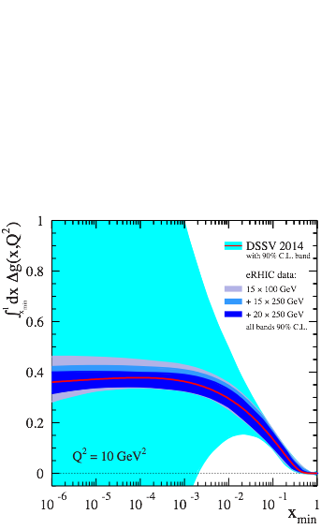
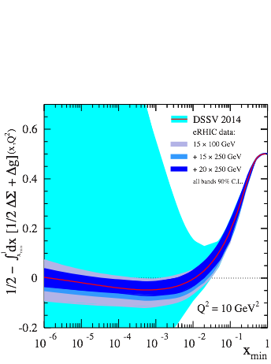
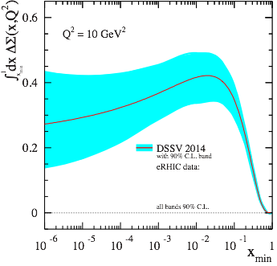
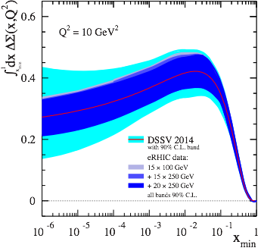
EIC: Longitudinal Spin of the Proton (I)
Inclusive Measurement:
e+p → e′+X
Quark Spin
Gluon Spin
½-Gluon-Quark Spin
Leading Order:
(Quark Spin)
Combining information on ∆Σ and ∆g constrains angular momentum
Higher Order:
(Gluon Spin)
For ∫Ldt = 10 fb⁻¹ and 70% polarization
Current knowledge (DSSV): uses strong theoretical constraints
EIC projections do not ⇒ test w/o assumptions
Notes:
Mention: not even sign of L is constraint
polarized
gluon Δg(x,Q2) and quark Δq(x,Q2) distribution
Figure 2-5 shows the running integral
!"!ΔΣ(!, !!) !!!"#, which represents the contribution of all quark flavors to the spin of the proton
experimental access to the ∆f in lepton- scattering is obtained through the spin-dependent structure function g1(x,Q2), which ap- pears in the polarization difference of cross sections when the lepton and the nucleon collide with their spins anti-aligned or aligned:

Slide 27
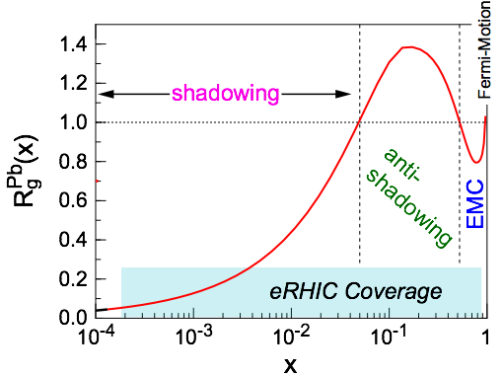
EIC: Nuclear Structure Functions (I)
Inclusive DIS on eA:
quark+anti-quark
gluon
F2 and FL are benchmark measurements:
Theory/models have to be able to describe the structure
functions and their evolution.
Leading twist pQCD models parameterize the observed suppression of the structure function with decreasing x using nuclear parton distribution functions (nPDFs)
Aim at extending our knowledge on structure functions into the realm where gluon saturation effects emerge
Notes:
\frac{d^2 \sigma^{eA\rightarrow eX}}{dx dQ^2} = \frac{4 \pi \alpha^2}{x Q^4} \left[ \left(1-y+\frac{y^2}{2}\right) {\color{blue}F_2(x, Q^2)} - \frac{y^2}{2} {\color{red}F_L(x, Q^2)}\right]

Slide 28
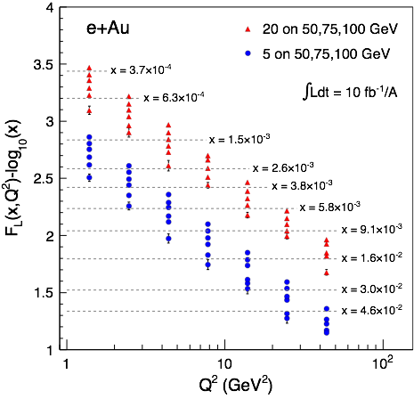
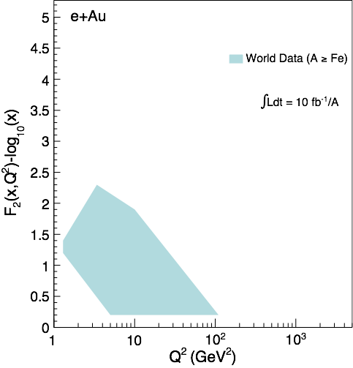
EIC: Nuclear Structure Functions (II)
Assume 3% systematic uncertainty
Systematic uncertainties dominate, not L hungry
Good lever arm at x~10⁻³
Also studied:
FL
statistics hungry
requires runs at various √s
F2,charm
provides compelling alternative to FL , sensitive to glue
Notes:
\frac{d^2 \sigma^{eA\rightarrow eX}}{dx dQ^2} = \frac{4 \pi \alpha^2}{x Q^4} \left[ \left(1-y+\frac{y^2}{2}\right) {\color{blue}F_2(x, Q^2)} - \frac{y^2}{2} {\color{red}F_L(x, Q^2)}\right]

Slide 29
EIC: Impact on Knowledge on nPDFs
Ratio of PDF(Pb)/PDF(p)
Without EIC, large uncertainties for sea quarks and gluons
Adding in EIC, pseudo-data significantly reduces the uncertainties, particularly at small-x
Fitting the charm pseudo-data has a dramatic effect at high-x
Something pA at RHIC & LHC will not be able to address

Slide 30
Hard Diffraction: What is It?
A DIS event (theoretical view)
A DIS event (experimental view)
A diffractive event (experimental view)
A diffractive event (theoretical view)
Activity in proton direction
?
HERA: large fraction of diffractive events (15% of total DIS rate)
High sensitivity to gluon density: σ~[g(x,Q²)]² due to color-neutral exchange

Slide 31
Hard Diffraction in eA ?
Black disk limit characterized by σdiff/σtot = 1/2 (Hera sees 1/7)
Large fraction of diffractive event is unambiguous signature for reaching the saturated limit
Theory predicts for saturation in eA up to σdiff/σtot ~ 25%

Slide 32
Spatial Gluon Distribution Through Diffraction
1950-60: Measurement of charge (proton) distribution in nuclei
Ongoing: Measurement of neutron distribution in nuclei
EIC: Measurement of gluon distribution in nuclei through Fourier transform of dσ/dt where t = (pout-pin)² of nucleus
~
t = Δ²/(1-x) ≈ Δ²
Recall: diffractive pattern in optics
position of minima θi related to size R of screen
Similarly: in coherent (elastic) scattering
dσ/dt resembles diffractive
pattern where |t| ≈ k²θ²
T. Toll & TU
PRC 87 (2013) 024913
Notes:
Momentum transfer t conjugate to transverse position (bT)

Slide 33
Take Away Message
EIC, with its high energy, high luminosity eA and polarized ep collisions, will provide answers to long-standing fundamental questions in QCD
ep: Precision studies of structure functions, TMDs, and GPDs will lead to the most comprehensive picture of the nucleon ever: its flavor, spin, and spatial structure
eA: Unprecedented study of matter in a new regime of QCD. New capabilities open a new frontier to study the saturation region, measure the gluonic structure of nuclei, and investigate color propagation, and fragmentation using the nucleus as analyzer.
For more:
arXiv:1212.1701
and …
Scientific American (May 2015)
The Glue That Binds Us
by R. Ent, R. Venugopalan, TU
This physics is tied to a future high-energy electron-ion collider
It cannot be done without.

Slide 34
Additional Slides

Slide 35
A Look Inside the “Saturated” Proton
Δt ∝1/ΔE
momentum

Slide 36
Semi-inclusive DIS: eA Dihadron Correlations
Simple Measurement
beam-view
pT^{trigger}
pT^{assoc}
π
Exp: Saturation versus
“conventional” scenario
Theory: Saturation
suppression
increasing with A
Clear differences between sat and no-sat models

Slide 37
Gluons: They Exist!
Physics Letters B, 15 December 1980
1979 Discovery of the Gluon
Mark-J, Tasso, Pluto, Jade experiment at PETRA (e⁺e– collider) at DESY (√s = 13 - 32 GeV)
e⁺ e⁻ → qq → 2-jets
e⁺ e⁻ → qq g → 3-jets
Notes:
The process of "gluon bremsstrahlung": the incoming electron and positron annihilate to form a photon, which in turn generates a quark-antiquark pair that fragments into hadrons and appears in the detector as two back-to-back hadron jets. These outgoing quarks can however also radiate a gluon, which creates a third hadron jet lying in the same plane as the other two.

Slide 38
Gluon Saturation in Nuclei: The Oomph
Enhancement of Q_{S} with A: saturation regime reached at significantly lower energy in nuclei (and lower cost)

Slide 39
Fragmentation
Color propagation and neutralization
Fundamental QCD Processes:
Partonic elastic scattering
In Nucleus: Gluon bremsstrahlung in vacuum and in medium (E-loss)
Color neutralization
Hadron formation
⎧⎨
⎩
dynamic confinement
Process not understood from first principles (QCD)
Parametrization: Fragmentation Functions
Nuclei as space-time analyzer allows to dissect process

Slide 40
EIC: Diffractive Events in eA
Diffractive physics will be a major component of the eA program at an EIC
High sensitivity to gluon density: σ~[g(x,Q²)]² due to color-neutral exchange
Only known process where spatial gluon distributions of nuclei can be extracted
2 Types: Coherent (A stays intact) & Incoherent (A breaks up)
Experimental challenging to identify
Rapidity gap ⇒ hermetic detector
Breakup needs to be detected ⇒ n and γ in Zero Degree Calorimeter, spectator tagging (Roman Pots), IR design!
Notes:
HERA: σdiff/σtot ~ 15%

Slide 41
The Community
Institutions/Country
EIC User Group
So far over 600 members from 134 institutions from 27 countries
http://eicug.org
UCB Meeting, Jan 6-9, 2016
Notes:
623 members
134 institutions
27 countries (6 world regions)

Slide 42
3D Imaging at an EIC: TMDs & GPDs
Transverse Momentum Distributions (TMDs):
2D+1 picture in momentum space (kT)
Generalized Parton Distributions (GPDs):
2D+1 picture in coordinate space (bT)
S
⊕
z
Notes:
The density in the transverse-momentum plane for unpolarized quarks with x = 0:1
in a nucleon polarized along the ^y direction. The anisotropy due to the proton polarization is
described by the Sivers function, for which the model of [77] is used. The deep red (blue)
indicates large negative (positive) values for the Sivers function.
Impact parameter dependent parton distribution u(x, b?) for the simple model
First, there is a general decrease in magnitude with increasing x ,
which arises mostly due to the decrease of q (x ). Furthermore, one can also a notice
a decreasing transverse width of the distribution q (x, b⊥ ) as x increases, which is
in accord with our general prediction

Slide 43
EIC - Status
April ’14: Nuclear Science Advisory Committee charged by DOE/NSF to create NP Long Range Plan
September ’14: Town Meeting of QCD community (incl. BNL and JLab) support EIC (highest priority for new construction)
January ’15: NSAC sub-panel EIC cost estimate review
April ’15: LRP Resolution Meeting
October ’15: LRP submitted to DOE/NSF
Site selection expected after positive LRP decision

Slide 44
EIC Kinematic Reach
polarized ep
eA (A ≥ Fe)
Large Q² Hadronization
Energy-Loss
Low-x
Saturation
Q² = x y s ⇒ √s important for low-x reach and Q² lever arm to test evolution
Acceptance is typically limited due to experimental constraints to 0.01 < y < 0.95 ⇒ acceptance band
EIC (here eRHIC) reaches unknown territory

Slide 45
Requirements: √s and Polarization
polarized
ep, μp, pp
Need to reach low-x where gluons dominate (∆G, ∆Σ range!)
Flexible energies (see also structure functions later)
Need sufficient lever arm in Q² at fixed x (evolution eq. along Q² or x)
Electrons and protons/light nuclei (p, He³ or D) highly polarized (70%)
Notes:
Mention importance of Q2 lever arm at fixed x
fixed target experiments limited in kinematic coverage

Slide 46
Requirements: √s and Beam Masses
eA, μA, νA
(A ≥ Fe)
Large Q², large ν
Hadronization
Energy-Loss
Low-x
Saturation
Saturation physics needs low-x reach and wide range of nuclei (A dependence) up to the heaviest A (Qs enhancement): d ➟ U
Need sufficient lever arm in Q² up to at least x = 10⁻³ to verify non-linear evolution equations of CGC

Slide 47
Why Else Is Diffraction So Important?
Recall: diffractive pattern in optics
position of minima θi related to size R of screen
small angle scattering
Similarly: in coherent (elastic) scattering
dσ/dt resembles diffractive
pattern where |t| ≈ k²θ²
Crucial differences: target not always “black disc”
sensitivity to “size” of probe / onset of black disc limit
Strong sensitivity to gluons & saturation
due to required
color-neutral exchange
Bonus:
Fourier
spatial distribution of gluons
transform

Slide 48
EIC: Spatial Gluon Distribution from dσ/dt
1950-60: Measurement of charge (proton) distribution in nuclei
Ongoing: Measurement of neutron distribution in nuclei
EIC ⇒ Gluon distribution in nuclei
Fourier Transform
Method:
Diffractive vector meson production:
e + Au → e′ + Au′ + J/ψ, φ, ρ
incoherent
Momentum transfer t = |pAu-pAu′|² conjugate to bT
coherent
PRC 87 (2013) 024913
dσ/dt: diffractive pattern known from wave optics
φ sensitive to saturation effects, smaller J/ψ shows no effect
J/ψ perfectly suited to extract source distribution
Converges to input F(b) rapidly: |t| < 0.1 almost enough
Recover accurately any input distribution used in model used to generate pseudo-data (here Wood-Saxon)
Systematic measurement requires ∫Ldt >> 1 fb⁻¹/A
Notes:
spin-dependent gluon distribution

Slide 49
Hard Diffraction: What is It?
HERA: large fraction of diffractive events (15% of total DIS rate)
Close relative of DIS
Need in addition:
t : momentum transfer squared
MX : mass of diffractive final-state
Diffractive event characterized by large rapidity gap
mediated by color neutral exchange (e.g. 2 or more gluons)
Terminology:
coherent
incoherent
p/A stays intact
p/A breaks up
ep: detect intact protons in forward detectors
eA: need to tag on emitted neutrons from nuclear breakup

Slide 50
Requirements: Luminosity & Detector
High Luminosity ~ 10³³ cm⁻²s⁻¹ and higher
Requirement affected by binning (N-differential distribution always more powerful the higher N) ⇔ close collaboration with theory
Affected by systematic uncertainties dominated by luminosity and polarization measurements (use past and existing facilities as a guide, e.g. HERA)
Detector to explore full capabilities
with good PID (e/h and π, K, p)
wide acceptance to reach edges of kinematic range
See talk by Elke

Slide 51
eRHIC: A Design that Matches Physics Goals
Ions: d up to U
Polarization ~70%/80%
for eA: EA = Ep*Z/A, L ∝ 1/A

