Slide 1
eRHIC Design and Development
eRHIC design goals
Conceptual design study with reduced technical risk
- Ring LINAC option
- Ring-Ring option
R&D for future upgrades
Ferdinand Willeke, BNL

Slide 2
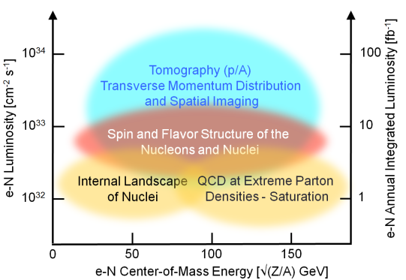
eRHIC Requirements (EIC White Paper)
Large peak luminosity of preferably L =10³⁴s⁻¹cm⁻², at least L =10³³s⁻¹cm⁻²
Center of mass energy between (20-150) GeV
Both Hadron and Electron beams are longitudinally spin polarized
Large acceptance: - forward scattered protons (200 MeV ≤ p_{T} ≤1.6 GeV/c )
- forward neutron acceptance 4mrad
Access to small Bjorken-X<10⁻⁴ ➔ need Electron-Ion collisions; large Q²

Slide 3
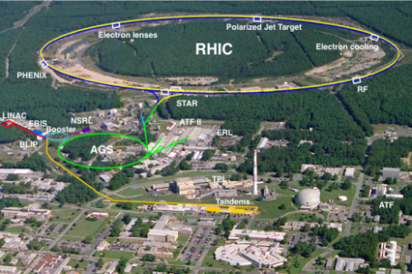
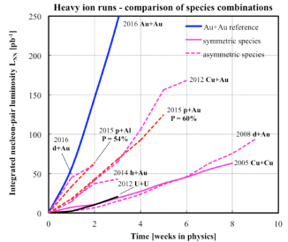
The Relativistic Heavy Ion Collider at BNL
Since 1999 operating with heavy ions and polarized proton collisions serving multiple experimental detectors
Circumference : 3.8 km
Max dipole field : 3.5 T
Energy : 255 GeV p …100 GeV Au
Species : ph to U (incl. asymmetric)
Experiments : STAR, PHENIX
Continuous Performance Increase
Improving machine luminosity in every run
Only facility with high energy polarized proton beams; employing numerous techniques to achieve high proton polarization (up to 60%) in collisions
Present plan: to continue A-A and polarized p-p experiments till 2024
Rich Physics Program
Discovery and detailed study of properties of quark-gluon perfect fluid matter,
Study of proton spin composition, especially its gluon component

Slide 4
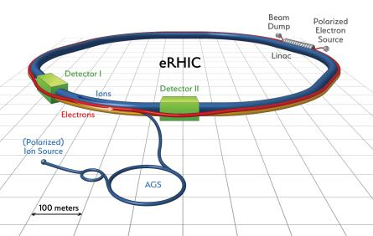
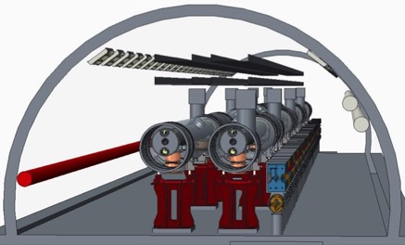
eRHIC Design
Exploiting the RHIC with its
- superconducting magnets, 275 GeV protons
- its large accelerator tunnel and
- its long straight sections
- its existing Hadron injector complex by adding an electron accelerator of 18 GeV in the same tunnel
- high energy reach in e-Ion collisions
- with modest synchrotron radiation, (low operating cost)
- making use of - superconducting LINAC technology - and multi-turn recirculation
- using either the energy recovery (ERL) concept or a high intensity electron storage ring
- achieve high luminosity electron-Hadron collisions over a large range of CM Energies

Slide 5
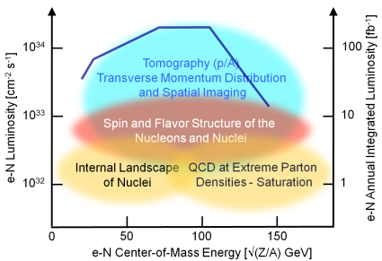
Ultimate eRHIC Design
An eRHIC design has been worked out (published 2014) meeting all the demanding requirements of the EIC physics program (EIC White Paper),
in particular
Luminosities >10³³s⁻¹cm⁻² over the entire range of CM energies 25-140 GeV with a maximum Luminosity in excess of 10³⁴s⁻¹cm⁻²
However, this design is based on novel technology
Coherent Electron Cooling, FFAG return loops, Multi-cathode Gun
Requires strategic R&D program & demonstration of feasibility before a commitment can be made to build a large and costly facility based on this approach
Key Elements of the ongoing long term R&D program is Coherent Electron Cooling ➔ for small Hadron beam emittance for ultra-high luminosity
To move forward➔ Design towards lower Luminosity (10³²-10³³⁾ s⁻¹cm⁻²
but provide access to all components of EIC physics program

Slide 6
eRHIC Design Study with acceptable technical risk
Achievable Luminosity with proven technology is in the range of L = 10³³s⁻¹cm⁻²
will provide access to compelling initial physics program
The reduced luminosity goal makes a storage ring based collider (RR) an interesting alternative to and multi-turn ERL based concept.
Strategy towards eRHIC Design:
Study simultaneously two solutions, both based on existing technology:
- multi-turn ERL (LINAC-Ring collider , LR)
- storage ring based collider (Ring-Ring collider RR)
carry common R&D elements (e.g. Crab cavity) in parallel
Work on experimental verification of critical, yet to be demonstrated design elements (electron source, superconducting Linac)
Carry out Value Engineering and R&D which might lead to saving cost (FFAG lattice with CBETA, Gatling Gun, Waveguide HOM damper)
Compare the two options in terms of performance, cost and residual risk, and feasibility of high luminosity upgrade
➔ Select a final eRHIC conceptual design as soon as possible
Pursue strategic R&D program addressing CeC, to pave the way for a high luminosity upgrade.

Slide 7
Primary eRHIC Design Requirements
Maximum Peak Luminosity ≥ 10³³s⁻¹cm⁻²
Center of Mass Energies 20 GeV-140 GeV
Proton Polarization 70%
Electron Polarization 80%
p_{T} acceptance 200 MeV/c – 1.3 GeV/c
Forward Neutron acceptance 4 mrad
Upgradable to high luminosity L= 10³⁴s⁻¹cm⁻²

Slide 8
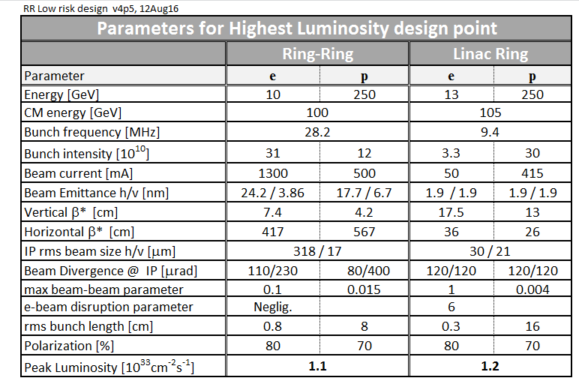
eRHIC Design Study: Important Parameters

Slide 9
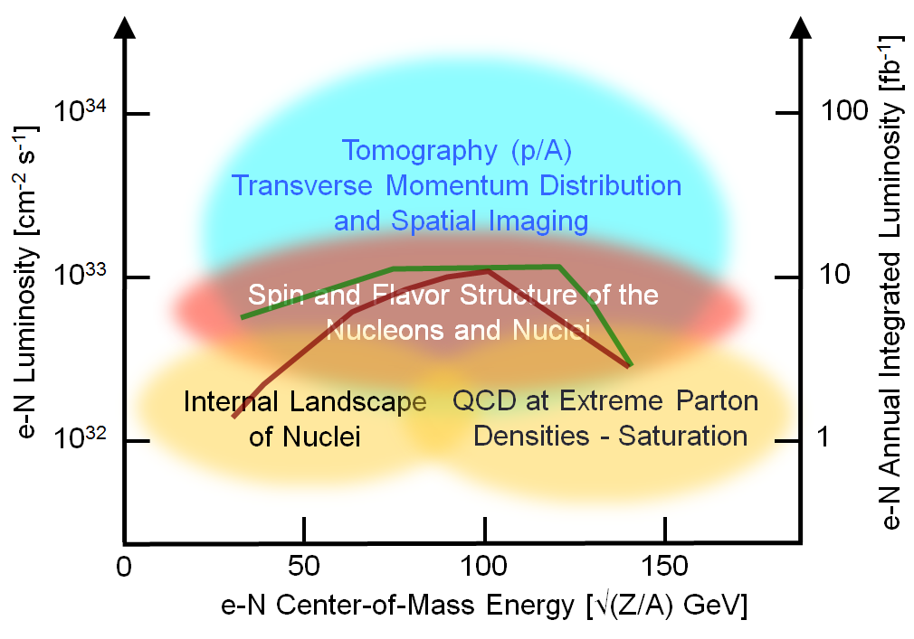
eRHIC Peak Luminosity vs. CM Energy
LR
RR

Slide 10
Main Features of the Recirculating ERL-Based Concept
Superconducting Multi-turn Energy Recovering LINAC
two 1.5 GeV s.c. LINAC 6 return loops➔ 18 GeV (recirculation, energy recovery demonstrated)
High current polarized electron source:
Eight parallel polarized guns each delivering 6.25 mA electrons 5nC/bunch, 10 MHz bunchfrequency,
fast switching between them
Low emittance RHIC protons and stochastically-cooled Heavy Ions, present operating parameters
Crossing angle collision geometry (14 mrad) requiring crab cavities
Spin rotator after injector and pair of spin rotators around IR

Slide 11

eRHIC LR Schematic View
Maximum electron energy: 18 GeV
50 mA polarized electron source employing merging electron current produced by multiple electron guns
Main ERL SRF linac(s): 647 MHz cavities, 3 GeV/turn
Six individual re-circulation beamlines based on electromagnets
No hadron cooling required for e-p in initial design.
Existing stochastic cooling system can be used for e-Au
Luminosity upgrade path to the Utlimate design: adding a cooling system (CeC)
Interaction region design with crab-crossing satisfying detector acceptance requirements
I_{e}=50 mA

Slide 12
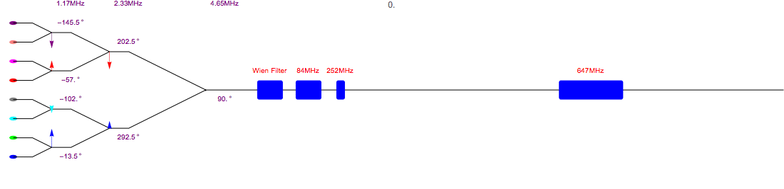
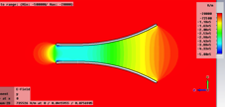
ERL-Ring Polarized Source Using Merging Scheme
4 mA polarized electron beam current was demonstrated in dedicated experiments in JLab
Although the Jlab gun design is not optimal for high bunch charge mA scale operation: small cathode size, no cathode cooling
Lowered risk eRHIC polarized source employs eight JLab-like guns (possibly with improved gun geometry, cathode size and cathode cooling) and combining scheme to produce up to 50 mA current at the source exit
1.17 MHz
2.33 MHz
4.65 MHz
Buncher cavities
20 MeV pre-accelerator
Polarized guns
The 10 MeV injector includes the eight beam combining scheme, spin rotator, buncher and pre-accelerator.
The frequency of the combiner and phase of the RF are listed.
  Detailed 3D simulations of high-charge bunch transport through all injector components are underway
  Experimental studies of single cathode lifetime dependencies (using a Gatling gun prototype)
  Measurements of surface charge limit for SL cathodes using cathode preparation system.
  A prototype gun is being designed, and will be built next year
Field distribution of copper plate deflector,
used in combining scheme

Slide 13
Polarized Electron Source
Need 3⋅10¹⁰ electrons per bunch at 9.8MHz @ 50 mA; 70% polarized
Meet this requirement using 8 parallel photo gun, fast switching between them
➔ 5.3 nC at 9.8MHz @ 6.25 mA; 70% polarized, GaAs Cathode, 350KeV, peak current
~beam current similar to JLAB polarized gun (4 mA),
but required peak current of ~5 A is 50 x larger (0.07 A) than JLAB Gun
~peak current of 5 A is similar to SLC gun (2.7 A),
but average current of 6.25 mA is much larger
however, SLC repetition frequencywas limited by other factors (LINAC, DR..) ➔ no attempt to obtain high average current
➔This requires an experimental verification by a prototype
Comprehensive development program underway to build prototype and demonstrate eRHIC Performance Parameters

Slide 14
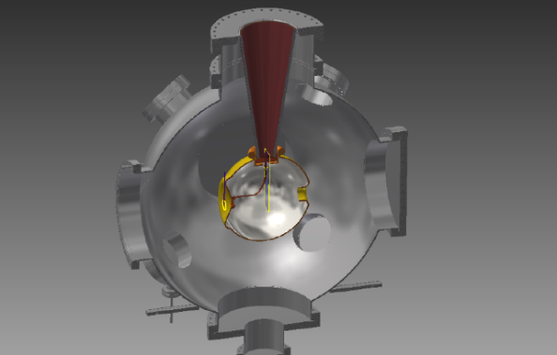
High Current Polarized Photo Electron Gun Design
Cathode Material: Ga-As (proven, but very sensitive material (short cathode lifetime due to ion bombardment) ➔ need extremely good vacuum (XHV) P=10⁻¹² torr; available now
Alternative materials:
Require long time R&D
Cathode Parameters:
Extra large cathode (25 mmǾ)
Large Laser spot 5 mm
Large laser pulse length:1.5 ns
High Voltage: 350 kV
Status:
Gun parts in procurement
Schedule: Test end of 2017

Slide 15
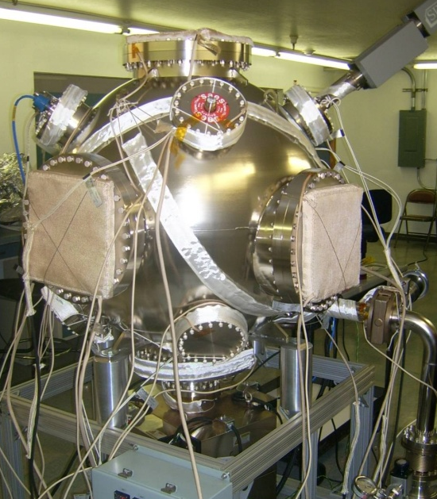
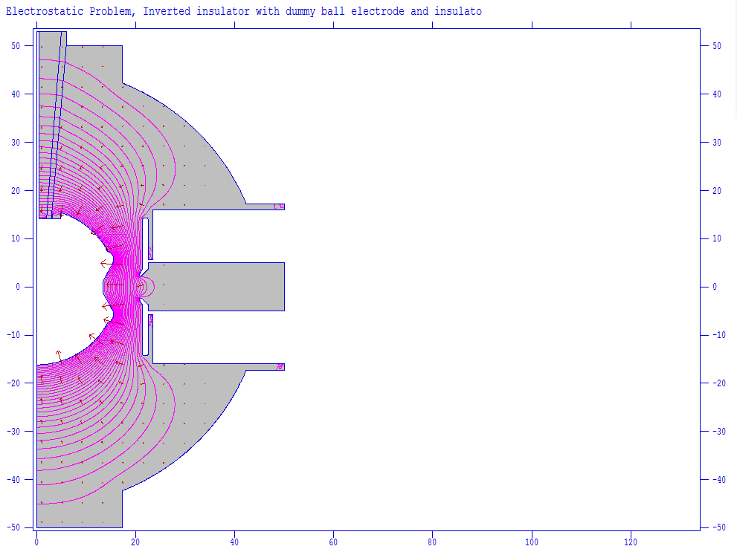
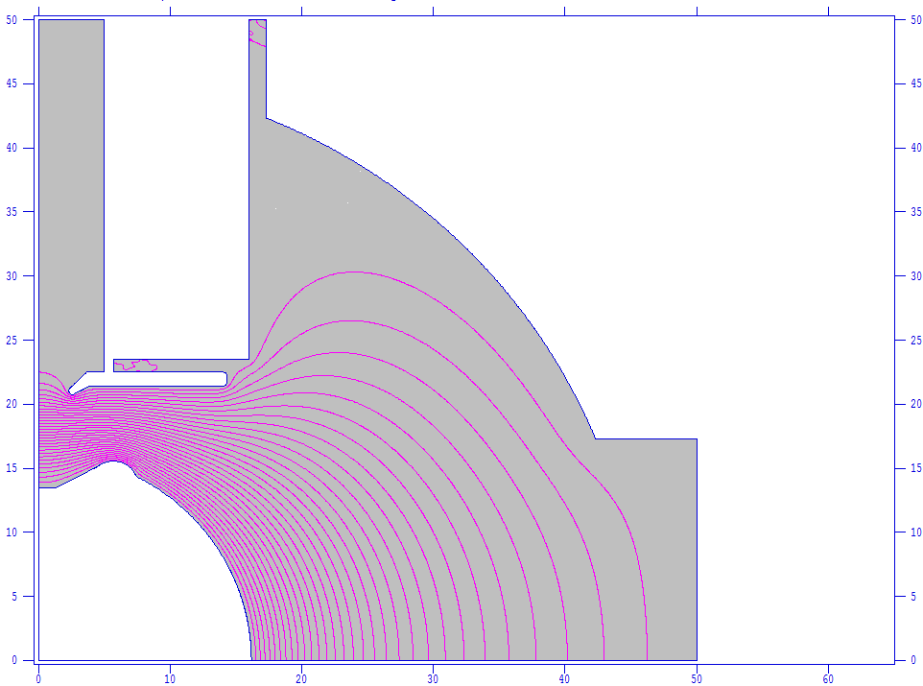
Electron Gun Design
Gap distance | 6.4 cm
Voltage | 350kV
Cathode size | 2.5 cm
Electrodes angle | 27.5 degs
Surface gradients | 2.5 MV/m
Maximum gradient | 9.8 MV/m

Slide 16
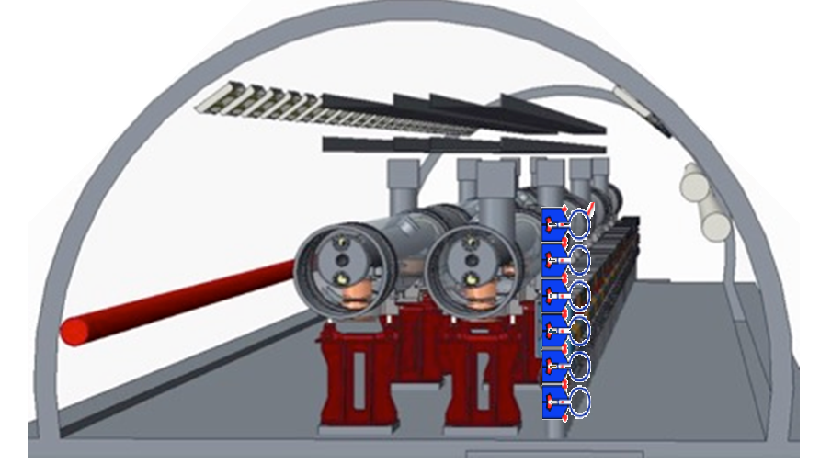
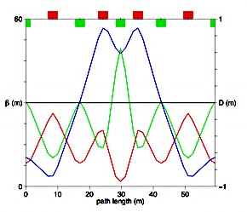
Superconducting Multi-turn Energy Recovering LINAC
2 x {1.5 GeV SC Linac, 200m long, 18 MV/m 36 cryo-modules, 6 turns } ➔ 18 GeV
6 vertically stacked isochronous return loops in the RHIC Tunnel
Beam current 600 mA (50mA/turn), 3mm bunches, Bunchpatterns optimized to minimize BBU
> 463 kW HOM power with beam-pipe HOM dampers (demonstrated at KEK and Cornell)

Slide 17
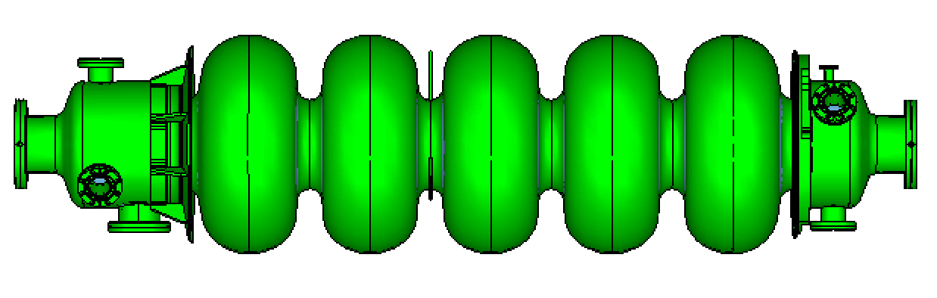
647 MHz Cavity
18 MV/m, CW, Q = 3⋅10¹⁰
Cooling 1.9K Lhe
Q_{ext} = 10⁷
RF power 26.7 kW
HOM power/cavity 3-8 kW
Total amount: 144 cavities in 72 cryostats
Cu model and Nb prototype underway

Slide 18
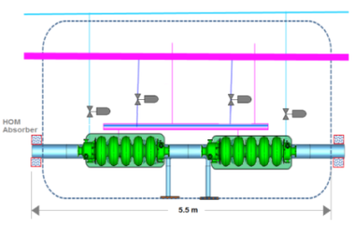
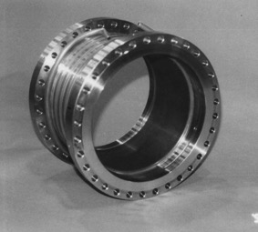
Major design components: main linac cryo modules
SiC beam pipe HOM Damper
The 2 linacs are placed in two long straight sections of RHIC of 200 m length each
There is a total of 2 x 36 5,5m long cryo-modules
Each has two 647 MHz cavities which provide 42 MV
Cryostat design is benefitting from the SRF development program for the Fermilab PIP II projectTwo cavities connected by 4K Stainless steel beam pipe
600 mA of total beam current in the Linac ➔ HOM power of 6-14 MW cryostat
  - similar to storage rings at KEKB and Cornell with Ampere of beam currents where
  ~10 kW of HOM power is absorbed with Ferrite or SiC beam- pipe HOM damper
  - Space consuming, waveguide coupler would be more compact (Value Engineering R&D)

Slide 19
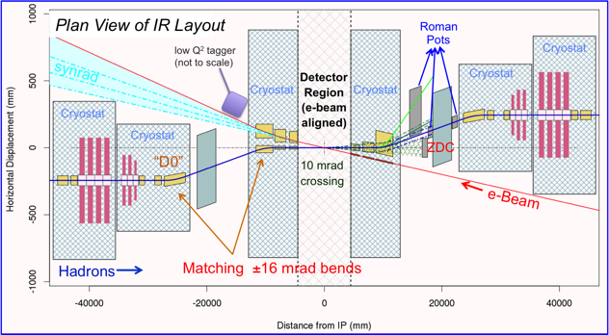
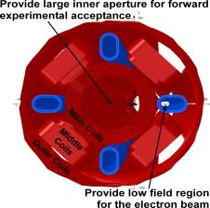
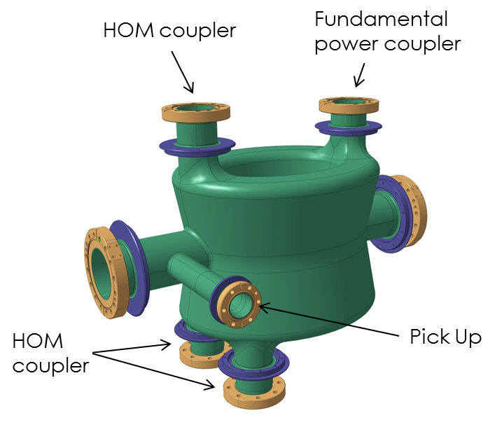
eRHIC High-luminosity, Full Acceptance IR
IR layout for ERL-Ring design
14 mrad
crossing
Crab-cavities
ERL-ring design: “Sweet spot” IR magnet design concept arranges a field-free electron pass between SC coils.
Crab-crossing scheme (14 mrad crossing angle;
140-340 MHz SRF crab cavities)
Special design of SC IR magnets to satisfy forward acceptance requirements and arrange passage of electron beam
Detector elements (Roman Pots, ZDC, luminosity monitor) integrated into the IR design
Soft bending of electron beam within 60 m upstream of the IP to simplify SR protection
Ring-ring design: an outer coil is used to have magnetic flux contained. Utilizing active shielding technique developed for ILC.
400 MHz DQW crab-cavity built
for LHC upgrade

Slide 20
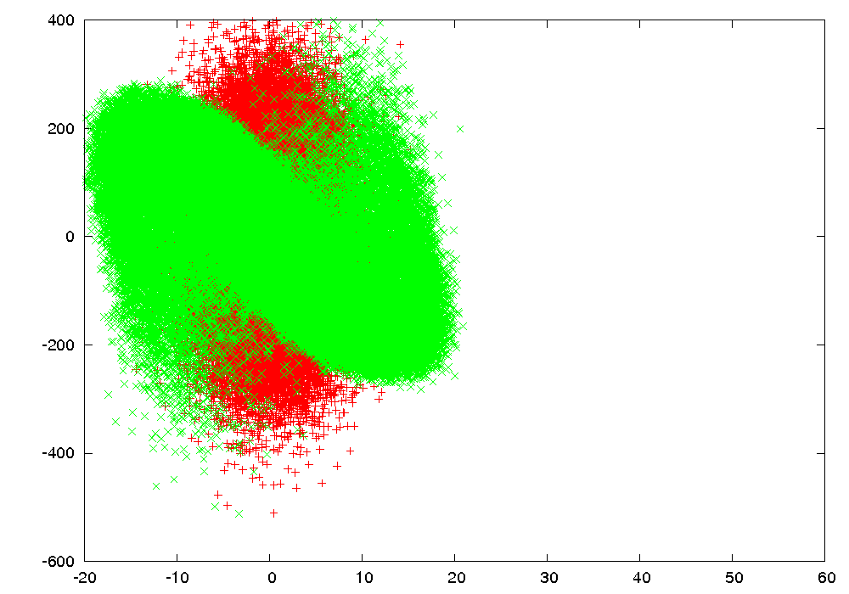
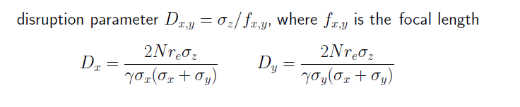
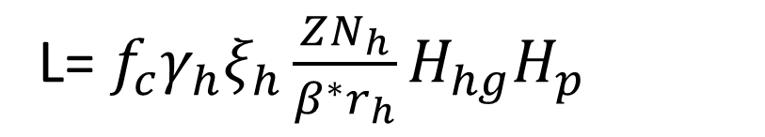
Luminosity
L= ${f_{c}γ}_{h}ξ_{h}\frac{ZN_{h}}{β^{∗}r_{h}}H_{hg}H_{p}$
Limitations:
Polarized Electron Average current 50mA
Minimum b* of 5cm (electrons, hadrons)
Hadron Space charge tune-shift < 0.08
Electron Beam Synchrotron Radiation power < 3 MW
Note: Limits are not achieved simultaneously
Note: e beam disruption is not considered a limitation

Slide 21
Main Feature of the Ring-Ring Design Option
Full Energy, Polarized Electrons injected and stored in a Storage ring
To reach high luminosity operate with many bunches and high electron beam current, flat beams
IR geometry and detector that can accept the larger electron beam emittance.
Crossing angle collision geometry (22 mrad) requiring crab cavities
Bunch-to-bunch spin sign control by full energy injector and frequent electron bunch replacement
Injector based on low current polarized gun, small accumulator ring recirculating s.c. linac for low beam current (4mA), runs at 1Hz , doesn’t need energy recovery
RHIC hadron beams
Electron beam current limited by synchrotron radiation at high electron energies power need 10 MW RF power (high cost)

Slide 22
Ring-Ring Design: Reaching High Luminosity
High electron beam current
( up to 1.3 A)
Demonstrated at B-factories;
Linear SR power load < 4 kW/m
    Luminosity is defined by beam-beam limits:
    ξ_{p} < 0.015, ξ_{e} < 0.1.
    Split arc dipoles are used to enhance radiation damping at lower electron energies
    Increased number of RHIC hadron bunches (by factor 3 from present)
  Injector system upgrade; (~10 nsec kicker risetime)
  Copper coating of RHIC beam pipe.
  In-situ coating methods are being developed
  Electron cloud and associated heating load is being evaluated
Robinson wigglers in straight sections: to provide proper electron emittance control for matching hadron beam size at IP at different hadron energies
Split arc dipole geometry and their field
e-ring lattice

Slide 23
Ring-Ring: Achieving High Electron Polarization
The accelerator technology to achieve high polarization at high energies includes:
highly efficient orbit correction,
beam-based alignment of Beam Position Monitors relative to quadrupole field centers
harmonic spin matching
well controlled betatron coupling
spin matching of spin rotator insertion
eRHIC
Beam polarization requirement determines the injector features:
Full energy injector
To provide the complex spin pattern
Frequent electron bunch replacement (up to 1Hz replacement rate)
To have average beam polarization above 70%.
Low average current, high bunch charge polarized e-source (similar to a SLAC polarized source)
Considered injector options:
  650 MHz SRF linac, consistent with following upgrade to the Ultimate ERL-Ring
  Recirculating linac based on XFEL/LCLS-2 cryo-modules.
Sokolov-Ternov self-polarization time vs energy

Slide 24
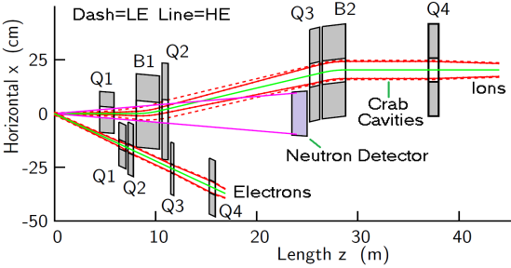
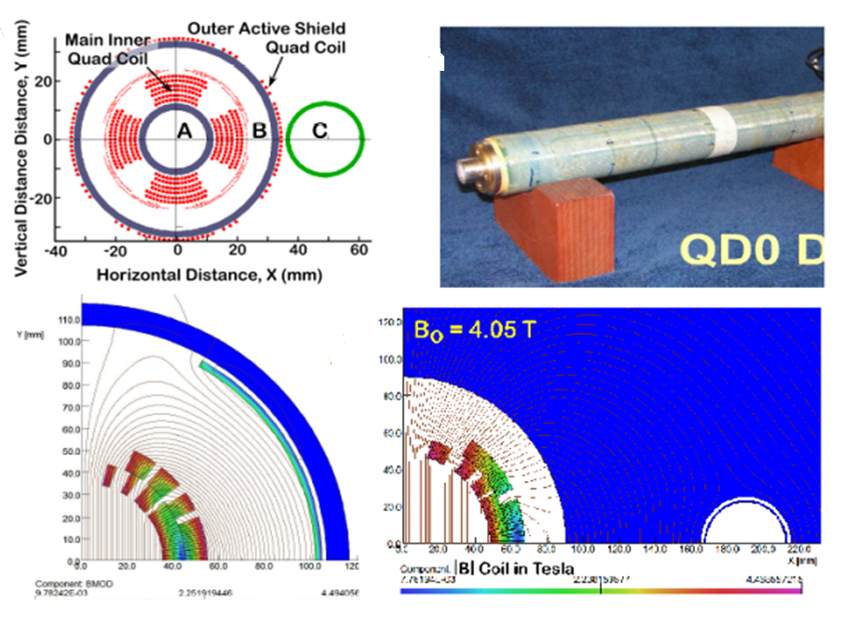
Ring-Ring Interaction Region
More challenging since electron maximum beta should not become too large
Interleaved electron and hadron low beta quadrupoles
Need actively shield coil to cancel unwanted stray fields
Magnet design study performed with direct wound coil like for
Full acceptance for Neutrons and p_{T}
Large Luminosity gain (2.6) for limited p_{T} acceptance

Slide 25
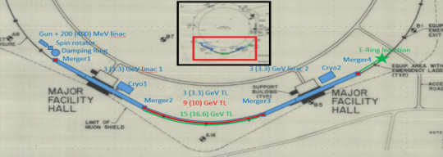
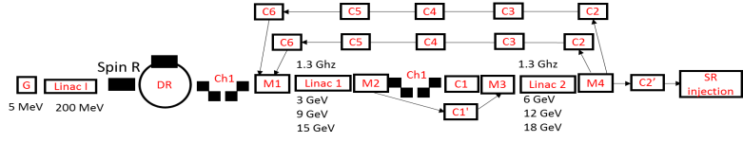
Electron injector
Recirculating linac pulsed RF
- XFEL/LCLS-2 modules, With two 2.25 GeV linacs in two adjacent RHIC straights, 3 re-circulations 4 passages to 18 GeV or
- Alternatively 18 x 650MHz cryo-modules operated at 25 MV/m (makes the designs more compatible and easier interchangeable)

Slide 26
Studies + R&D for eRHIC Design in Progress
R&D on critical designs where demonstration is deemed necessary (highest priority)
Designs which take a long time for optimization and prototyping (medium priority)
R&D for cost saving designs (value engineering), (medium priority)
R&D for luminosity Upgrade (low priority)
A) R&D for required demonstration
50 mA polarized electron source (LR)
18 MV/m, 500 mA beam current superconducting accelerator structures (LR)
Simulation study of beam beam iteraction with aggressive parameters (RR)
Simulation of beam polarization preservation in the storage ring (RR)
Fesibility of synchrotron radation generated bckgounds by high intensity electron beams in the IR (RR)
B) Long Term design and prototyping effort
Crab cavity prototyping (collaboration with CERN) (LR+RR)
Study of in situ copper coating (LR+RR)
Design of new hadron injection kickers (RR)
(C) Value Engineering
Gatling gun concept (LR)
HOM Wave guide coupler (LR)
FFAG return loops for acceleration and energy recovery FFAG; prototype ERL ➔ Cbeta @ Cornell
(D) Luminosity Upgrade
Demonstration of coherent electron Cooling

Slide 27
Critical Design Component for Ring-Ring and Linac Ring
Large Hadron currents in eRHIC >500 mA (especially for luminosity upgrade) require Cu coating of of the RHIC beStainless steel beam pipe
➔ Design of a mole for in situ Cu coating with Ion bombardment to achieve good conductivity at cryogenic tempereatures

Slide 28
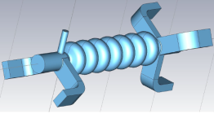
R&D Wave Guide HOM Couplers
Is part of Value Engineering effort
Reduced need of longitudinal space
Saves Cost
Design not yet started

Slide 29
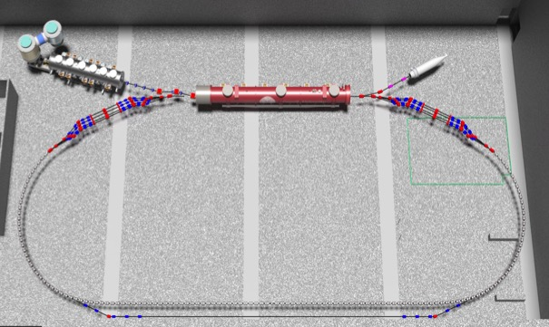
Multi-pass FFAG test-ERL at Cornell – an eRHIC prototype
Uses existing 6 MeV low-emittance and high-current injector & 48.5 MeV CW SRF Linac
ERL with single four-pass recirculation arc with x4 momentum range
Permanent magnets used for recirculation arc
Adiabatic transitions from curved to straight sections
Test of spreader/combiner beam lines
High current can be used to test HOM damping by replacing Linac with eRHIC Linac cryostat
NY State funding
Cost/schedule review (“CD2/3”) in October
6 MeV
6 MeV
+/- 48.5 MeV
54.5, 103, 151.5, 200 MeV

Slide 30
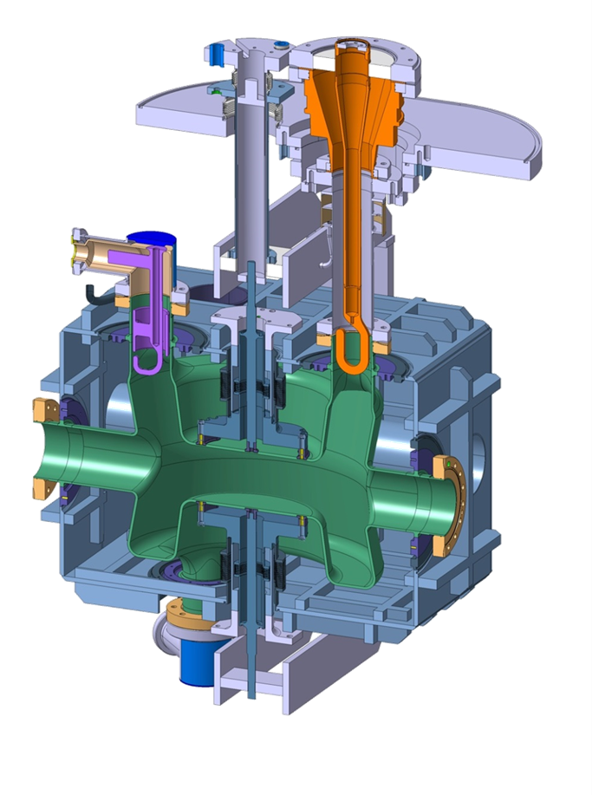
Crab Cavity Development
Crossing Angles 14 mrad (LR)
22 mrad (RR)
Need Crab Cavities for Hadrons (at least) to eliminate impact on luminosity
Frequencies: 122 MHz, 422 MHz,
Voltage = 53 MV, 3 MV
Crab Cavities needed to achieve high luminosity in eRHIC design option
Critical R&D Effort
BNL in-house design
Prototypes being developed in collaboration with CERN (needed for LHC luminosity upgrade)
Two prototypes under construction at CERN and BNL

Slide 31
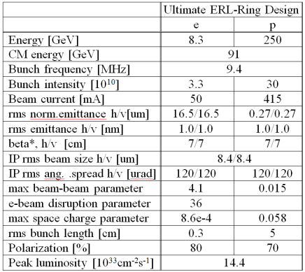
Performance Upgrade
Ultimate luminosity in excess of 10³⁴s⁻¹cm⁻² requires the implementation of the novel Coherent electron cooling scheme (LL and LR)
Both design concepts can be upgraded to higher luminosity by implementation of
Coherent Electron Cooling of the Hadron beams
For LR with CeC is the major required additional system
RR can be upgraded with CeC and by further increasing bunch frequency and beam current
alternatively
RR could be upgraded to ultimate luminosity
by turning into an ultimate LR
- needs more study
- Efforts to make LL and LR designs more similar with more common components started
CeC proof of principle test in RHIC is in progress
(see V. Litvinienko’s presentation)

Slide 32
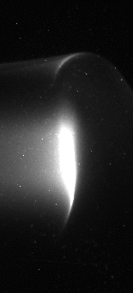
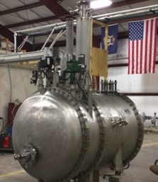
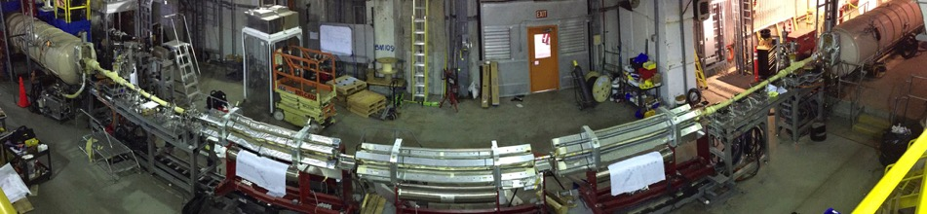
Coherent electron Cooling (CeC) Demonstration Experiment
DOE NP R&D project aiming for demonstration of CeC technique is in progress since 2012
Phase I of the equipment and most of infrastructure installed into RHIC’s IP2
First beam from SRF gun (3 nC/bunch, 1.7 MeV) on 6/24/2015; exceeds performance of all operating CW electron guns
20 MeV SRF linac and helical wigglers for FEL amplifier are installed, 8 MeV beam transported to beam dump (June 2016)
Proof-of-principle demonstration with 40 GeV/n Au beam scheduled during RHIC Run 17
Micro-bunching test also planned with same set-up
WEPOA59 (V.N.Litvinenko)
WEPOB60 (I. Pinayev)

Slide 33
Summary
eRHIC design covers the complete EIC White Paper science case, provides
L= 10³² - 10³³ s⁻¹ cm⁻² luminosity and is highly cost effective.
Two design options studied at present:
- ERL-Ring eRHIC design worked out which combines high performance and relatively low technical risk with high energy efficiency.
- Ring-Ring eRHIC design, meets high performance requirements using existing technology.
While developing cost estimates for final comparison and design choice carry out critical R&D on Crab cavities, 50 mA electron source
as well as value engineering which could enable substantial cost savings
Cost effective upgrade to ~ 10³⁴ s⁻¹ cm⁻² luminosity ERL-Ring design possible for both options.
Crucial R&D programs underway to mitigate technical risks of ultrahigh luminosity (CeC)
Efforts to improve organization of Design and R&D process and keep well aligned with development of EIC physics case

