Slide 1
High-Energy DIS Studies with Nuclei
Thomas Ullrich (BNL/Yale)
DIS 2018
Kobe, April 20, 2018

Slide 2
Driving Fundamental Questions in e+A
Nucleus is:
What is the fundamental quark-gluon structure of light and heavy nuclei?
⎧
⎨
⎩
Object of
Interest
⎧
⎪⎪⎨
⎪⎪⎩
Can we experimentally find and explore a novel regime in QCD of weakly coupled high density matter?
What is the role of saturated strong gluon fields, and what are the degrees of freedom in this strongly interacting regime?
Quark & gluon distribution in nuclei (nPDF, nTMD, nGPD)
Source of nuclear modification?
Short range forces in nuclei: Can they be described in terms of the quark and gluon degrees of freedom?
Impact: High-Temperature QCD, Nuclear Structure
Amplifier
⎧
⎪⎨
⎪⎩
Can the nuclear color filter provide novel insight into propagation, attenuation and hadronization of colored probes?
Gluon saturation, QS^{A}(x) ~ QS(x)∙A^{⅓}
Color Glass Condensate
New evolution equations (JIMWLK, BK)
Universality?
Analyzer
Energy loss in cold nuclear matter
Fragmentation Functions

Slide 3
Electron-Ion Collider Initiatives
Past
Future
 | HERA@DESY | LHeC@CERN | HIAF@CAS | ENC@GSI | JLEIC@JLab | eRHIC@BNL
√s (GeV) | 320 | 800-1300 | 12-65 | 14 | 20-64 | 32-140
Proton xmin | 1×10⁻⁵ | 5×10⁻⁷ | 3×10⁻⁴ | 5×10⁻³ | 3×10⁻⁴ | 5×10⁻⁵
Ions | p | p … Pb | p … U | p … Ca | p … Pb | p … U
L (cm⁻²s⁻¹) | 2×10³¹ | ~10³⁴ | ~10³²⁻³⁵ | ~10³² | ~10³³⁻³⁵ | ~10³³⁻³⁴
IRs | 2 | 1 | 1 | 1 | 2+ | 2+
Year | 1992-2007 | post ALICE | > 2020 | Fair Upgrade | post 12 GeV | post RHIC
High-Energy Physics
Nuclear Physics
World-wide interest in e+A collisions
All future collider include e+A in their planning
typically up to heaviest nuclei

Slide 4
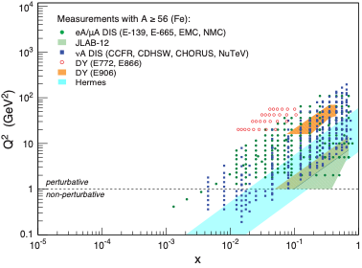
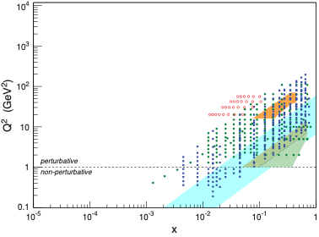
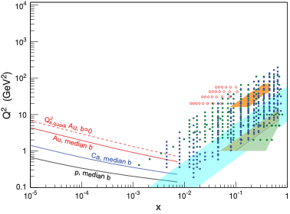
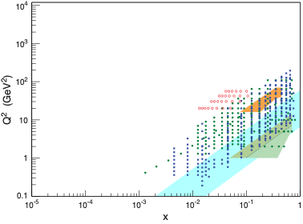
Landscape of e+A Physics
Requirements
reach to lower-x ⇒ get into the region where gluons and sea quarks dominate
large Q² lever arm ⇒ needed for comparison and verification of evolution equations
Nucleus as Analyzer:
Hadronization (Color Neutralization)
E-loss (Color Propagation)
Color Transparency
pT-Broadening (Fluctuations)
Jets
Terra Incognita:
Gluon Saturation/Strong Color Fields
Strongly correlated non-linear QCD
What is the right effective theory (CGC, …)?
Large Q², large ν
Low-x

Slide 5
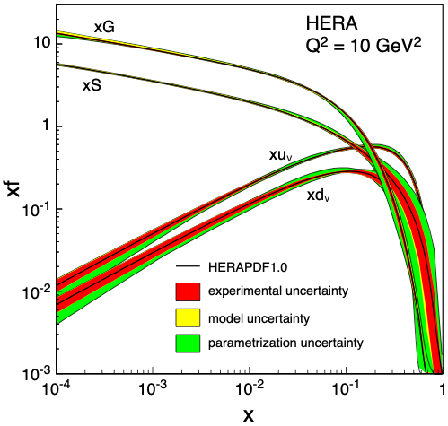
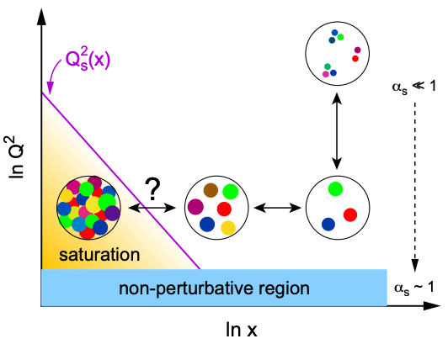
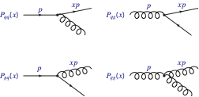
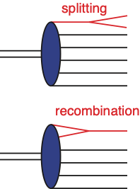
Key Topic in e+A: Gluon Saturation
QCD evolution drives the gluon distribution rising at small-x
pQCD
evolution
equation
DGLAP
BFKL
Lowest order QCD splitting function
New Approach: Non-Linear Evolution
BFKL→BK: Recombination compensates gluon splitting
Saturation of gluon densities characterized by scale Q_{s}(x)
New evolution equations at low-x (JIMWLK)
Effective theory: Color Glass Condensate
Explosion of gluon density ⇒ violates unitarity

Slide 6
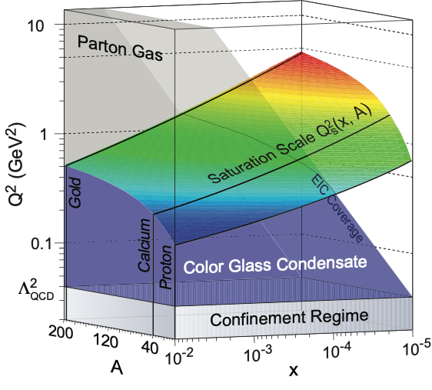
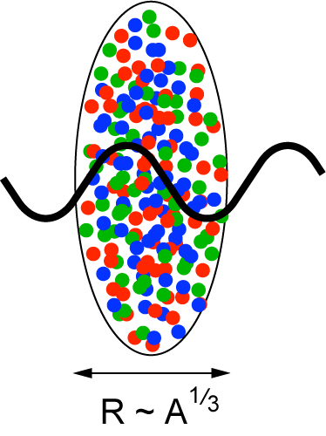
Nuclear Oomph: Gluon Saturation in e+A
Eur.Phys.J. A52 (2016), 268
Enhancement of Q_{S} with A: saturation regime reached at significantly lower energy in nuclei (and lower cost)

Slide 7
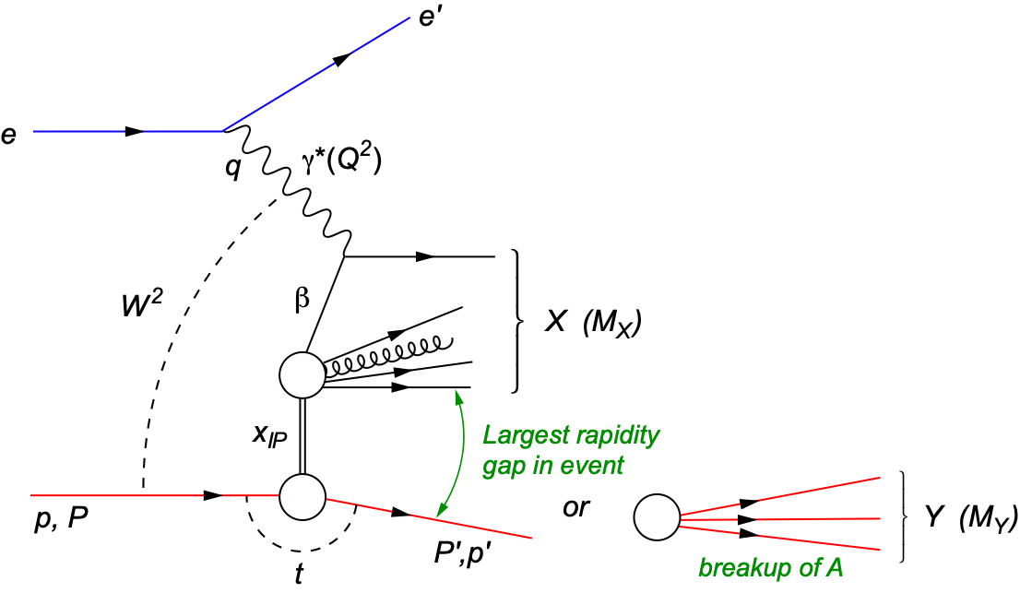
Diffraction for the 21st Century
Diffraction is most precise probe of non-linear dynamics in QCD
Will be major component of any e+A program
HERA: σdiff/σtot ~ 14%
High sensitivity to gluon density: σ~[g(x,Q²)]² due to color-neutral exchange (e.g. in exc. VM prod.)
Only known process in e+A where spatial gluon distributions can be extracted (relevant for HI)
t: momentum transfer
squared
MX: mass of diffractive final-state
coherent
incoherent
p/A stays intact
p/A breaks up

Slide 8
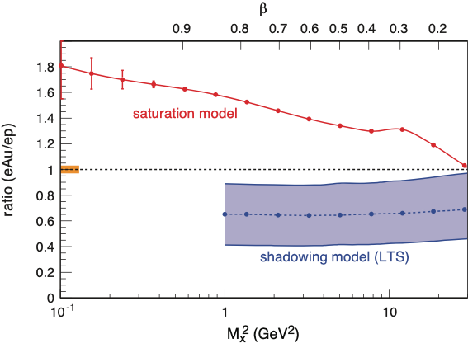
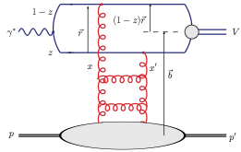
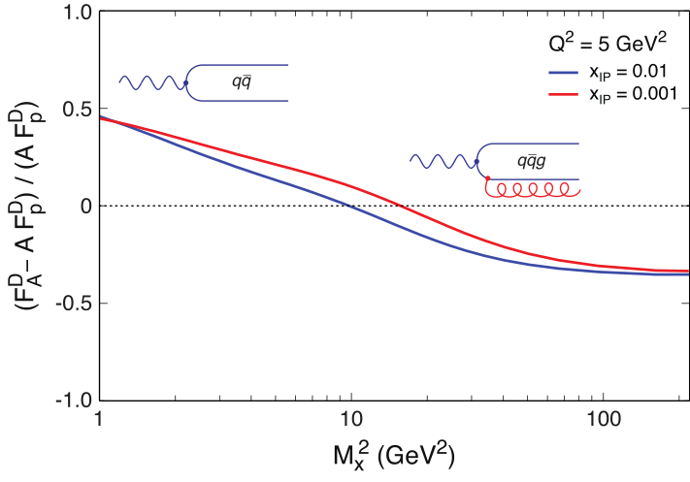
σdiffractive/σtotal
HERA observed: ~14% of all events are diffractive
Saturation models (CGC) predict up to σdiff/σtot ~ 25% in eA
Ratio enhanced for small MX and suppressed for large MX
Standard QCD predicts no MX dependence and a moderate suppression due to shadowing.
Sign Change:
Eur.Phys.J. A52 (2016), 268
arXiv:1708.01527
Observing these M_{x} dependencies
over wide range in x and Q² is crucial!
Unambiguous signature for reaching the saturation limit
Notes:
Dipole cross-section is closer to the unitarity limit than the proton - it is “blacker”. The elastic scattering probability of a qq̅ dipole is maximal in the “black” limit
The qq̅g component is suppressed for nuclei compared to the proton.
This is due to the fact that in a nucleus the scattering amplitude
is closer to the unitarity limit when the qq̅g component vanishes
different b -dependences from each other and from the inclusive
cross section. The q ¯q -component is enhanced at small b (closer to the black disk limit),
whereas the q ¯qg -part is dominated by larger b (because it vanishes in the black disk limit).
Depending on the mass of the diffractive system MX
or, equivalently, , the diffractive structure function is
dominated by either the q ¯q or q ¯qg Fock states.
invariant mass of the diffractive system is large, and
this large phase space is filled by radiation of additional
gluons, each of them being suppressed by
alpha_s .
The q ¯q -components of
the FD
2A are enhanced compared to A times the proton
diffractive structure functions. This is to be expected,
because of the fact that in a gold nucleus the dipole cross
section is, on average over the transverse area, closer to
the unitarity limit than the proton - it is “blacker”. The
elastic scattering probability of a q ¯q dipole is maximal in
the “black” limit and the approach to it is quicker in a
large nucleus. The q ¯qg component, on the other hand,
is suppressed for nuclei compared to the proton. This is
due to the fact that in a nucleus the scattering amplitude
is closer to the unitarity limit when the q ¯qg component
vanishes, as can be seen e.g. from Eq. (13). This
leads to a nuclear suppression of the diffractive structure
function in the small region, where the q ¯qg component
dominates. The net result of the different contributions
is that FD
2A , for a large range in , is close to AFD
2p .

Slide 9
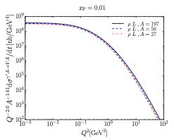
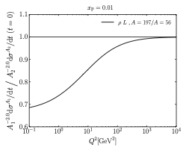
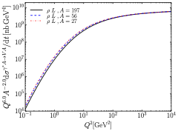
Q² and A Scaling of Diffractive VM Production
Saturation models predict very special and strong dependencies in A and Q² that are different above and below Q²S
Q² > Q²S
σ ~ 1/Q⁶
σ(t=0) ~ A²
σ ~ A^{4/3}
Q² < Q²S
σ ~ Q²
σ(t=0) ~ A^{4/3 ↔︎} A^{5/3}
σ ~ A^{2/3 ↔︎} A
Q² scaling
t = 0
A² scaling
1/Q⁶ scaling
Mantysaari and Venugopalan, arxiv:1712.02508
Non-Saturation scenarios do not show this behavior making A, Q² dependencies a key measurement

Slide 10
EIC: Spatial Gluon Distribution from dσ/dt
Diffractive vector meson production:
e + Au → e′ + Au′ + J/ψ, φ, ρ
Momentum transfer t = |pAu-pAu′|² conjugate to bT
~
t = Δ²/(1-x) ≈ Δ²
PRC 87 (2013) 024913
Converges to input F(b) rapidly: |t| < 0.1 almost enough
Provides constraints on nuclear GPDs
Notes:
spin-dependent gluon distribution

Slide 11
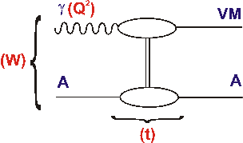
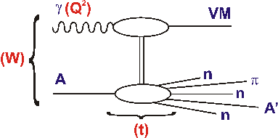
LHeC: Diffractive vector meson production
Detecting incoherent diffraction is experimental challenge in e+A affecting detector and IR design
Need suppression of > 1000 for |t| > 0.2 GeV²

Slide 12
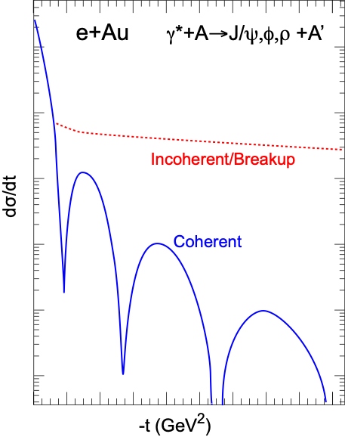
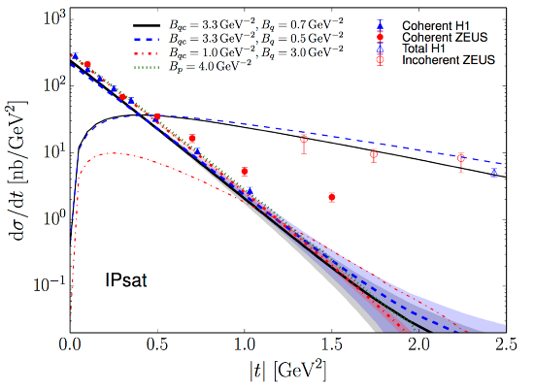
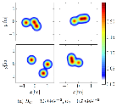
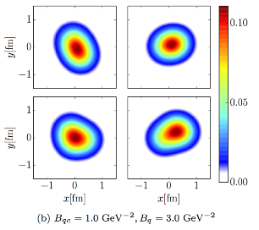
Importance of Incoherent Diffraction
Nucleus dissociates: f ≠ i
Incoherent CS is the variance of the amplitude ⇒ measure of fluctuation of the source G(x, Q², b)
Important for understanding of A+A, p+A correlations/shape fluctuations
Note: Incoherent contribution disappears in black disk limit (see talk by H. Mäntysaari)
Example from ep:
H. Mäntysaari,
B. Schenke,
PRL 117 (2016) 052301
Notes:
\begin{eqnarray*}
\sigma_\text{incoherent} &\propto & \sum_{f \neq i} \left< i|{\cal{A}}|f \right>\left< f|{\cal{A}}|i \right>\\
&=& {\color{blue} \left< |{\cal{A}}|^2 \right> } - {\color{red}\left< |{\cal{A}}| \right>^2}
\end{eqnarray*}
\color{red}\frac{\text{d}\sigma_\text{coherent}}{\text{d} t} = \frac{1}{16 \pi} \left< |{\cal A}| \right>^2

Slide 13
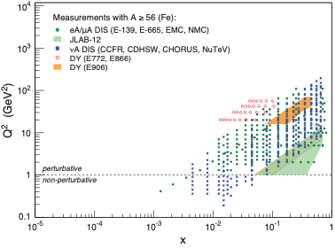
Nuclear PDFs
nPDFs less well known due to lack of data
Theory/models have to be able to describe the structure functions and their evolution
DGLAP:
predicts Q² but not A and x dependence
Saturation models (JIMWLK):
predict A and x dependence but not Q²
Need: large Q² lever-arm for fixed x, A-scan
e+A: Aim at extending our knowledge on structure functions into the realm where gluon saturation (higher twist) effects emerge
⇒ different evolution (JIMWLK)

Slide 14
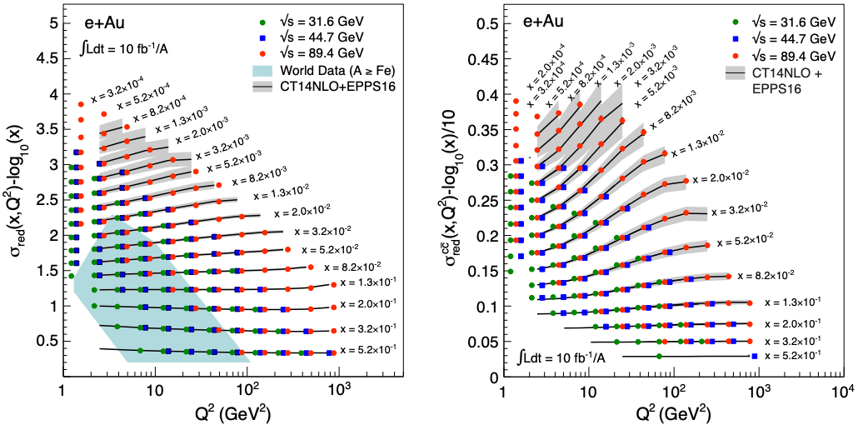
EIC: Structure Functions in eA
EIC pseudo-data
σred, FL, F2, F2^{cc} values from EPPS16 (state-of-the-art nPDF)
Errors (sys and stat.) from simulations for ∫Ldt=10 fb⁻¹/A
arXiv:1708.01527, 1708.05654

Slide 15
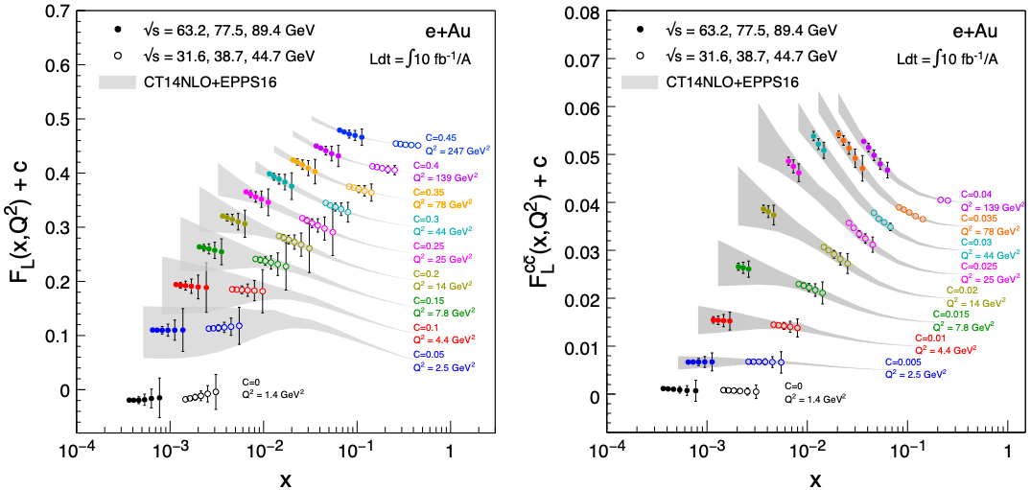
EIC: FL Structure Function
FL probes glue more directly
FL is small and requires running at different √s and thus has larger systemic uncertainties than F2

Slide 16
LHeC: F2 Structure Functions
Similar studies at LHeC ⇒ Pseudo-data
σred(Pb) /σred(p)
NC
∫Ldt=10 fb⁻¹/A
H. Paukkunen, POETIC 2018
Advantage at LHeC
NC+extended reach for CC
substantial lower-x reach
Errors in FL larger due to (voluntarily) restriction in √s range
Neither at EIC nor LHeC luminosity is essential: σsys is key

Slide 17
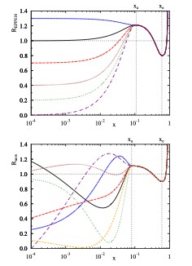
The Problem of Estimating nPDF Constraints
Methods:
Use σred (includes F2 and FL (F3)) pseudo data
Re-weighting EPPS16
EPPS16 is a bit stiff at low-x, over-constraints at low-x
EPPS16* (arXiv:1708.05654, Hannu Paukkunen)
more flexible form cures EPPS16 problem (low-x bias)
might underestimate impact?
EPPS16
EPPS16*
Notes:
Inclusive DIS cross-section, simplified (reduced) by dividing out the Mott cross-section.

Slide 18
EIC’s Impact on nPDFs (Rglue)
Improves uncertainties substantially out to 10⁻⁴
Shrinks uncertainty band by factors 4-8
Charm: no additional constraint at low-x but dramatic impact at large-x
Q² ~ 1.7 GeV²
Q² ~ 10 GeV²
arXiv:1708.01527

Slide 19
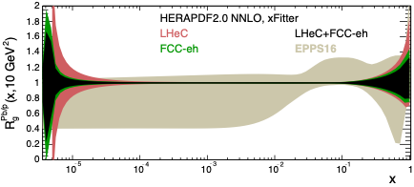
LHeC’s Impact on nPDFs (Rglue)
See also talk by N. Armesto
Work in progress
Large correlations among the fit parameters
Need MC methods to more reliably map the uncertainties
A typical result using a more flexible form for the gluons:
EPPS16*
EPPS16*
Alternative approach:
Use same pseudodata as above but within xFitter and HERAPDF2.0 parametrisation to estimate the ‘ultimate’ precision (Armesto & Agostini):

Slide 20
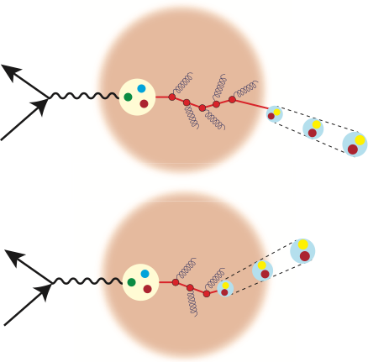
Exploring QCD at Large Q², ν
Color propagation and neutralization
Fundamental QCD Processes:
Partonic elastic scattering
Gluon bremsstrahlung in vacuum and in medium (E-loss)
Color neutralization
Hadron formation
⎧⎨
⎩
dynamic confinement
High Energy: hadronization outside
→ partonic evolution altered in medium
Nuclei as space-time analyzer
high Q² and ν (→ large x):
Energy of struck quark (the probe) is known
No color spectators (as in p+A)
Hadronization in and out of medium can be varied (ν)
Low Energy: hadronization inside
→ formation time, (pre-) hadronic absorption

Slide 21
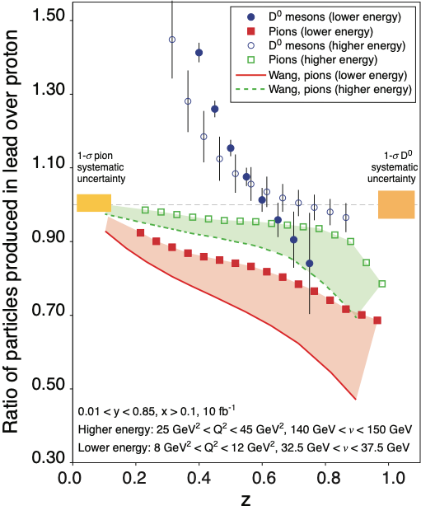
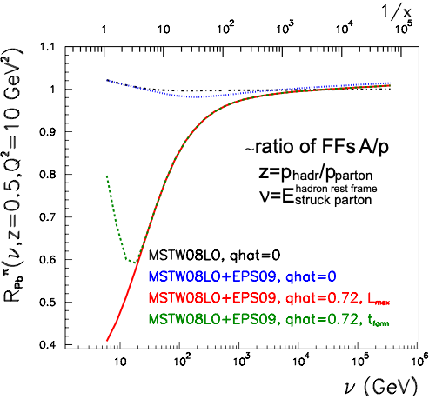
Multiplicity Ratios: Semi-Inclusive Studies
EIC
HERMES: ν = 2-25 GeV
EIC: 10 < ν < 1600 GeV
LHeC: ν < 5∙10⁵ GeV
LHeC+EIC: heavy flavor!
D⁰
LHeC
without E-loss
p
Different
models
with E-loss
with
absorption
á
Slope of D’s sensitive to q and FF
Strong Sensitivity of Shape on ν is powerful tool
Notes:
Points: energy loss models with attenuation of pre-hadrons + medium induced energy loss.
Lines: pure energy loss calculations
EIC has PID: Get whole picture/even structure of process
The fact that the energy loss matches the active parton to the fragmentation function at a larger value of z leads to two dramatically different phenomena in the
semi-inclusive production of light and heavy mesons at the EIC
The dramatic difference between the multiplicity ratios of D0 meson production and that of pions, as shown in Fig. 3.23, is an immediate consequence of the difference in the
fragmentation functions shown in Fig. 3.22 (Right). The enhancement of the ratio is caused by the peak in the D0’s fragmentation function. The slope of the enhancement
is sensitive to the amount of energy loss, or equivalently, the transport coefficient, ˆq of cold nuclear matter, and the shape of the fragmentation function [

Slide 22
Exploring Short Range Nuclear Forces
Miller, Sievert, Venugopalan, Phys.Rev. C93 (2016)
Can the short range contributions to NN scattering be described directly in terms of the quark and gluon DoF in QCD?
Vector meson production in e+D collisions
Cross-section can be expressed in terms of a gluon Transition Generalized Parton Distribution (T-GPD)
The hard scale in the final state makes the T-GPD sensitive to the short distance nucleon-nucleon interaction.
New opportunities - needs more studies (in progress)
Notes:
nuclear force is described by pion exchange, and is well understood
within the framework of effective field theories. At shorter distances, two pion
exchange, tensor interactions, and vector meson exchange contributions become important,
which are harder to capture in the framework of effective field theories. At short distances,
the nucleon-nucleon interaction has a strong repulsive core, which is essential for the stability
of matter.

Slide 23
e+A - Take Away Message
e+A collisions will allow the unprecedented study of matter in a new regime of QCD.
New capabilities open a new frontier to study the saturation region, measure the gluonic structure of nuclei, and investigate color propagation, and fragmentation using the nucleus as analyzer
Physics connects many fields: Heavy-Ions, Hadron Physics, Nuclear Structure, HEP, …
Important: Theory is making excellent progress: higher orders, robust calculations, new ideas are being explored
An e+A program at a collider is also an experimental challenge
new difficulties compared to e+p
never conducted in a collider
IR & detector designs, roman pots, forward spectrometer, machine integration and many more

Slide 24
Backup Slides

Slide 25
N.B.: Important Dual Description of DIS
Bjorken frame
Dipole frame [A. Mueller, 01; Parton Saturation-An Overview]
Bjorken: Partonic picture of a hadron is manifest. Saturation shows up as a limit on the occupation number of quarks and gluons.
Dipole: Partonic picture is no longer manifest. Saturation appears as the unitarity limit (black disk) for scattering. Convenient to resum the multiple gluon interactions.

Slide 26
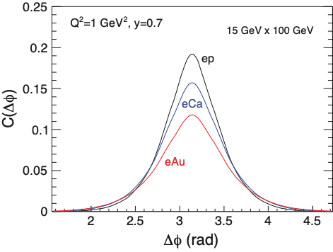
Dihadron Correlations (I)
Forward dihadron correlation in Dilute-Dense factorizations as a probe to saturation.
Experimental Simple Measurement
beam-view
pT^{trigger}
suppression
increasing with A
pT^{assoc}
p
Already tantalizing hints from p+A
studies at RHIC
Predicted [C. Marquet, 09] as important hint of saturation
Interpretation: decorrelation due to interaction with low-x gluonic matter
Robust calculations available (Albacete, Dominguez, Lappi, Marquet, Stasto, Xiao) including Sudakov resummation in dijet processes

Slide 27
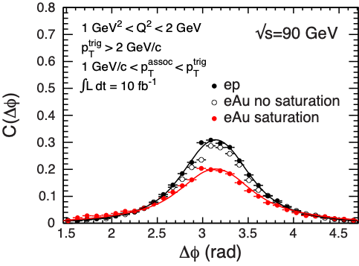
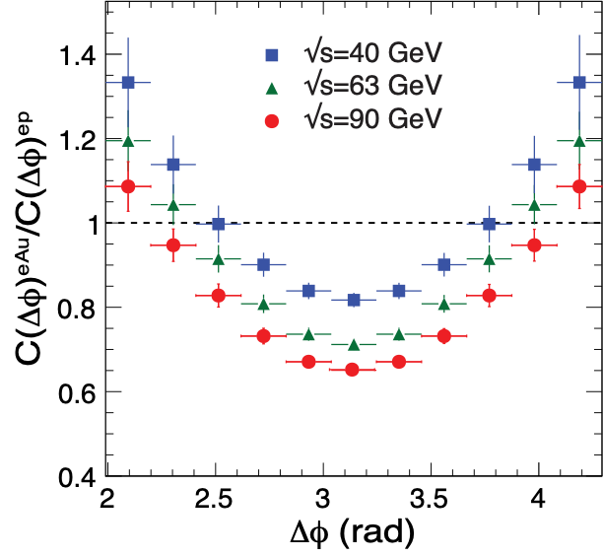
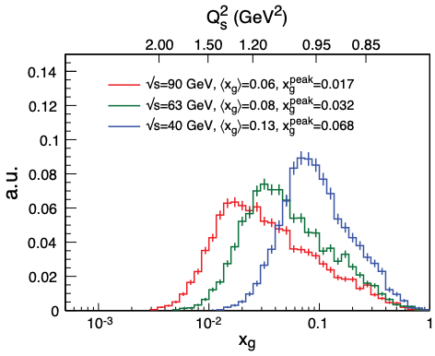
Zheng et al., PRD89 (2014) 074037;
BNL-114111-2017, arXiv:1708.01527
Back-to-back Correlations
Substantial suppression, √s helps
Also LHeC simulation (CDR/J.Phys. G39 (2012) 075001)
Similar Dijet Correlations
Unique measurement of WW Gluon Distributions (nTMDs)
see arXiv:1508.04438,1708.01527

