Slide 1
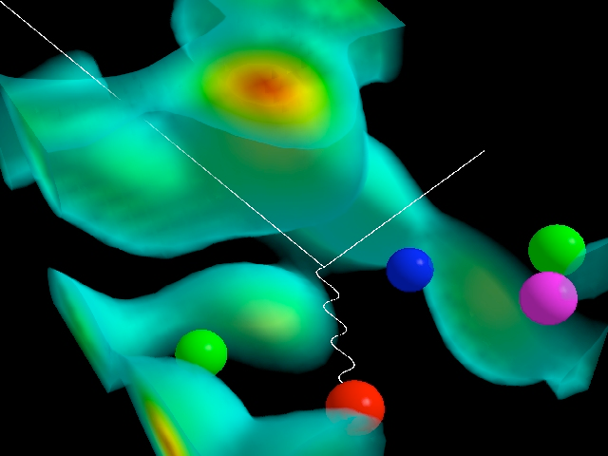
The Glue That Binds Us
Probing Gluonic Matter With the World's First Electron-Ion Collider
Thomas Ullrich (BNL/Yale)
Michigan State University
February 23, 2017
D. Leinweber (Three quarks localized by the gluon field & e scatter)

Slide 2
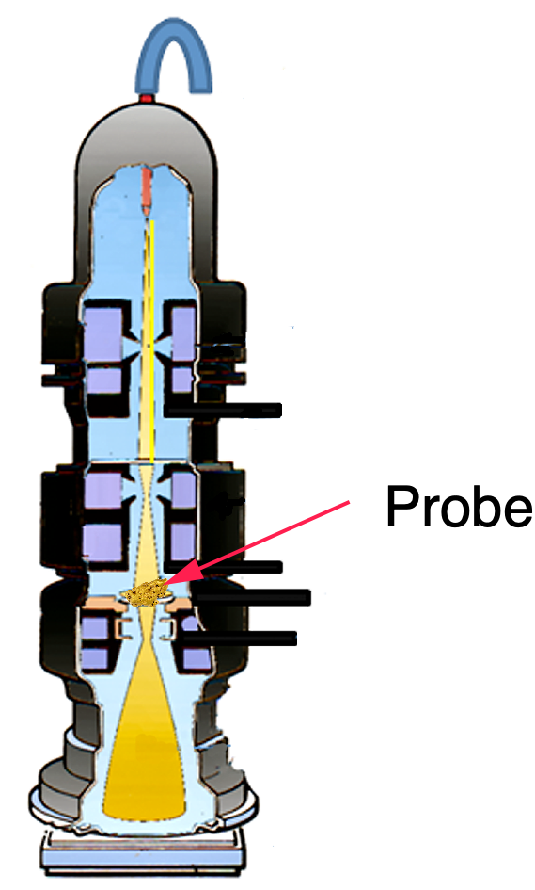
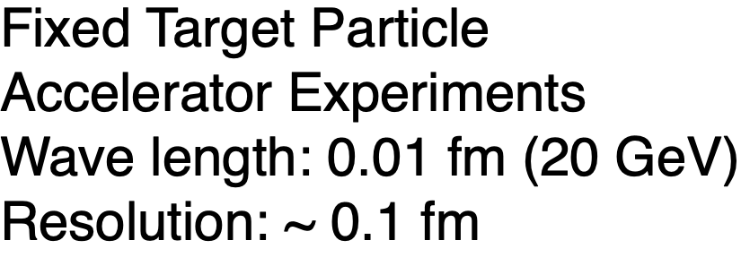
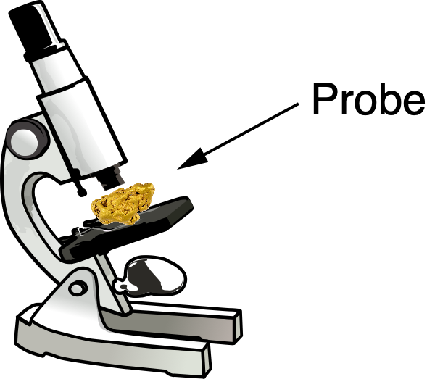
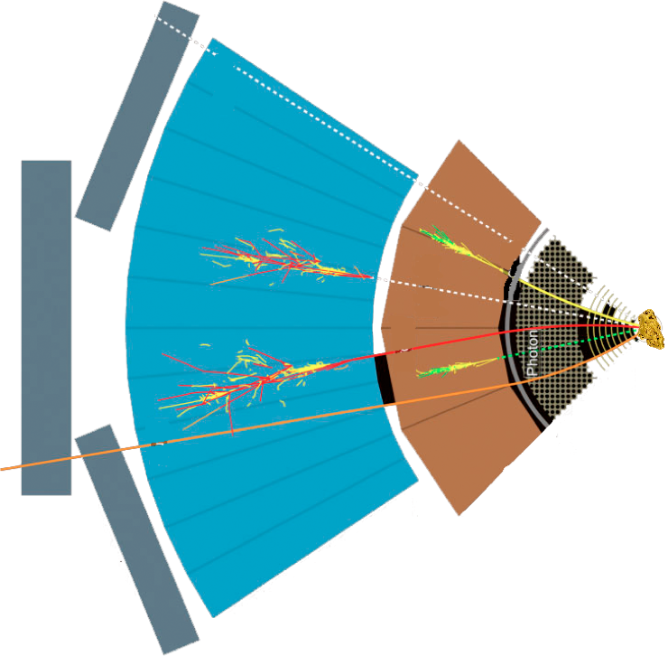
Studying Matter at Small Scales
Target
SLAC, EMC, NMC, E665, BCDMS,
HERMES, JLab, COMPASS, …
Detector

Slide 3
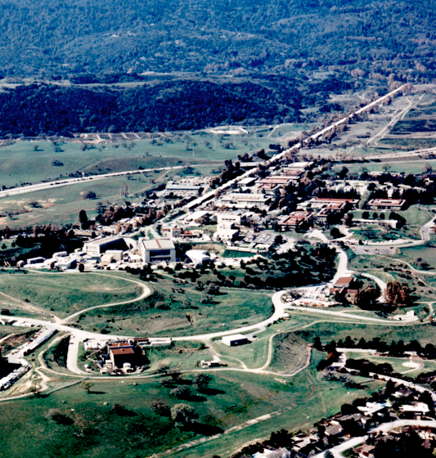
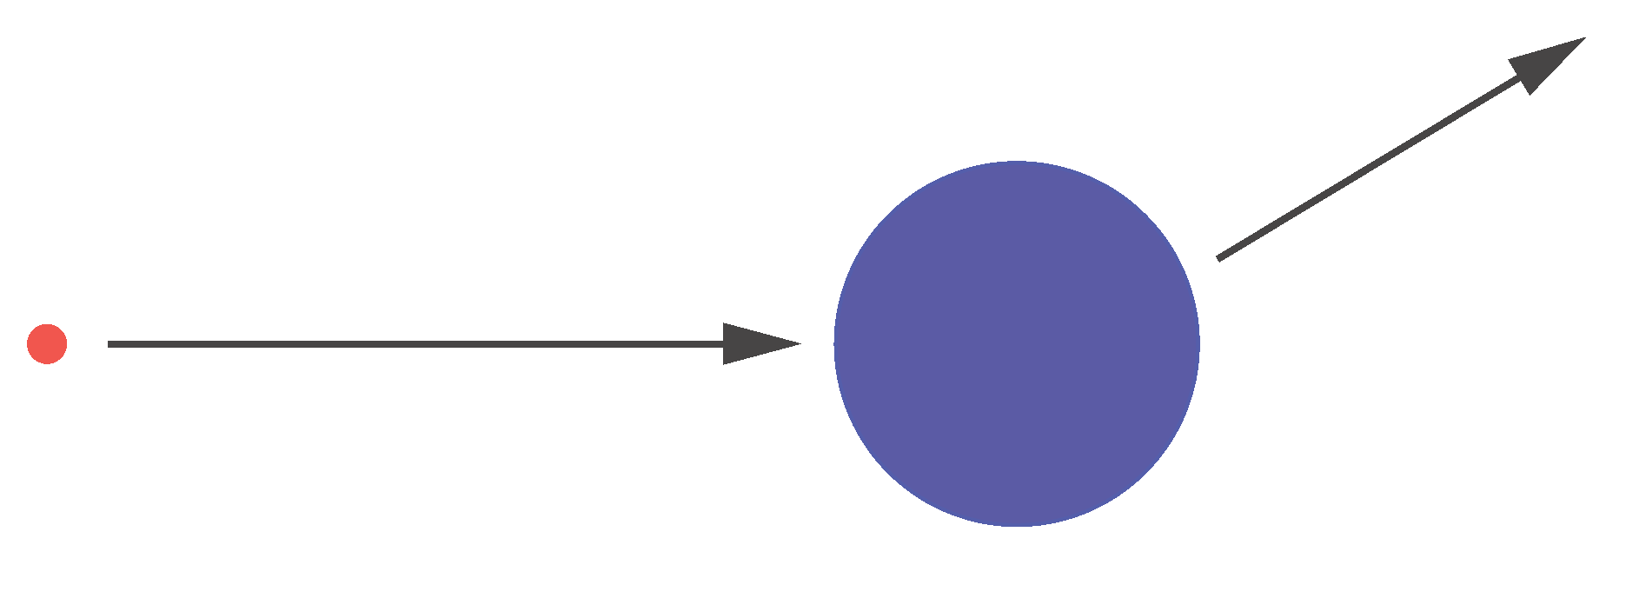
Probing Matter with Hard Probes
The SLAC experiments in the 1960s established the
quark model and our modern view of particle physics.
proton
Constant F(q²):
⇒ scattering on point-like constituent of the nucleon
free quarks
Mott = Rutherford + Spin
electron
p₂
?
p₁
inelastic
elastic
Formfactor: F(q²)
Fourier transform
of charge distributions
Notes:
Parton Model (Feynman & Bjorken): nucleons as made up of point-like constituents
provides a very simple framework for calculating scattering cross-sections
as well as structure functions.
Parton Model: every object with a finite size has a formfactor and therefore experiences a dependence of
the 4-momentum transfer (Q2 dependence) from the scattered particle.
\frac{d\sigma}{d\Omega} = \left( \frac{d\sigma}{d\Omega} \right)_\mathrm{Mott} |F(q^2)|^2
q^2 = (\mathbf{p}_1 - \mathbf{p}_2)^2
Friedmann, Kendall, Taylor

Slide 4
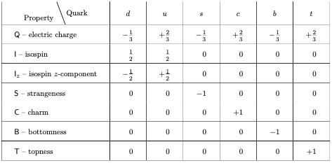
“Static” Quark Model
Quarks: spin 1/2 fermions, color charge
M. Gell-Mann,
K. Nishijima (> 1964)
Baryons:
q
Mesons:
q
q
q
q
Eight-fold Way: Account for every hadron we found so far
Where’s the Dynamics?
Notes:
In physics, the Eightfold Way is a term coined by American physicist Murray Gell-Mann for a theory organizing subatomic baryons and mesons into octets (alluding to the Noble Eightfold Path of Buddhism). The theory was independently proposed by Israeli physicist Yuval Ne'eman and led to the subsequent development of the quark model.
Particles along the same horizontal line share the same strangeness, s, while those on the same diagonals share the same charge, q.
In addition to organizing the mesons and spin-1/2 baryons into octets, the principles of the Eightfold Way also applied to the spin-3/2 baryons, forming a decuplet. However, one of the particles of this decuplet had never been previously observed. Gell-Mann called this particle the Ω⁻ and predicted in 1962 that it would have a strangeness −3, electric charge −1 and a mass near 1,680 MeV/c². In 1964 a particle closely matching these predictions was discovered[1] by a particle accelerator group at Brookhaven, making the Eightfold Way a triumphant success. Gell-Mann received the 1969 Nobel Prize in physics for his work on the theory of elementary particles.
The baryon octet
The Eightfold Way may be understood in modern terms as a consequence of flavor symmetries between various kinds of quarks. Since the strong nuclear force is the same for quarks of any flavor, replacing one flavor of quark with another in a hadron should not alter its mass very much. Mathematically, this replacement may be described by elements of the group SU(3). The octets and other arrangements are representations of this group; for a more detailed explanation of this fact, see the article Particle physics and representation theory.

Slide 5
Quantum Chromodynamics (QCD)
Quantum Chromo Dynamics is the “nearly perfect” fundamental theory of the strong interactions
F. Wilczek, hep-ph/9907340
Three color charges: red, green and blue
q
q
Exchange particles (gluons) carry color charge and can self-interact
Self-interaction: QCD significantly harder to analyze than QED
Rich in symmetries:
Evolution: DGLAB (Q²), BFKL (x) - later more
Notes:
QCD is a type of quantum field theory called a non-abelian gauge theory with symmetry group SU(3).
Gauge “color” symmetry: unbroken but confined
Global “chiral” symmetry: exact for massless quarks
Baryon number and axial charge (m=0) are conserved
also:
Scale invariance of quark (m=0) and gluon fields
Discrete C,P & T symmetries

Slide 6
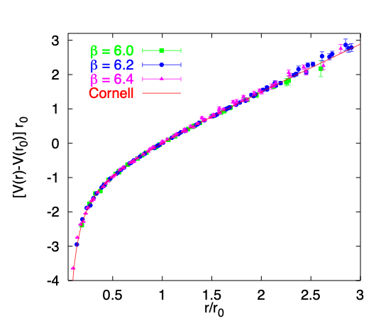
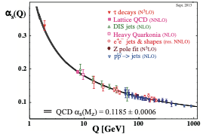
Gluons in QCD - Emergent Phenomena
Confinement:
Asymptotic freedom:
“Gluon” potential between
heavy quark-antiquark pair
Phys. Rept. 343, 1 (2001)
The self-interaction of gluons is fundamentally responsible for the asymptotic freedom of quarks and gluons in QCD
~1/r at short range
long range ~ r
Quarks experience force of 16 tons
2004, Gross, Politzer, Wilczek
Notes:
screening corrections (g->qq->g) and anti-screening corrections )g->gg->g

Slide 7
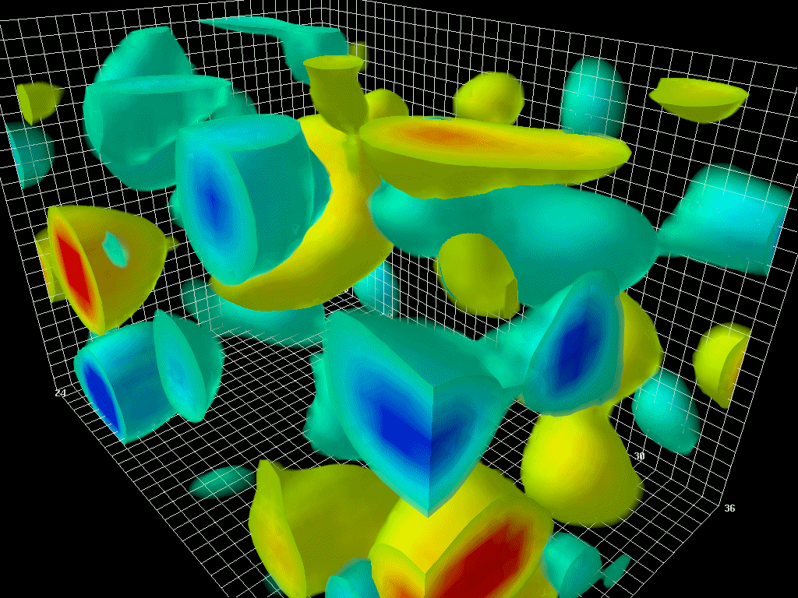
The Essential Mystery
There is an elegance and simplicity to nature’s strongest force we do not understand
(Nearly) all visible matter is made up of quarks and gluons
But quarks and gluons are not visible
All strongly interacting matter is an emergent consequence of many-body quark-gluon dynamics.
Understanding the origins of matter demands we develop a deep and varied knowledge of this emergent dynamics
Notes:
The animations to the right and above illustrate the typical four-dimensional structure of gluon-field configurations averaged over in describing the vacuum properties of QCD. The volume of the box is 2.4 by 2.4 by 3.6 fm, big enough to hold a couple of protons. Contrary to the concept of an empty vacuum, QCD induces chromo-electric and chromo-magnetic fields throughout space-time in its lowest energy state. After a few sweeps of smoothing the gluon field (50 sweeps of APE smearing), a lumpy structure reminiscent of a lava lamp is revealed. This is the QCD Lava Lamp. The action density (top) and the topological charge density (right) are displayed. The former is similar to an energy density while the latter is a measure of the winding of the gluon field lines in the QCD vacuum.

Slide 8
Studying Matter at the Smallest Scales
ep/eA Collider Experiments
Wave Length: 0.0001 fm (10 GeV + 100 GeV)
Resolution: ~ 0.01-0.001 fm
Past: HERA,
Future: EIC, LHeC, …

Slide 9
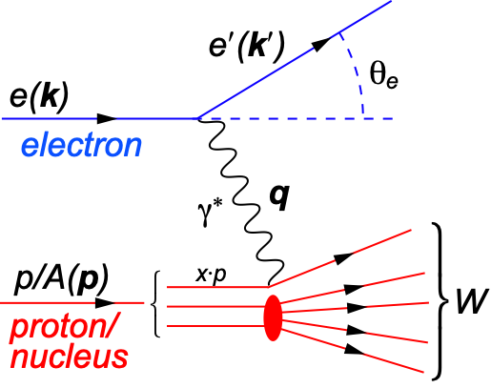
Deep Inelastic Scattering (DIS)
DIS:
As a probe, electron beams provide unmatched precision of the electromagnetic interaction
Direct, model independent, determination of kinematics of physics processes
x:
y:
s:
Q²:
square of center-of-mass energy of electron-hadron system
Bjorken-x
x is fraction of the nucleon’s momentum carried by the struck quark
0 < x < 1
squared momentum transfer from scattered electron
Virtuality
“Resolution” power
Inelasticity
Fraction of electron’s energy lost in nucleon restframe
0 < y < 1
s: center-of-mass energy squared
Q²: resolution power
x: momentum fraction of parton
y: inelasticity
quark+anti-quark
momentum distributions
gluon momentum distribution
Notes:
W2 can also be interpreted as the center-of-mass energy of the gauge boson nucleon system.
Q2 max = s
Q2: negative square of the momentum transfer q, denotes virtuality
x: make Remark that for e+p 0 < x < 1 while for e+A scattering 0 < x < A.
y: is the fraction of the lepton’s energy lost in the nucleon rest frame. It it thus also the fraction of the incoming electron energy (also known as inelasticity) carried by the exchange boson (photon) in the rest frame of the nucleon
Q^2 &=& -q^2 = - (k-k^\prime)^2 \\
&\approx& 4 E E^\prime \sin^2\left(\frac{\theta}{2}\right)

Slide 10
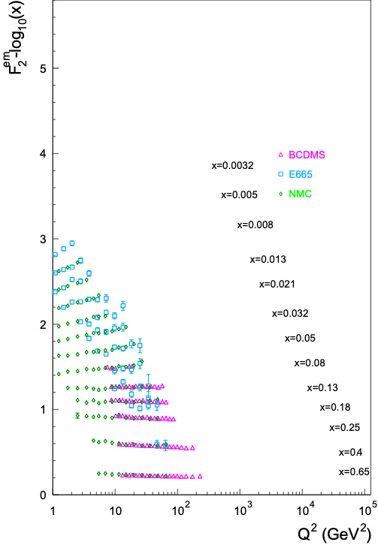
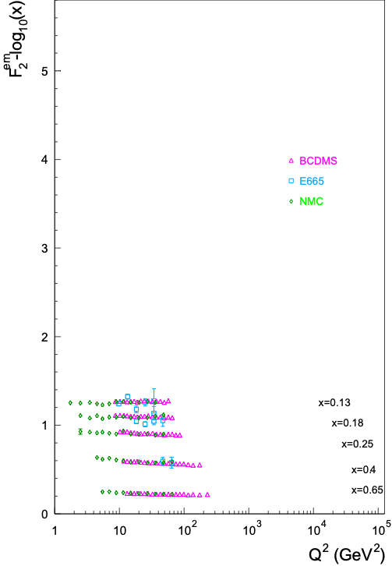
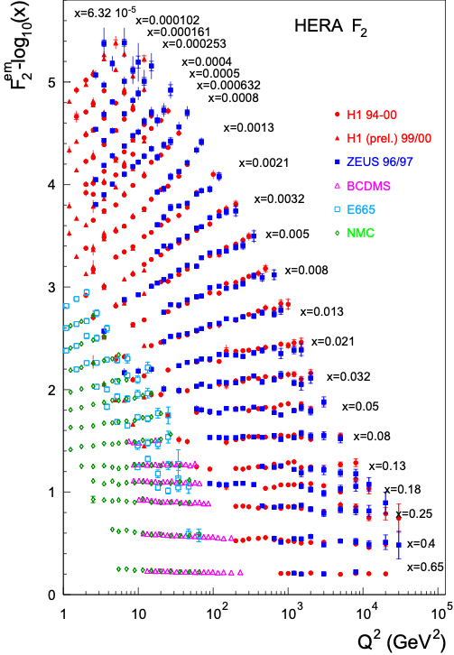
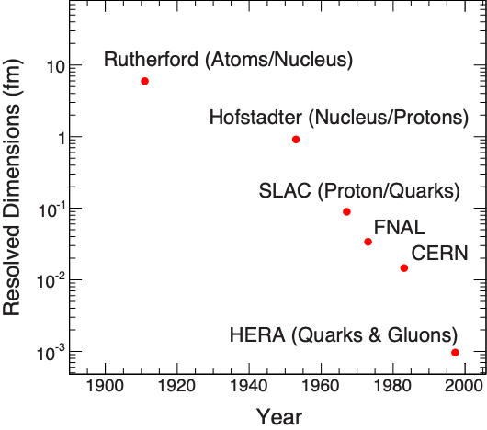
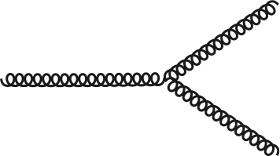
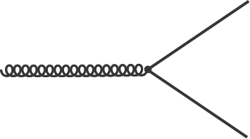
F2: The Key Structure Function
Bjorken Scaling: F2(x, Q²) ≠ F2(x)
Broken - Big Time
It’s the Glue !!!
λ ~ ℏc/Q
Q² ≈ s⋅x
Bjorken Scaling: F2(x, Q²) → F2(x)
virtual photon interacts with a
single essentially free quark
Notes:
Bjorken Scaling: virtual photon interacts with a single essentially free quark

Slide 11
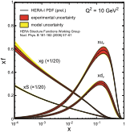
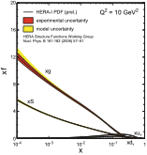
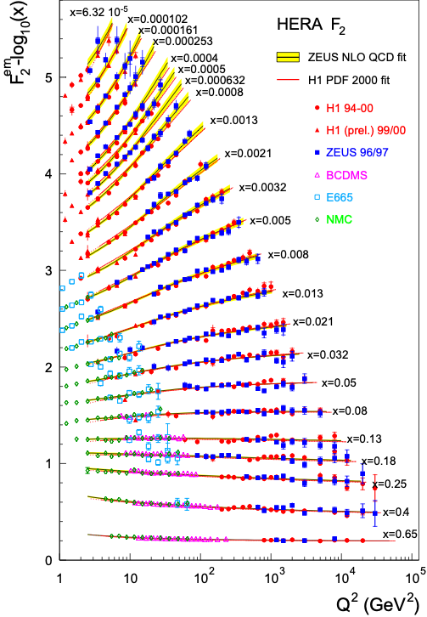
Quark and Gluon Distributions
Structure functions allows us to extract the quark q(x,Q²) and gluon g(x,Q²) distributions.
In LO: Probability to find parton with x, Q² in proton
Alternative Methods:
Directly via FL (~G(x,Q²))
Through 2+1 jets (large x only)
Through charm production (moderate x)
Through diffractive events (~G(x,Q²)²)
pQCD+
DGLAP Evolution
F₂
dF₂ /dlnQ²
Proton is almost entirely glue by x<0.1
(for Q² = 10 GeV²)
Þ
+
Notes:
integro-differential equations

Slide 12
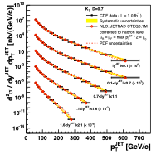
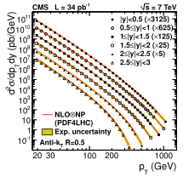
Perturbative QCD: Benchmark for New Physics
Structure functions measured at HERA ep collider
Jet cross-sections: pp collisions at LHC andpp collisions at Fermilab
At large momenta, the weak QCD coupling (asymptotic freedom!) enables systematic computations
Are we done?
Notes:
Perturbative QCD describes only a small part of the total cross-section
Lattice QCD is of very limited utility in describing scattering

Slide 13
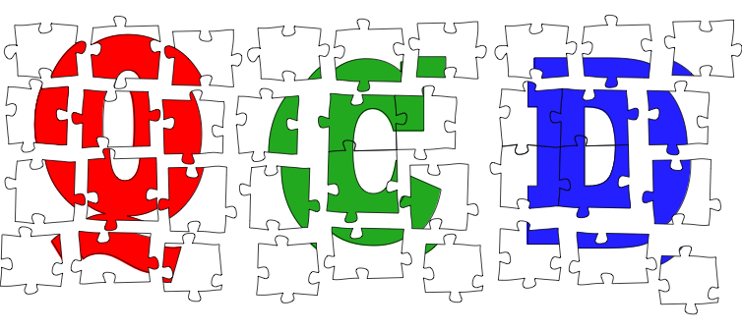
The Frontiers of Our Ignorance
... that motivate an Electron-Ion Collider

Slide 14
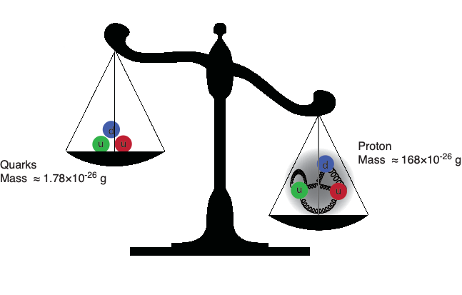
The Mass Puzzle
The Higgs is responsible for quark masses
~ 2% of the proton mass.
Gluons are massless…yet their dynamics are responsible for
(nearly all) the mass of visible matter. We do not know how?
Notes:
Mass from binding energy
Binding through gluons

Slide 15
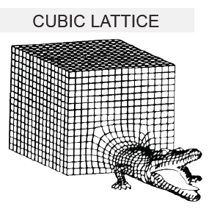
Scattering in the Strong Interactions
Perturbative QCD:
Describes only a small part of the total cross-section
Lattice QCD:
First principles treatment of static properties of QCD: masses, moments, thermodynamics
Very challenging for dynamical processes and very limited utility in describing scattering
Instead ⇒ Effective theories:
How do quark and gluon degrees organize themselves to describe the bulk of the cross-section?

Slide 16
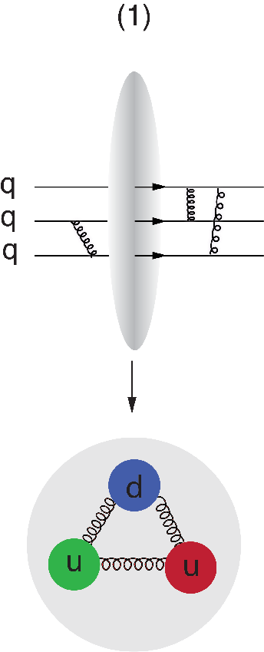
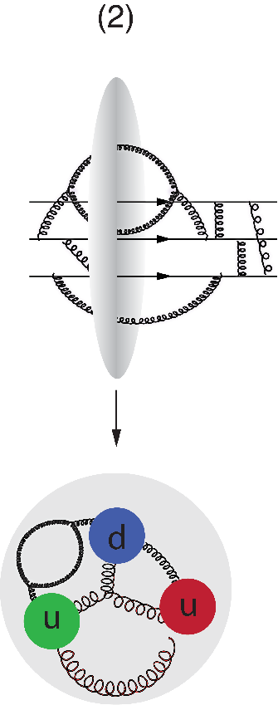
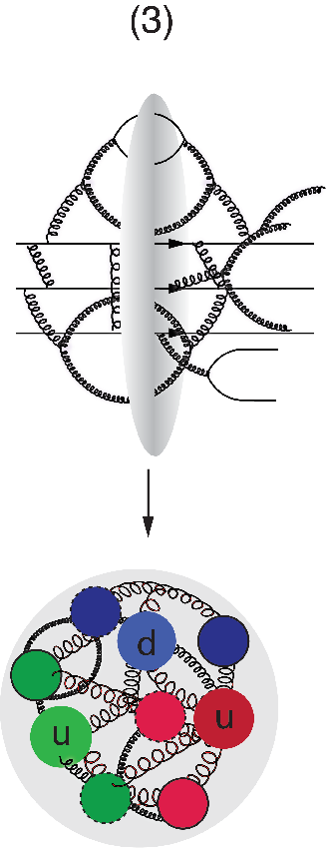
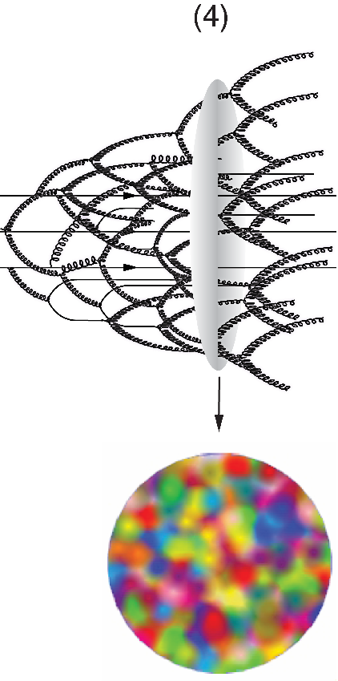
A Look Inside the Boosted Proton
Is the proton a runaway popcorn machine?
In QCD, the proton is made up of quanta that fluctuate in and out of existence
Boosted proton:
Fluctuations time dilated on strong interaction time scales
Long lived gluons can radiate further small x gluons…
Explosion of gluon density
Δt ∝1/ΔE
momentum

Slide 17
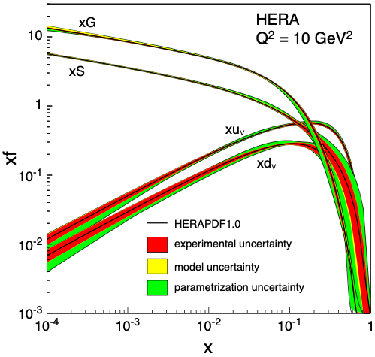
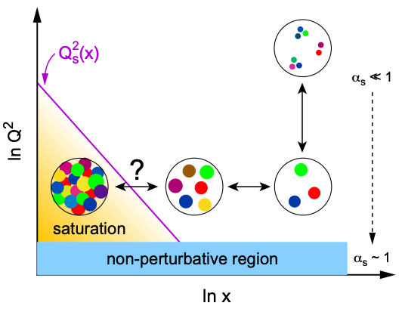
Gluon Saturation
Ever growing G(x,Q²)?
Explosion of gluon density violates unitarity!
Cross-sections must be finite
pQCD
evolution
equation
New Approach: Non-Linear Evolution
Recombination compensates gluon splitting
New evolution equations at low-x & low to moderate Q²
Saturation of gluon densities characterized by scale Q_{s}(x)
Saturation ⇒ New Effective Field Theory:
Color-Glass-Condensate (CGC)
Dramatic consequences: Q² < Q²S ⇒ αs(Q²S)

Slide 18
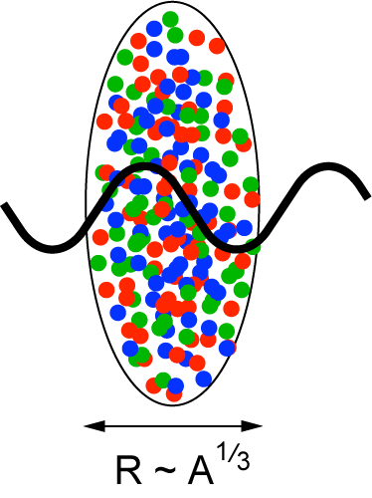
Gluon Saturation in Nuclei: The Oomph
Probes interact over distances L ~ (2m_{N} x)⁻¹
Probe interacts coherently with all nucleons for L > 2 R_{A} ∼ A^{1/3}
Enhancement of Q_{S} with A: saturation regime reached at significantly lower energy in nuclei (and lower cost)
Nucleus serves as amplifier of the saturation scale

Slide 19
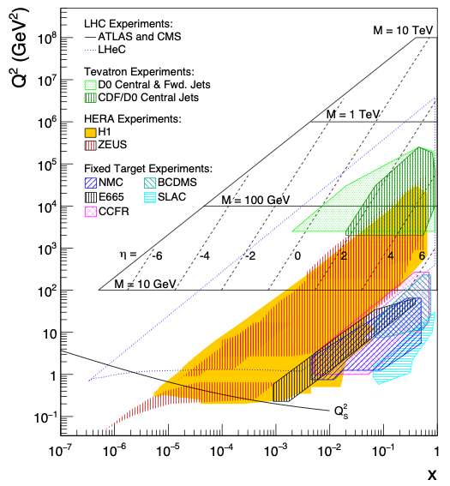
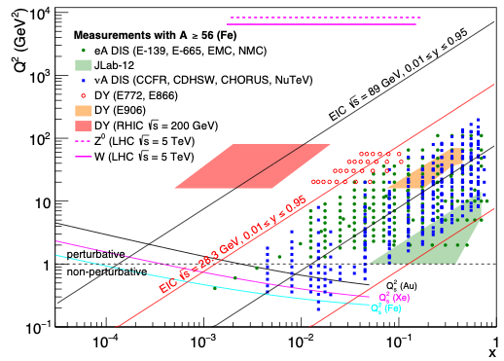
Gluon Saturation: Past Experimental Reach
HERA (ep)
Marginal reach of Qs
Only at low Q² making comparison with perturbative QCD impossible
Fixed Target DIS Experiment
eA, μA, νA
Same marginal reach
Only at low Q² (Q² < 1 GeV²)

Slide 20
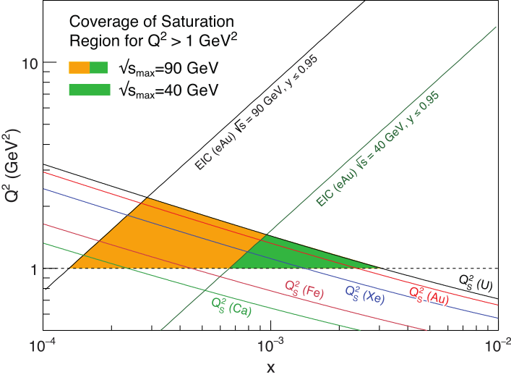
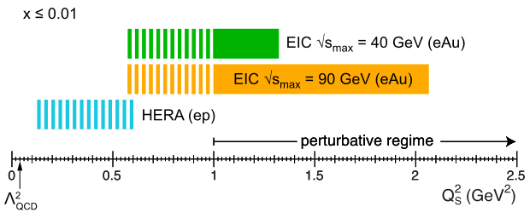
Gluon Saturation: √s Matters
Future EIC:
Need to push into regime where comparison with our current understanding can be made ⇒ Q² > 1 GeV/c²
Require lever arm in Q, x, and A to study evolution
Need to push for highest energy (money can afford) and heaviest ions

Slide 21
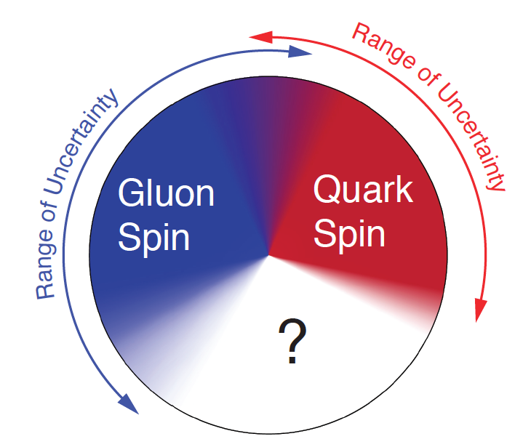
Proton Spin Puzzle
What are the appropriate degrees of freedom in QCD that would explain the “spin” of a proton?
After 20 years effort
Quarks (valence and sea): ~30% of proton spin in limited x-range
Gluons (latest RHIC data): ~20% of proton spin in limited x-range
Where is the rest?
It is more than the number ½! It is the interplay between the intrinsic properties and interactions of quarks and gluons
Notes:
If we do not understand the proton spin, we don’t understand QCD

Slide 22
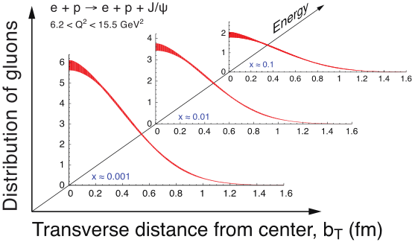
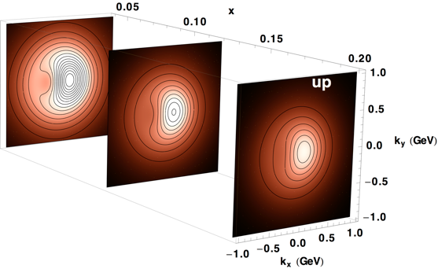
What Does a Proton Look Like?
In transverse momentum?
In transverse space?
How are these distributions correlated with overall nucleon properties, such as spin direction?
Transverse Momentum Distributions (TMDs):
2D+1 picture in momentum space (kT)
Generalized Parton Distributions (GPDs):
2D+1 picture in coordinate space (bT)
3D Imaging with EIC
Study through azimuthal asymmetries in semi-inclusive DIS
Requires π/K/p PID
Study through exclusive processes (DVCS, diffraction, VM production)
Luminosity hungry

Slide 23
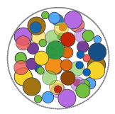
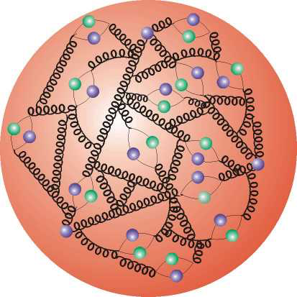
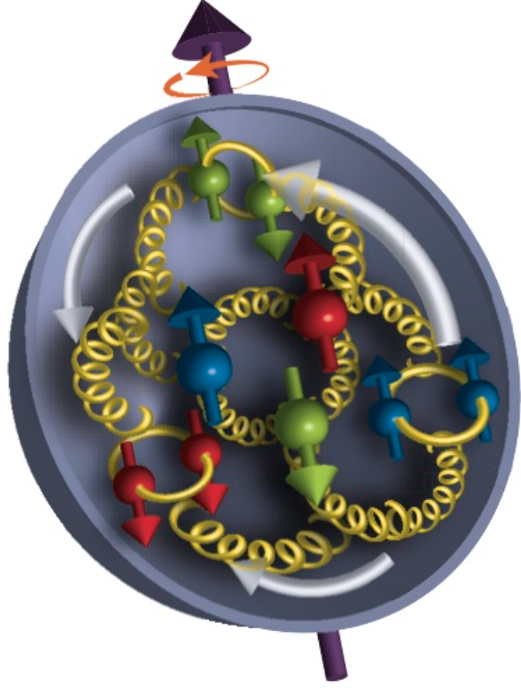
Electron-Ion Collider
Investigate with precision universal dynamics of gluons
Central themes:
Probing the momentum-dependence of gluon densities and the onset of saturation in nucleons and nuclei
Mapping the transverse spatial and spin distributions of partons in the gluon-dominated regime
Provide novel insight into propagation, attenuation and hadronization of colored probes
Ultimate QCD machine:
The world’s first polarized electron-polarized proton collider
Spin structure
The world’s first electron-heavy ion collider
High gluon densities, saturation
Luminosities: a hundred to up to a thousand times HERA
3D imaging (momentum & space) of nucleons and nuclei
Large center-of-mass energy coverage
Access to x and Q² over a wide range, evolution studies
Saturation
Regime
QCD Radiation
Dominated
Regime
Many-body
Regime
Few-Body/
Valence Quark
Regime
x (proton)
10⁻⁵
10⁻⁴
10⁻³
10⁻²
10⁻¹
1

Slide 24
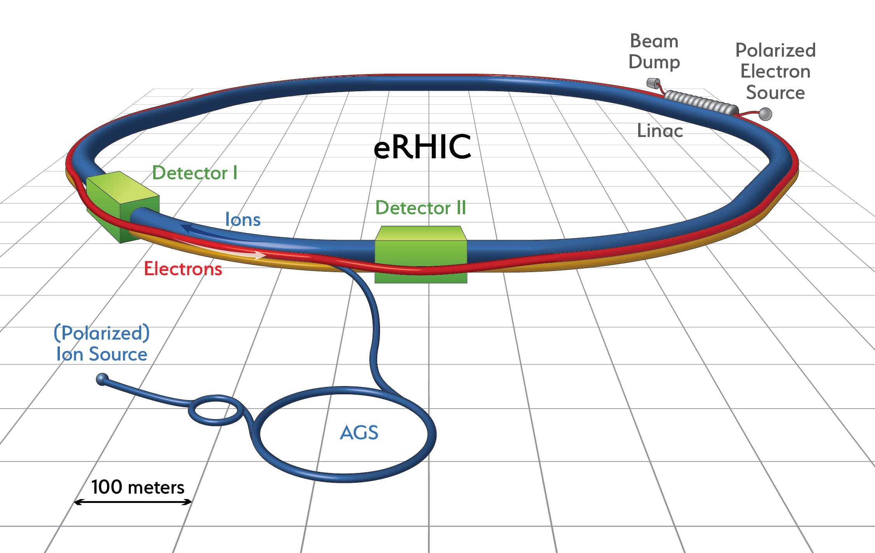
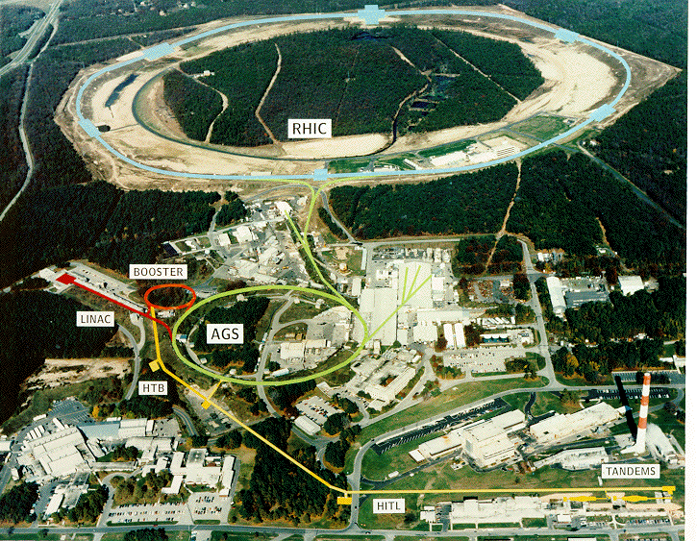
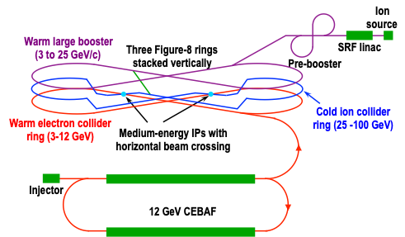
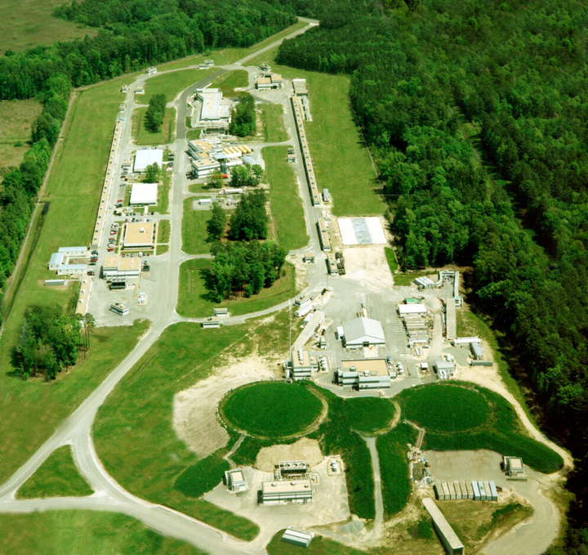
US Electron Collider: Accelerator Designs
eRHIC (BNL)
Add e Rings to RHIC facility, recirculating Linac-Ring or Ring-Ring
Electrons up to 18 GeV
Protons up to 275 GeV
Ions (Au) up to √s=90 GeV/u
L ≈ 1.2×10³³ cm⁻² s⁻¹ at √s=120 GeV
JLEIC (JLab)
Figure-8 Ring-Ring Collider, use of CEBAF
Electrons 3-10 GeV
Protons 20-100 GeV
Ions up to √s=40 GeV/u
L ≈ 2×10³⁴ cm⁻² s⁻¹/A at √s=22 GeV
eRHIC: arXiv:1409.1633, JLEIC: arXiv:1209.0757
Notes:
The designed frequency matching scheme allows operation with hadron energies down to 40 GeV/u, but the energies between 46 and 98 GeV/u cannot be used.

Slide 25
Examples of Key Measurements at an EIC
New: including latest studies on importance of √s

Slide 26
EIC: Longitudinal Spin of the Proton
Inclusive Measurement:
e+p → e′+X
Leading Order:
(Quark Spin)
Higher Order:
(Gluon Spin)
The polarized structure function g1(x,Q²) is key to our understanding of the spin of the proton
but
it is very √s demanding
Notes:
Mention: not even sign of L is constraint
polarized
gluon Δg(x,Q2) and quark Δq(x,Q2) distribution
Figure 2-5 shows the running integral
!"!ΔΣ(!, !!) !!!"#, which represents the contribution of all quark flavors to the spin of the proton
experimental access to the ∆f in lepton- scattering is obtained through the spin-dependent structure function g1(x,Q2), which ap- pears in the polarization difference of cross sections when the lepton and the nucleon collide with their spins anti-aligned or aligned:

Slide 27
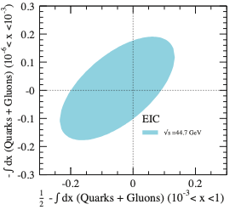
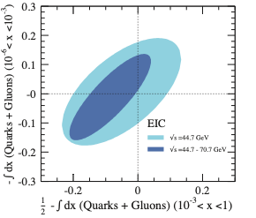
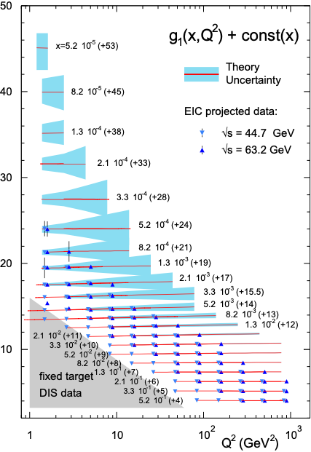
EIC: Longitudinal Spin of the Proton (II)
An EIC can settle the spin puzzle and determine spin of quarks, gluons and the contribution from angular spin but it will require the originally envisioned √s ~ 140 GeV
Notes:
Mention: not even sign of L is constraint
polarized
gluon Δg(x,Q2) and quark Δq(x,Q2) distribution
Figure 2-5 shows the running integral
!"!ΔΣ(!, !!) !!!"#, which represents the contribution of all quark flavors to the spin of the proton
experimental access to the ∆f in lepton- scattering is obtained through the spin-dependent structure function g1(x,Q2), which ap- pears in the polarization difference of cross sections when the lepton and the nucleon collide with their spins anti-aligned or aligned:

Slide 28
EIC: Nuclear Structure Functions (I)
Inclusive DIS on eA:
quark+anti-quark
gluon
F2 and FL are benchmark measurements:
Theory/models have to be able to describe the structure
functions and their evolution.
Leading twist pQCD models parameterize the observed suppression of the structure function with decreasing x using nuclear parton distribution functions (nPDFs)
Aim at extending our knowledge on structure functions into the realm where gluon saturation effects emerge
Notes:
\frac{d^2 \sigma^{eA\rightarrow eX}}{dx dQ^2} = \frac{4 \pi \alpha^2}{x Q^4} \left[ \left(1-y+\frac{y^2}{2}\right) {\color{blue}F_2(x, Q^2)} - \frac{y^2}{2} {\color{red}F_L(x, Q^2)}\right]

Slide 29
EIC: Nuclear Structure Functions (II)
Ratio of PDF(Pb)/PDF(p)
Without EIC, large uncertainties
Adding in EIC significantly reduces the uncertainties, particularly at small-x
Gluon distribution ~ dσ(x,Q²)/dlnQ²
Notes:
\frac{d^2 \sigma^{eA\rightarrow eX}}{dx dQ^2} = \frac{4 \pi \alpha^2}{x Q^4} \left[ \left(1-y+\frac{y^2}{2}\right) {\color{blue}F_2(x, Q^2)} - \frac{y^2}{2} {\color{red}F_L(x, Q^2)}\right]

Slide 30
EIC: Nuclear Structure Functions (III)
Ratio of PDF(Pb)/PDF(p)
Fitting the charm pseudo-data has a dramatic effect at high-x
Direct Access to gluons at medium to high x by tagging photon-gluon fusion through charm events
Notes:
\frac{d^2 \sigma^{eA\rightarrow eX}}{dx dQ^2} = \frac{4 \pi \alpha^2}{x Q^4} \left[ \left(1-y+\frac{y^2}{2}\right) {\color{blue}F_2(x, Q^2)} - \frac{y^2}{2} {\color{red}F_L(x, Q^2)}\right]

Slide 31
EIC: Nuclear Structure Functions (IV)
Projected Errors on FL(x,Q2)
Structure function FL(x, Q²) most sensitive to “glue”
Errors dominated by systematic errors
Need highest EIC energies to affect LHC A-A and p-A program
Notes:
\frac{d^2 \sigma^{eA\rightarrow eX}}{dx dQ^2} = \frac{4 \pi \alpha^2}{x Q^4} \left[ \left(1-y+\frac{y^2}{2}\right) {\color{blue}F_2(x, Q^2)} - \frac{y^2}{2} {\color{red}F_L(x, Q^2)}\right]

Slide 32
Hard Diffraction: What is It?
A DIS event (theoretical view)
A DIS event (experimental view)
A diffractive event (experimental view)
A diffractive event (theoretical view)
Activity in proton direction
?
HERA: large fraction of diffractive events (15% of total DIS rate)
High sensitivity to gluon density: σ~[g(x,Q²)]² due to color-neutral exchange
Notes:
HERA 27x900 ~ fixed target 50 TeV

Slide 33
Spatial Gluon Distribution Through Diffraction
1950-60: Measurement of charge (proton) distribution in nuclei
Ongoing: Measurement of neutron distribution in nuclei
EIC: Measurement of spatial gluon distribution in nuclei through dσ/dt where t = (pout-pin)² of nucleus (t conjugate to bT)
~
t = Δ²/(1-x) ≈ Δ²
Recall: diffractive pattern in optics
position of minima θi related to size R of screen
Similarly: in coherent (elastic) scattering
dσ/dt resembles diffractive
pattern where |t| ≈ k²θ²
T. Toll & TU
PRC 87 (2013) 024913
Notes:
Momentum transfer t conjugate to transverse position (bT)

Slide 34
Take Away Message
EIC, with its high energy, high luminosity eA and polarized ep collisions, will provide answers to long-standing fundamental questions in QCD
ep: Precision studies of structure functions, TMDs, and GPDs will lead to the most comprehensive picture of the nucleon ever: its flavor, spin, and spatial structure
eA: Unprecedented study of matter in a new regime of QCD. New capabilities open a new frontier to study the saturation region, measure the gluonic structure of nuclei, and investigate color propagation, and fragmentation using the nucleus as analyzer.
For more:
arXiv:1212.1701
and …
Scientific American (May 2015)
The Glue That Binds Us
by R. Ent, R. Venugopalan, TU
Latest studies indicate that maximal possible √s is vital for majority of physics program ⇒ important input into ongoing machine design

Slide 35
Backup Slides

Slide 36
EIC
Kinematic Reach

Slide 37
EIC Kinematic Reach
polarized ep
eA (A ≥ Fe)
Large Q² Hadronization
Energy-Loss
Low-x
Saturation
Q² = x y s ⇒ √s important for low-x reach and Q² lever arm to test evolution
Acceptance is typically limited due to experimental constraints to 0.01 < y < 0.95 ⇒ acceptance band
EIC (here eRHIC) reaches unknown territory

Slide 38
Requirements: √s and Polarization
polarized
ep, μp, pp
Need to reach low-x where gluons dominate (∆G, ∆Σ range!)
Flexible energies (see also structure functions later)
Need sufficient lever arm in Q² at fixed x (evolution eq. along Q² or x)
Electrons and protons/light nuclei (p, He³ or D) highly polarized (70%)
Notes:
Mention importance of Q2 lever arm at fixed x
fixed target experiments limited in kinematic coverage

Slide 39
Requirements: √s and Beam Masses
eA, μA, νA
(A ≥ Fe)
Large Q², large ν
Hadronization
Energy-Loss
Low-x
Saturation
Saturation physics needs low-x reach and wide range of nuclei (A dependence) up to the heaviest A (Qs enhancement): d ➟ U
Need sufficient lever arm in Q² up to at least x = 10⁻³ to verify non-linear evolution equations of CGC

Slide 40
eA
Diffractive VM Production

Slide 41
Key Observables for Saturation
Diffraction:
Diffractive events are indicative of a color neutral exchange between the virtual photon and the proton or nucleus over several units in rapidity.
M_{X}²: Squared mass is the diffractive final state
x_{IP}: Momentum fraction of the “Pomeron” with respect to the hadron.
The rapidity gap between produced particles and the proton or nucleus is
Y ~ ln(1/x_{IP} )

Slide 42
3d-Imaging of Nuclei
1950-60: Measurement of charge (proton) distribution in nuclei
Ongoing: Measurement of neutron distribution in nuclei
EIC ⇒ spatial gluon distribution in nuclei → Saturated or non-saturated ?
Method:
Diffractive vector meson production:
e + Au → e′ + Au′ + J/ψ, φ, ρ
Momentum transfer t = |pAu-pAu′|² conjugate to bT
Only eRHIC has enough phase space to map out the 3d gluon distribution in the saturation regime

Slide 43
EIC: Spatial Gluon Distribution from dσ/dt
1950-60: Measurement of charge (proton) distribution in nuclei
Ongoing: Measurement of neutron distribution in nuclei
EIC ⇒ Gluon distribution in nuclei
Fourier Transform
Method:
Diffractive vector meson production:
e + Au → e′ + Au′ + J/ψ, φ, ρ
incoherent
Momentum transfer t = |pAu-pAu′|² conjugate to bT
coherent
PRC 87 (2013) 024913
dσ/dt: diffractive pattern known from wave optics
φ sensitive to saturation effects, smaller J/ψ shows no effect
J/ψ perfectly suited to extract source distribution
Converges to input F(b) rapidly: |t| < 0.1 almost enough
Recover accurately any input distribution used in model used to generate pseudo-data (here Wood-Saxon)
Systematic measurement requires ∫Ldt >> 1 fb⁻¹/A
Notes:
spin-dependent gluon distribution

Slide 44
eA
σdiffractive / σtotal

Slide 45
Key Observables for Saturation: Inclusive Diffraction
Only eRHIC has sufficient phase space in x and Q² to map out the effect of saturation on
inclusive diffractive events

Slide 46
Day 1 Measurement: σdiffractive/σtotal
HERA observed: ~14% of all events are diffractive
Saturation models (CGC) predict up to σdiff/σtot ~ 25% in eA
Ratio enhanced for small MX and suppressed for large MX ⇒ sign change
Standard QCD predicts no MX dependence and a moderate suppression due to shadowing.
Nucleus is “blacker” than proton. Elastic scattering probability of a qq̅ dipole is maximal in the “black” limit
qq̅g component vanishes in black disk limit
Observing these dependencies
on M_{x} over a wide range in x and Q² is crucial!
Again large √s is key
Unambiguous signature for reaching the saturation limit
Notes:
Dipole cross-section is closer to the unitarity limit than the proton - it is “blacker”. The elastic scattering probability of a qq̅ dipole is maximal in the “black” limit
The qq̅g component is suppressed for nuclei compared to the proton.
This is due to the fact that in a nucleus the scattering amplitude
is closer to the unitarity limit when the qq̅g component vanishes
different b -dependences from each other and from the inclusive
cross section. The q ¯q -component is enhanced at small b (closer to the black disk limit),
whereas the q ¯qg -part is dominated by larger b (because it vanishes in the black disk limit).
Depending on the mass of the diffractive system MX
or, equivalently, , the diffractive structure function is
dominated by either the q ¯q or q ¯qg Fock states.
invariant mass of the diffractive system is large, and
this large phase space is filled by radiation of additional
gluons, each of them being suppressed by
alpha_s .
The q ¯q -components of
the FD
2A are enhanced compared to A times the proton
diffractive structure functions. This is to be expected,
because of the fact that in a gold nucleus the dipole cross
section is, on average over the transverse area, closer to
the unitarity limit than the proton - it is “blacker”. The
elastic scattering probability of a q ¯q dipole is maximal in
the “black” limit and the approach to it is quicker in a
large nucleus. The q ¯qg component, on the other hand,
is suppressed for nuclei compared to the proton. This is
due to the fact that in a nucleus the scattering amplitude
is closer to the unitarity limit when the q ¯qg component
vanishes, as can be seen e.g. from Eq. (13). This
leads to a nuclear suppression of the diffractive structure
function in the small region, where the q ¯qg component
dominates. The net result of the different contributions
is that FD
2A , for a large range in , is close to AFD
2p .

Slide 47
eA
Di-Hadrons

Slide 48
Key Observables for Saturation
Di-Hadron Correlations:
side-view:
jet-1
beam-view:
p
A
p
High gluon density (eA):
2 → many process
⇒ expect broadening of away-side
jet-2
Low gluon density (ep):
pQCD predicts 2→2 process
⇒ back-to-back di-jet
Only eRHIC allows to study the evolution of Q_{s} with x
x
Ratio

Slide 49
Semi-inclusive DIS: eA Dihadron Correlations
Simple Measurement
beam-view
pT^{trigger}
pT^{assoc}
p
Exp: Saturation versus
“conventional” scenario
Theory: Saturation
suppression
increasing with A
Clear differences between sat and no-sat models

Slide 50
ep/eA
Jets

Slide 51
Observables: Jets
Jets have in the last years turned out as the golden tool to study quarks and gluons
both in (un)polarized ep, pp, pA and AA
At an EIC inclusive jets and di-jets can be used for the first time in eA and to study
spin effects in ep
Jet Physics in eA:
EIC opens unique possibilities to study jet/hadron production in cold dense QCD matter
and provides ideal kinematics
Event shape observables can be used for precise extraction of the strong coupling constant
Jet and hadron production at the EIC will pinpoint the transport properties of large nuclei, the stopping power nuclear matter, and test the strong gluon field paradigm
Hadron production and attenuation in semi‐inclusive DIS will shed light on the process
of hadronization and the nature of color neutralization and confinement
Jet substructure observables will provide a detailed picture of in-medium parton shower
(longitudinal and transverse structure) in the background of strong color fields
Jet Physics in ep:
High x unpolarised parton distributions functions → gluons
polarised gluon distribution functions
polarised and unpolarised photon structure

Slide 52
Observables: Jets
Only eRHIC can access jet observables for a wide range of di-jet masses and inclusive jet-pt

Slide 53
ep/eA
Charge Current

Slide 54
Observables: Charge Current in ep and eA
W-exchange: direct access to the quark flavor
→ without the complication of fragmentation
eRHIC has a large kinematic coverage for
charge current events ( )
The larger cross section at higher √s does
eliminate the need for luminosities > 10³⁴ cm⁻²s⁻¹
→ Different for JLEIC

Slide 55
ep
Spin

Slide 56
EIC: Longitudinal Spin of the Proton (I)
Inclusive Measurement:
e+p → e′+X
Quark Spin
Gluon Spin
½-Gluon-Quark Spin
Leading Order:
(Quark Spin)
Combining information on ∆Σ and ∆g constrains angular momentum
Higher Order:
(Gluon Spin)
For ∫Ldt = 10 fb⁻¹ and 70% polarization
Current knowledge (DSSV): uses strong theoretical constraints
EIC projections do not ⇒ test w/o assumptions
Notes:
Mention: not even sign of L is constraint
polarized
gluon Δg(x,Q2) and quark Δq(x,Q2) distribution
Figure 2-5 shows the running integral
!"!ΔΣ(!, !!) !!!"#, which represents the contribution of all quark flavors to the spin of the proton
experimental access to the ∆f in lepton- scattering is obtained through the spin-dependent structure function g1(x,Q2), which ap- pears in the polarization difference of cross sections when the lepton and the nucleon collide with their spins anti-aligned or aligned:

Slide 57
The current knowledge about g₁
as function of x at Q²=10 GeV²

Slide 58
What we Learn from Precision Spin Measurement
Quark contribution to the spin of the proton
ΔΣ(x,Q2) as function of x
test if SU(3) flavor symmetry is broken
importance of sea-quark contribution to the spin of the proton
Why is separating the quark spin contribution into the different flavors important?
understand dynamics of the quark-antiquark fluctuations ⇒ flavor asymmetry in the light quark sea in the proton
unpolarized: ubar ≠ dbar polarised case ?
Gluon contribution to the spin of the proton
gluons dominate the unpolarized proton structure
Do we see the same for the polarized proton structure
significant gluon polarization at low x
Sign of polarized QCD vacuum ⇒ surprise as most models predict small contribution from gluon radiation dominated x-region
x-evolution of polarized gluon distribution sensitive to double logs in Q2
can we see saturation effects in Δg(x,Q2)
Precision measurement of gluon and and quark contribution the only possibility to pin down orbital angular momentum contribution to Jaffe & Manahor spin sum rule

Slide 59
EIC: Longitudinal Spin of the Proton (I)
Inclusive Measurement:
e+p → e′+X
Quark Spin
Gluon Spin
½-Gluon-Quark Spin
Leading Order:
(Quark Spin)
Combining information on ∆Σ and ∆g constrains angular momentum
Higher Order:
(Gluon Spin)
For ∫Ldt = 10 fb⁻¹ and 70% polarization
Current knowledge (DSSV): uses strong theoretical constraints
EIC projections do not ⇒ test w/o assumptions
Notes:
Mention: not even sign of L is constraint
polarized
gluon Δg(x,Q2) and quark Δq(x,Q2) distribution
Figure 2-5 shows the running integral
!"!ΔΣ(!, !!) !!!"#, which represents the contribution of all quark flavors to the spin of the proton
experimental access to the ∆f in lepton- scattering is obtained through the spin-dependent structure function g1(x,Q2), which ap- pears in the polarization difference of cross sections when the lepton and the nucleon collide with their spins anti-aligned or aligned:

Slide 60
EIC
Program

Slide 61
EIC Deliverables the first 4 years
Year 1 and 2 Run eAu at full energy:
∫L ~1.2 fb⁻¹ this would give the first result in completely unknown territory
nuclear PDFs
first look to saturation through di-hadrons and diffraction
Year 3 Run longitudinal polarized ep beams at full energy:
∫L ~2.6 fb⁻¹ this would give very important results on
the spin structure of the proton
unpolarized PDFs at large Q² and x
(un-)polarized fragmentation functions
Year 4 split the run between transverse polarized ep running at full energy and eA running for different nuclear beams and energies
∫L ~5 fb⁻¹ transverse polarized ep data would give very important first results on
the momentum and spatial 3d structure of the proton
∫L ~5 fb⁻¹ eA data with different nuclei and energies would address
nuclear PDFs
study the evolution of Q_{s} with x and A

Slide 62
First High Impact Results
We assume the following machine ramp up in luminosity for the first 4 y of EIC
further both beams can be polarized from the beginning and nuclear beams are available
as well as eRHIC can reach its highest √s
year | L_{Av} (10³³) | ∫L/year (fb)
1 | 0.1 | 0.2
2 | 0.3 | 1.1
3 | 0.6 | 2.6
4 | 1.8 | 11.3
5 | 6.5 | 46.3 (w cooling)
need to correlate key EIC physics topics to machine luminosity

Slide 63
EIC Physics vs. Luminosity and Energy
Remember:
needs nuclear beams up to highest A
needs polarized lepton and hadron beams
10³⁴
100
Tomography (p/A) Transverse Momentum Distribution and Spatial Imaging
10³³
Luminosity (cm⁻² sec⁻¹)
Spin and Flavor Structure of the Nucleon and Nuclei
10
Integrated Luminosity [fb⁻¹/yr]
QCD at Extreme
Parton Densities -
Saturation
10³²
Internal Landscape
of the Nucleus
1
year =10⁷ sec
40
80
120
√s (GeV)

Slide 64
ep/eA
EIC User Group

Slide 65
The Community
Institutions/Country
EIC User Group
So far over 600 members from 134 institutions from 27 countries
http://eicug.org
UCB Meeting, Jan 6-9, 2016
Notes:
623 members
134 institutions
27 countries (6 world regions)

Slide 66
ep/eA
Fragmentation

Slide 67
Fragmentation
Color propagation and neutralization
Fundamental QCD Processes:
Partonic elastic scattering
In Nucleus: Gluon bremsstrahlung in vacuum and in medium (E-loss)
Color neutralization
Hadron formation
⎧⎨
⎩
dynamic confinement
Process not understood from first principles (QCD)
Parametrization: Fragmentation Functions
Nuclei as space-time analyzer allows to dissect process

Slide 68
ep
Imaging

Slide 69
3D Imaging at an EIC: TMDs & GPDs
Transverse Momentum Distributions (TMDs):
2D+1 picture in momentum space (kT)
Generalized Parton Distributions (GPDs):
2D+1 picture in coordinate space (bT)
S
Å
z
Notes:
The density in the transverse-momentum plane for unpolarized quarks with x = 0:1
in a nucleon polarized along the ^y direction. The anisotropy due to the proton polarization is
described by the Sivers function, for which the model of [77] is used. The deep red (blue)
indicates large negative (positive) values for the Sivers function.
Impact parameter dependent parton distribution u(x, b?) for the simple model
First, there is a general decrease in magnitude with increasing x ,
which arises mostly due to the decrease of q (x ). Furthermore, one can also a notice
a decreasing transverse width of the distribution q (x, b⊥ ) as x increases, which is
in accord with our general prediction

Slide 70
ep
Diffraction

Slide 71
Hard Diffraction: What is It?
HERA: large fraction of diffractive events (15% of total DIS rate)
Close relative of DIS
Need in addition:
t : momentum transfer squared
MX : mass of diffractive final-state
Diffractive event characterized by large rapidity gap
mediated by color neutral exchange (e.g. 2 or more gluons)
Terminology:
coherent
incoherent
p/A stays intact
p/A breaks up
ep: detect intact protons in forward detectors
eA: need to tag on emitted neutrons from nuclear breakup

Slide 72
Why Else Is Diffraction So Important?
Recall: diffractive pattern in optics
position of minima θi related to size R of screen
small angle scattering
Similarly: in coherent (elastic) scattering
dσ/dt resembles diffractive
pattern where |t| ≈ k²θ²
Crucial differences: target not always “black disc”
sensitivity to “size” of probe / onset of black disc limit
Strong sensitivity to gluons & saturation
due to required
color-neutral exchange
Bonus:
Fourier
spatial distribution of gluons
transform

Slide 73
EIC: Diffractive Events in eA
Diffractive physics will be a major component of the eA program at an EIC
High sensitivity to gluon density: σ~[g(x,Q²)]² due to color-neutral exchange
Only known process where spatial gluon distributions of nuclei can be extracted
2 Types: Coherent (A stays intact) & Incoherent (A breaks up)
Experimental challenging to identify
Rapidity gap ⇒ hermetic detector
Breakup needs to be detected ⇒ n and γ in Zero Degree Calorimeter, spectator tagging (Roman Pots), IR design!
Notes:
HERA: σdiff/σtot ~ 15%

Slide 74
eA
Nuclear Oomph

Slide 75
Gluon Saturation in Nuclei: The Oomph
Enhancement of Q_{S} with A: saturation regime reached at significantly lower energy in nuclei (and lower cost)

