Slide 1
The Electron-Ion Collider
Lecture 3
Thomas Ullrich (BNL/Yale)
EJC2018, October 11-12, 2018

Slide 2
Syllabus
Probing Matter
Scattering Experiments
Electron Scattering
Quark Models and QCD
Static Quark Model
QCD
Gluons
Studying Matter at the Smallest Scale
DIS & Kinematics
Structure Functions
Parton Distribution Function
The Frontiers of Our Ignorance
Mass
Cross-Sections
Saturation
Spin Puzzle
Imaging
Fragmentation
Landscape of QCD
Big question and what we need to answer them
Realization of an EIC
Detectors
Examples of Key Measurements at an EIC
Spin of the proton
Imaging
Structure Functions and Nuclear PDFs in eA Collisions
Dihadron Correlations
Diffractive physics in eA
Closing comments and further reading

Slide 3
Few Examples of Key Measurements at an EIC

Slide 4
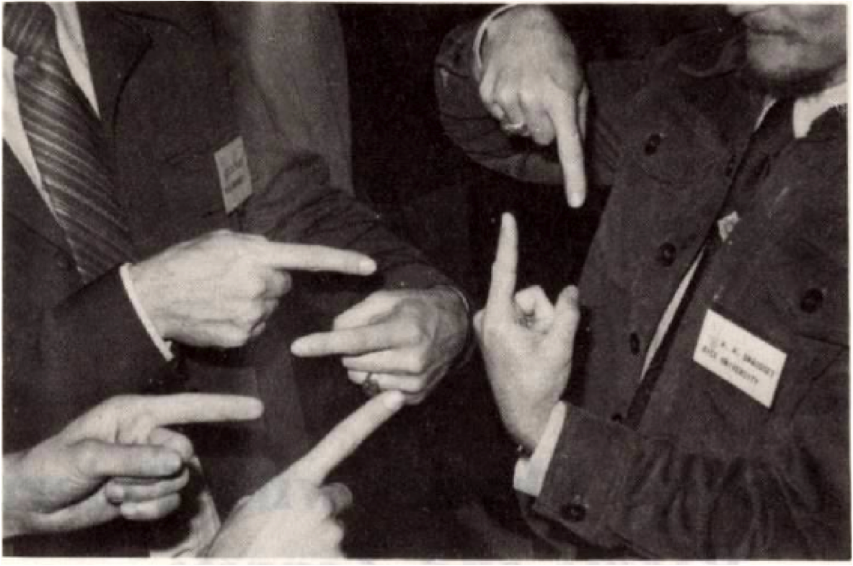
9.1 Spin of the Proton

Slide 5
EIC: Longitudinal Spin of the Proton (I)
To determine the contribution of quarks and gluons to the proton spin need to measure spin-dependent structure function g1 as function of x and Q²:
Inclusive Measurement:
e+p → e′+X
Leading Order:
(Quark Spin)
Higher Order:
(Gluon Spin)
Notes:
Mention: not even sign of L is constraint
polarized
gluon Δg(x,Q2) and quark Δq(x,Q2) distribution
Figure 2-5 shows the running integral
!"!ΔΣ(!, !!) !!!"#, which represents the contribution of all quark flavors to the spin of the proton
experimental access to the ∆f in lepton- scattering is obtained through the spin-dependent structure function g1(x,Q2), which ap- pears in the polarization difference of cross sections when the lepton and the nucleon collide with their spins anti-aligned or aligned:

Slide 6
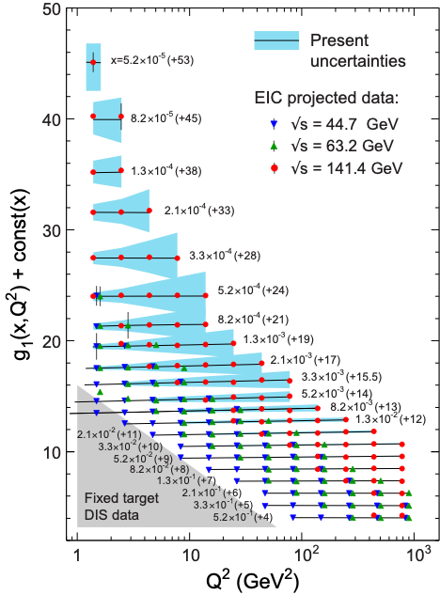
EIC: Longitudinal Spin of the Proton (II)
For ∫Ldt = 10 fb⁻¹ and 70% polarization
Current knowledge (DSSV): uses strong theoretical constraints
EIC projections do not ⇒ test w/o assumptions
Recall Jaffe-Manohar sum rule:
Don’t know what x contribute!
Need to measure over wide range down to lowest x.

Slide 7
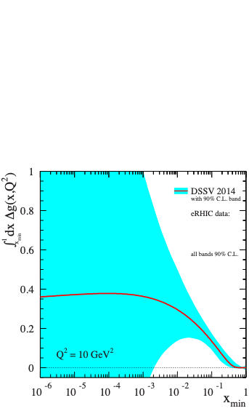
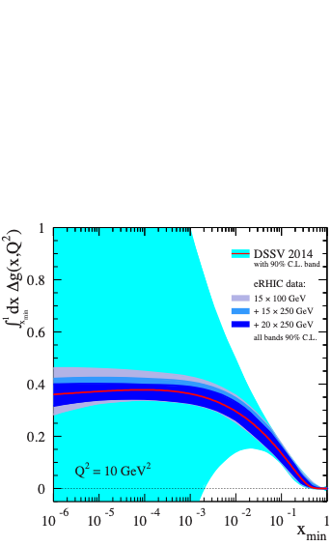
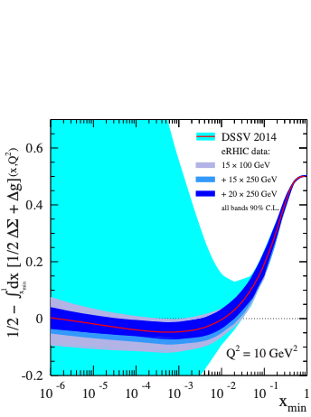
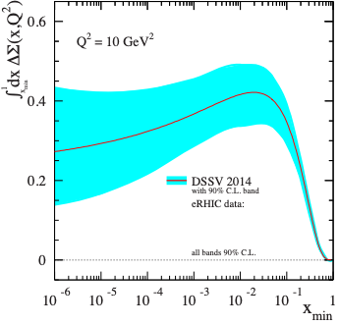
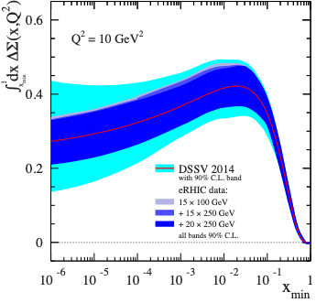
EIC: Longitudinal Spin of the Proton (III)
Using the simulated g1(x,Q²) pseudo-data the following constrains on quark and gluon spin emerge:
Quark Spin
Gluon Spin
½-Gluon-Quark Spin
Combining information on ∆Σ and ∆g constrains angular momentum
Notes:
Mention: not even sign of L is constraint
polarized
gluon Δg(x,Q2) and quark Δq(x,Q2) distribution
Figure 2-5 shows the running integral
!"!ΔΣ(!, !!) !!!"#, which represents the contribution of all quark flavors to the spin of the proton
experimental access to the ∆f in lepton- scattering is obtained through the spin-dependent structure function g1(x,Q2), which ap- pears in the polarization difference of cross sections when the lepton and the nucleon collide with their spins anti-aligned or aligned:

Slide 8
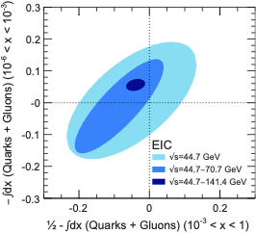
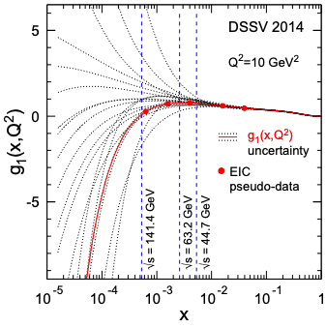
EIC: Longitudinal Spin of the Proton (IV)
Constraining spin of the sea-quarks and gluons at low-x is important but requires high √s

Slide 9
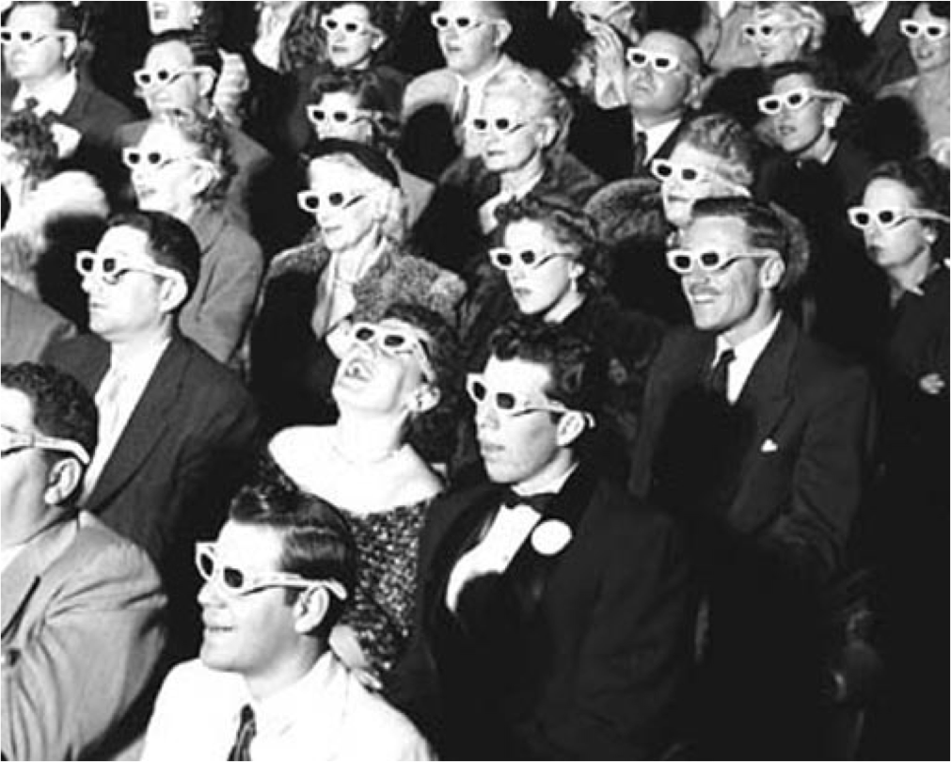
9.2 Imaging

Slide 10
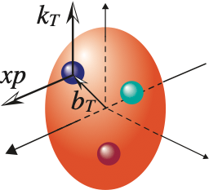
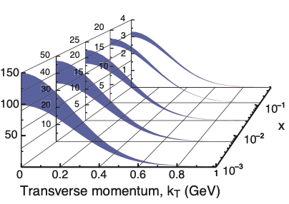
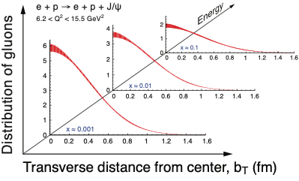
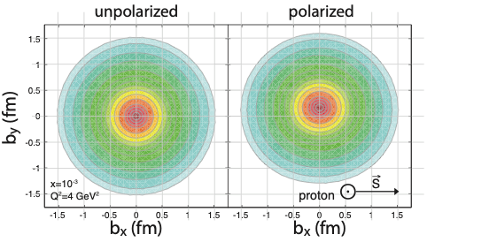
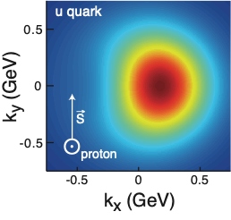
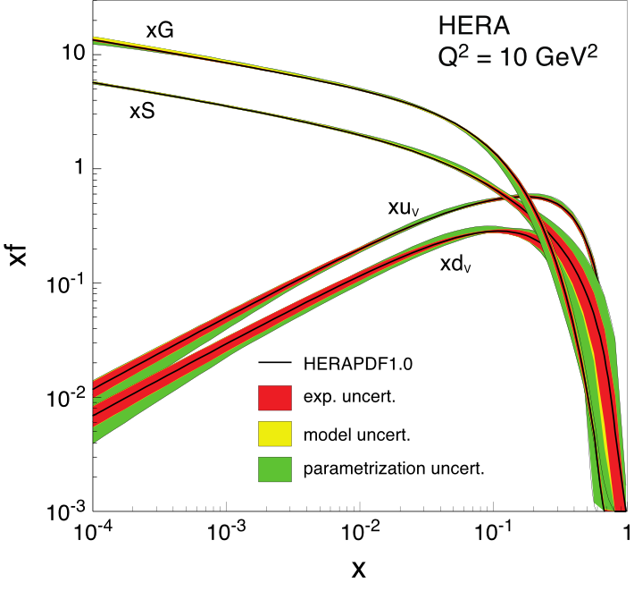
3-D Imaging of Quarks and Gluons
W(x,b_{T},k_{T})
Momentum
space
Coordinate
space
∫d²b_{T}
∫d²k_{T}
f(x,k_{T})
f(x,b_{T})
Quarks
Gluons
∫d²k_{T}
∫d²b_{T}
f(x)
Mother of all functions describing the structure of the proton:
5D Wigner Function: W(x, kT, bT)
Was considered not measurable.
Recent ideas via dijet measurements
are evolving …
Spin-dependent 3D momentum space
images from semi-inclusive scattering
Spin-dependent 2D (transverse spatial) + 1D (longitudinal momentum) coordinate space images from exclusive scattering
Transverse Momentum
Distributions (TMDs)
Generalized Parton
Distributions (GPDs)

Slide 11
3-D Imaging of Quarks and Gluons
Imaging is big part of EIC program:
luminosity and energy hungry
multi-year program
GPD: measured via DVCS and diffractive vector meson production
TMD: semi-inclusive DIS
See lecture by Raphäel Dupré
Diffractive Virtual Compton
Scattering (DVCS)
Diffractive Exclusive Vector Meson Production
Notes:
Diagrams depicting deeply virtual Compton scattering (left ) and exclusive vector meson production
(right ) in terms of GPDs, represented by the yellow blobs. The upper
lled oval in the right
gure represents the
meson wave function. The symbol re
ects the asymmetry in the longitudinal momentum fraction of the struck
parton in the initial and
nal state.

Slide 12
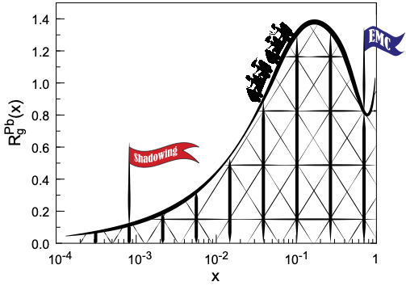
9.3. Structure Functions and
Nuclear PDFs in eA Collisions

Slide 13
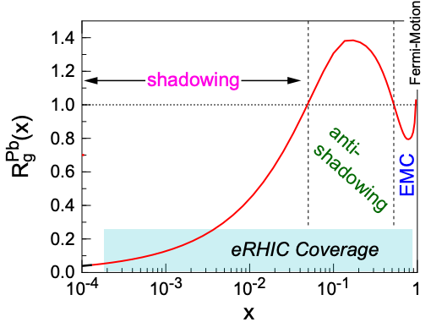
Nuclear PDFs (nPDFs)
Goal: Describe initial state of nuclei
For nuclei typically formulated
as ratio of structure fct A/p
3 distinguished regions:
shadowing
anti-shadowing
EMC effect region
none is understood
nPDFs are of interest in their own right but are also
important for other fields (Heavy-Ions, Cosmic Rays etc)

Slide 14
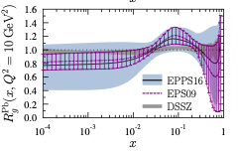
Nuclear PDFs
nPDFs less well known due to lack of data
Theory/models have to be able to describe the structure functions and their evolution
DGLAP:
predicts Q² but not A and x dependence
Saturation models (JIMWLK):
predict A and x dependence but not Q²
Need: large Q² lever-arm for fixed x, A-scan
nPDF fits typically performed on reduced cross-section
e+A: Aim at extending our knowledge on structure functions into the realm where gluon saturation (higher twist) effects emerge
⇒ different evolution (JIMWLK)

Slide 15
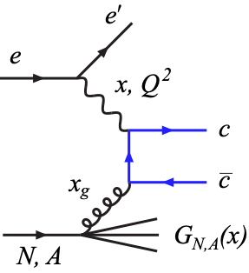
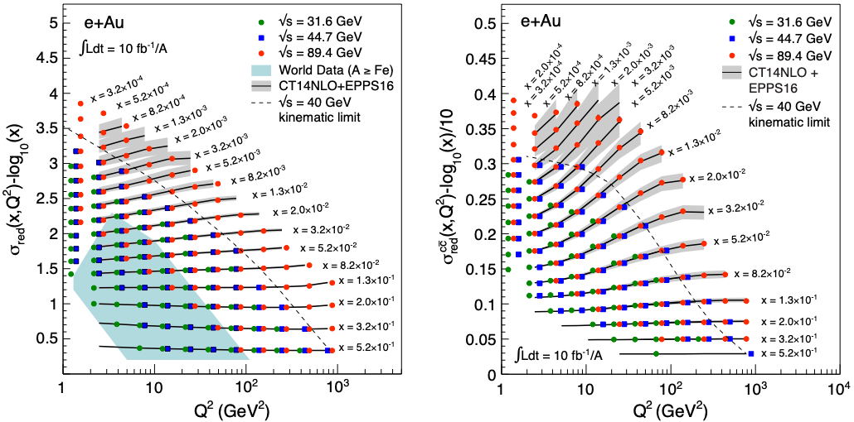
EIC: Structure Functions in eA
EIC pseudo-data
FL, F2, σred, F2^{cc} values from EPPS16
Errors (sys and stat.) from simulations for ∫Ldt=10 fb⁻¹/A
arXiv:1708.01527, 1708.05654

Slide 16
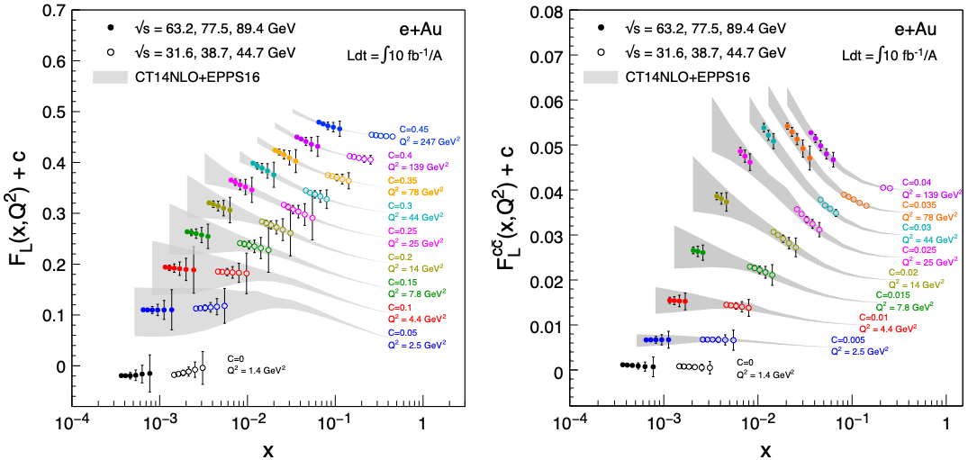
EIC: FL Structure Function
FL probes glue more directly
FL is small and requires running at different √s and thus has larger systemic uncertainties than F2
Dramatic improvements with EIC at highest energy

Slide 17
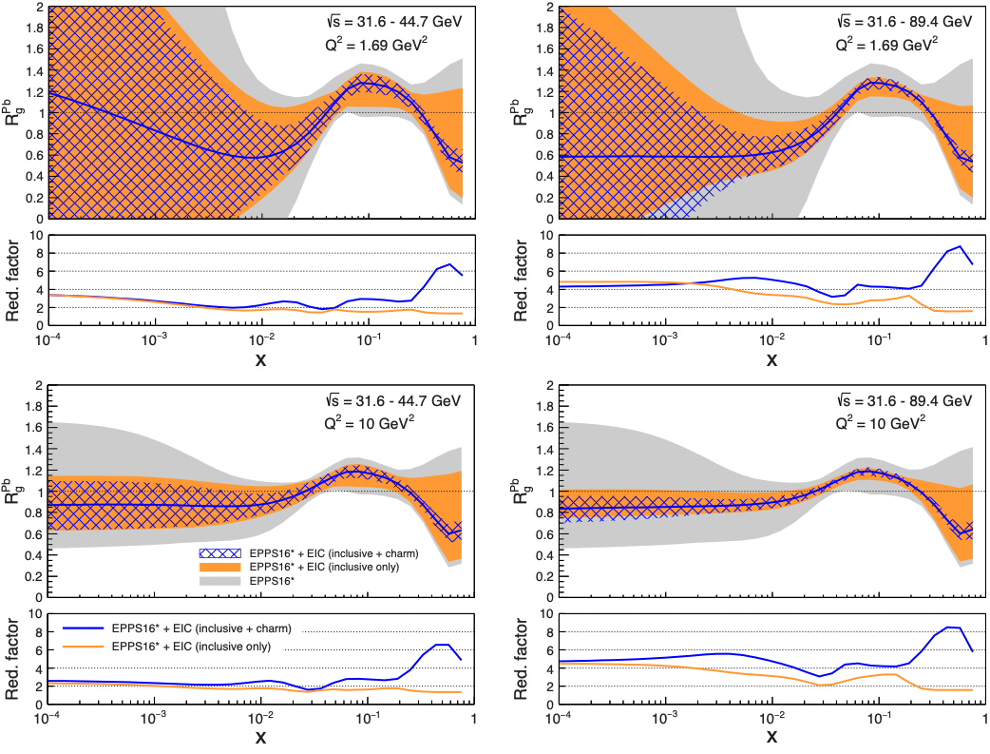
EIC’s Impact on nPDFs (Rglue)
Improves uncertainties substantially out to 10⁻⁴
Shrinks uncertainty band by factors 4-8
Charm: no additional constraint at low-x but dramatic impact at large-x
Q² ~ 1.7 GeV²
Q² ~ 10 GeV²
arXiv:1708.01527

Slide 18
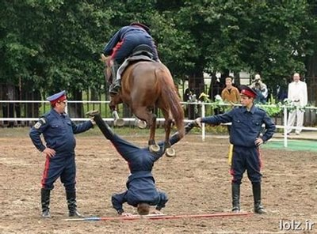
9.4 Dihadron Correlations

Slide 19
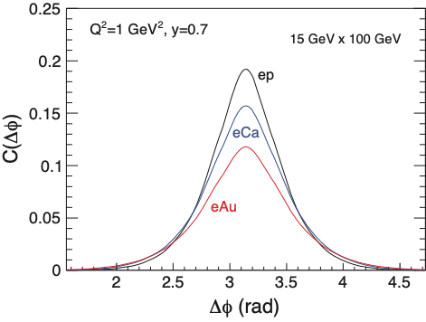
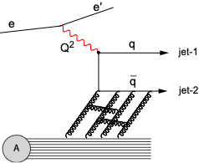
Dihadron Correlations
Dihadron correlation as a probe to saturation.
Saturation models predict suppression of away-side peak
Experimental Simple Measurement
beam-view
pT^{trigger}
pT^{assoc}
p
suppression
increasing with A
Interpretation: decorrelation due to interaction with low-x gluonic matter
Predicted [C. Marquet, 09] as important hint of saturation
Robust calculations available (Albacete, Dominguez, Lappi, Marquet, Stasto, Xiao) including Sudakov resummation in dijet processes

Slide 20
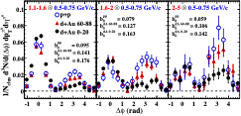
Reminder: Dihadrons at RHIC
p/d+Au at forward rapidities
Tantalizing hint for initial state suppression as predicted by CGC
Cannot assure that effect is initial state in p/d+A
Large background, no access to process kinematics (xg)
⇒ e+A
Notes:
FIG. 2: (color online). Pedestal-subtracted cluster-π0 per- trigger correlation functions measured at forward rapidity (3.0 < η < 3.8) for, as indicated, p+p, d+Au peripheral (60–88% c√entrality) and d+Au central (0-20% centrality) col- lisions at sNN = 200 GeV; the correlation functions are for associated π0’s of pT = 0.5–0.75 GeV/c and trigger clusters over the indicated pT ranges. Systematic uncertainties of up to 30% on the near side (|∆φ| < 0.5) are not shown. The subtracted pedestal values, b0, are also indicated.

Slide 21
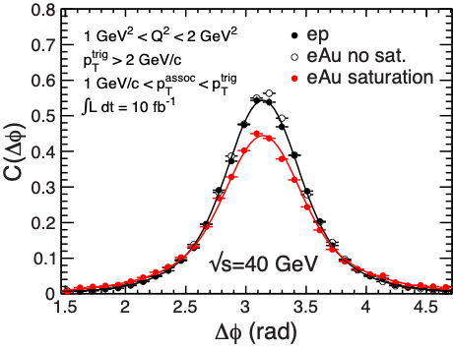
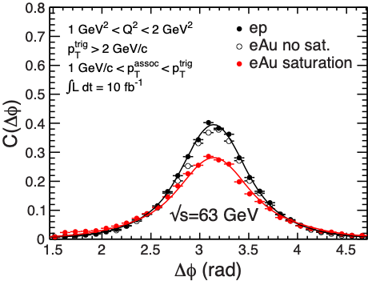
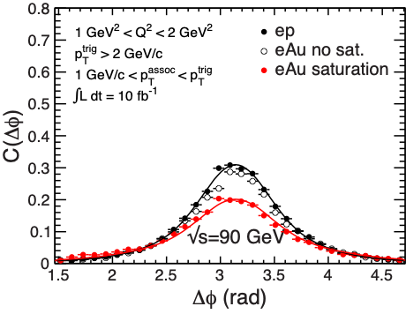
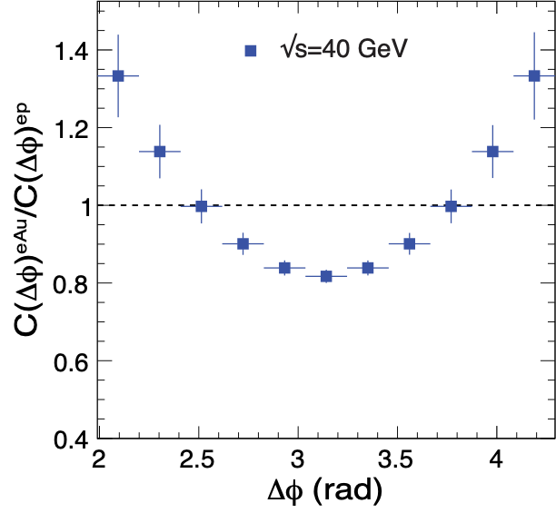
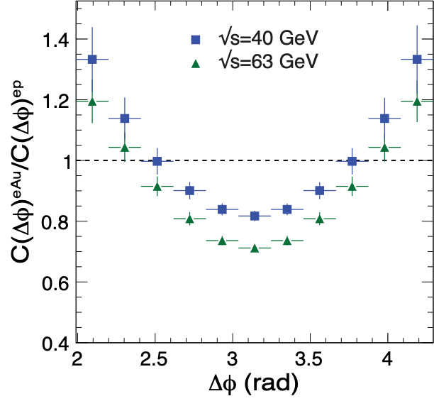
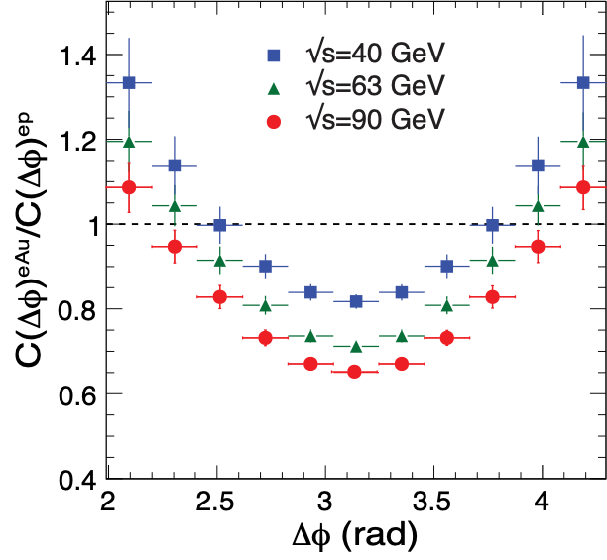
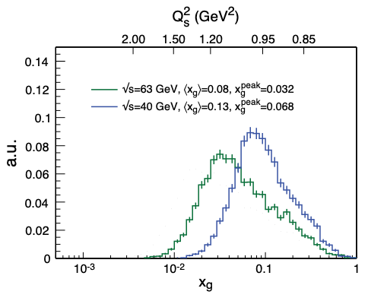
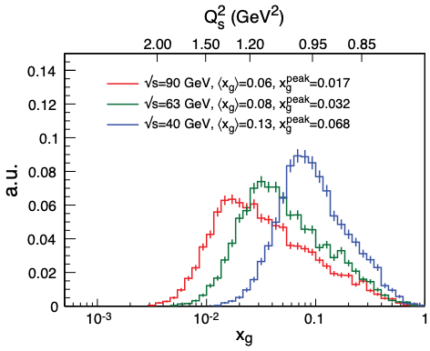
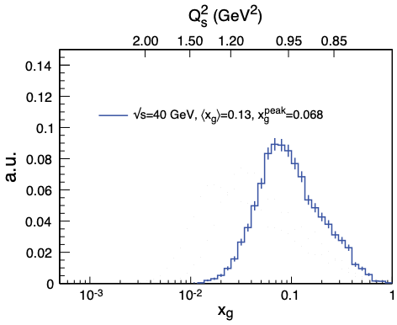
EIC Simulation Results: Dihadrons
Ratio
Zheng et al., PRD89 (2014) 074037;
BNL-114111-2017, arXiv:1708.01527
Model
Uncertainties
Clear saturation signature
Allows us to extract the spatial multi-gluon correlations
Similar Dijet Correlations
Unique measurement of WW Gluon Distributions (nTMDs)

Slide 22
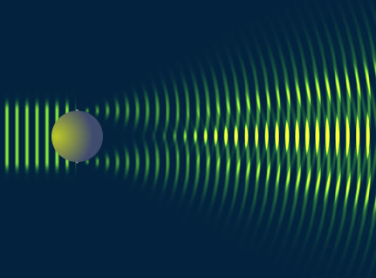
9.5 Diffractive Physics in eA

Slide 23
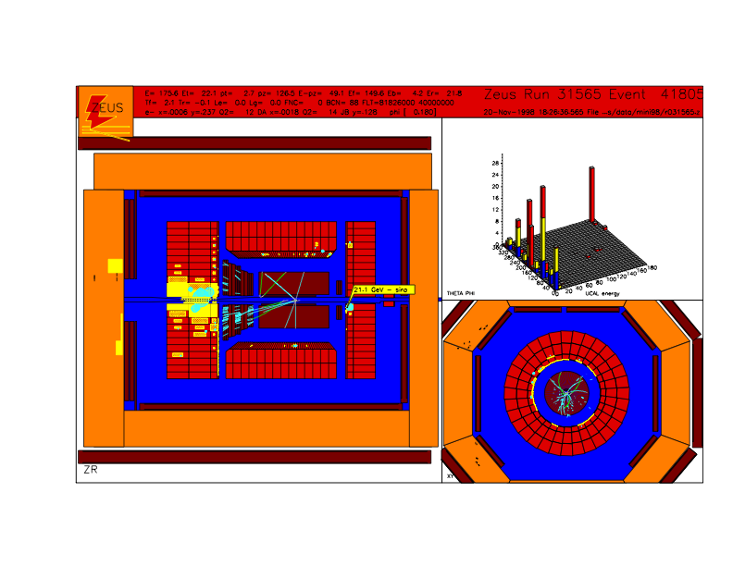
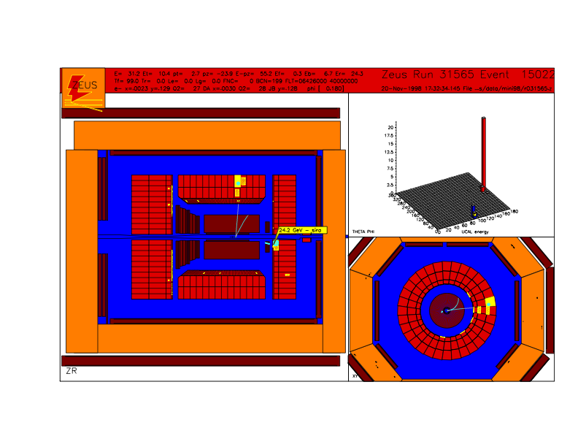
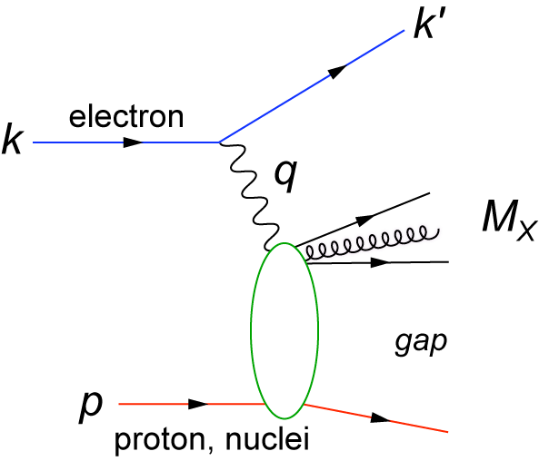
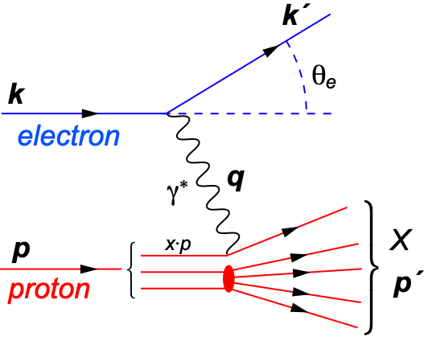
Hard Diffraction: What is It?
A DIS event (theoretical view)
A DIS event (experimental view)
A diffractive event (experimental view)
A diffractive event (theoretical view)
Activity in proton direction
?
HERA: large fraction of diffractive events (15% of total DIS rate)
Notes:
HERA 27x900 ~ fixed target 50 TeV

Slide 24
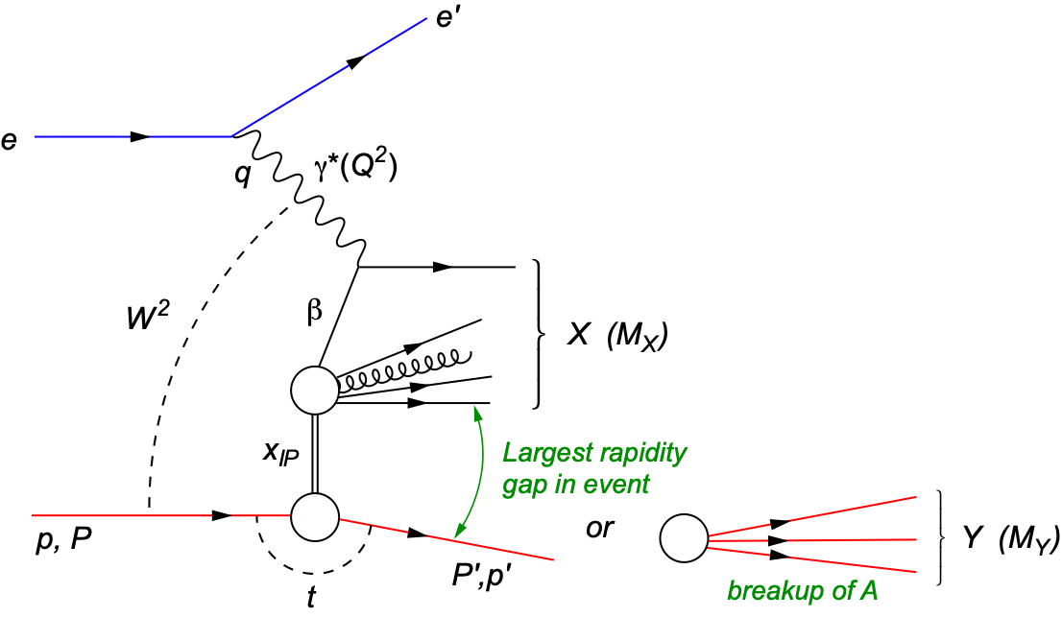
Diffraction for the 21st Century
Diffractive physics will be a major component of the e+A program at an EIC
HERA: σdiff/σtot ~ 14%
Diffractive event characterized by large rapidity gap mediated by color neutral exchange (e.g. 2 or more gluons) aka Pomeron
t: momentum transfer
squared (p-p’)²
MX: mass of diffractive final-state
coherent
incoherent
p/A stays intact
p/A breaks up

Slide 25
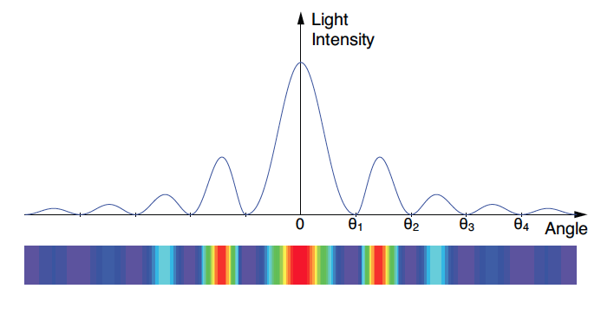
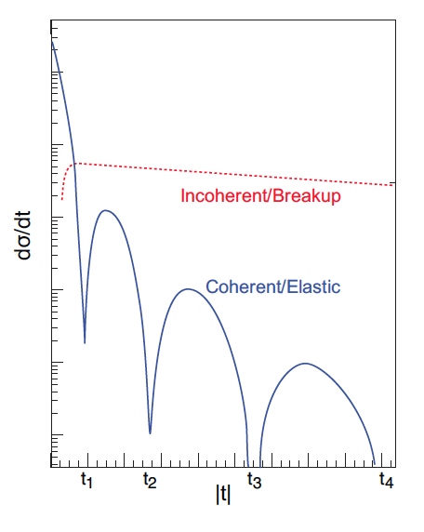
Why Is Diffraction So Important?
Recall: diffractive pattern in optics
Position of minima θi related to size R of screen
small angle scattering
Similarly: in coherent (elastic) scattering dσ/dt resembles diffractive
pattern where |t| ≈ k²θ²
Crucial differences:
target not always “black disc”
sensitivity to “size” of probe / onset of black disc limit
incoherent (inelastic) contribution

Slide 26
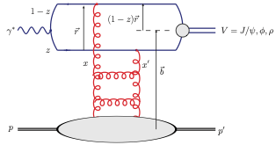
High Sensitivity to g(x,Q²)
Diffraction is most precise probe of non-linear dynamics in QCD
Example: Exclusive diffractive production of a vector meson
Dipole Model
$$γ^{*}p→Vp^{′}$$
$$γ^{*}A→VA^{′}$$
High sensitivity to gluon density: σ~[g(x,Q²)]² due to color-neutral exchange

Slide 27
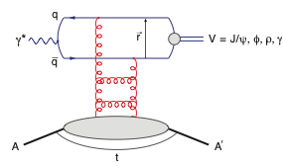
Exclusive Diffractive Vector Meson Production
t can be measured in e+p with a forward spectrometer measuring the scattered p
in e+A this is not possible. A’ stays in the beam pipe.
Only process where this is possible is VM production.

Slide 28
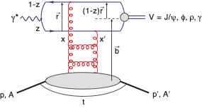
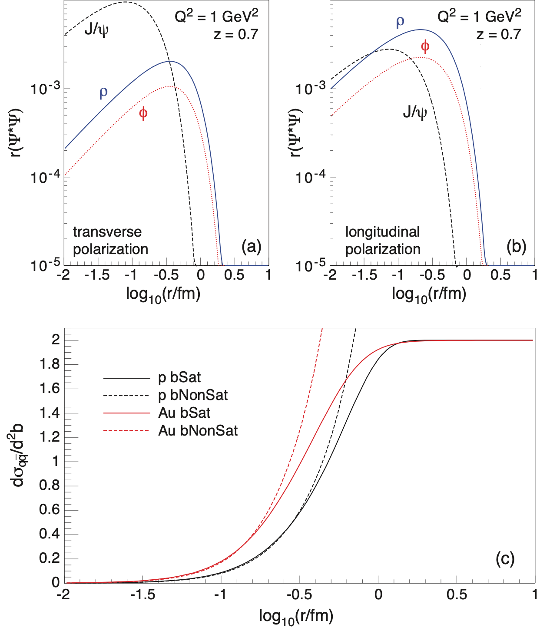
Sartre 1: Diffractive Vector Meson Production
f
J/ψ
Wave overlap function Ψ∗Ψ falls steeply for large dipole radii
J/ψ not sensitive to saturation.
Need to look at φ, or ρ that “see” more of the dipole amplitude
Notes:
\begin{eqnarray*}
\mathcal{A}_{T,L}^{\gamma^*p\rightarrow Vp}(x,Q,\Delta) =
i\int{\rm d} r\int\frac{{\rm d} z}{4\pi}\int{\rm d}^2{\bf b}{\color{red}\left(\Psi^*_V\Psi\right)(r, z)}
\nonumber &~&\\\times
2\pi rJ_0([1-z]r\Delta)
e^{-i{\bf b}\cdot{\Delta}}{\color{blue}\frac{{\rm d}\sigma_{q\bar q}^{(p)}}{{\rm d}^2{\bf b}}(x, r, {\bf b})}
\end{eqnarray*}
\frac{\mathrm{d}\sigma_\mathrm{total}}{\mathrm{d}t} = \frac{1}{16 \pi} \langle |{\cal A}(x, Q^2, t, \Omega |^2 \rangle_\Omega

Slide 29
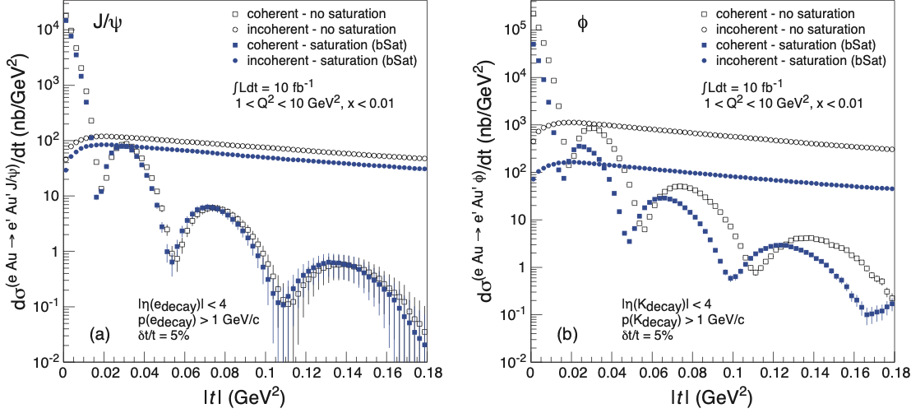
Vector Meson Production: dσ/dt
Find: Typical diffractive pattern for coherent (non-breakup) part
As expected: J/Ψ less sensitive to saturation than φ
Need this sliced in x bins ⇒ luminosity hungry
Crucial: t resolution and reach
T. Toll and TU,
PRC 87 (2013) 024913

Slide 30
Spatial Gluon Distribution from dσ/dt
Diffractive vector meson production:
e + Au → e′ + Au′ + J/ψ
Momentum transfer t = |pAu-pAu′|² conjugate to bT
~
t = Δ²/(1-x) ≈ Δ²
Toll and TU,
PRC 87 (2013) 024913
Converges to input F(b) rapidly: |t| < 0.1 almost enough
Fourier transformation requires ∫Ldt > 1 fb⁻¹/A
Notes:
spin-dependent gluon distribution

Slide 31
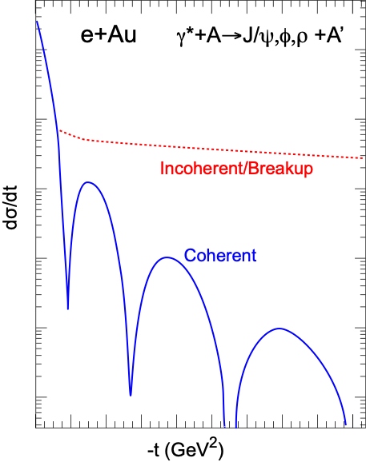
Importance of Incoherent Diffraction
Nucleus dissociates: f ≠ i
Incoherent CS is the variance of the amplitude ⇒ measure of fluctuation of the source G(x, Q², b) at scale ~1/t
Note: Variance disappears in black disk limit! Clear saturation signature.
Example from ep:
H. Mäntysaari,
B. Schenke,
PRL 117 (2016) 052301
Notes:
\begin{eqnarray*}
\sigma_\text{incoherent} &\propto & \sum_{f \neq i} \left< i|{\cal{A}}|f \right>\left< f|{\cal{A}}|i \right>\\
&=& {\color{blue} \left< |{\cal{A}}|^2 \right> } - {\color{red}\left< |{\cal{A}}| \right>^2}
\end{eqnarray*}
\color{red}\frac{\text{d}\sigma_\text{coherent}}{\text{d} t} = \frac{1}{16 \pi} \left< |{\cal A}| \right>^2

Slide 32
Diffractive over Total Cross-Section
Saturation models (CGC) predict up to σdiff/σtot ~ 25% in eA (Hera in ep ~15%)
Enhanced at large β, i.e. small MX²
β = momentum fraction of the struck parton with respect to the Pomeron
contributions to the proton
diffractive structure function
Q²=5 GeV², xIP = 10⁻³
Phys.Rev. C78 (2008) 045201
Notes:
beta is the momentum fraction of the struck parton with
respect to the Pomeron, and
xIP is the momentum fraction of the Pomeron with respect
to the hadron..

Slide 33
Key Measurement: σdiffractive/σtotal
Studies using diffractive event generator Sartre based on Dipole model.
Ratio enhanced for small MX and suppressed for large MX
Standard QCD predicts no MX dependence and a moderate suppression due to shadowing.
Eur.Phys.J. A52 (2016), 268
Simple Day 1 Measurement: Ratio of cross-sections
Unambiguous signature for reaching the saturation limit
$$\frac{σ_{diff}/σ_{total}(eA)}{σ_{diff}/σ_{total}(ep)}$$
Notes:
Dipole cross-section is closer to the unitarity limit than the proton - it is “blacker”. The elastic scattering probability of a qq̅ dipole is maximal in the “black” limit
The qq̅g component is suppressed for nuclei compared to the proton.
This is due to the fact that in a nucleus the scattering amplitude
is closer to the unitarity limit when the qq̅g component vanishes
different b -dependences from each other and from the inclusive
cross section. The q ¯q -component is enhanced at small b (closer to the black disk limit),
whereas the q ¯qg -part is dominated by larger b (because it vanishes in the black disk limit).
Depending on the mass of the diffractive system MX
or, equivalently, , the diffractive structure function is
dominated by either the q ¯q or q ¯qg Fock states.
invariant mass of the diffractive system is large, and
this large phase space is filled by radiation of additional
gluons, each of them being suppressed by
alpha_s .
The q ¯q -components of
the FD
2A are enhanced compared to A times the proton
diffractive structure functions. This is to be expected,
because of the fact that in a gold nucleus the dipole cross
section is, on average over the transverse area, closer to
the unitarity limit than the proton - it is “blacker”. The
elastic scattering probability of a q ¯q dipole is maximal in
the “black” limit and the approach to it is quicker in a
large nucleus. The q ¯qg component, on the other hand,
is suppressed for nuclei compared to the proton. This is
due to the fact that in a nucleus the scattering amplitude
is closer to the unitarity limit when the q ¯qg component
vanishes, as can be seen e.g. from Eq. (13). This
leads to a nuclear suppression of the diffractive structure
function in the small region, where the q ¯qg component
dominates. The net result of the different contributions
is that FD
2A , for a large range in , is close to AFD
2p .

Slide 34
Sign Flip
Sign Change in relative ratio of
diffractive structure functions
Nucleus is “blacker” than proton. Elastic scattering probability of a qq̅ dipole is maximal in the “black” limit
arXiv:1708.01527
qq̅g component vanishes in black disk limit
Observing these dependencies
on M_{x} over a wide range in x and Q² is crucial!
Notes:
Dipole cross-section is closer to the unitarity limit than the proton - it is “blacker”. The elastic scattering probability of a qq̅ dipole is maximal in the “black” limit
The qq̅g component is suppressed for nuclei compared to the proton.
This is due to the fact that in a nucleus the scattering amplitude
is closer to the unitarity limit when the qq̅g component vanishes
different b -dependences from each other and from the inclusive
cross section. The q ¯q -component is enhanced at small b (closer to the black disk limit),
whereas the q ¯qg -part is dominated by larger b (because it vanishes in the black disk limit).
Depending on the mass of the diffractive system MX
or, equivalently, , the diffractive structure function is
dominated by either the q ¯q or q ¯qg Fock states.
invariant mass of the diffractive system is large, and
this large phase space is filled by radiation of additional
gluons, each of them being suppressed by
alpha_s .
The q ¯q -components of
the FD
2A are enhanced compared to A times the proton
diffractive structure functions. This is to be expected,
because of the fact that in a gold nucleus the dipole cross
section is, on average over the transverse area, closer to
the unitarity limit than the proton - it is “blacker”. The
elastic scattering probability of a q ¯q dipole is maximal in
the “black” limit and the approach to it is quicker in a
large nucleus. The q ¯qg component, on the other hand,
is suppressed for nuclei compared to the proton. This is
due to the fact that in a nucleus the scattering amplitude
is closer to the unitarity limit when the q ¯qg component
vanishes, as can be seen e.g. from Eq. (13). This
leads to a nuclear suppression of the diffractive structure
function in the small region, where the q ¯qg component
dominates. The net result of the different contributions
is that FD
2A , for a large range in , is close to AFD
2p .

Slide 35
Closing Comments
EIC will provide answers to profound questions in QCD
ep: Precision studies of structure functions, TMDs, and GPDs will lead to the most comprehensive picture of the nucleon ever: its flavor, spin, and spatial structure
eA: Unprecedented study of matter in a new regime of QCD. New capabilities open a new frontier to study the saturation region, measure the gluonic structure of nuclei, and investigate color propagation, and fragmentation using the nucleus as analyzer.
There is precedent for surprises in nature, provided you look

Slide 36
Selected Reading
EIC White Paper:
Electron Ion Collider: The Next QCD Frontier
Eur.Phys.J. A52 (2016) no.9, 268
arXiv:1212.1701
Scientific American (May 2015)
The Glue That Binds Us
by R. Ent, R. Venugopalan, TU

Slide 37
Backup Slides

Slide 38
Exploring Short Range Nuclear Forces
Miller, Sievert, Venugopalan, Phys.Rev. C93 (2016)
Can the short range contributions to NN scattering be described directly in terms of the quark and gluon DoF in QCD?
Vector meson production in e+D collisions
Cross-section can be expressed in terms of a gluon Transition Generalized Parton Distribution (T-GPD)
The hard scale in the final state makes the T-GPD sensitive to the short distance nucleon-nucleon interaction.
New opportunities - needs more studies (in progress)
Notes:
nuclear force is described by pion exchange, and is well understood
within the framework of effective field theories. At shorter distances, two pion
exchange, tensor interactions, and vector meson exchange contributions become important,
which are harder to capture in the framework of effective field theories. At short distances,
the nucleon-nucleon interaction has a strong repulsive core, which is essential for the stability
of matter.

Slide 39
Q² and A Scaling of Diffractive VM Production
Saturation models predict very special and strong dependencies in A and Q² that are different above and below Q²S
Q² > Q²S
σ ~ 1/Q⁶
σ(t=0) ~ A²
σ ~ A^{4/3}
Q² < Q²S
σ ~ Q²
σ(t=0) ~ A^{4/3 ↔︎} A^{5/3}
σ ~ A^{2/3 ↔︎} A
Q² scaling
t = 0
A² scaling
1/Q⁶ scaling
Mantysaari and Venugopalan, arxiv:1712.02508
Non-Saturation scenarios do not show this behavior making A, Q² dependencies a key measurement

Slide 40
EIC: Gluon TMDs from Dijet Production
Thus far, focus on quark TMDs while the available studies of gluon TMDs are sparse
Of particular interest: WW gluon distribution G⁽¹⁾ and its linearly polarized partner hT⁽¹⁾ inside unpolarized hadron
These gluon distributions play also central role in small-x saturation phenomena.
G⁽¹⁾ and hT⁽¹⁾ can be accessed through measuring azimuthal anisotropies in processes such as jet pair (dijet) production in e+p and e+A scattering.
A. Metz and J. Zhou, Phys. Rev. D84 , 051503 (2011), arXiv:1105.1991.
D. Boer, P. J. Mulders, and C. Pisano, Phys. Rev. D80 , 094017 (2009), arXiv:0909.4652
D. Boer, S. J. Brodsky, P. J. Mulders, and C. Pisano, Phys. Rev. Lett. 106 , 132001 (2011), arXiv:1011.4225.
F. Dominguez, J.-W. Qiu, B.-W. Xiao, and F. Yuan, Phys. Rev. D85 , 045003 (2012), arXiv:1109.6293.
A. Dumitru, L. McLerran, and V. Skokov, Phys. Lett. B743 , 134 (2015), arXiv:1410.4844.
A. Dumitru and V. Skokov, Phys. Rev. D91 , 074006 (2015), arXiv:1411.6630.
A. Dumitru, T. Lappi, and V. Skokov, Phys. Rev. Lett. 115 , 252301 (2015), arXiv:1508.04438.
A. Dumitru and V. Skokov, Phys. Rev. D94 , 014030 (2016), arXiv:1605.02739.
Notes:
(WW) gluon distribution (G(1)) + linearly polarized partner (h(1))

Slide 41
Kinematics: Dijets in γ*A
Key observables: PT and qT
the difference in momenta (imbalance)
the average transverse momentum of the jets
φ is angle between PT and qT
work in “correlation limit” PT >> qT
azimuthal asymmetry arising from the linearly polarized gluon distribution: v2 = ⟨cos 2φ⟩
Dominguez, Marquet, Xiao, Yuan, PRD 2011
Notes:
Dijet production in e+A at high energies originates from long-ranged eikonal interactions ⇒ parameterizing the azimuthal structure arising from the linearly polarized gluon distribution also in terms of v2
“Correlation limit” PT >> qT involves only 2-point functions / TMDs
z: lightcone momentum fractions

Slide 42
Elliptic Anisotropy in DiJet Production (I)
Dipartons from McDijet event generator (V. Skokov) → showers via Pythia → experimental cuts → jet-finding with ee-kt (FastJet)
All polarizations
Trans. γ*
Long. γ*
Dijets recover the anisotropy (v2) quite well
NOTE: phase shift between long. and trans. γ* (dominated by T)
Gluon TMDs via:
A. Dumitru, T. Lappi, and V. Skokov, Phys. Rev. Lett. 115 , 252301 (2015), arXiv:1508.04438.

Slide 43
Elliptic Anisotropy in Dijet Production (III)
Detailed simulations show that in e+A the EIC can perform this challenging measurement
Can separate background from signal djets
Can separate v2^{L} and v2^{T}
Measurement requires large EIC energies (jet physics!)

Slide 44
Exclusive Diffractive Vector Meson Production
Full simulations using Sartre event generator based on IPSat (aka bSat) model
Suppression larger for φ than for J/ψ as expected
Straightforward measurement for early days of an EIC
Note: A^{4/3} scaling strictly only
valid at large Q²

Slide 45
The Problem of Estimating nPDF Constraints
Methods:
Use σred (includes F2 and FL (F3)) pseudo data
Re-weighting EPPS16
EPPS16 is a bit stiff at low-x, over-constraints at low-x
EPPS16* (arXiv:1708.05654, Hannu Paukkunen)
more flexible form cures EPPS16 problem (low-x bias)
might underestimate impact?
EPPS16
EPPS16*
Notes:
Inclusive DIS cross-section, simplified (reduced) by dividing out the Mott cross-section.

Slide 46
Gluon Saturation: Past Experimental Reach
HERA (ep)
Marginal reach of Qs
Only at very low Q² making comparison with perturbative QCD impossible
Fixed Target DIS Experiment
eA, μA, νA
Same marginal reach
Only at low Q² (Q² < 1 GeV²)

Slide 47
Relation to Chiral Magnetic Effect
RHIC & LHC: intriguing hints of CME
Key challenge: understanding dynamics of axial charge production during the very early pre-equilibrium stages (see talk by Niklas Mueller)
Tuomas Lappi, Soren Schlichting, arXiv:1708.08625
Chern-Simons current correlator (the source of axial charge)
Immediate link between dijet DIS (and TMDs) and CME

