Slide 1
The Electron-Ion Collider
Lecture 1&2
Thomas Ullrich (BNL/Yale)
EJC2018, October 11-12, 2018

Slide 2
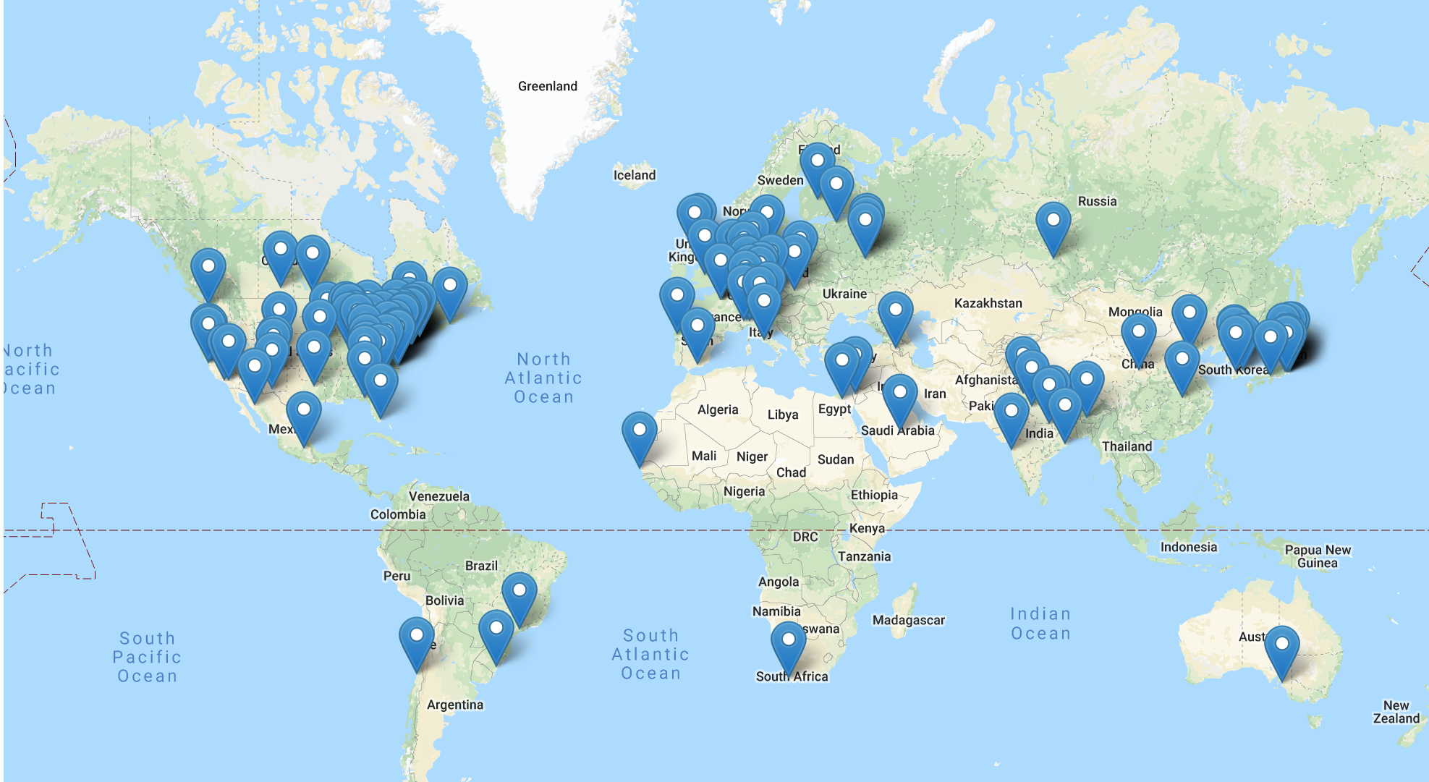
The Electron-Ion Collider
does not exist
Yet!!
Over 800 people from 169 institutions and 29 countries are working hard to make it happen within the next decade.
I am one of them.
Notes:
822 members
173 institutions
30 countries (7 world regions)
Experiment Scientists: 475, Theory Scientists: 163, Accelerator Scientists: 142, Support: 3, Other: 39

Slide 3
The Electron-Ion Collider on One Page
The Electron-Ion Collider will be a machine for learning about the secrets of gluons that binds the building blocks of visible matter in the universe.
Tools:
The world’s first polarized electron-polarized proton collider
The world’s first electron-heavy ion collider
Fine resolution inside proton down to 10⁻¹⁸ meters
Counter rotating beams of electrons and protons/ions collide at an interaction point
The probe (electron) is structure-less and scatters off a “target”. The process is called Deep Inelastic Scattering.
e′
e
p or A

Slide 4
Syllabus
Probing Matter
Scattering Experiments
Electron Scattering
Quark Models and QCD
Static Quark Model
QCD
Gluons
Studying Matter at the Smallest Scale
DIS & Kinematics
Structure Functions
Parton Distribution Function
The Frontiers of Our Ignorance
Mass
Cross-Sections
Saturation
Spin Puzzle
Imaging
Fragmentation
Landscape of QCD
Big question and what we need to answer them
Realization of an EIC
Detectors
Examples of Key Measurements at an EIC
Spin of the proton
Imaging
Structure Functions and Nuclear PDFs in eA Collisions
Dihadron Correlations
Diffractive physics in eA
Closing comments and further reading

Slide 5
Probing Matter
Scattering of protons on protons
is like colliding Swiss watches to find out how they are build.
R. Feynman

Slide 6
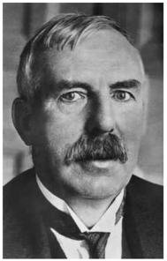
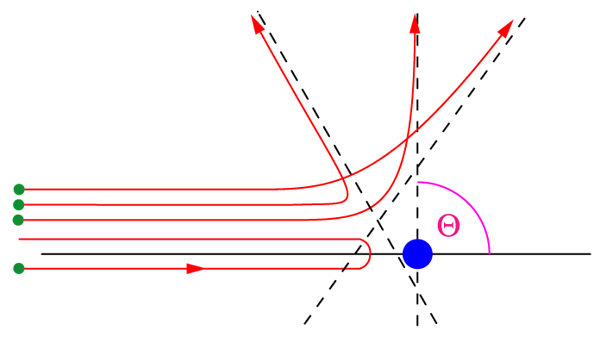
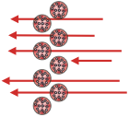
Probing Matter (1909)
The first exploration of subatomic structure was undertaken by Rutherford at Manchester using Au atoms as targets and α particles as probes.
Elastic scattering of charged particles in Coulomb field (point-like source):
Observed
result:
Thomson’s
Plum Pudding Model
a
Predicted
result:
Detail of gold foil (Thomson):
a
Positive Nucleus Theory
explain α deflection:
a
Z
E
Z′
Au
Expected
marks on screen
Notes:
\frac{d\sigma}{d\Omega} = \left( \frac{Z Z^\prime}{E}\right)^2 \frac{1}{\sin^4 (\frac{1}{2} \theta)}

Slide 7
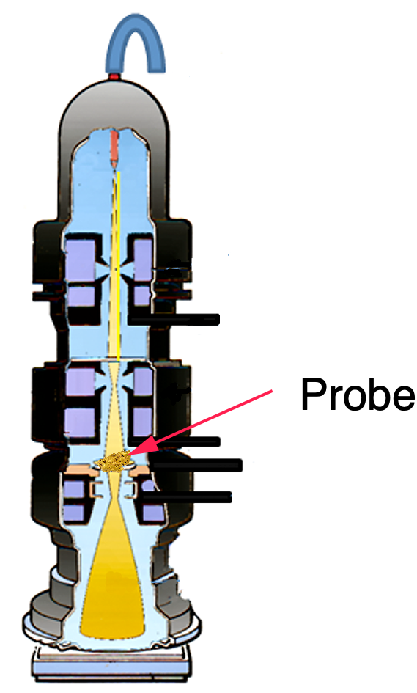
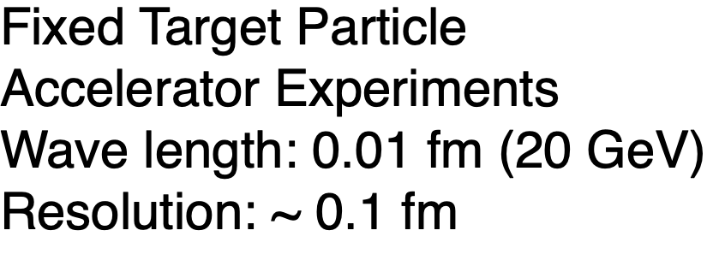
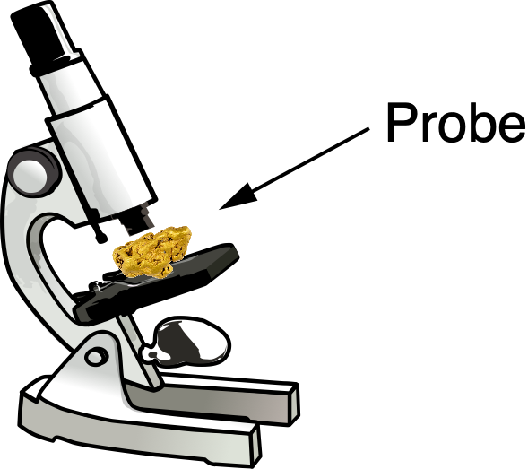
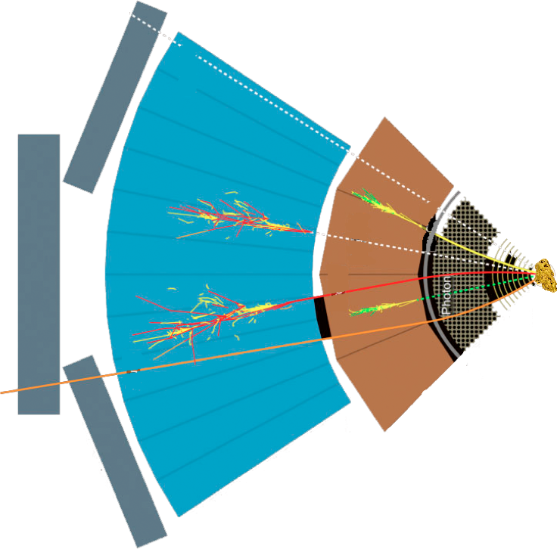
Studying Matter at Small Scales
Note: Optical/electron microscopy involve the diffraction, reflection, or refraction of electromagnetic radiation/electron beams interacting with the target, and the collection of the scattered radiation to create an image. They don’t go deep.
Target
SLAC, EMC, NMC, E665, BCDMS,
HERMES, JLab, COMPASS, …
Detector

Slide 8
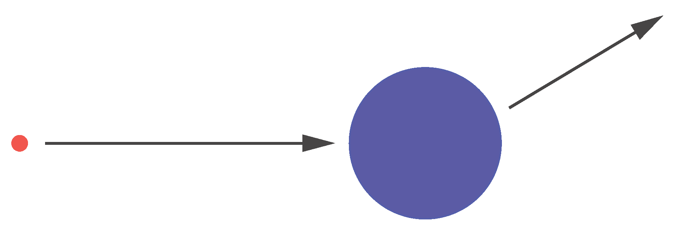
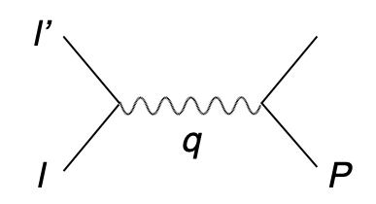
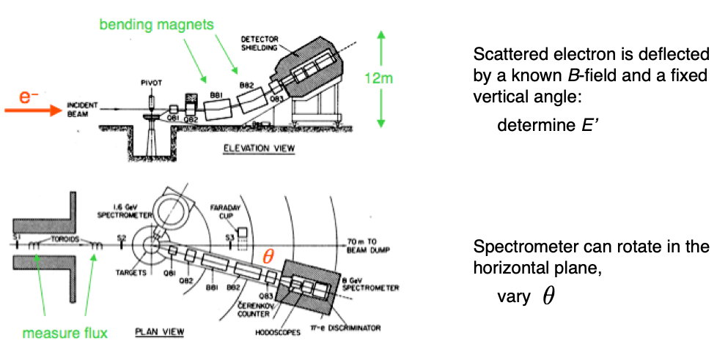
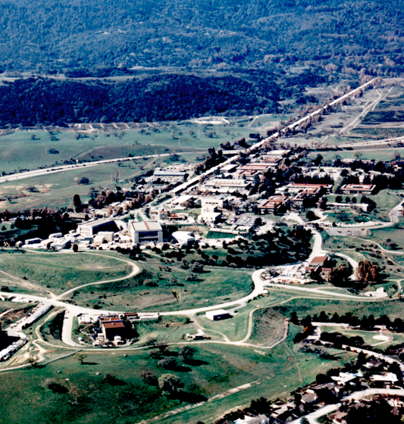
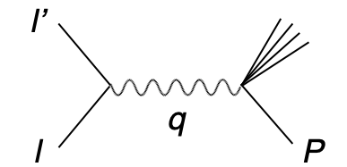
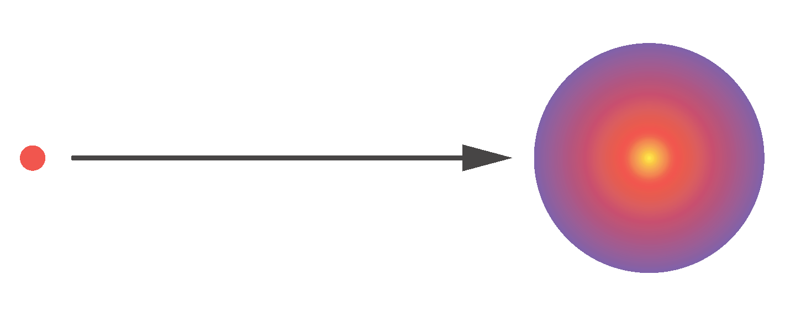
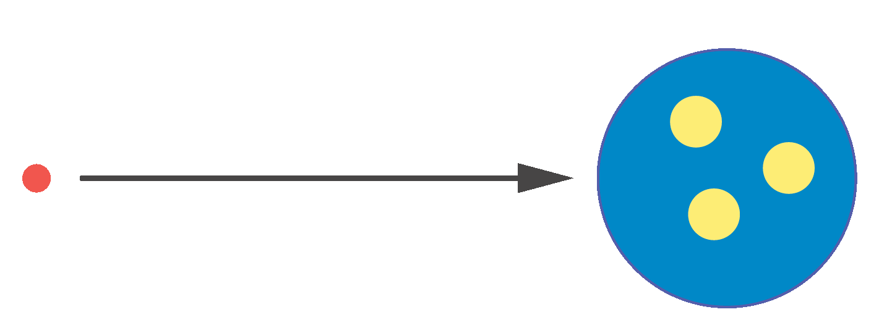
Probing Matter with Electrons
The SLAC experiments in the 1960s established the
quark model and our modern view of particle physics.
proton
Mott = Rutherford + Spin
electron
p₂
elastic:
electron
beam
?
p₁
inelastic
Target
Detector
inelastic:
?
Detector
Constant F(q²):
⇒ scattering on point-like constituent of the nucleon
quarks
elastic
Formfactor: F(q²)
Fourier transform
of charge distributions
?
Notes:
Parton Model (Feynman & Bjorken): nucleons as made up of point-like constituents
provides a very simple framework for calculating scattering cross-sections
as well as structure functions.
Parton Model: every object with a finite size has a formfactor and therefore experiences a dependence of
the 4-momentum transfer (Q2 dependence) from the scattered particle.
\frac{d\sigma}{d\Omega} = \left( \frac{d\sigma}{d\Omega} \right)_\mathrm{Mott} |F(q^2)|^2
q^2 = (\mathbf{p}_1 - \mathbf{p}_2)^2
Friedmann, Kendall, Taylor

Slide 9
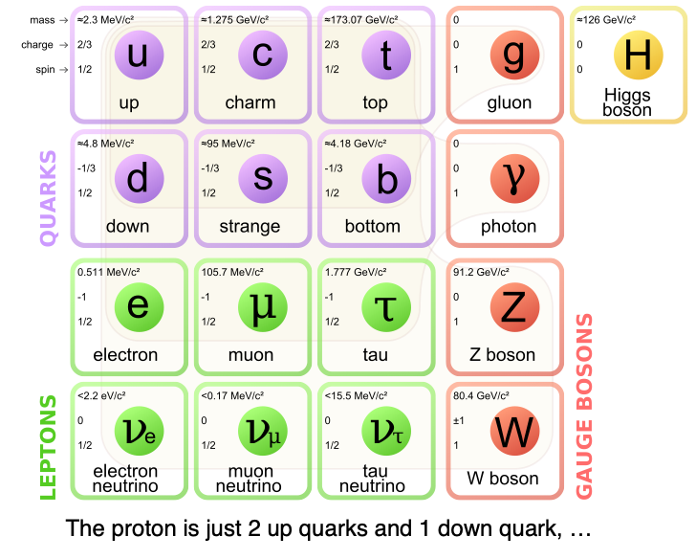
Quarks Gluons and QCD

Slide 10
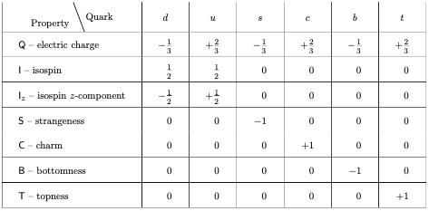
“Static” Quark Model
Quarks: spin 1/2 fermions, color charge
M. Gell-Mann,
K. Nishijima (> 1964)
For detailed properties of multi-quark systems the static (constituent) model has failed almost completely and given no predictions which have been verified by experiment.
How can a model be so successful in the quark-antiquark and three quark systems and fail for almost everything else?
What’s missing?
Baryons:
q
Mesons:
q
q
q
q
Eight-fold Way: Account for every hadron we found so far
Notes:
In physics, the Eightfold Way is a term coined by American physicist Murray Gell-Mann for a theory organizing subatomic baryons and mesons into octets (alluding to the Noble Eightfold Path of Buddhism). The theory was independently proposed by Israeli physicist Yuval Ne'eman and led to the subsequent development of the quark model.
Particles along the same horizontal line share the same strangeness, s, while those on the same diagonals share the same charge, q.
In addition to organizing the mesons and spin-1/2 baryons into octets, the principles of the Eightfold Way also applied to the spin-3/2 baryons, forming a decuplet. However, one of the particles of this decuplet had never been previously observed. Gell-Mann called this particle the Ω⁻ and predicted in 1962 that it would have a strangeness −3, electric charge −1 and a mass near 1,680 MeV/c². In 1964 a particle closely matching these predictions was discovered[1] by a particle accelerator group at Brookhaven, making the Eightfold Way a triumphant success. Gell-Mann received the 1969 Nobel Prize in physics for his work on the theory of elementary particles.
The baryon octet
The Eightfold Way may be understood in modern terms as a consequence of flavor symmetries between various kinds of quarks. Since the strong nuclear force is the same for quarks of any flavor, replacing one flavor of quark with another in a hadron should not alter its mass very much. Mathematically, this replacement may be described by elements of the group SU(3). The octets and other arrangements are representations of this group; for a more detailed explanation of this fact, see the article Particle physics and representation theory.

Slide 11
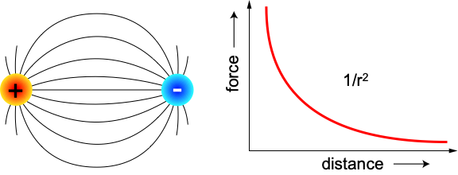
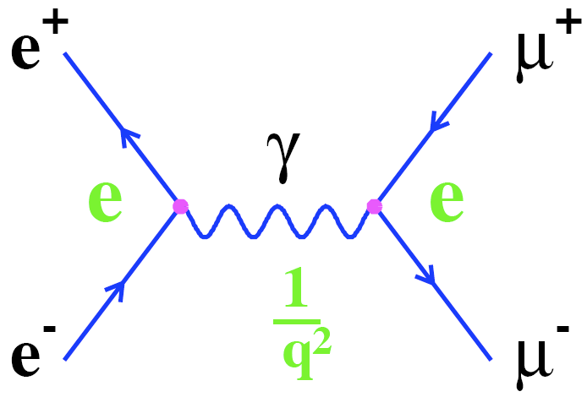
Recall: Quantum Electrodynamic
Theory of electromagnetic interactions
Exchange particles (photons) do not carry electric charge
Flux is not confined: V(r) ~ 1/r, F(r) ~ 1/r²
Example Feynman Diagram:
e⁺e⁻ annihilation
a
a
1/q²
Coupling constant (α): Interaction Strength
In QED: αem = 1/137

Slide 12
Quantum Chromodynamics (QCD)
Quantum Chromo Dynamics is the “nearly perfect” fundamental theory of the strong interactions
F. Wilczek, hep-ph/9907340
Three color charges: red, green and blue
q
q
Exchange particles (gluons) carry color charge and can self-interact
Self-interaction: QCD significantly harder to analyze than QED
Flux is confined:
~1/r at short range
long range ~ r
Long range aspect ⇒ quark confinement and existence of nucleons
Notes:
Quantum electrodynamics is an abelian gauge theory with the symmetry group U(1) and has one gauge field, the electromagnetic four-potential, with the photon being the gauge boson. The Standard Model is a non-abelian gauge theory with the symmetry group U(1) × SU(2) × SU(3) and has a total of twelve gauge bosons: the photon, three weak bosons and eight gluons.
QCD is a type of quantum field theory called a non-abelian gauge theory, with symmetry group SU(3).

Slide 13
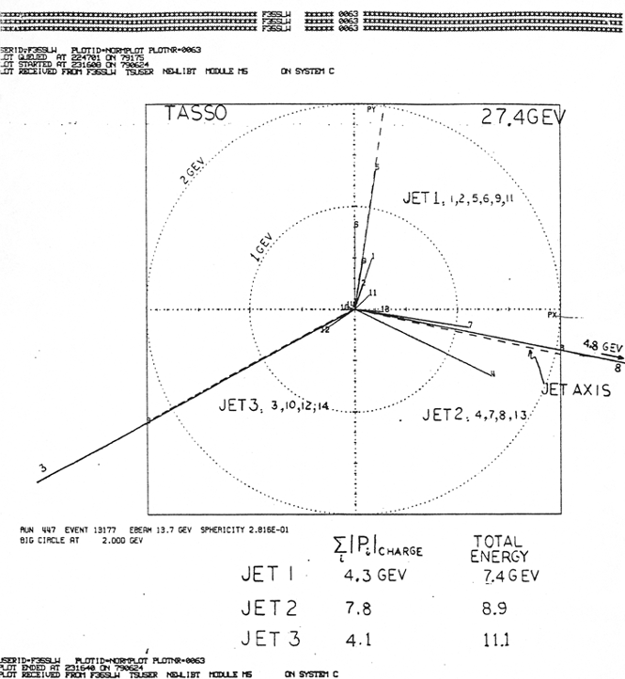
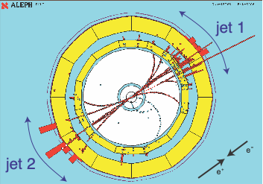
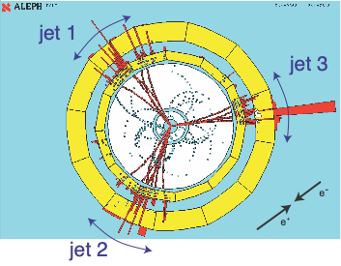
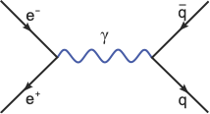
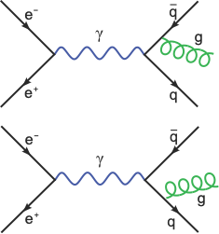
Gluons: They Exist!
Physics Letters B, 15 December 1980
1979 Discovery of the Gluon
Mark-J, Tasso, Pluto, Jade experiment at PETRA (e⁺e– collider) at DESY (√s = 13 - 32 GeV)
e⁺ e⁻ → q‾q → 2-jets
e⁺ e⁻ → q‾q g → 3-jets
J. Ellis, arXiv:1409.4232
Notes:
The process of "gluon bremsstrahlung": the incoming electron and positron annihilate to form a photon, which in turn generates a quark-antiquark pair that fragments into hadrons and appears in the detector as two back-to-back hadron jets. These outgoing quarks can however also radiate a gluon, which creates a third hadron jet lying in the same plane as the other two.

Slide 14
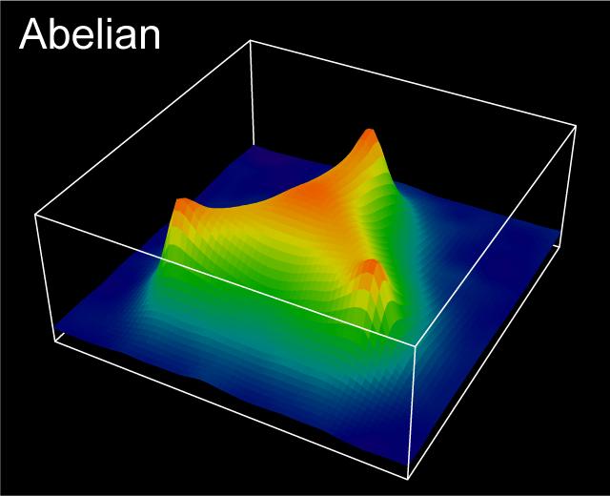
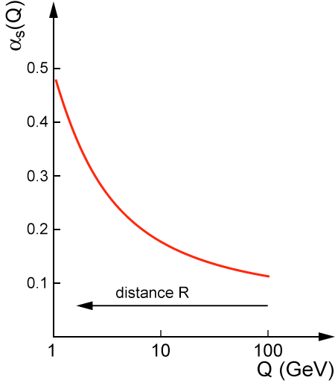
Understanding QCD ?
“Emergent” Phenomena not evident from Lagrangian
Asymptotic Freedom
αs(Q²) ~ 1 / log(Q²/Λ²)
in vacuum (Q ~ 1/R)
Confinement
Free quarks not observed in nature
Quarks only in bound states
Cannot “see” the glue in the low-energy world
Despite this conjectured dominance, properties of gluons in matter remain largely unexplored
Action (~energy) density fluctuations of gluon-fields in QCD vacuum (Derek Leinweber)
G. Schierholz
Action density in 3q system (lattice)
Gluons & their self-interaction
Determine essential features of strong interactions
Dominate structure of QCD vacuum (fluctuations in gluon fields)
Responsible for > 98% of the visible mass in universe
Notes:
Wallenberg foundation: prize for explanation of confinement
The animations to the right and above illustrate the typical four-dimensional structure of gluon-field configurations averaged over in describing the vacuum properties of QCD. The volume of the box is 2.4 by 2.4 by 3.6 fm, big enough to hold a couple of protons. Contrary to the concept of an empty vacuum, QCD induces chromo-electric and chromo-magnetic fields throughout space-time in its lowest energy state. After a few sweeps of smoothing the gluon field (50 sweeps of APE smearing), a lumpy structure reminiscent of a lava lamp is revealed. This is the QCD Lava Lamp. The action density (top) and the topological charge density (right) are displayed. The former is similar to an energy density while the latter is a measure of the winding of the gluon field lines in the QCD vacuum.

Slide 15
Studying Matter at the Smallest Scale

Slide 16
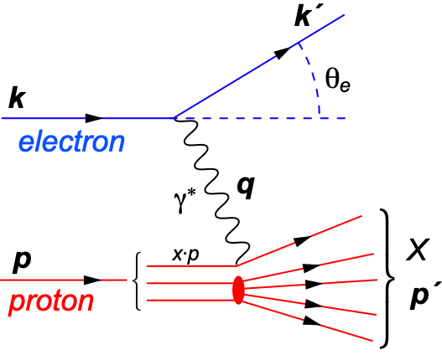
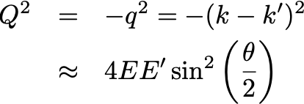
Deep Inelastic Scattering (DIS)
s:
y:
x: momentum fraction of parton
Q²: resolution power
y: inelasticity
s: center-of-mass energy sq.
x:
Q²:
square of center-of-mass energy of electron-hadron system
Bjorken-x
x is fraction of the nucleon’s momentum carried by the struck quark
Inelasticity
Fraction of electron’s energy lost in nucleon restframe
0 < y < 1
4-momentum transfer from scattered electron
invariant mass sq. of γ*
“Resolution” power
Virtuality
real photon Q = 0
Deep (Q² ≫ mp²)
Inelastic (W² ≫ mp²)
Scattering = DIS
N.B.: This picture was developed in the “infinite momentum frame” (IMF). That works nicely when one assume massless quarks and gluons (partons). Despite all this it is also used for example for massive charm quarks. Some care has to be taken and x needs to be “adjusted”.
Notes:
W2 can also be interpreted as the center-of-mass energy of the gauge boson nucleon system.
Q2 max = s
Q2: negative square of the momentum transfer q, denotes virtuality
x: make Remark that for e+p 0 < x < 1 while for e+A scattering 0 < x < A.
y: is the fraction of the lepton’s energy lost in the nucleon rest frame. It it thus also the fraction of the incoming electron energy (also known as inelasticity) carried by the exchange boson (photon) in the rest frame of the nucleon
Q^2 &=& -q^2 = - (k-k^\prime)^2 \\
&\approx& 4 E E^\prime \sin^2\left(\frac{\theta}{2}\right)

Slide 17
The x-Q² Plane
Energy s
y = const
log Q²
y = const
log x
1
Low-x reach requires large √s
Large-Q² reach requires large √s
y at colliders typically limited to approx. 0.01 < y < 0.95

Slide 18
Structure Functions
Inclusive e+p collisions:
(only scattered electron is measured, rest ignored)
quark+anti-quark
momentum distributions
gluon momentum distribution
F2 and FL are key in understanding the structure of hadrons
N.B.: At very high energies a 3rd structure function comes into play: F3
Ignored here and in the rest

Slide 19
More Practical: Reduced Cross-Section
Inclusive Cross-Section:
Reduced Cross-Section:
Rosenbluth Separation:
Recall Q² = x y s
Measure at different √s
Plot σred versus y2/Y⁺ for fixed x, Q²
F2 is σred at y2/Y⁺ = 0
FL = Slope of y2/Y⁺
fixed x, Q²
σred
0
1
y²/Y⁺

Slide 20
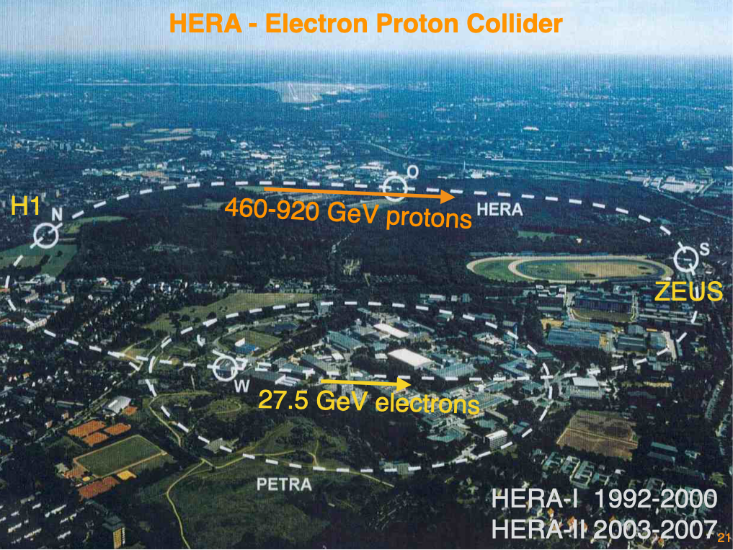
Studying Matter at the Smallest Scales
ep/eA Collider Experiments
Wave Length: 0.0001 fm (10 GeV + 100 GeV)
Resolution: ~ 0.01-0.001 fm
Past: HERA,
Future: EIC, LHeC, …

Slide 21
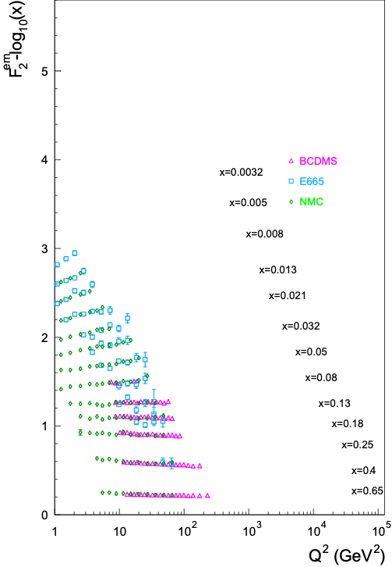
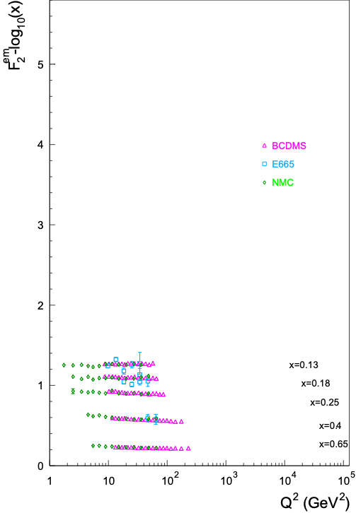
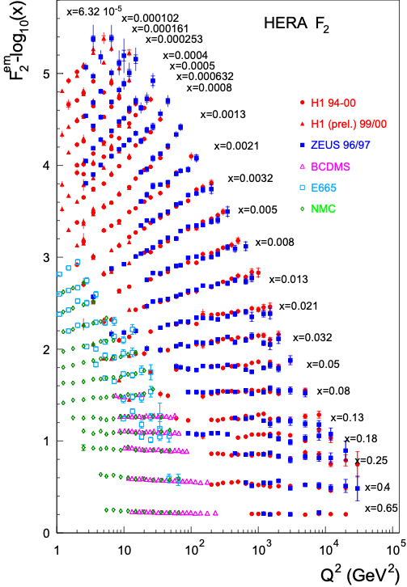
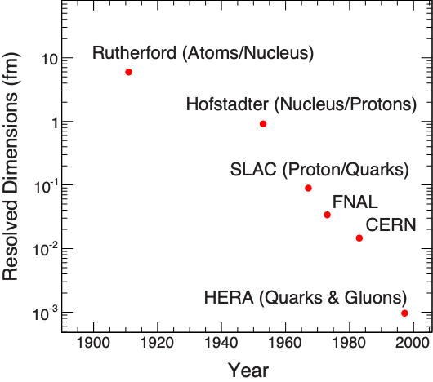
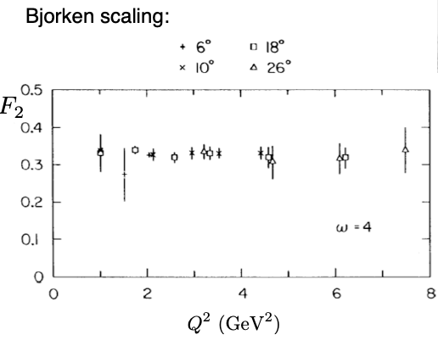
F2: The Key Structure Function
λ ~ ℏc/Q
Q² ≈ s⋅x
Point-like particles cannot be further resolved.
Their measurement does not depend on wavelength, hence Q² independence.
Bjorken Scaling: F2(x, Q²) → F2(x)
virtual photon interacts with a
single essentially free quark
Bjorken Scaling: F2(x, Q²) ≠ F2(x)
Broken - Big Time
It’s the Glue !!!
Notes:
Bjorken Scaling: virtual photon interacts with a single essentially free quark

Slide 22
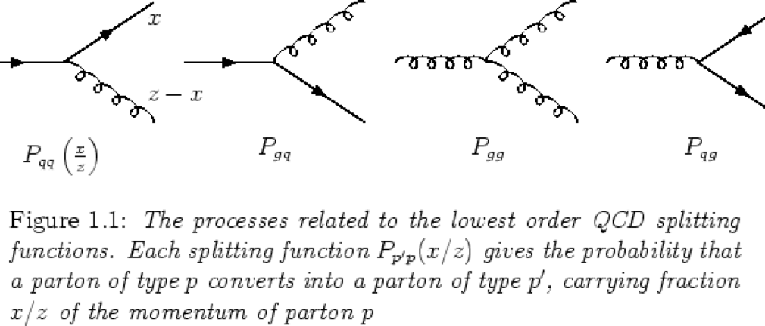
Quark and Gluon Distributions
Structure functions allows us to extract the quark q(x,Q²) and gluon g(x,Q²) distributions (PDFs).
In LO: Probability to find parton with x, Q² in proton
What is Needed:
Good data
Best: F2 (ep), jets, Drell-Yan (pp)
Bad: Hadrons
pQCD Calculation of the processes
LO, NLO, NNLO
QCD Evolution Equations
DGLAP: Evolution in Q² (small to large) at fixed x (integro-differential equations)
BFKL: Evolution in x at fixed Q²
PDF: Connecting experiment (e.g. pp) with theory
Jets, Drell-Yan, etc.:
Parton Distribution
Function (PDF)
Theoretical
Calculations
Observable
log Q²
DGLAP
Hadron Production:
BFKL
Fragmentation
Functions
log x
Notes:
integro-differential equations

Slide 23
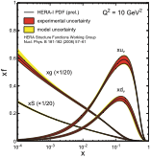
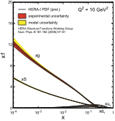
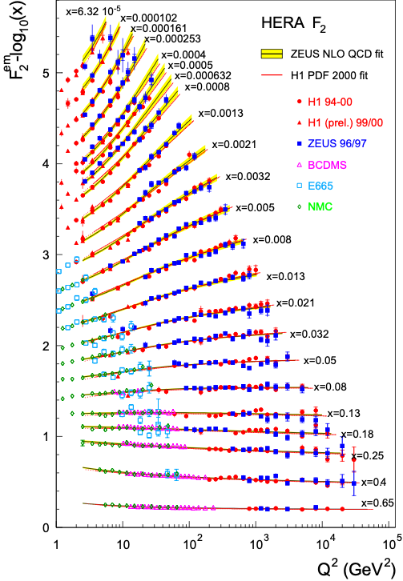
Quark and Gluon Distributions
Quarks: qi(x,Q²) from F2 (or reduced cross-section)
Gluons: g(x,Q²) through scaling violation: dF²/dlnQ²
F₂
dF₂ /dlnQ²
pQCD+
DGLAP Evolution
Þ
+
Proton is almost entirely glue for x<0.1
Here goes the naive picture that protons are made of 3 quarks (recall static quark model)
Notes:
integro-differential equations

Slide 24
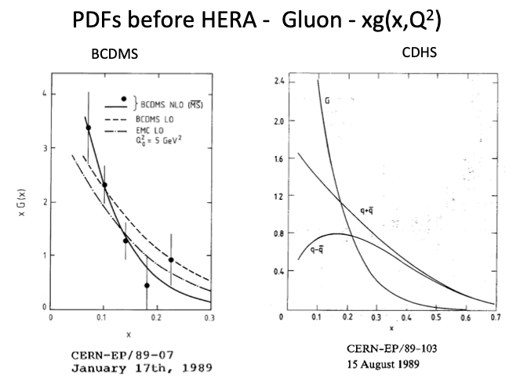
Hera’s Impact

Slide 25
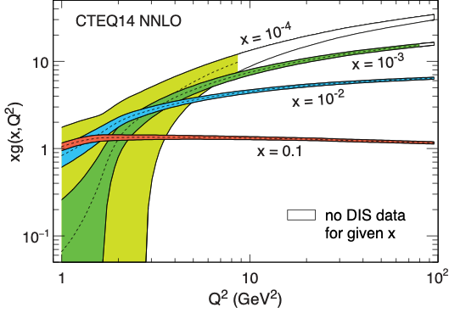
PDFs: Much Progress, Still Shortcomings
CTEQ14: a modern proton PDF
Large uncertainties at x=10⁻³ and 10⁻⁴ at the small Q² although high quality data exist.
The precision of low Q² data is ineffectual due to the lack of data at the larger Q² (Evolution from low to high Q²)
Uncertainties from PDF dominate many “BSM” searches
Notes:
In LO: Probability to find parton with x, Q2 in proton
DGLAP (RGE)

Slide 26
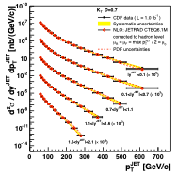
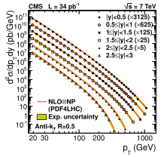
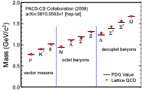
Strong Evidence that QCD is the Correct Theory
Structure functions measured at HERA ep collider
Jet cross-sections: pp collisions at LHC andpp collisions at Fermilab
Lattice QCD
Are we done?
Notes:
Perturbative QCD describes only a small part of the total cross-section
Lattice QCD is of very limited utility in describing scattering

Slide 27
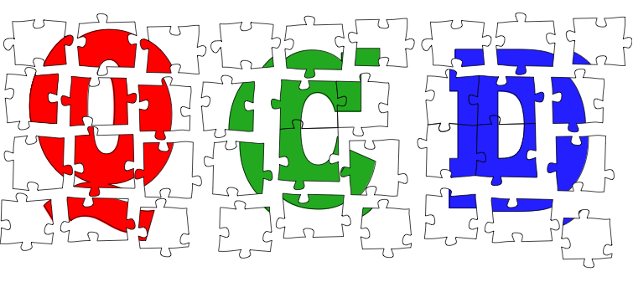
The Frontiers of Our Ignorance
... that motivate an Electron-Ion Collider

Slide 28
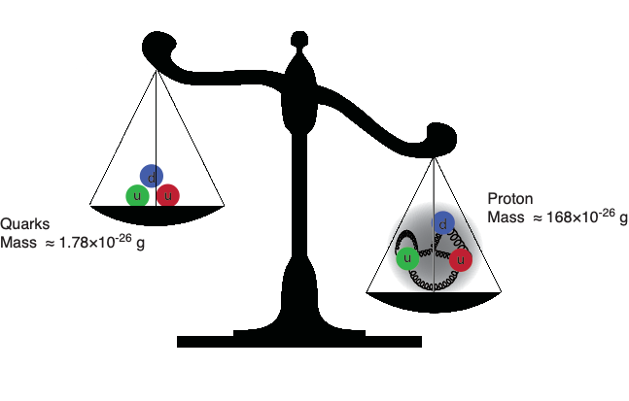
The Mass Puzzle
The Higgs is responsible for quark masses
~ 2% of the proton mass.
Gluons are massless…yet their dynamics are responsible for
(nearly all) the mass of visible matter. We do not know how?
Notes:
Mass from binding energy
Binding through gluons

Slide 29
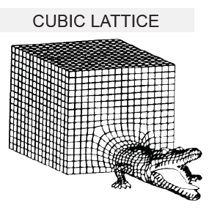
Scattering in the Strong Interactions
Perturbative QCD:
Describes only a small part of the total cross-section
Lattice QCD:
First principles treatment of static properties of QCD: masses, moments, thermodynamics
Very challenging for dynamical processes and very limited utility in describing scattering
Instead ⇒ Effective theories:
How do quark and gluon degrees organize themselves to describe the bulk of the cross-section?

Slide 30
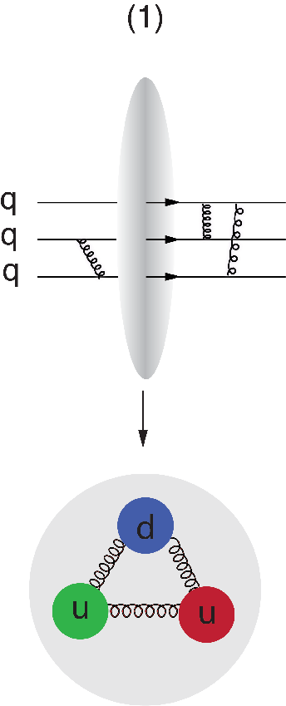
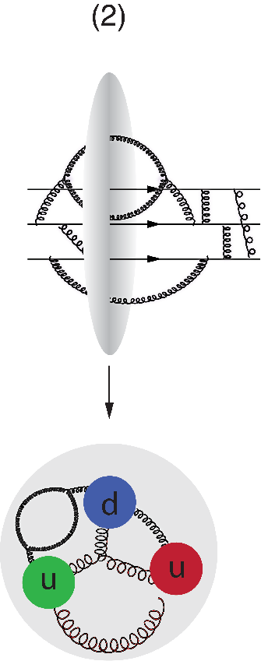
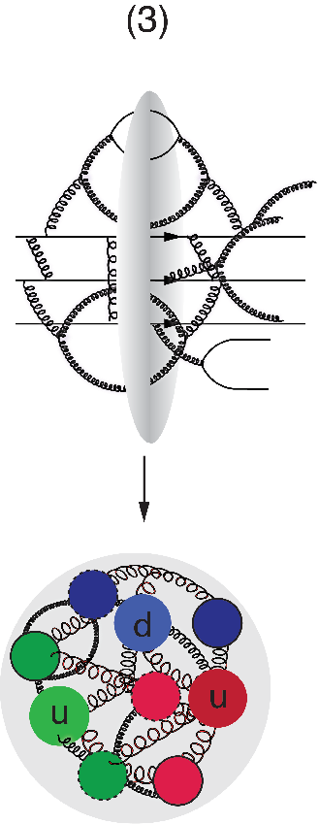
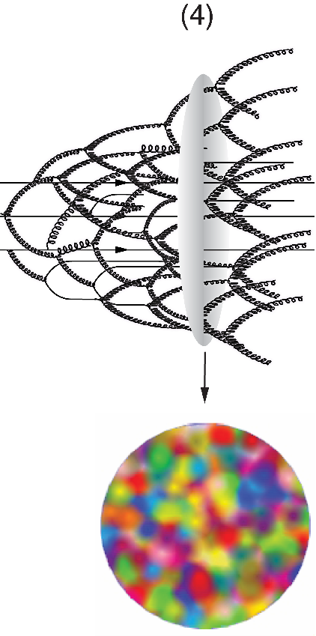
A Look Inside the Boosted Proton
In QCD, the proton is made up of quanta that fluctuate in and out of existence
Boosted proton:
Fluctuations time dilated on strong interaction time scales
Long lived gluons can radiate further small x gluons…
Explosion of gluon density
Δt ∝1/ΔE
electron
momentum

Slide 31
Issues with our Current Understanding
Linear DGLAP Evolution Scheme
built in high energy “catastrophe”
G rapid rise violates unitary bound
Linear BFKL Evolution Scheme
Density along with σ grows as a power of energy
Can densities & σ rise forever?
Black disk limit: σtotal ≤ 2 π R²
Something’s wrong:
Gluon density is growing too fast
⇒ Must saturate (gluons recombine)
What’s the underlying dynamics? Need New Approach
Notes:
… theoretically the energy for a quark in isolation is infinite… Having only a finite amount of energy to work with, Nature always finds a way to short-circuit the ultimate thundercloud.”
Confinement of color-coordinated quarks inside hadrons cancels the “thundercloud” at long distances from the hadron. But the short-circuit mechanism also needs saturation of gluon densities (via gg g recombination) to limit the growth of gluon fields inside the hadron.
DGLAP works well at HERA - signs that linear DGLAP cannot be the final answer
Established Model:
Linear DGLAP evolution scheme
Weird behavior of xG and F_{L} from HERA at small x and Q²
Could signal saturation, higher twist effects, need for more/better data?
Unexpectedly large diffractive cross-section
more severe:
Linear Evolution has a built in high
energy “catastrophe”
xG rapid rise for decreasing x and violation of (Froissart) unitary bound
⇒ must saturate
What’s the underlying dynamics?
Froissard Unitarity Bound: sigma ~ (ln s)²
Regimes of QCD Wave Function
Balitsky-Kovchekov (BK)
Jalilian-Marian, Ianescu, McLerran, Weigert, Leonidov, Kovner

Slide 32
Gluon Saturation
In transverse plane: nucleus/nucleon densely packed with gluons
McLerran-Venugopalan Model:
Weak coupling description of the wave function
Gluon field Aμ~1/g ⇒ gluon fields are strong classical fields!
Most gluons kT ~ QS
kT ~ Qs
pQCD
evolution
equation
New Approach: Non-Linear Evolution:
At very high energy: recombination compensates gluon splitting
Cross sections reach unitarity limit ⇒ saturation
Needs new evolution equations (JIMWLK/BK)
Saturation regime characterized by Q_{s}(x,A)
BFKL:
BK adds:
Notes:
Nuclear small-x wave function is perturbative!
Froissard Unitarity Bound: sigma ~ (ln s)²
Regimes of QCD Wave Function
Balitsky-Kovchekov (BK)
Jalilian-Marian, Ianescu, McLerran, Weigert, Leonidov, Kovner
"Color" in the name "color glass condensate" refers to a type of charge that quarks and gluons carry as a result of the strong nuclear force. The word "glass" is borrowed from the term for silica and other materials that are disordered and act like solids on short time scales but liquids on long time scales. In the "gluon walls," the gluons themselves are disordered and do not change their positions rapidly because of time dilation. "Condensate" means that the gluons have a very high density.

Slide 33
Color Glass Condensate (CGC)
The saturated regime is called a Color Glass Condensate
"Color" in the name refers to the color charge of quarks and gluons
“Glass” is borrowed from the term for silica and other materials that are disordered and act like solids on short time scales but liquids on long time scales. In the CGC the gluons themselves are disordered and do not change their positions rapidly because of time dilation.
"Condensate" means that the gluons have a very high density (there is some speculation if the CGC is a BEC)
The effective theory that describes the CGC is also called the CGC (just to confuse you)
The CGC evolution equation is called JIMWLK and it’s mean field equivalent BK (replacing BFKL)

Slide 34
A Look Inside the “Saturated” Proton
Δt ∝1/ΔE
momentum

Slide 35
N.B.: Important Dual Description of DIS
Dipole Cross-Section:
sat
non-sat
Bjorken frame: Partonic picture of a hadron is manifest. Saturation shows up as a limit on the occupation number of quarks and gluons.
Dipole frame: Partonic picture is no longer manifest. Saturation appears as the unitarity limit (black disk) for scattering. Convenient to resum the multiple gluon interactions.
Dipole frame commonly used to describe diffractive processes
[A. Mueller, 01; Parton Saturation-An Overview]

Slide 36
Nuclear Oomph
Scattering of electrons off nuclei:
Probes interact over distances L ~ (2m_{N} x)⁻¹
For L > 2 R_{A} ~ A^{1/3} probe cannot distinguish between nucleons in front or back of nucleon
Probe interacts coherently with all nucleons
“Expected”
Nuclear Enhancement Factor
(Pocket Formula):

Slide 37
Enhancement of Saturation Scale
Enhancement of Q_{S} with A: saturation regime reached at significantly lower energy in nuclei (and lower cost)

Slide 38
Some Interesting Ideas
Conjecture I:
at very low-x all hadrons QS(x) becomes equal for nucleons, nuclei, mesons, baryons …
maybe even for photons (more later)
truly universal regime
Conjecture II:
as Qs(x) grows towards small-x, Qs becomes the largest scale, hence αs(Q²) → αs(Qs²)
end of the line for αs (as long as Q < Qs) ?
Physics at extreme low-x appears to be a wonderland. Experimentally we might not get there in our life time.

Slide 39
Key Topic in ep: Proton Spin Puzzle
What are the appropriate degrees of freedom in QCD that would explain “spin” of a proton?
After 20 years effort
Quarks (valence and sea): ~30% of proton spin in limited range
Gluons (latest RHIC data): ~20% of proton spin in limited range
Where is the rest?
It is more than the number ½! It is the interplay between the intrinsic properties and interactions of quarks and gluons
Jaffe-Manohar sum rule:
Notes:
\frac{1}{2} = \frac{1}{2}\int_0^1 \mathrm{d}x \Delta\Sigma(x, Q^2) + \int_0^1 \mathrm{d}x \Delta g(x, Q^2) + \sum_q{L_q + L_g}

Slide 40
What Does a Proton Look Like?
In transverse momentum?
In transverse space?
How are these distributions correlated with overall nucleon properties, such as spin direction?
Transverse Momentum Distributions (TMDs):
2D+1 picture in momentum space (kT)
Generalized Parton Distributions (GPDs):
2D+1 picture in coordinate space (bT)
3D Imaging with EIC
S
Å
z

Slide 41
Fragmentation
Color propagation and neutralization
Fundamental QCD Processes:
Partonic elastic scattering
In Nucleus: Gluon bremsstrahlung in vacuum and in medium (E-loss)
Color neutralization
Hadron formation
⎧⎨
⎩
dynamic confinement
Process not understood from first principles (QCD)
Parametrization: Fragmentation Functions
Nuclei as space-time analyzer allows to dissect process

Slide 42
Landscape of QCD

Slide 43
Landscape of QCD
QCD coupling is large, the fields are nonlinear, and the physics is nonperturbative.
What the degrees of freedom describing this
transition region are, is not understood
The coupling becomes weak due to asymptotic freedom, and perturbative QCD describes well the interactions of quarks and gluons.
At large Q², as one moves towards higher parton density, many-body correlations between quarks and gluons become increasingly important.
Total
cross-sections in high energy scattering are dominated
by the physics of small x and low Q². The least understood region
The feature of weak coupling is key because it allows, for the
first time, systematic computations of the manybody
dynamics of quarks and gluons in an intrinsically
nonlinear regime of QCD.

Slide 44
Big Question and what we need to answer them

Slide 45
The Essential Mystery
There is an elegance and simplicity to nature’s strongest force we do not understand
(Nearly) all visible matter is made up of quarks and gluons
But quarks and gluons are not visible
All strongly interacting matter, their properties and dynamics are an emergent consequence of many-body quark-gluon dynamics.
Understanding the origins of matter demands we develop a deep and varied knowledge of this emergent dynamics
Notes:
The animations to the right and above illustrate the typical four-dimensional structure of gluon-field configurations averaged over in describing the vacuum properties of QCD. The volume of the box is 2.4 by 2.4 by 3.6 fm, big enough to hold a couple of protons. Contrary to the concept of an empty vacuum, QCD induces chromo-electric and chromo-magnetic fields throughout space-time in its lowest energy state. After a few sweeps of smoothing the gluon field (50 sweeps of APE smearing), a lumpy structure reminiscent of a lava lamp is revealed. This is the QCD Lava Lamp. The action density (top) and the topological charge density (right) are displayed. The former is similar to an energy density while the latter is a measure of the winding of the gluon field lines in the QCD vacuum.

Slide 46
Driving Fundamental Questions in e+p
Proton
serves as:
⎧
⎪⎪⎨
⎪⎪⎩
How do quark and gluon dynamics generate the proton spin?
What is the role of the orbital motion of sea quarks and gluons in building up the nucleon spin?
How are the sea quarks and gluons distributed in space and transverse momentum inside the nucleon?
How are these distributions correlated with overall nucleon properties, such as spin direction?
Object of
Interest

Slide 47
Driving Fundamental Questions in e+A
Nucleus
serves as:
What is the fundamental quark-gluon structure of atomic nuclei?
Can we experimentally find and explore a novel universal regime of strongly correlated QCD dynamics?
What is the role of saturated strong gluon fields, and what are the degrees of freedom in this strongly interacting regime?
Can the nuclear color filter provide novel insight into propagation, attenuation and hadronization of colored probes?
⎧
⎨
⎩
Object of
Interest
⎧
⎪⎪⎨
⎪⎪⎩
Amplifier
⎧
⎪⎨
⎪⎩
Analyzer

Slide 48
Requirements: What is Needed?
Access to wide range in x and Q²
Large center-of-mass energy (√s) range
Access to spin structure of nucleons and nuclei
Access to 3D spatial and momentum structure of nucleon
Polarized electron and hadron beams
Accessing the highest gluon densities (QS² ~ A⅓)
Nuclear beams, the heavier the better (up to U)
Essential for mapping 3D structure of nucleons and nuclei access to rare probes
Studying observables as a fat of x, Q², A, etc.
High luminosity (100x HERA)

Slide 49
Realization of an EIC

Slide 50
Reality Check
Designing a dream machine is easy but
It has to be fundable
The technology has to be available
Find the parameters that do the job (here EIC White Paper):
Highly polarized (70%) e- and p beams
Ion beams from D to U
Variable center-of-mass energies from √s=20-140 GeV
High collision luminosity 10³³⁻³⁴ cm⁻²s⁻¹ (HERA ~ 10³¹)
Possibilities of having more than one interaction region

Slide 51
Electron-Ion Collider Initiatives
Past
Future
 | HERA@DESY | LHeC@CERN | HIAF@CAS | ENC@GSI | JLEIC@JLab | eRHIC@BNL
√s (GeV) | 320 | 800-1300 | 12-65 | 14 | 20-64 | 32-140
Proton xmin | 1×10⁻⁵ | 5×10⁻⁷ | 3×10⁻⁴ | 5×10⁻³ | 3×10⁻⁴ | 5×10⁻⁵
Ions | p | p … Pb | p … U | p … Ca | p … Pb | p … U
L (cm⁻²s⁻¹) | 2×10³¹ | ~10³⁴ | ~10³²⁻³⁵ | ~10³² | ~10³³⁻³⁵ | ~10³³⁻³⁴
IRs | 2 | 1 | 1 | 1 | 2+ | 2+
Year | 1992-2007 | post ALICE | > 2020 | Fair Upgrade | post 12 GeV | post RHIC
High-Energy Physics
Nuclear Physics
World-wide interest in EIC
All future collider include e+A in their planning

Slide 52
EIC: Kinematic Range
e+p
e+A
EIC cannot compete with e+p at HERA (√s = 318 GeV)
EIC’s strength is polarized e↑+p↑ and e+A collisions
Here the kinematic reach extends substantially compared to past (fixed target) coverage
Q²×20, x/20 for e+A
Q²×20, x/100 for polarized e↑+p↑

Slide 53
US Electron Collider: eRHIC Options
eRHIC (BNL)
Add e Rings to RHIC facility: Ring-Ring (alt. recirculating Linac-Ring)
Electrons up to 18 GeV
Protons up to 275 GeV
√s=30-140 √(Z/A) GeV
L ≈ 1×10³⁴ cm⁻²s⁻¹ at √s=105 GeV
2 IRs
eRHIC
Psync ~ E⁴
eRHIC: pre-CDR in preparation
Notes:
The designed frequency matching scheme allows operation with hadron energies down to 40 GeV/u, but the energies between 46 and 98 GeV/u cannot be used.

Slide 54
US Electron Collider: JLEIC Option
JLEIC (JLab)
Figure-8 Ring-Ring Collider, use of CEBAF as injector
Electrons 3-10 GeV
Protons 20-100 GeV
e+A up to √s=40 GeV/u
e+p up to √s= 64 GeV
L ≈ 2×10³⁴ cm⁻² s⁻¹ at √s=45 GeV
arXiv:1504.07961
Notes:
The designed frequency matching scheme allows operation with hadron energies down to 40 GeV/u, but the energies between 46 and 98 GeV/u cannot be used.

Slide 55
Status of US Based EIC?
2015:
US Nuclear Physics Long Range Plan:
“We recommend a high-energy high-luminosity polarized EIC as the highest priority for new facility construction following the completion of FRIB.”
2018: National Academy EIC Review
“An EIC—with its exceptionally powerful probing capability—would uniquely address profound, fundamental questions about nucleons (neutrons and protons) and their assembly into nuclei of atoms …”
https://www.nap.edu/catalog/25171/an-assessment-of-us-based-electron-ion-collider-science

Slide 56
Department of Energy Process
DOE’s Order 413.3B outlines a series of staged project approvals, referred to as a “Critical Decision (CD)”
CD-0 – Approve Mission Need
CD-1 – Approve Alternative Selection and Cost Range
CD-2 – Approve Performance Baseline
CD-3 – Approve Start of Construction
CD-4 – Approve Start of Operations or Project Completion

Slide 57
Where is the EIC in this Process?
At the very beginning!
CD-0 expected this calendar year (2018)
Important step since the EIC is becoming a “project” and not just a cool idea
Site Selection
somewhere between CD-0 and CD-1
DOE has not hinted how this process will look like
We hope it will be more like this
rather than this

Slide 58
Detectors

Slide 59
Setting the Stage: EIC Detector(s)
Consensus within the EIC community:
A least 1 general purpose detector
Needs for a second detector - majority favors a second general purpose detector instead of more specialized detector
Arguments for 2 detectors similar as for every collider
The 2 detectors should be complementary (different strengths) - success of combined HERA data is good example
Both machine designs include at least 2 IRs

Slide 60
General Purpose EIC Detectors
Backward
Forward

Slide 61
General Purpose EIC Detectors
Backward
Forward
Magnet
Originally many solutions discussed (Dipole, Toroid, …)
Focus now on Solenoidal Magnet
Compact EIC detector requires large fields: B ~ 3T
Available magnet: BaBar B = 1.5 T
No ongoing R&D

Slide 62
General Purpose EIC Detectors
Backward
Forward
blue = ongoing R&D
Polarization/Luminosity
Electron Polarization: Compton Process (need 1% or better)
Proton/Light Ion Polarization: experience from RHIC but tighter requirements at EIC
Luminosity Measurements

Slide 63
General Purpose EIC Detectors
Backward
Forward
blue = ongoing R&D
Barrel
Si-Vertex tracker: low X/X0, resolve charm vertices ⇒ MAPS, ….
Main tracker: p, dE/dx ⇒ TPC, Si-Tracker, GEM, MMG, μRWELL, …
Particle ID (PID): p < 10 GeV ⇒ DIRC, EMCal, …
EM Calorimetry: e/h, γ, π⁰, …
Hadron Calorimetry: jets (neutral component) ⇒ optional
Muon Detector: vector mesons ⇒ optional

Slide 64
General Purpose EIC Detectors
Backward
Forward
Forward
Si-Vertex tracker: resolve charm vertices ⇒ MAPS, ….
Tracker: p ⇒ GEM, MMG, μRwell, …
Particle ID (PID): p < 50 GeV ⇒ RICH, TRD, …
EM Calorimetry: E, e/h, γ, π0, …
Hadron Calorimetry: E, e/h, jets ⇒ high resolution needed

Slide 65
General Purpose EIC Detectors
Backward
Forward
Very Forward
Nuclear Breakup/Fragments: ZDC, Roman Pots, Forward proton detector
Proton pT, t measurement: Roman Pots

Slide 66
General Purpose EIC Detectors
Backward
Forward
Backward
Si-Vertex tracker
Tracker: p ⇒ GEM, MMG, μRwell, …
Particle ID (PID): ⇒ RICH, EMCal
EM Calorimetry: E, e/h ⇒ high resolution needed

Slide 67
General Purpose EIC Detectors
Backward
Forward
Very Backward
Access to low Q² region: Low Q2 tracker

Slide 68
Challenges
Big View:
Hermetic detector, low mass inner tracking
good PID (e and π/K/p)
extreme requirements in forward region
Good calorimetry
HCAL: extreme req. in forward region
EMCAL: extreme req. backwards region
Moderate radiation hardness requirements, low pile-up, low multiplicity
Challenges:
PID
EMCal at 2%/√E
p (GeV/c)

Slide 69
R&D Driver: Requirements
From R&D Handbook (later more)

Slide 70
Generic EIC Detector Concepts
Brookhaven concept: BEAST
Jefferson lab concept: JLEIC
Current Concepts
Important as test bed for detector R&D
Each attempt to match requirements
Nothing is cast in stone
Will evolve as new concepts are developed
sPhenix → ePhenix
Argonne concept: TOPSiDE

Slide 71
BEAST (Brookhaven eA Solenoidal Tracker)
-3.5 < η < 3.5: Tracking & e/m Calorimetry (hermetic coverage)
hadronic calorimeters
e/m calorimeters
RICH detectors
9.0m
hadrons
electrons
silicon trackers
TPC
GEM trackers
Micromegas barrels
3T solenoid cryostat
magnet yoke

Slide 72
JLEIC Concept Detector
Similar concept to BEAST
Vertex detector
Central tracker (all options – TPC considered)
Forward tracking
Cerenkov detectors
Electromagnetic calorimeters
Hadron calorimeter in the forward and barrel region (new), possible in rear direction
Muon chambers considered
RICH
ECAL

