Slide 1
Physics of a U.S.-Based Electron Ion-Collider
Thomas Ullrich (BNL/Yale)
Initial Stages 2017
Kraków, September 22, 2017

Slide 2
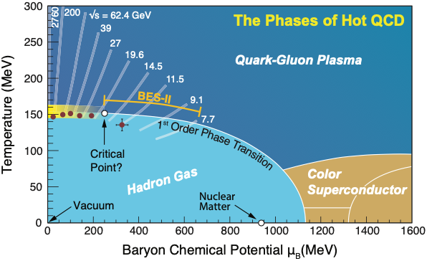
QCD Landscape (T ≥ 0 Picture)
Physics of the “Initial State” is not encapsulated in this Phase Diagram

Slide 3
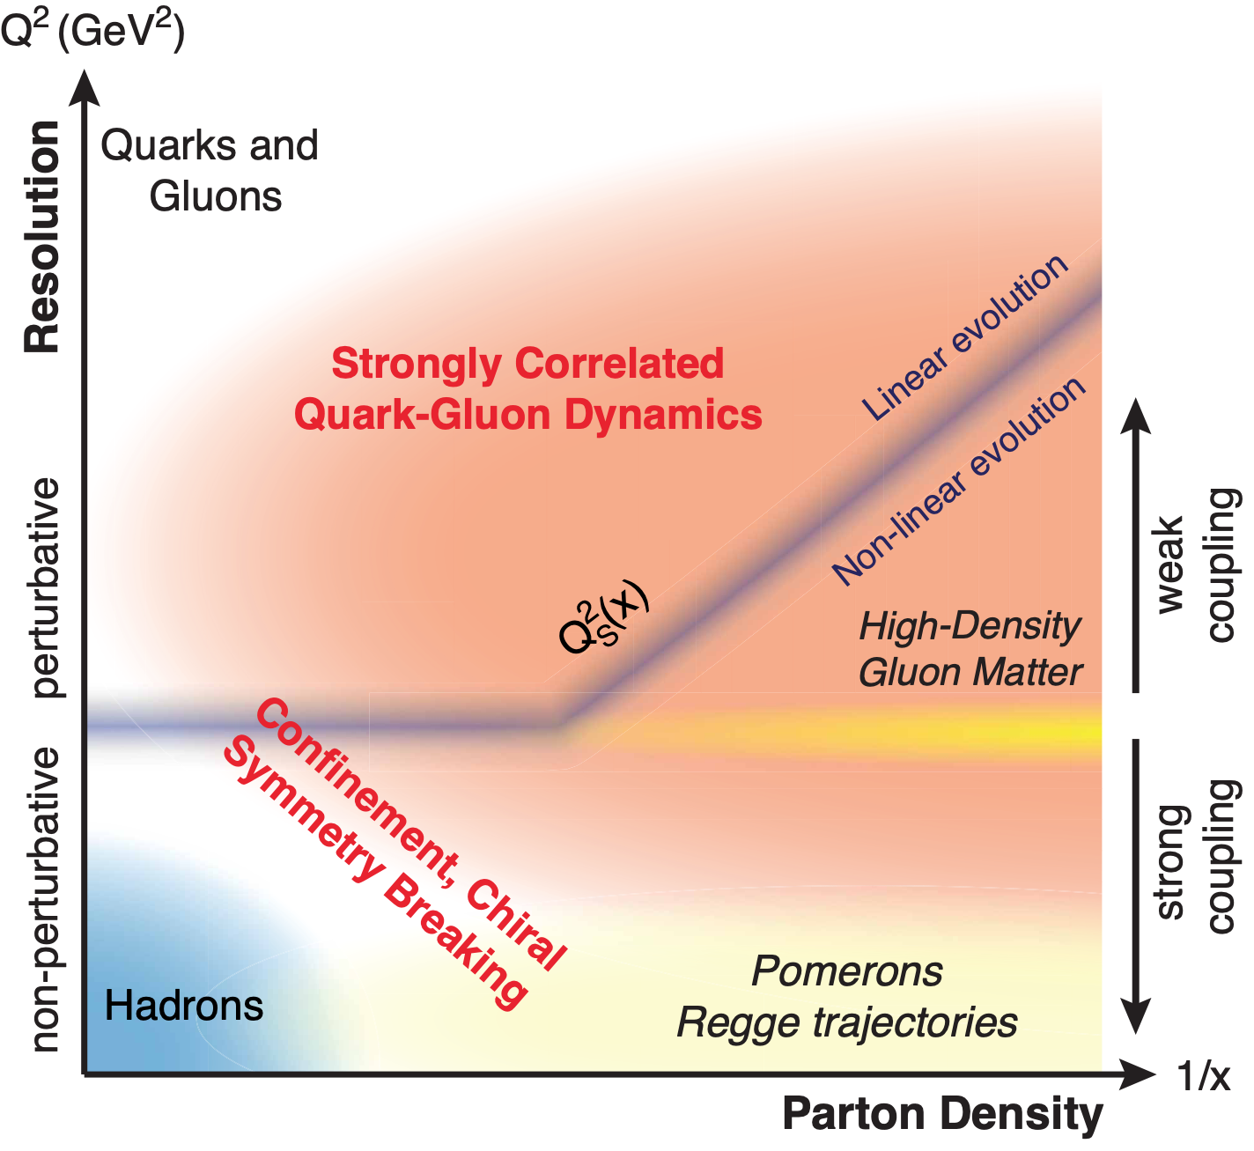
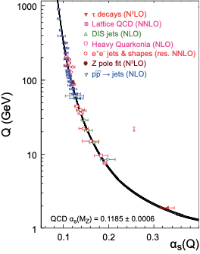
QCD Landscape (x-Q² Picture)
Strong to Weak
While quarks and gluons (partons) anchor one corner of this landscape, and hadrons another, our knowledge of the dynamics of the rest is fragile
Notes:
TOP: QCD at high resolution (Q2) —weakly correlated quarks and gluons are well-described
CGC: An exciting opportunity: Observation by EIC of a new regime in QCD of weakly coupled high density matter

Slide 4
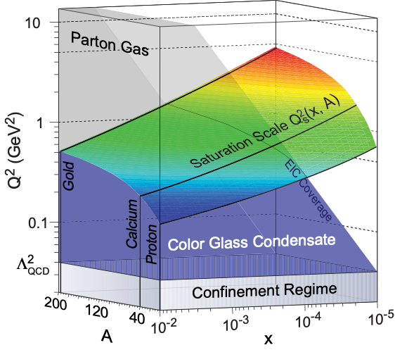
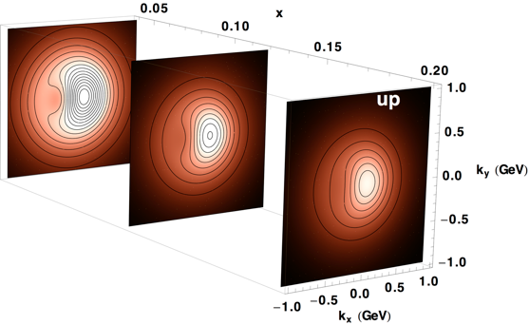
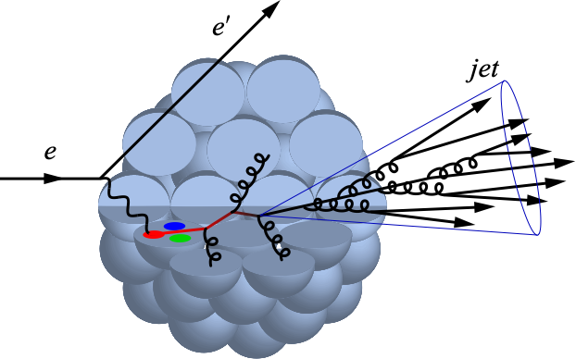
Electron-Ion Collider
Impact on Heavy-Ion Collisions
Not a driving theme … but
… EIC will map regions and dynamic of QCD that are relevant for our understanding of heavy-ion collisions and the much discussed small system phenomena
Initial state
Impact of saturation phenomena
Hadronization of colored probes
N.B.: In photo-production limit (Q²≈0) results in eA match on to p+A correlations (e.g. ridge)
Four Central Themes:
Saturation
CGC & non-linear evolution
Spin of the proton
Helicities of quarks and gluons and their orbital motion?
Imaging in nucleons and nuclei
TMDs, GPDs, Wigner Function
Hadronization and fragmentation
Propagation, attenuation

Slide 5
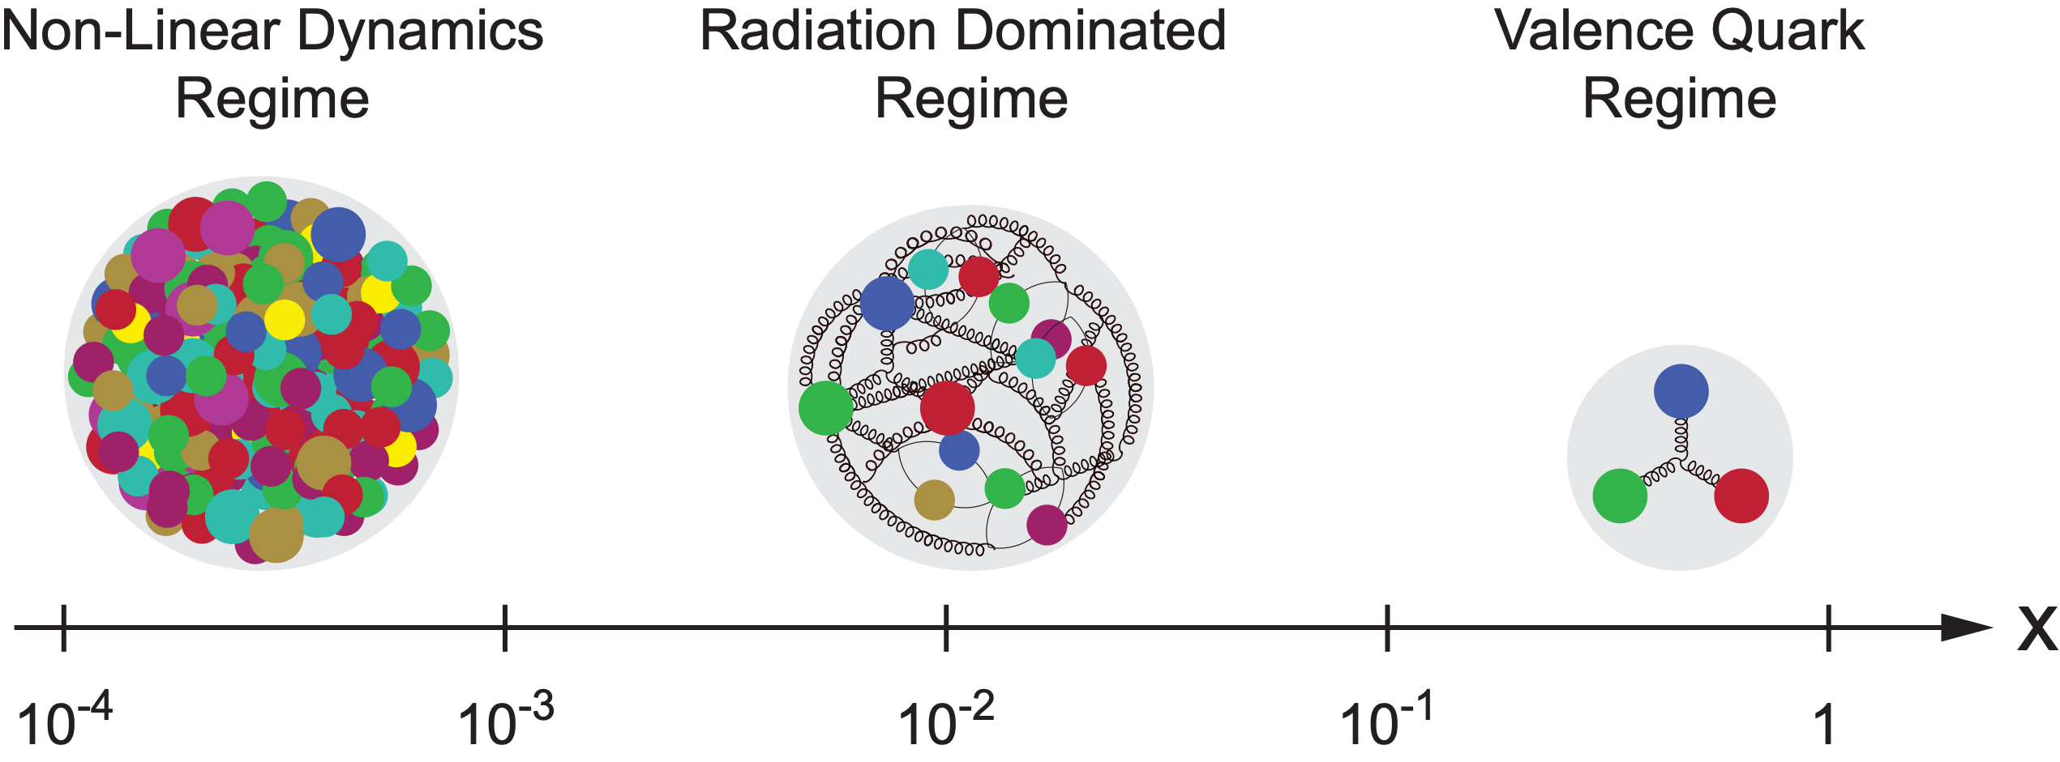
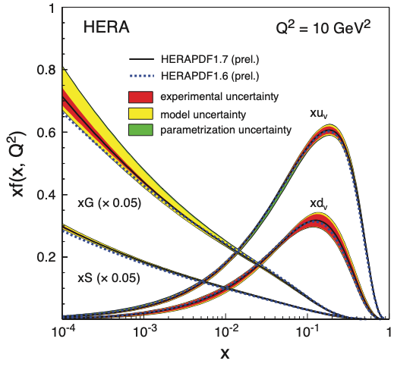
EIC Science: Requirements
Large center-of-mass coverage
Access to wide range in x and Q²
Polarized electron and hadron beams
Access to spin structure of nucleons and nuclei
Spin vehicle to access 3D spatial and momentum structure of the nucleon
Nuclear beams
Accessing the highest gluon densities (QS² ~ A^{⅓})
High luminosity
Essential for mapping 3D structure of nucleons and nuclei access to rare probes

Slide 6
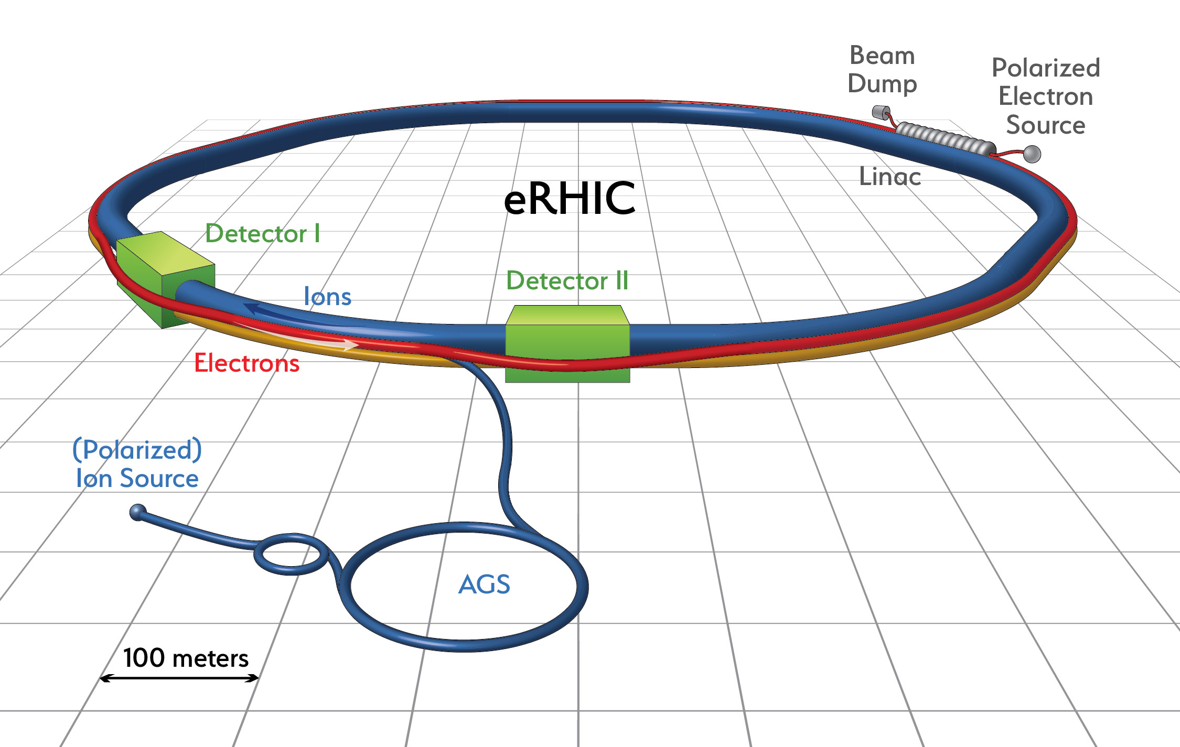
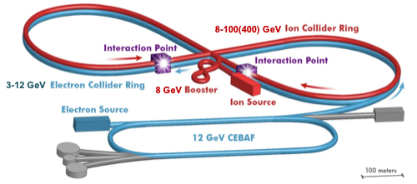
US Electron Collider: Realization
eRHIC (BNL)
Add e Rings to RHIC facility: Ring-Ring (alt. recirculating Linac-Ring)
Electrons up to 18 GeV
Protons up to 275 GeV
√s=30-140 √(Z/A) GeV
L ≈ 1×10³⁴ cm⁻²s⁻¹ at √s=105 GeV
JLEIC (JLab)
Figure-8 Ring-Ring Collider, use of CEBAF as injector
Electrons 3-10 GeV
Protons 20-100 GeV
e+A up to √s=40 GeV/u
e+p up to √s= 64 GeV
L ≈ 2×10³⁴ cm⁻² s⁻¹ at √s=45 GeV
eRHIC: arXiv:1409.1633, JLEIC: arXiv:1504.07961
Notes:
The designed frequency matching scheme allows operation with hadron energies down to 40 GeV/u, but the energies between 46 and 98 GeV/u cannot be used.

Slide 7
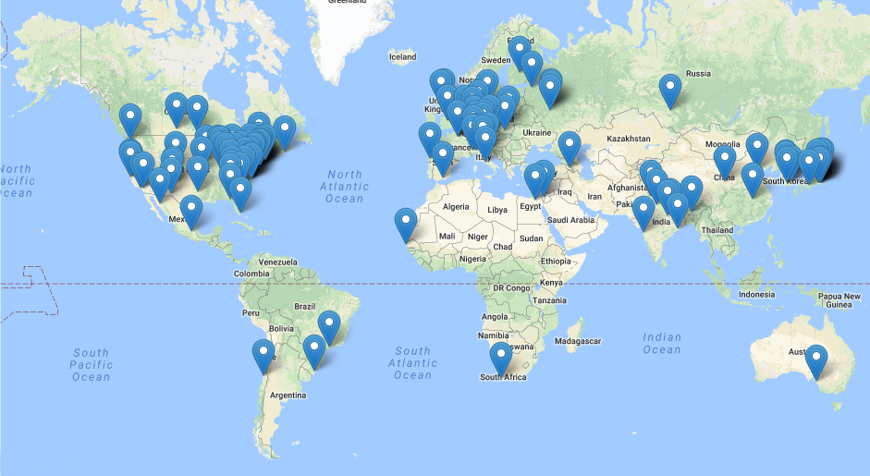
EIC Project Status
2015: Long Range Plan of U.S. nuclear physics community recommends an EIC as the highest priority for new facility construction.
2016: Organize EIC Users Group (http://www.eicug.org)
2017: National Academy of Sciences Review of EIC
Assess the scientific justification for a US EIC
Expect report around March 2018
708 member
162 institutions
29 countries
2018: CD-0*
Indicated by T. Hallman, Associate Director for NP of the Office of Science at DOE at the EIC Users’ Group Meeting in Trieste in July 2017

Slide 8
Examples of Key Measurements with Impact on Heavy-Ion Physics
Assessing the Energy Dependence of Key Measurements
(arXiv:1708.01527)

Slide 9
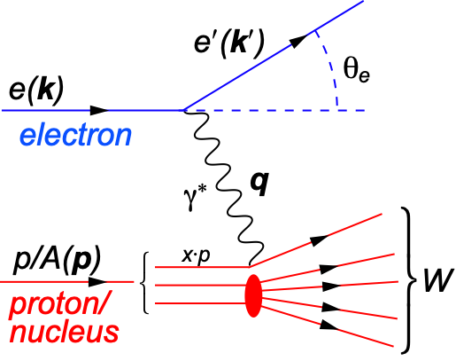
DIS and Structure Functions
s: center-of-mass energy squared
Q²: resolution power
x: momentum fraction of parton
y: inelasticity
Inclusive ep/eA collisions:
quark+anti-quark
momentum distributions
gluon momentum distribution
Note: FL(x, Q²) implies measurements at different s

Slide 10
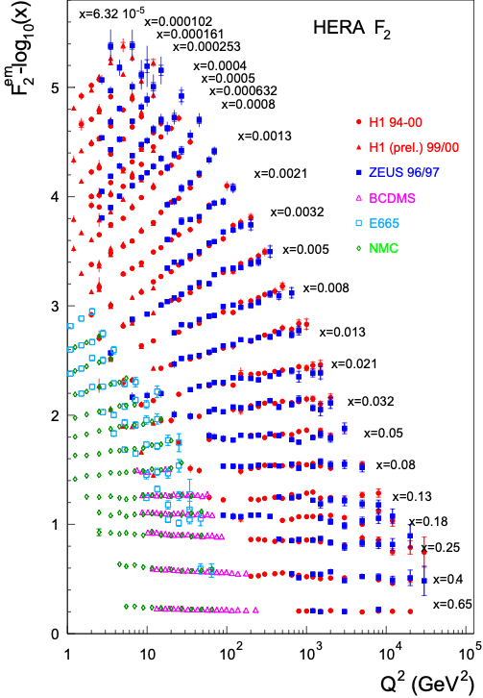
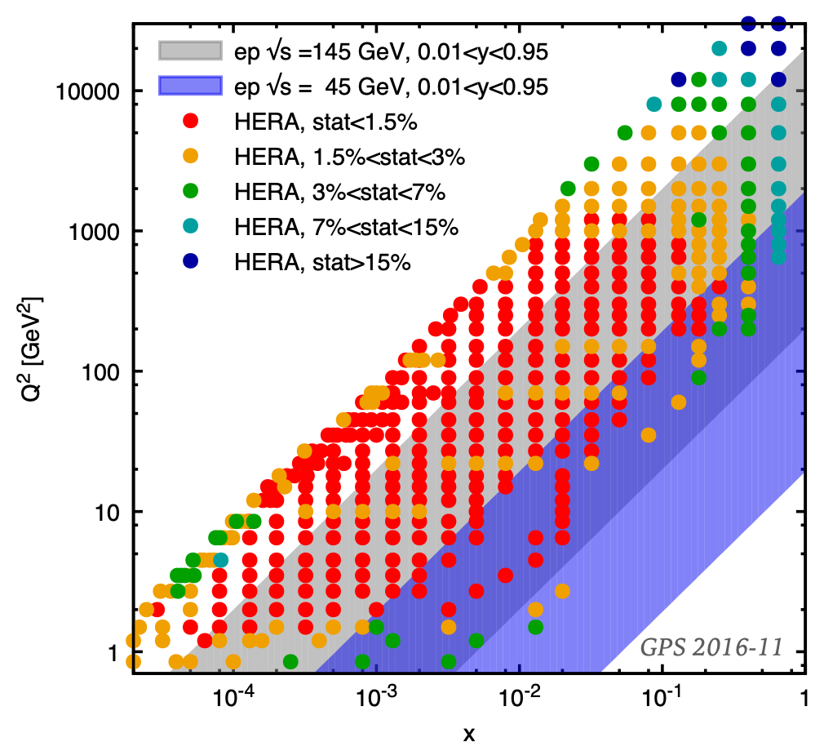
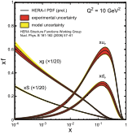
Parton Distribution Functions
Gluon PDFs via
Scaling violation dF2 /dlnQ²
Charm production
Directly via FL (~G(x,Q²))
proton PDFs well known thanks to ep at HERA
EIC (high √s version) can improve in ep at large-x, large-Q²
proton
pQCD/
DGLAP
in
LO
NLO
NNLO
…
Notes:
W2 can also be interpreted as the center-of-mass energy of the gauge boson nucleon system.
Q2 max = s
Q2: negative square of the momentum transfer q, denotes virtuality
x: make Remark that for e+p 0 < x < 1 while for e+A scattering 0 < x < A.
y: is the fraction of the lepton’s energy lost in the nucleon rest frame. It it thus also the fraction of the incoming electron energy (also known as inelasticity) carried by the exchange boson (photon) in the rest frame of the nucleon
Q^2 &=& -q^2 = - (k-k^\prime)^2 \\
&\approx& 4 E E^\prime \sin^2\left(\frac{\theta}{2}\right)

Slide 11
Nuclear PDFs
nPDFs less well known due to lack of data
Theory/models have to be able to describe the structure functions and their evolution
DGLAP:
predicts Q² but not A and x dependence
Saturation models (JIMWLK):
predict A and x dependence but not Q²
Need: large Q² lever-arm for fixed x, A-scan
EIC: Aim at extending our knowledge on structure functions into the realm where gluon saturation effects emerge ⇒ different evolution (JIMWLK)

Slide 12
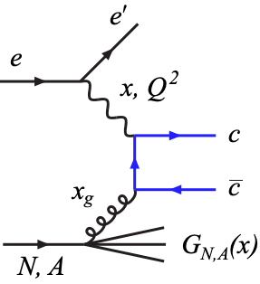
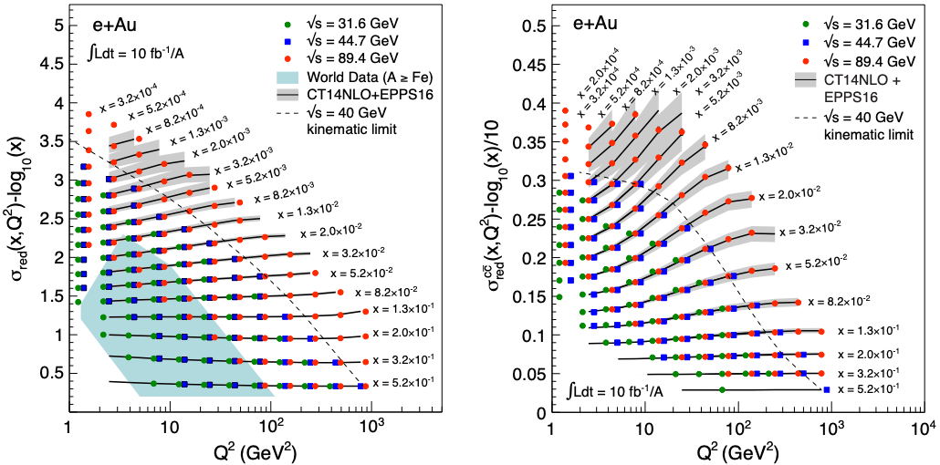
EIC: Structure Functions in eA
EIC pseudo-data
FL, F2, σred, F2^{cc} values from EPPS16
Errors (sys and stat.) from simulations for ∫Ldt=10 fb⁻¹/A
arXiv:1708.01527, 1708.05654

Slide 13
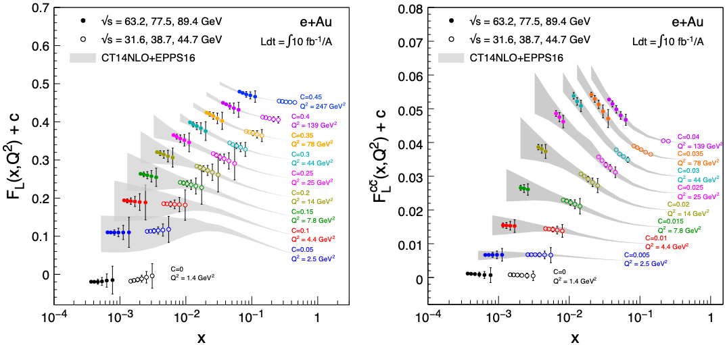
EIC: FL Structure Function
FL probes glue more directly
FL is small and requires running at different √s and thus has larger systemic uncertainties than F2
Dramatic improvements with EIC at highest energy

Slide 14
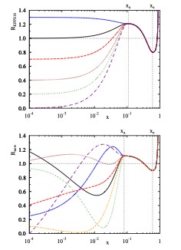
EIC’s Impact on nPDFs
Methods:
Use σred (includes F2 and FL) pseudo data
Re-weighting EPPS16
EPPS16 is a bit stiff at low-x, over-constraints at low-x
EPPS16* (arXiv:1708.05654, Hannu Paukkunen)
more flexible form cures EPPS16 problem
might underestimate impact?
Notes:
Inclusive DIS cross-section, simplified (reduced) by dividing out the Mott cross-section.

Slide 15
EIC’s Impact on nPDFs (Rglue)
Improves uncertainties substantially out to 10⁻⁴
Shrinks uncertainty band by factors 4-8
Charm: no additional constraint at low-x but dramatic impact at large-x
Highest EIC √s is key for low-x reach
Q² ~ 1.7 GeV²
Q² ~ 10 GeV²

Slide 16
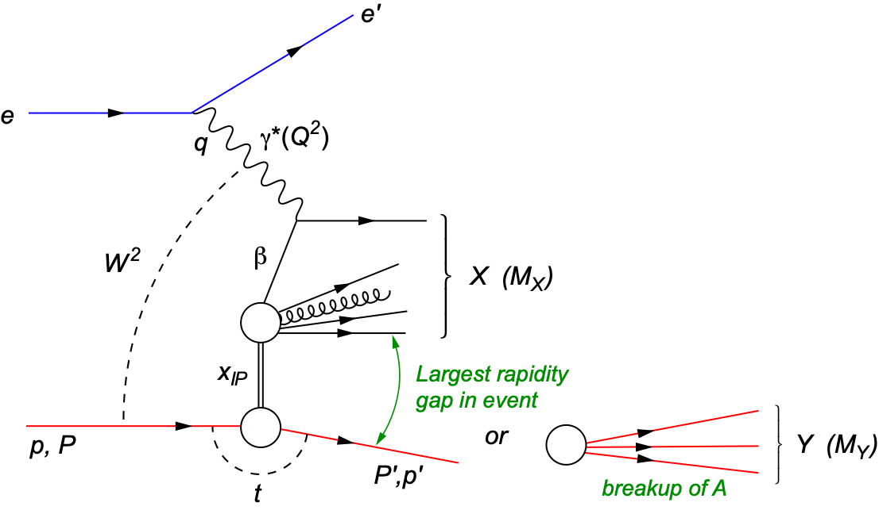
Diffraction for the 21st Century
Diffractive physics will be a major component of the e+A program at an EIC
High sensitivity to gluon density: σ~[g(x,Q²)]² due to color-neutral exchange
Only known process where spatial gluon distributions can be extracted (relevant for HI)
HERA: σdiff/σtot ~ 14%
t: momentum transfer
squared
MX: mass of diffractive final-state
coherent
incoherent
p/A stays intact
p/A breaks up

Slide 17
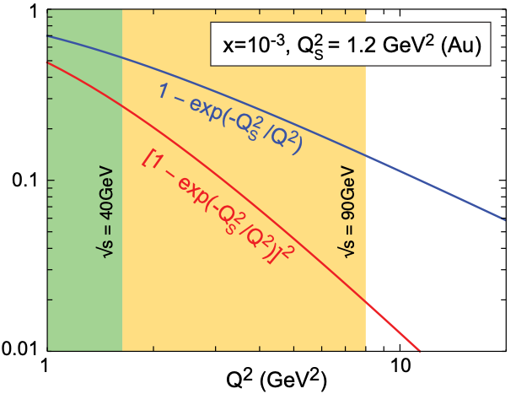
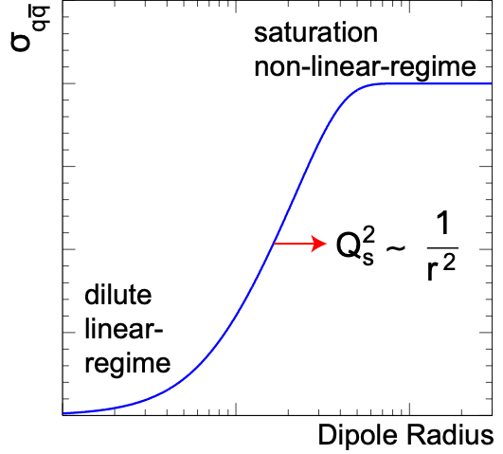
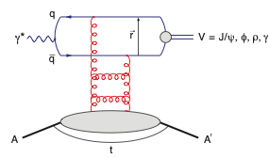
Exclusive Diffractive Vector Meson Production
Allows to measure momentum transfer t in eA
in general, cannot detect the outgoing nucleus and its p
Here:
Apropos dipole cross-section:
Dipole Cross-Section:
sat
non-sat
small size (J/Ψ): cuts off saturation region
large size (φ,ρ, ...): “sees more of dipole amplitude” → more sensitive to saturation
J/ψ
ϕ
Notes:
This quantity changes by a factor 25 over
the Q2 range at ps = 90 GeV, but only by 1.7 for
the lower center-of-mass energy.

Slide 18
Spatial Gluon Distribution from dσ/dt
Diffractive vector meson production:
e + Au → e′ + Au′ + J/ψ, φ, ρ
Momentum transfer t = |pAu-pAu′|² conjugate to bT
~
t = Δ²/(1-x) ≈ Δ²
PRC 87 (2013) 024913
Converges to input F(b) rapidly: |t| < 0.1 almost enough
Provides constraints on nuclear GPDs
Notes:
spin-dependent gluon distribution

Slide 19
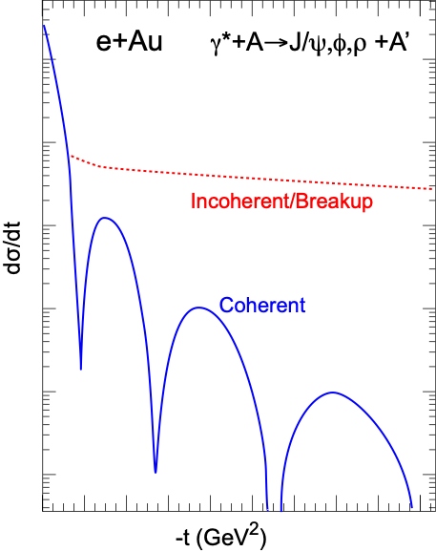
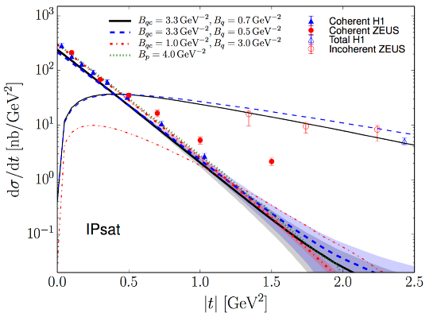
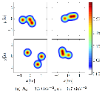
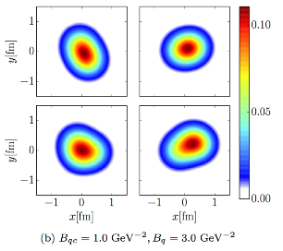
Importance of Incoherent Diffraction
Nucleus dissociates: f ≠ i
Incoherent CS is the variance of the amplitude ⇒ measure of fluctuation of the source G(x, Q², b)
Substantial impact on understanding of A+A, p+A correlations/shape fluctuations
Example from ep(see Bjorn’s talk):
H. Mäntysaari,
B. Schenke,
PRL 117 (2016) 052301
Notes:
\begin{eqnarray*}
\sigma_\text{incoherent} &\propto & \sum_{f \neq i} \left< i|{\cal{A}}|f \right>\left< f|{\cal{A}}|i \right>\\
&=& {\color{blue} \left< |{\cal{A}}|^2 \right> } - {\color{red}\left< |{\cal{A}}| \right>^2}
\end{eqnarray*}
\color{red}\frac{\text{d}\sigma_\text{coherent}}{\text{d} t} = \frac{1}{16 \pi} \left< |{\cal A}| \right>^2

Slide 20
EIC: Gluon TMDs from Dijet Production
Thus far, focus on quark TMDs while the available studies of gluon TMDs are sparse
Of particular interest: WW gluon distribution G⁽¹⁾ and its linearly polarized partner hT⁽¹⁾ inside unpolarized hadron
These gluon distributions play also central role in small-x saturation phenomena.
G⁽¹⁾ and hT⁽¹⁾ can be accessed through measuring azimuthal anisotropies in processes such as jet pair (dijet) production in e+p and e+A scattering.
A. Metz and J. Zhou, Phys. Rev. D84 , 051503 (2011), arXiv:1105.1991.
D. Boer, P. J. Mulders, and C. Pisano, Phys. Rev. D80 , 094017 (2009), arXiv:0909.4652
D. Boer, S. J. Brodsky, P. J. Mulders, and C. Pisano, Phys. Rev. Lett. 106 , 132001 (2011), arXiv:1011.4225.
F. Dominguez, J.-W. Qiu, B.-W. Xiao, and F. Yuan, Phys. Rev. D85 , 045003 (2012), arXiv:1109.6293.
A. Dumitru, L. McLerran, and V. Skokov, Phys. Lett. B743 , 134 (2015), arXiv:1410.4844.
A. Dumitru and V. Skokov, Phys. Rev. D91 , 074006 (2015), arXiv:1411.6630.
A. Dumitru, T. Lappi, and V. Skokov, Phys. Rev. Lett. 115 , 252301 (2015), arXiv:1508.04438.
A. Dumitru and V. Skokov, Phys. Rev. D94 , 014030 (2016), arXiv:1605.02739.
Notes:
(WW) gluon distribution (G(1)) + linearly polarized partner (h(1))

Slide 21
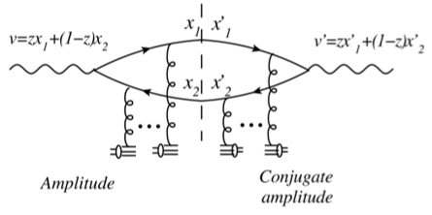
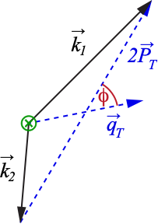
Kinematics: Dijets in γ*A
Key observables: PT and qT
the difference in momenta (imbalance)
the average transverse momentum of the jets
φ is angle between PT and qT
work in “correlation limit” PT >> qT
azimuthal asymmetry arising from the linearly polarized gluon distribution: v2 = ⟨cos 2φ⟩
Dominguez, Marquet, Xiao, Yuan, PRD 2011
Notes:
Dijet production in e+A at high energies originates from long-ranged eikonal interactions ⇒ parameterizing the azimuthal structure arising from the linearly polarized gluon distribution also in terms of v2
“Correlation limit” PT >> qT involves only 2-point functions / TMDs
z: lightcone momentum fractions

Slide 22
Elliptic Anisotropy in DiJet Production (I)
Dipartons from McDijet event generator (V. Skokov) → showers via Pythia → experimental cuts → jet-finding with ee-kt (FastJet)
All polarizations
Trans. γ*
Long. γ*
Dijets recover the anisotropy (v2) quite well
NOTE: phase shift between long. and trans. γ* (dominated by T)
Gluon TMDs via:
A. Dumitru, T. Lappi, and V. Skokov, Phys. Rev. Lett. 115 , 252301 (2015), arXiv:1508.04438.

Slide 23
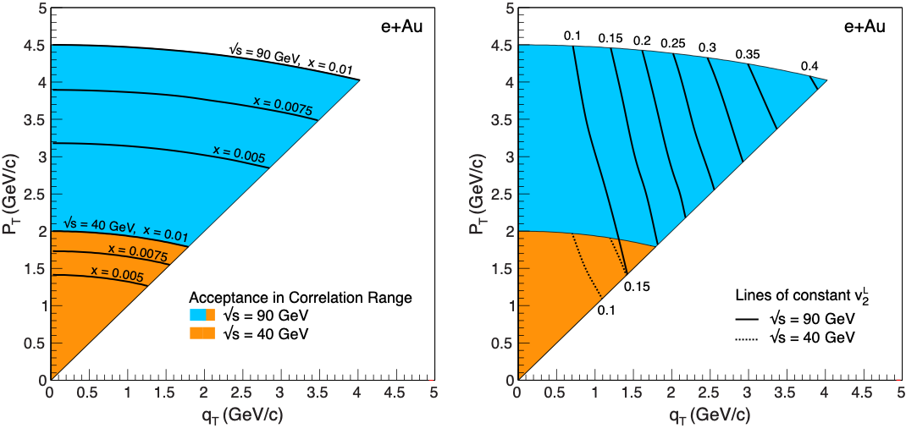
Elliptic Anisotropy in Dijet Production (III)
Detailed simulations show that the in eA an EIC can perform this challenging measurement
Can separate background from signal djets
Can separate v2^{L} and v2^{T}
Measurement requires large EIC energies (~ √s = 90 GeV)

Slide 24
Relation to Chiral Magnetic Effect
RHIC & LHC: intriguing hints of CME
Key challenge: understanding dynamics of axial charge production during the very early pre-equilibrium stages (see talk by Niklas Mueller)
Tuomas Lappi, Soren Schlichting, arXiv:1708.08625
Chern-Simons current correlator (the source of axial charge)
Immediate link between dijet DIS (and TMDs) and CME

Slide 25
Summary
EIC effort is making excellent progress
Strong and large user community (eicug.org)
NP Long Range Plan recommendation for construction
Ongoing National Academy of Science review
CD-0 likely in 2018 after release of NAS report
Physics studies continue enriching the EIC’s program
Recent: assessments of energy dependence of key measurements (arXiv: 1708.01527)
Impact of EIC eA program on Heavy-Ions Physics will be substantial
Initial state: nPDFs, nTMDs, nGPDs (not studied yet), spatial gluon distribution, CME, …
Role of saturation in p/A+A and impact on final state
Energy loss, attenuation in cold matter (not discussed here)

Slide 26
Backup Slides

Slide 27
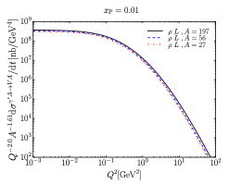
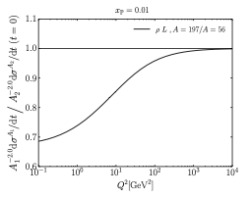
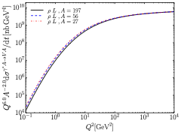
Q² and A Scaling of Diffractive VM Production
Saturation models predict very special and strong dependencies in A and Q² that are different above and below Q²S
Q² > Q²S
σ ~ 1/Q⁶
σ(t=0) ~ A²
σ ~ A^{4/3}
Q² < Q²S
σ ~ Q²
σ(t=0) ~ A^{4/3 ↔︎} A^{5/3}
σ ~ A^{2/3 ↔︎} A
Q² scaling
t = 0
A² scaling
1/Q⁶ scaling
H. Mantysaari and R. Venugopalan
Non-Saturation models do not show this behavior making A, Q² dependencies a key measurement

Slide 28
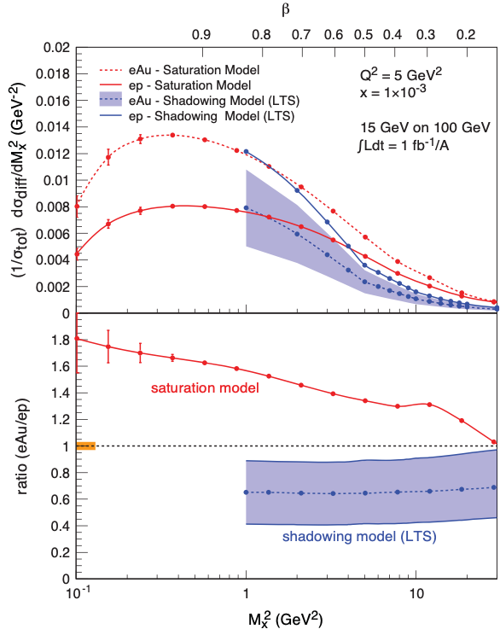
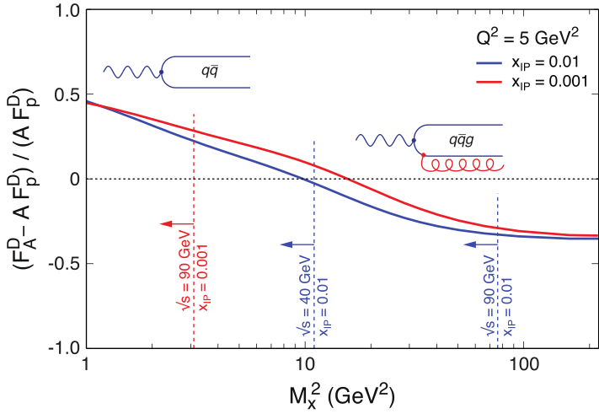
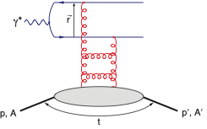
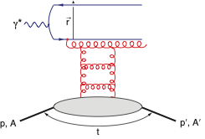
Day 1 Measurement: σdiffractive/σtotal
Sign Change:
HERA observed: ~14% of all events are diffractive
Saturation models (CGC) predict up to σdiff/σtot ~ 25% in eA
Ratio enhanced for small MX and suppressed for large MX
Standard QCD predicts no MX dependence and a moderate suppression due to shadowing.
Nucleus is “blacker” than proton. Elastic scattering probability of a qq̅ dipole is maximal in the “black” limit
qq̅g component vanishes in black disk limit
Observing these dependencies
on M_{x} over a wide range in x and Q² is crucial to study saturation.
Maximizing √s is key
Unambiguous signature for reaching the saturation limit
Notes:
Dipole cross-section is closer to the unitarity limit than the proton - it is “blacker”. The elastic scattering probability of a qq̅ dipole is maximal in the “black” limit
The qq̅g component is suppressed for nuclei compared to the proton.
This is due to the fact that in a nucleus the scattering amplitude
is closer to the unitarity limit when the qq̅g component vanishes
different b -dependences from each other and from the inclusive
cross section. The q ¯q -component is enhanced at small b (closer to the black disk limit),
whereas the q ¯qg -part is dominated by larger b (because it vanishes in the black disk limit).
Depending on the mass of the diffractive system MX
or, equivalently, , the diffractive structure function is
dominated by either the q ¯q or q ¯qg Fock states.
invariant mass of the diffractive system is large, and
this large phase space is filled by radiation of additional
gluons, each of them being suppressed by
alpha_s .
The q ¯q -components of
the FD
2A are enhanced compared to A times the proton
diffractive structure functions. This is to be expected,
because of the fact that in a gold nucleus the dipole cross
section is, on average over the transverse area, closer to
the unitarity limit than the proton - it is “blacker”. The
elastic scattering probability of a q ¯q dipole is maximal in
the “black” limit and the approach to it is quicker in a
large nucleus. The q ¯qg component, on the other hand,
is suppressed for nuclei compared to the proton. This is
due to the fact that in a nucleus the scattering amplitude
is closer to the unitarity limit when the q ¯qg component
vanishes, as can be seen e.g. from Eq. (13). This
leads to a nuclear suppression of the diffractive structure
function in the small region, where the q ¯qg component
dominates. The net result of the different contributions
is that FD
2A , for a large range in , is close to AFD
2p .

Slide 29
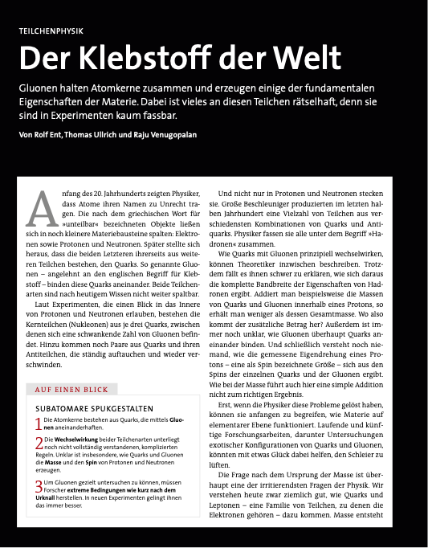
EIC: Documenting the Physics Case
2010:
INT Workshop on EIC Science Case
(arXiv:1108.1713 )
2012/2014:
White Paper defines Science Case of an EIC (Eur. Phys. J. A52 (2016), arXiv:1212.1701)
Scientific American (May 2015)
The Glue That Binds Us
by R. Ent, R. Venugopalan, TU
2017:
Assessing the Energy Dependence of Key Measurements
(arXiv:1708.01527)

Slide 30
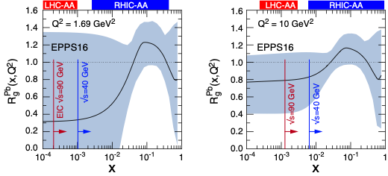
Impact on Heavy-Ion Program
AA and pA studies require nPDFs
nPDFs themselves not constrained by AA measurements
pA has only moderate impact (see arXiv:1612.05741) on improving nPDFs so far
LHC/RHIC: |y|<1
Only eRHIC energies constrain nPDFs for A-A and p-A program at the LHC

Slide 31
At large Q2, as one
moves towards higher parton density, many-body
correlations between quarks and gluons become increasingly
important.
the coupling becomes weak due
to asymptotic freedom, and perturbative QCD describes
well the interactions of quarks and gluons.
At very large parton densities, or small x,
gluon degrees of freedom become dominant
The feature of weak coupling is key because it allows, for the
first time, systematic computations of the manybody
dynamics of quarks and gluons in an intrinsically
nonlinear regime of QCD.
what the degrees of freedom describing this
transition region are, is not understood
Total
cross-sections in high energy scattering are dominated
by the physics of small x and low Q2.
QCD coupling is large,
the fields are nonlinear, and the physics is nonperturbative.
the least understood
Notes:
TOP: QCD at high resolution (Q2) —weakly correlated quarks and gluons are well-described
CGC: An exciting opportunity: Observation by EIC of a new regime in QCD of weakly coupled high density matter

Slide 32
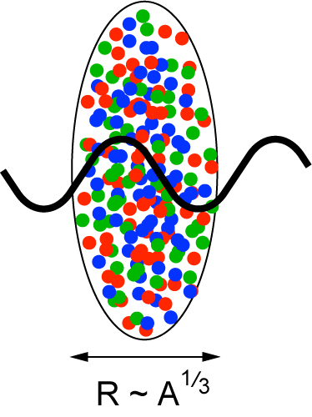
Gluon Saturation in Nuclei: The Oomph
Probes interact over distances L ~ (2m_{N} x)⁻¹
Probe interacts coherently with all nucleons for L > 2 R_{A} ∼ A^{1/3}
Enhancement of Q_{S} with A: saturation regime reached at significantly lower energy in nuclei (and lower cost)
Nucleus serves as amplifier of the saturation scale

Slide 33
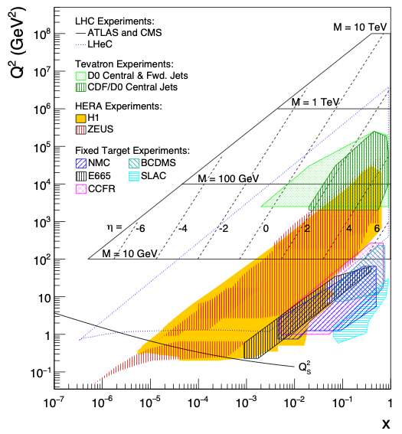
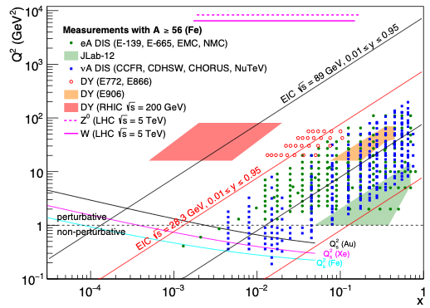
Gluon Saturation: Past Experimental Reach
HERA (ep)
Marginal reach of Qs
Only at low Q² making comparison with perturbative QCD impossible
Fixed Target DIS Experiment
eA, μA, νA
Same marginal reach
Only at low Q² (Q² < 1 GeV²)

Slide 34
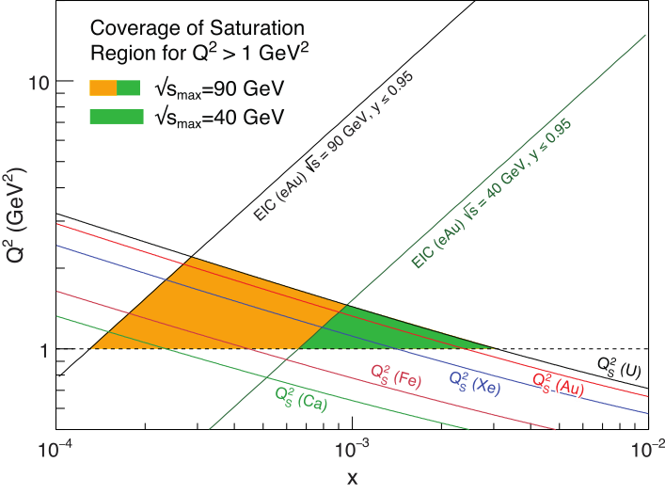
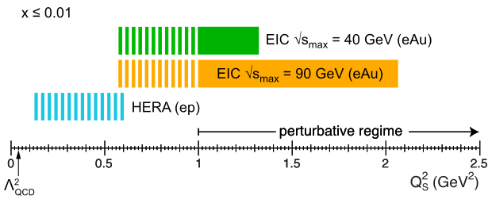
Gluon Saturation: √s Matters
Future EIC:
Need to push into regime where comparison with our current understanding can be made ⇒ Q² > 1 GeV/c²
Require lever arm in Q, x, and A to study evolution
Need to push for highest energy (money can afford) and heaviest ions

Slide 35
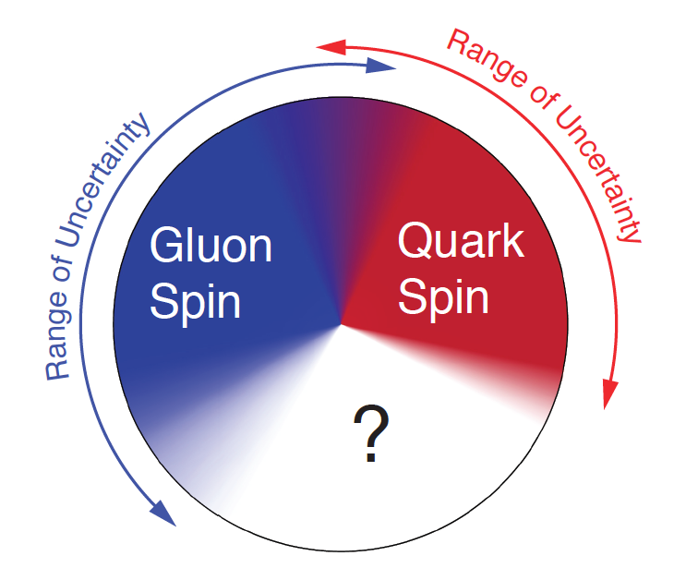
Proton Spin Puzzle
What are the appropriate degrees of freedom in QCD that would explain the “spin” of a proton?
After 20 years effort
Quarks (valence and sea): ~30% of proton spin in limited x-range
Gluons (latest RHIC data): ~20% of proton spin in limited x-range
Where is the rest?
It is more than the number ½! It is the interplay between the intrinsic properties and interactions of quarks and gluons
Notes:
If we do not understand the proton spin, we don’t understand QCD

Slide 36
EIC: Longitudinal Spin of the Proton
Inclusive Measurement:
e+p → e′+X
Leading Order:
(Quark Spin)
Higher Order:
(Gluon Spin)
The polarized structure function g1(x,Q²) is key to our understanding of the spin of the proton
but
it is very √s demanding
Notes:
Mention: not even sign of L is constraint
polarized
gluon Δg(x,Q2) and quark Δq(x,Q2) distribution
Figure 2-5 shows the running integral
!"!ΔΣ(!, !!) !!!"#, which represents the contribution of all quark flavors to the spin of the proton
experimental access to the ∆f in lepton- scattering is obtained through the spin-dependent structure function g1(x,Q2), which ap- pears in the polarization difference of cross sections when the lepton and the nucleon collide with their spins anti-aligned or aligned:

Slide 37
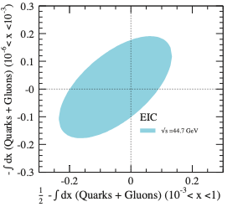
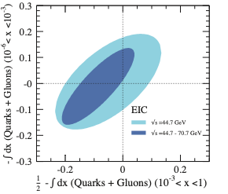
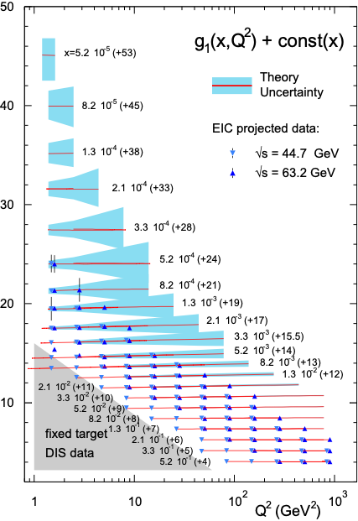
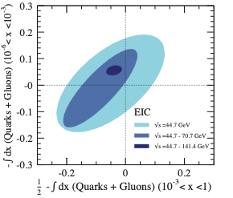
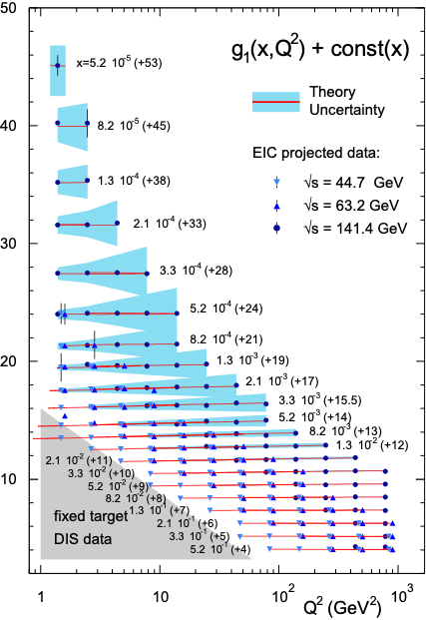
EIC: Longitudinal Spin of the Proton (II)
An EIC can settle the spin puzzle and determine spin of quarks, gluons and the contribution from angular spin but it will require the originally envisioned √s ~ 140 GeV
Notes:
Mention: not even sign of L is constraint
polarized
gluon Δg(x,Q2) and quark Δq(x,Q2) distribution
Figure 2-5 shows the running integral
!"!ΔΣ(!, !!) !!!"#, which represents the contribution of all quark flavors to the spin of the proton
experimental access to the ∆f in lepton- scattering is obtained through the spin-dependent structure function g1(x,Q2), which ap- pears in the polarization difference of cross sections when the lepton and the nucleon collide with their spins anti-aligned or aligned:

Slide 38
The current knowledge about g₁
as function of x at Q²=10 GeV²

Slide 39
EIC: Nuclear Structure Functions (I)
Inclusive DIS on eA:
quark+anti-quark
gluon
F2 and FL are benchmark measurements:
Theory/models have to be able to describe the structure
functions and their evolution.
Leading twist pQCD models parameterize the observed suppression of the structure function with decreasing x using nuclear parton distribution functions (nPDFs)
Aim at extending our knowledge on structure functions into the realm where gluon saturation effects emerge
Notes:
\frac{d^2 \sigma^{eA\rightarrow eX}}{dx dQ^2} = \frac{4 \pi \alpha^2}{x Q^4} \left[ \left(1-y+\frac{y^2}{2}\right) {\color{blue}F_2(x, Q^2)} - \frac{y^2}{2} {\color{red}F_L(x, Q^2)}\right]

Slide 40
EIC: Nuclear Structure Functions (II)
Ratio of PDF(Pb)/PDF(p)
Without EIC, large uncertainties
Adding in EIC significantly reduces the uncertainties, particularly at small-x
Gluon distribution ~ dσ(x,Q²)/dlnQ²
Notes:
\frac{d^2 \sigma^{eA\rightarrow eX}}{dx dQ^2} = \frac{4 \pi \alpha^2}{x Q^4} \left[ \left(1-y+\frac{y^2}{2}\right) {\color{blue}F_2(x, Q^2)} - \frac{y^2}{2} {\color{red}F_L(x, Q^2)}\right]

Slide 41
EIC: Nuclear Structure Functions (III)
Ratio of PDF(Pb)/PDF(p)
Fitting the charm pseudo-data has a dramatic effect at high-x
Direct Access to gluons at medium to high x by tagging photon-gluon fusion through charm events
Notes:
\frac{d^2 \sigma^{eA\rightarrow eX}}{dx dQ^2} = \frac{4 \pi \alpha^2}{x Q^4} \left[ \left(1-y+\frac{y^2}{2}\right) {\color{blue}F_2(x, Q^2)} - \frac{y^2}{2} {\color{red}F_L(x, Q^2)}\right]

Slide 42
EIC: Nuclear Structure Functions (IV)
Projected Errors on FL(x,Q2)
Structure function FL(x, Q²) most sensitive to “glue”
Errors dominated by systematic errors
Need highest EIC energies to affect LHC A-A and p-A program
Notes:
\frac{d^2 \sigma^{eA\rightarrow eX}}{dx dQ^2} = \frac{4 \pi \alpha^2}{x Q^4} \left[ \left(1-y+\frac{y^2}{2}\right) {\color{blue}F_2(x, Q^2)} - \frac{y^2}{2} {\color{red}F_L(x, Q^2)}\right]

Slide 43
Observables: Charge Current in ep and eA
W-exchange: direct access to the quark flavor
→ without the complication of fragmentation
eRHIC has a large kinematic coverage for
charge current events ( )
The larger cross section at higher √s does
eliminate the need for luminosities > 10³⁴ cm⁻²s⁻¹
→ Different for JLEIC

Slide 44
EIC: Longitudinal Spin of the Proton (I)
Inclusive Measurement:
e+p → e′+X
Quark Spin
Gluon Spin
½-Gluon-Quark Spin
Leading Order:
(Quark Spin)
Combining information on ∆Σ and ∆g constrains angular momentum
Higher Order:
(Gluon Spin)
For ∫Ldt = 10 fb⁻¹ and 70% polarization
Current knowledge (DSSV): uses strong theoretical constraints
EIC projections do not ⇒ test w/o assumptions
Notes:
Mention: not even sign of L is constraint
polarized
gluon Δg(x,Q2) and quark Δq(x,Q2) distribution
Figure 2-5 shows the running integral
!"!ΔΣ(!, !!) !!!"#, which represents the contribution of all quark flavors to the spin of the proton
experimental access to the ∆f in lepton- scattering is obtained through the spin-dependent structure function g1(x,Q2), which ap- pears in the polarization difference of cross sections when the lepton and the nucleon collide with their spins anti-aligned or aligned:

Slide 45
3D Imaging at an EIC: TMDs & GPDs
Transverse Momentum Distributions (TMDs):
2D+1 picture in momentum space (kT)
Generalized Parton Distributions (GPDs):
2D+1 picture in coordinate space (bT)
S
Å
z
Notes:
The density in the transverse-momentum plane for unpolarized quarks with x = 0:1
in a nucleon polarized along the ^y direction. The anisotropy due to the proton polarization is
described by the Sivers function, for which the model of [77] is used. The deep red (blue)
indicates large negative (positive) values for the Sivers function.
Impact parameter dependent parton distribution u(x, b?) for the simple model
First, there is a general decrease in magnitude with increasing x ,
which arises mostly due to the decrease of q (x ). Furthermore, one can also a notice
a decreasing transverse width of the distribution q (x, b⊥ ) as x increases, which is
in accord with our general prediction

Slide 46
Gluon Saturation in Nuclei: The Oomph
Probes interact over distances L ~ (2m_{N} x)⁻¹
Probe interacts coherently with all nucleons for L > 2 R_{A} ∼ A^{1/3}
Enhancement of Q_{S} with A: saturation regime reached at significantly lower energy in nuclei (⇒ lower cost)
Nucleus serves as amplifier of the saturation scale

Slide 47
Gluon Saturation: Past Experimental Reach
HERA (ep)
Marginal reach of Qs
Only at low Q² making comparison with perturbative QCD impossible
Fixed Target DIS Experiment
eA, μA, νA
Same marginal reach
Only at low Q² (Q² < 1 GeV²)

Slide 48
Gluon Saturation: √s Matters
eA at EIC:
Need to push into regime where comparison with our current understanding can be made ⇒ Q² > 1 GeV/c²
Require lever arm in Q, x to study evolution
CGC predicts very characteristic A dependence ⇒ need large A lever arm
Need to push for highest energy and heaviest ions

Slide 49
Remark on Nuclear PDFs
Latest state-of-the-art nPDF is EPPS16 replacing EPS09
includes latest LHC data
long awaited new functional form that provides less constraints for x < xdata ⇒ important for eRHIC/JLEIC comparison
not released yet
authors work with us to show eRHIC/JLEIC impact (work in progress, will be in write-up)
Ratio g(x,Q²)_{Pb}/g(x,Q²)_{p}

Slide 50
Nuclear Structure Functions: FL
Projected Errors on FL(x,Q2)
Direct access to gluons through the tagging of gluon initiated processes
FL requires measurements at different √s
eRHIC extends x-reach by a factor 5
Errors dominated by systematic errors like for all SF measurements. Not luminosity hungry!

Slide 51
Reminder: Dihadrons at RHIC
Simple Measurement
beam-view
pT^{trigger}
pT^{assoc}
p
p/d+Au at forward rapidities
tantalizing hint for initial state suppression predicted by CGC
Cannot assure that effect is initial state in p/d+A
Large background, no access to process kinematics (xg)
⇒ e+A
Notes:
FIG. 2: (color online). Pedestal-subtracted cluster-π0 per- trigger correlation functions measured at forward rapidity (3.0 < η < 3.8) for, as indicated, p+p, d+Au peripheral (60–88% c√entrality) and d+Au central (0-20% centrality) col- lisions at sNN = 200 GeV; the correlation functions are for associated π0’s of pT = 0.5–0.75 GeV/c and trigger clusters over the indicated pT ranges. Systematic uncertainties of up to 30% on the near side (|∆φ| < 0.5) are not shown. The subtracted pedestal values, b0, are also indicated.

Slide 52
Dihadrons at eRHIC and JLEIC
Ratio
Factor 2 larger suppression at eRHIC
important given model uncertainties and systematics
Only eRHIC allows to study the evolution of QS with x

Slide 53
Day 1 Measurement: σdiffractive/σtotal
Sign Change:
HERA observed: ~14% of all events are diffractive
Saturation models (CGC) predict up to σdiff/σtot ~ 25% in eA
Ratio enhanced for small MX and suppressed for large MX
Standard QCD predicts no MX dependence and a moderate suppression due to shadowing.
Nucleus is “blacker” than proton. Elastic scattering probability of a qq̅ dipole is maximal in the “black” limit
qq̅g component vanishes in black disk limit
Observing these dependencies
on M_{x} over a wide range in x and Q² is crucial!
Again large √s is key
Unambiguous signature for reaching the saturation limit
Notes:
Dipole cross-section is closer to the unitarity limit than the proton - it is “blacker”. The elastic scattering probability of a qq̅ dipole is maximal in the “black” limit
The qq̅g component is suppressed for nuclei compared to the proton.
This is due to the fact that in a nucleus the scattering amplitude
is closer to the unitarity limit when the qq̅g component vanishes
different b -dependences from each other and from the inclusive
cross section. The q ¯q -component is enhanced at small b (closer to the black disk limit),
whereas the q ¯qg -part is dominated by larger b (because it vanishes in the black disk limit).
Depending on the mass of the diffractive system MX
or, equivalently, , the diffractive structure function is
dominated by either the q ¯q or q ¯qg Fock states.
invariant mass of the diffractive system is large, and
this large phase space is filled by radiation of additional
gluons, each of them being suppressed by
alpha_s .
The q ¯q -components of
the FD
2A are enhanced compared to A times the proton
diffractive structure functions. This is to be expected,
because of the fact that in a gold nucleus the dipole cross
section is, on average over the transverse area, closer to
the unitarity limit than the proton - it is “blacker”. The
elastic scattering probability of a q ¯q dipole is maximal in
the “black” limit and the approach to it is quicker in a
large nucleus. The q ¯qg component, on the other hand,
is suppressed for nuclei compared to the proton. This is
due to the fact that in a nucleus the scattering amplitude
is closer to the unitarity limit when the q ¯qg component
vanishes, as can be seen e.g. from Eq. (13). This
leads to a nuclear suppression of the diffractive structure
function in the small region, where the q ¯qg component
dominates. The net result of the different contributions
is that FD
2A , for a large range in , is close to AFD
2p .

Slide 54
Day 1 Measurement: σdiffractive/σtotal
Where can I see the sign-change?
For given x, Q² plot value of lowest ratio < 0 in kinematical allowed region
Only eRHIC at √s=90 GeV has sufficient phase space in x and Q² to map out the effect of saturation on inclusive diffractive events
Notes:
I did something like what we discussed: I plot inclusive diffractive structure function ratio such that we see the sign change (qqg suppression at large Mx means negative result).
Then, I do as follows: at each x,Q^2, go to the largest possible Mx^2 allowed by sqrt(s). Then see what is this ratio. Then I plot this ratio in x,Q^2 plane in the region where it is negative. So basically white means that we have no access into this region, and more “hot” the color is, more deep we are within this region.
The heatmap shows some artifacts of the smoothening as I had quite spare grid, but this can be improved. But let me know if this is useful. It might be “too complicated to explain quickly”

Slide 55
Imaging of Nuclei
1950-60: Measurement of charge (proton) distribution in nuclei
Ongoing: Measurement of neutron distribution in nuclei
EIC: Measurement of spatial gluon distribution in nuclei via dσ/dt where t = (pout-pin)² of nucleus (t conjugate to bT)
Other than in ep in eA, measuring the scattered A’ is impossible for heavy nuclei (stays in beam pipe)
Exclusive vector meson production and DVCS are the only processes where t can be extracted: e+A → e’+A’+VM
J/ψ is key since it is the least affected by saturation effects and reflects the source best
Notes:
Momentum transfer t conjugate to transverse position (bT)

Slide 56
Imaging of Nuclei
Diffractive vector meson production
coherent part ⇒ average shape
incoherent part ⇒ variance/lumpiness
probes fluctuations at scale ~1/t
Just Wood-Saxon+nucleon g(bT)?
Possible Source distribution
Possible Source distribution
Fourier Transform
T. Toll & TU
PRC 87 (2013) 024913
Can recover chosen average input distribution
Notes:
In general, t-slope of incoherent cross section probes the fluctuations at scale ~1/t (e.g. 1011.1988). That is, at small |t| one can see fluctuations of the nucleon positions (slope is given by the size of the nucleon), and at higher t the slope is (in our picture) size of the “constituent quark”.
Without going to technical details, one could say that “incoherent part => variance/lumpiness at scale ~1/t”. Because if there is no small-scale structure, then incoherent cross section dies much faster at high |t| compared to the case where we have subnucleon structure that fluctuates. I can provide some plots also, but for the talk this more general discussion is probably enough.
Heikki

Slide 57
Imaging of Nuclei Needs Low-x Reach (√s)
Need low-x reach to probe pure gluon source distribution
Only eRHIC has enough phase space to map out the spatial gluon distribution in the saturation regime

