Slide 1
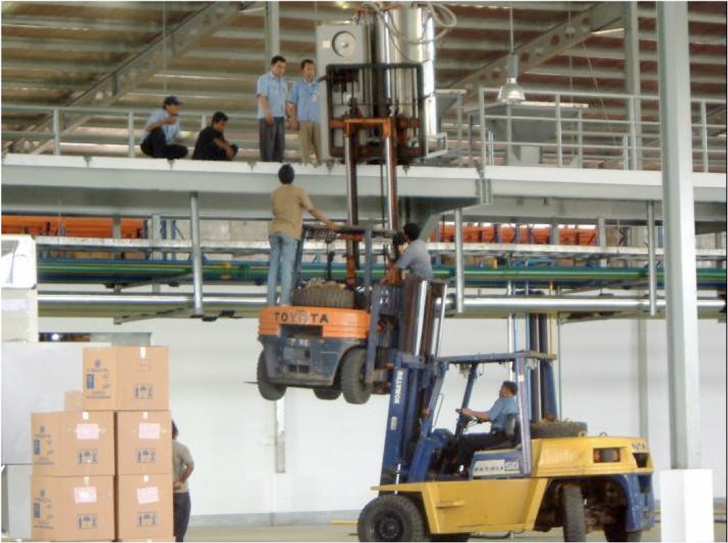
EIC Detector R&D
Thomas Ullrich
EIC User Meeting
ANL
July 9, 2016

Slide 2
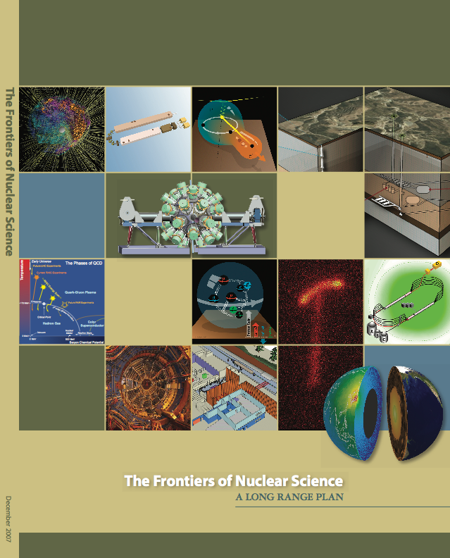
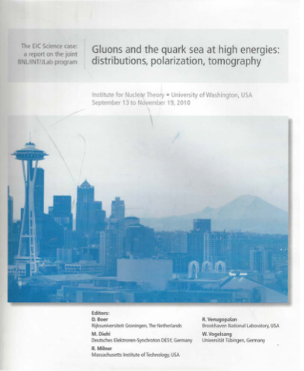
2010/2011 - EIC Key Years
Last LRP (2007) had good words for an EIC but no recommendation
“An EIC with polarized beams has been embraced by the U.S. nuclear science community as embodying the vision for reaching the next QCD frontier.”
“We recommend the allocation of resources to develop accelerator and detector technology necessary to lay the foundation for a polarized Electron-Ion Collider.”
No funding efforts of DOE for detector R&D
Fall 2010 INT Workshop “Gluons and the quark sea at high energies distributions, polarization, tomography”
551 page writeup in August 2011

Slide 3
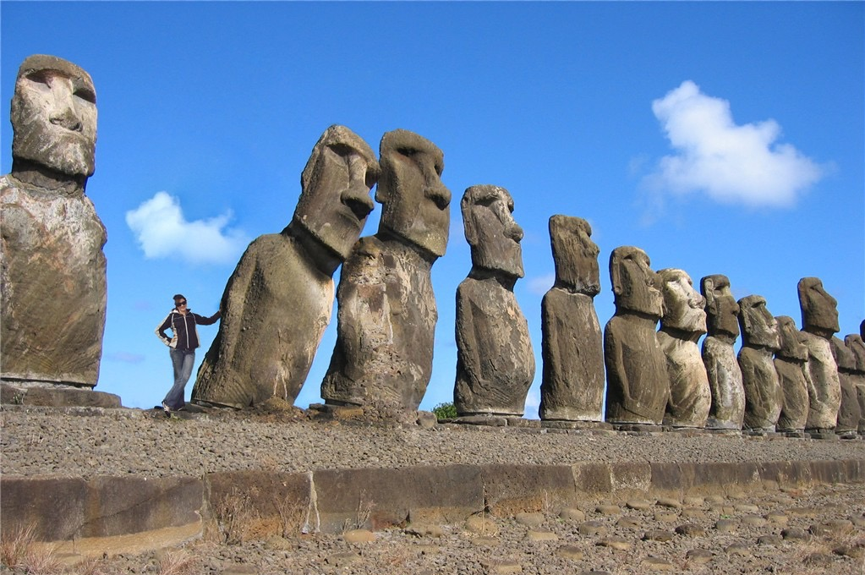
2010/2011 - EIC Key Years
Work on the EIC White Paper started
Working groups of few enthusiast
Few experimentalists from universities involved (although many were interested)
No organized user group in sight
Machine design at JLAB and BNL well underway
No detector design(s) nor R&D efforts
2010/2011 the need to get
the ball rolling was apparent

Slide 4
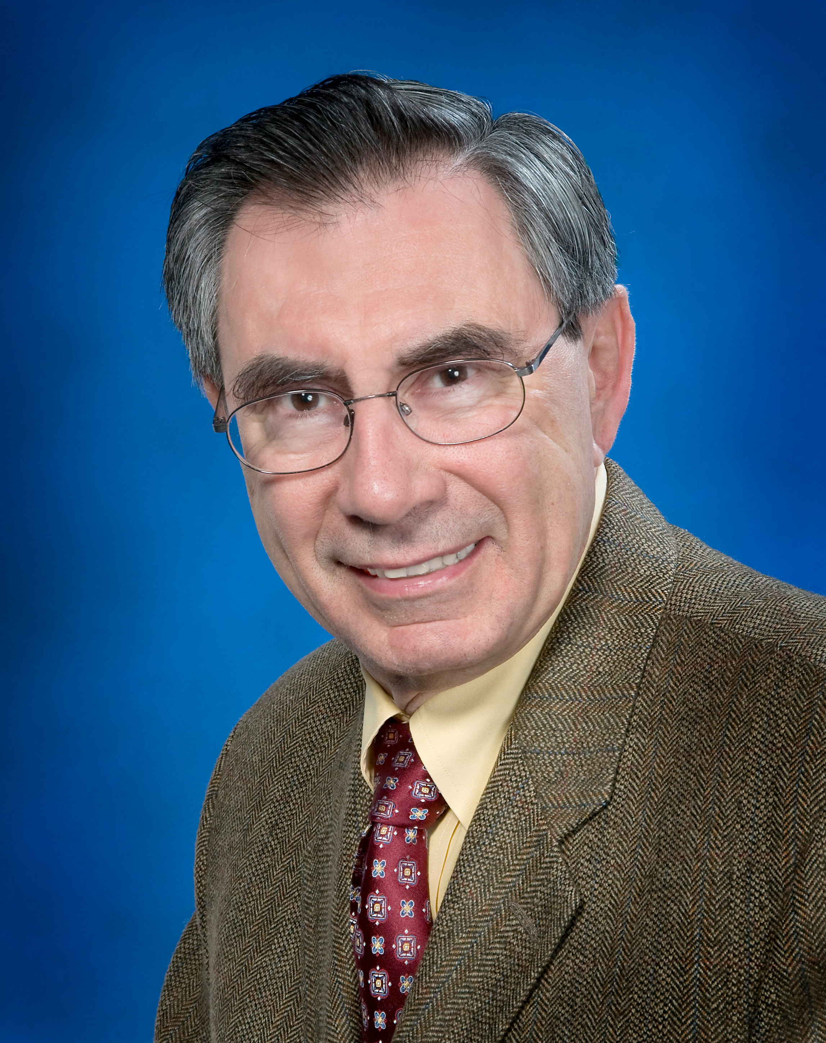
Generic Detector R&D for an EIC
In January 2011 BNL, in association with JLab and the DOE Office of NP, announced a generic detector R&D program to address the scientific requirements for measurements at a future EIC
Goals of Effort
Enable successful design and timely implementation of an EIC experimental program
Develop instrumentation solutions that meet realistic cost expectations
Stimulate the formation of user collaborations to design and build experiments
Peer-Reviewed program established in 2011 to enable EIC experiments
Initiator, driver, and coordinator until 2014: Tom Ludlam

Slide 5
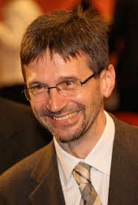
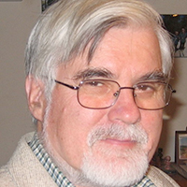
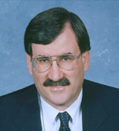
Generic Detector R&D for an EIC
Funded by DOE, managed by BNL: 1M$-1.5M$/year
Program explicitly open to international participation
Key to success: Standing EIC Detector Advisory Committee consisting of internationally recognized experts in detector technology and collider physics
Meets twice a year
~January: Review of ongoing projects
~July: Review and new proposals
Current: Marcel Demarteau* (ANL), Carl Haber (LBNL), Peter Krizan (Ljubljana),
Ian Shipsey (Oxford), Rick Van Berg (UPenn), Jerry Va’vra (SLAC), Glenn Young (JLab)
Retired:
Robert Klanner (Hamburg),
Howard Wieman (LBL)

Slide 6
Consortia
Committee was and is supporting the formation of consortia
Combining efforts of groups from universities and labs with similar targets
encourage close collaboration
sharing of resources, some freedom in distribution of funds
Currently:
Tracking consortium - 7 institutions
Calorimeter consortium - 12 institutions
PID consortium - 20 institutions
Potential future candidates:
Si Vertex consortium
Software and Computing consortium
First step toward building scientific collaborations to successfully build EIC detector components

Slide 7
Reminder: EIC Detector Requirements
There are site-dependent requirements but overall they are rather similar:
-3.5 < η < 3.5 is sufficient for the central detector
try to get to η = -4 if possible
Material budget of ≲ 5% X/X0
Momentum resolution on a (few) % level is fine
no need to do better at a cost of higher X/X0
Electron ID
-3.5 < η < 1; π suppression up to 1:10⁴
~2%/√E energy resolution (and low constant term) for η < -2
~7%/√E energy resolution for -2<η< 1
~10-12%/√E in barrel
π/K/p separation
momentum distributions are very η-dependent
Forward η: up to ~50 GeV/c
Central η: up to ~4++ GeV/c
Backward η: up to ~5-6 GeV/c
suppression factors ~100 required
Spatial resolution of primary vertex
~10-20 μm
Jets
HCAL needed at forward η; at mid-η no HCAL needed

Slide 8
EIC Detector Requirements and R&D in Context
In Short:
Hermetic detector, low mass inner tracking, good PID (e and π/K/p), calorimetry
Moderate radiation hardness requirements, low pile-up, low multiplicity
Comparison:
Majority of R&D in HEP and HENP is currently related to LHC phase-I and phase-II upgrades
Radiation hardness and rate are top R&D items for pp. Less emphasis on PID (notable exceptions is LHCb). High multiplicity and high data taking rate for AA (ALICE).
With end of phase-I R&D efforts on MAPS, PID, GEM-TPC will stop
Specific requirements for an EIC demand R&D that is not covered by main stream HEP, HENP R&D - we have to drive it ourselves

Slide 9
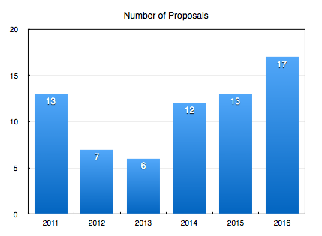
Some Statistics (I)
Note: < 2014 proposals were considered every 1/2 year. Those are added up.
Consortia
LRP
First year: moderate requests in terms of funding
FY17: Record participation this time (expected)
8 new proposals, new strong international groups

Slide 10
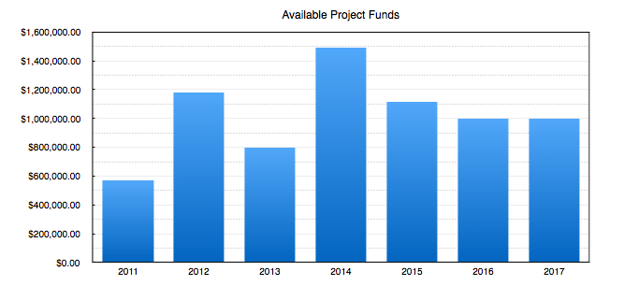
Some Statistics (II)
Fiscal Year
Total since 2011: $7,721,740
Total funds requested: $2.45M: worst ratio of available/requested funds ~ 0.41
Need to work on this together with DOE and EIC User Group SC

Slide 11
EIC R&D
Examples

Slide 12
eRD1: Calorimeter Consortium
Goal: Develop simple, cost effective, flexible techniques to build compact sampling calorimeters with good characteristics.
Efforts:
Sci-fiber EM calorimeter (SPACAL)
Compact W-scifi calorimeter, developed at UCLA
Investigating high resolution version for e-going endcap
Crystal EMCal
Option for high resolution e-going endcap calorimeter
Shashlik EMCal
Option for h-going endcap calorimeter
HCal
Prototype development in collaboration with STAR forward upgrade and sPHENIX
Sensor
SiPM and APDs, radiation studies and support electronics
BNL, CALTECH, CUA, JLAB, IUCF, NPN Orsay, PSU, TAMU, UCLA, USTC, YPI

Slide 13
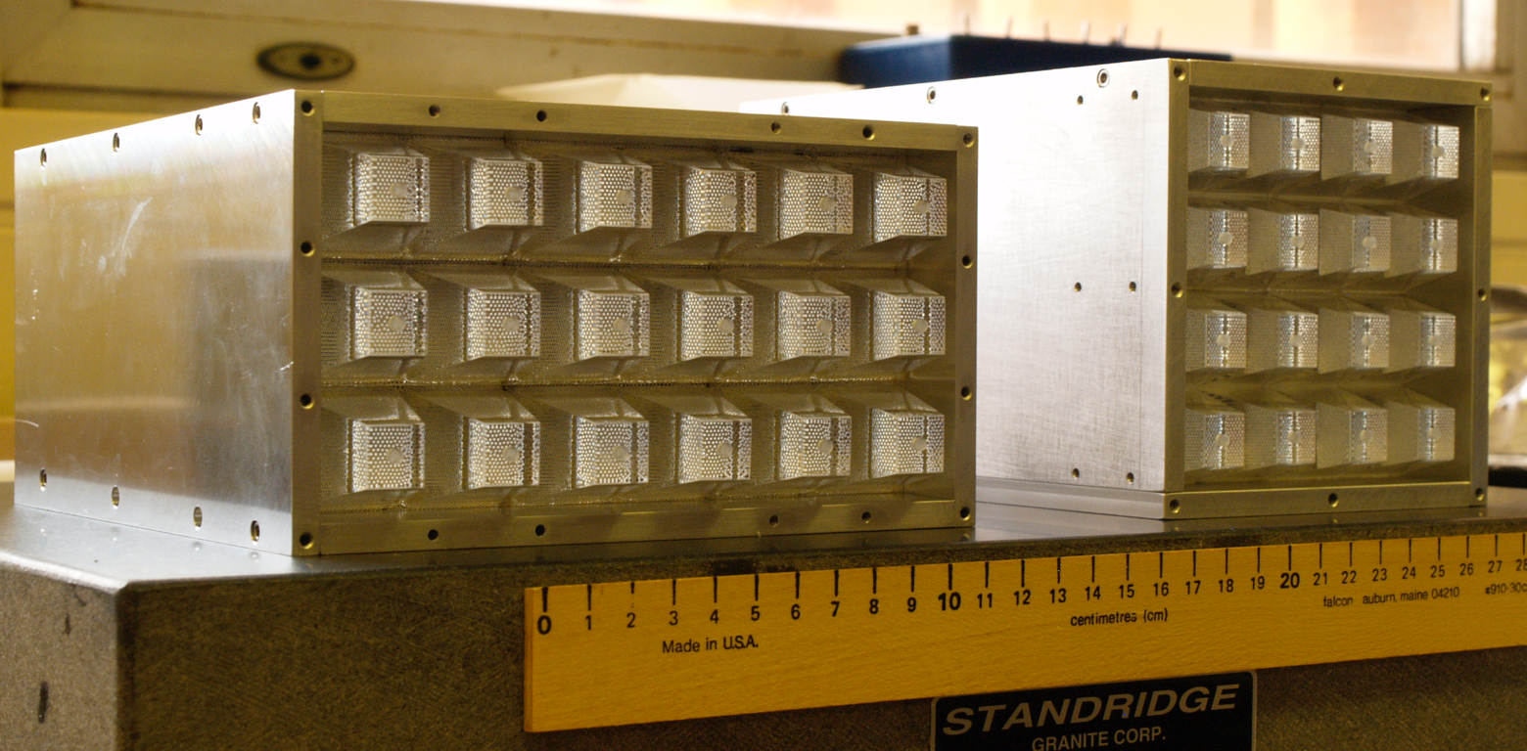
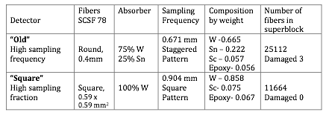
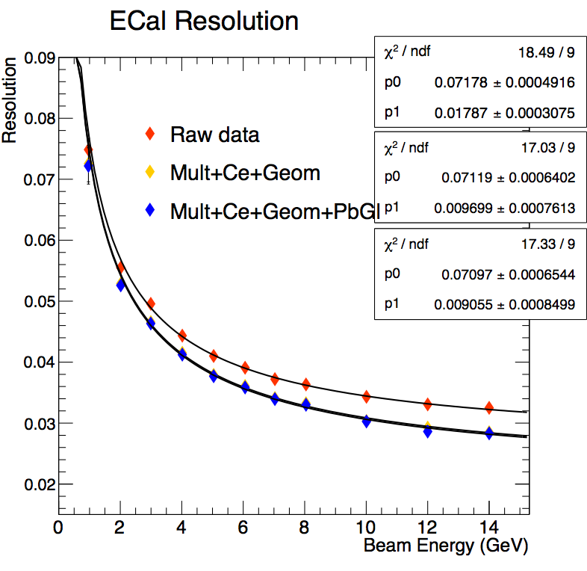
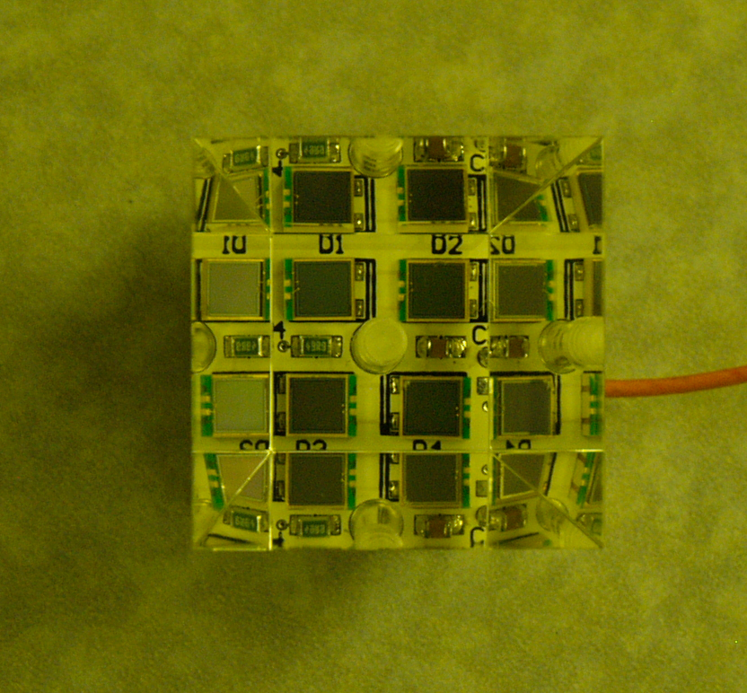
eRD1: W-SciFi SPACAL - EIC Forward
Thin fibers embedded in composite absorber
Two versions ‘O’ (old) and ’S’ (square)
EIC Barrel EMcal
EIC Forward
Very Bright
’S’ version: Achieve target of 7%/√E with constant term ~ 1% constant term at 10°, 2.9% at 4°
Next: Systematic study of behavior of Si sensors in realistic conditions, R&D on efficient and compact light collection scheme
SiPM Readout.
Test Run 2016 FNAL

Slide 14
eRD1: Crystal Calorimeter
e-going direction needs high precision calorimetry (few%/√E)
PbWO4 calorimeter desired for this role, extensively used for high precision calorimetry (CMS, JLab, PANDA…) because of its energy and time resolutions and its radiation hardness
BTCP (Russia) produced high quality crystals in the past but out of business
SICCAS (China) problems maintaining good crystal quality
New potential candidate: CRYTUR, Czech Republic
Goal:
Develop process towards acceptable crystals quality assurance towards EIC needs
Develop an alternate supplier of PbWO4 (CRYTUR) - evaluate quality, work with manufacturers to improve quality

Slide 15
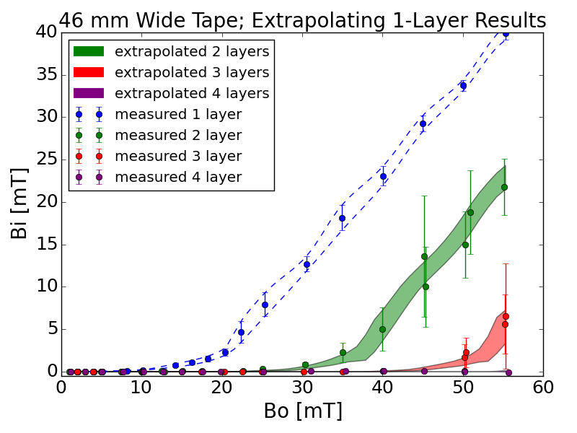
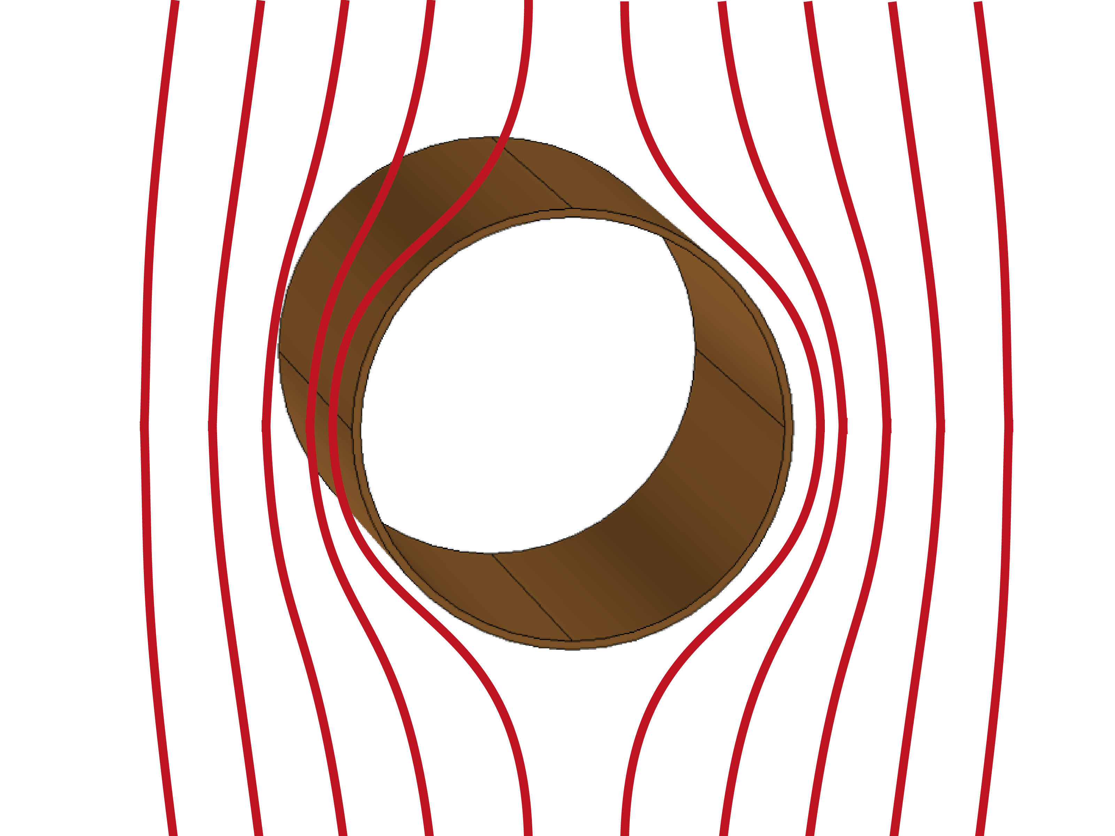
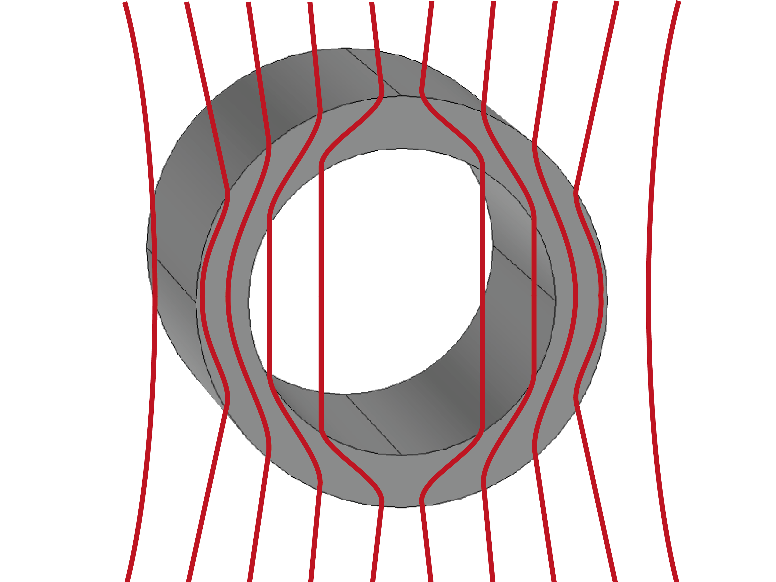
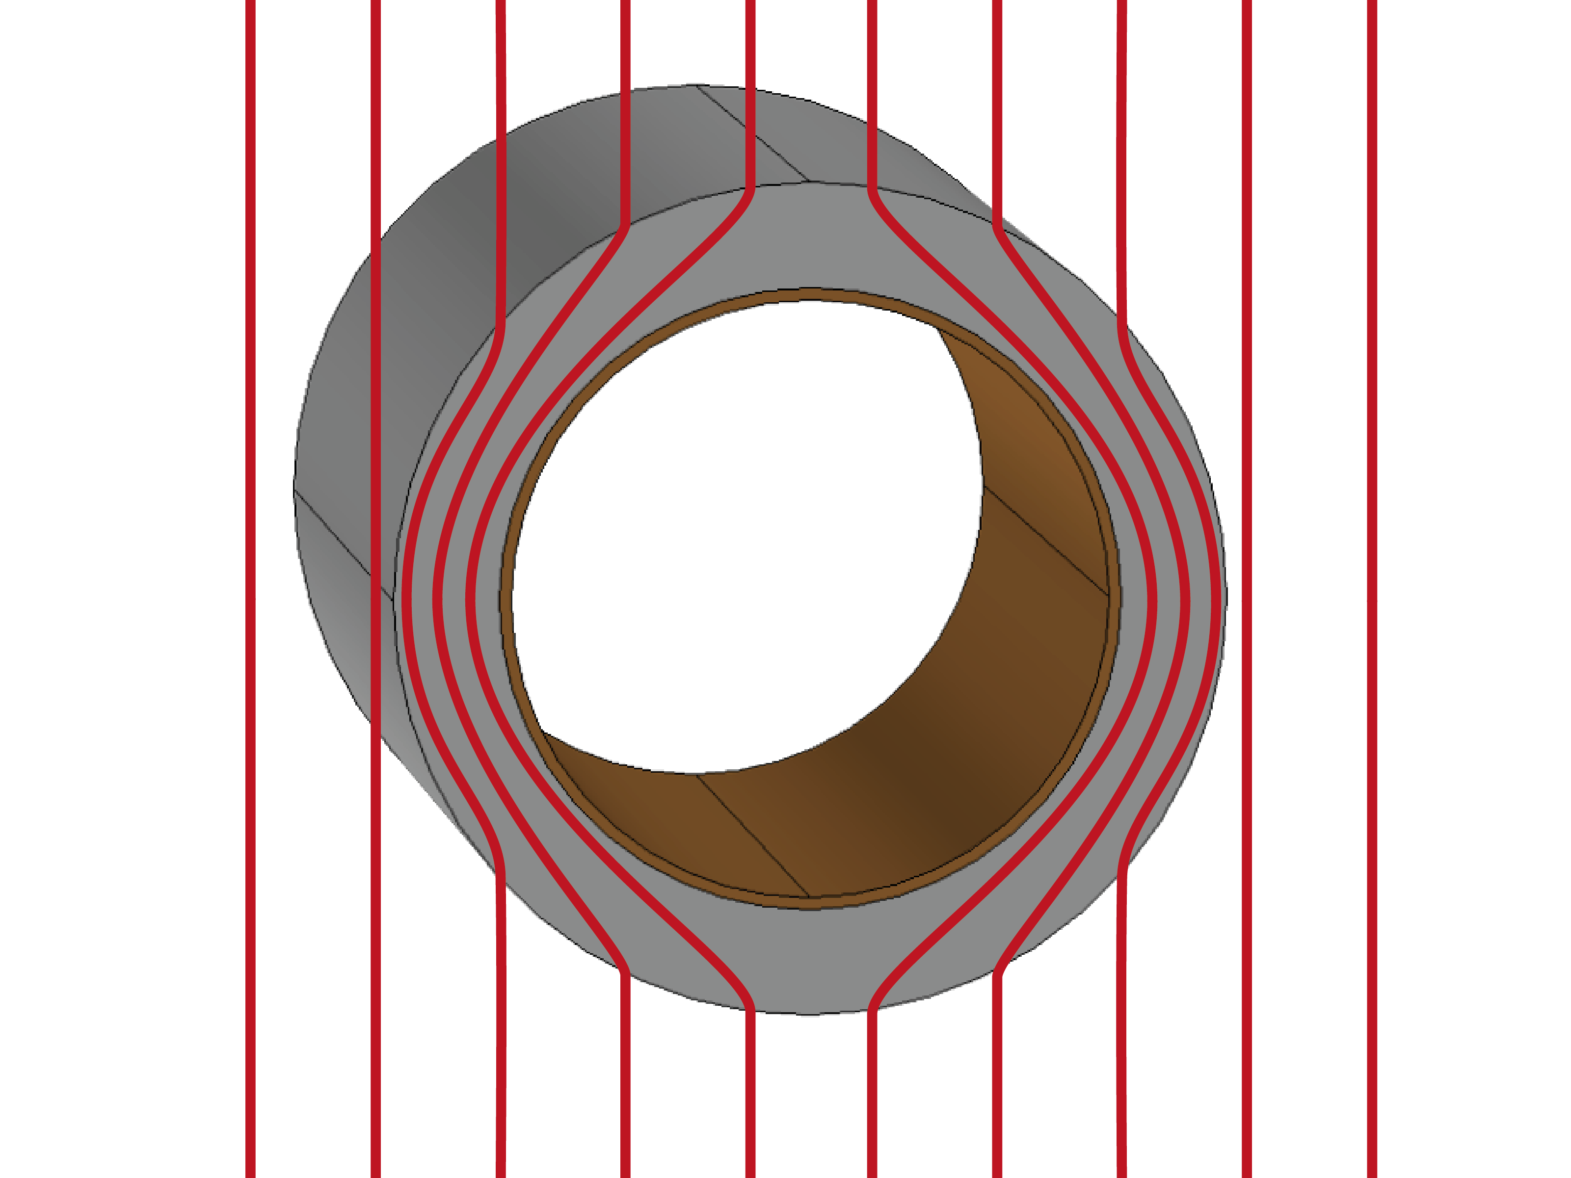
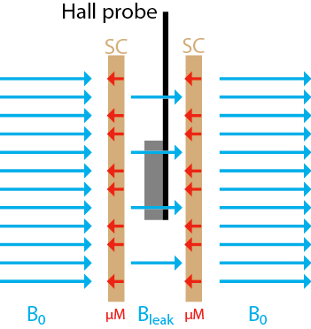
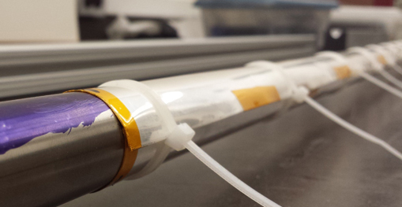
eRD2: A Magnetic Field Cloaking Device
Issue: Strong dipole magnets in forward/backward direction affect beam optics.
Goal: Shield beam pipe and allows beam to tunnel through magnetic fields w/o disturbance of outside fields
Method: Wrapping layers of layers of AMSC high-temperature superconductor around beam pipe
SUNY, RIKEN, BNL
45 layers → 0.5T
SUNY, RIKEN, BNL
Notes:
The results we reported previously predicted that a cylinder made from
45 (10) layers of 46 mm wide AMSC high-temperature superconductor wire
insert at liquid nitrogen (liquid helium) temperature could shield a magnetic
field of 0.5 T.

Slide 16
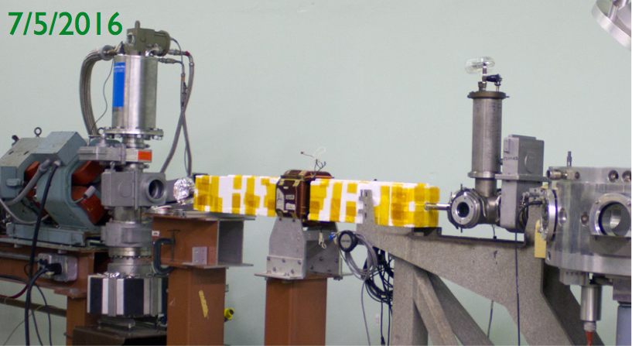
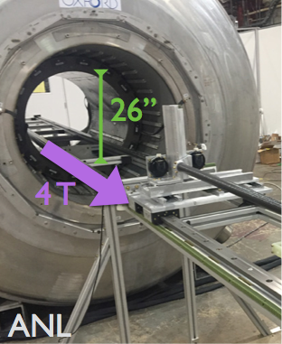
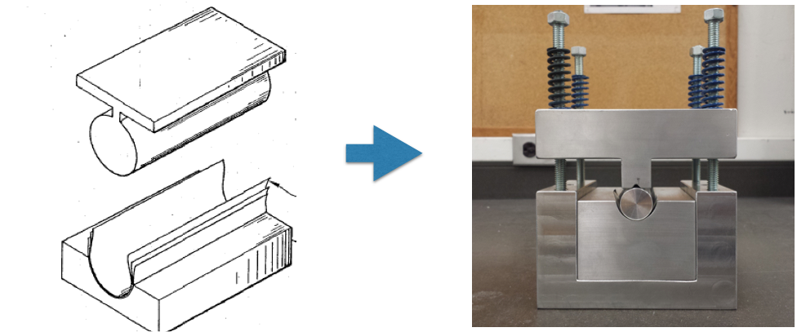
eRD2: A Magnetic Field Cloaking Device
Beam tests in progress:
BNL, Van de Graaff beam line
Shield beam from a transverse magnetic field with a 1.3 m SC cylinder at liquid nitrogen temperature
Coming up:
High-field shielding test with MRI magnet at ANL
Shield a 0.5 T field with a 10 cm SC cylinder at liquid nitrogen temperature.
Producing multi-layer shield
Successful first soldering and performance test with miniature version of shield
Notes:
The results we reported previously predicted that a cylinder made from
45 (10) layers of 46 mm wide AMSC high-temperature superconductor wire
insert at liquid nitrogen (liquid helium) temperature could shield a magnetic
field of 0.5 T.

Slide 17
EIC R&D: Involving HS Students Successfully in eRD2
“Most Outstanding Exhibit in Computer Science, Engineering, Physics or Chemistry”
Semi- finalist:
Ayesha Chhugani
Fall 2016: Egleston Research Scholar at Columbia University-Fu Foundation School of Engineering

Slide 18
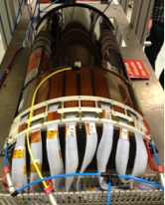
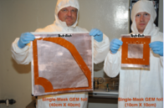
eRD3: Micro-Pattern EIC Tracking System
R&D effort focuses on intermediate tracking system
Barrel tracking system based on MM detectors (Dedicated barrel / curved MM EIC R&D program) manufactured as cylindrical shell elements and
Forward/Backward tracking system based on triple-GEM detectors manufactured as planar segments (Collaboration with eRD6 FIT/UVA)
R&D strategy:
Design and assembly of large cylindrical MM detector elements and large planar triple-GEM detectors
Test and characterization of MicroMegas and triple-GEM prototype detectors
Utilization of light-weight materials
Development and commercial fabrication of various critical detector elements
Temple, Saclay

Slide 19
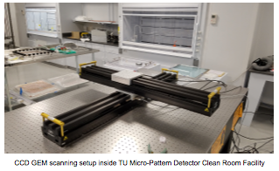
eRD3: Micro-Pattern EIC Tracking System
Highlights:
Substantial facility development at Saclay (Assembly and testing of MM detector) and Temple University (Assembly and testing of GEM detectors) for micro-pattern detectors
Work on commercial development of various components including GEM foils and 2D readout foils
Commercialization of GEM foils is issue
Successful development and application of a dedicated new chip readout system (DREAM chip) for micro-pattern detectors
Remaining program plans to focus on assembly and testing of larger detector elements using X-ray and cosmic-ray scans using novel assembly techniques

Slide 20
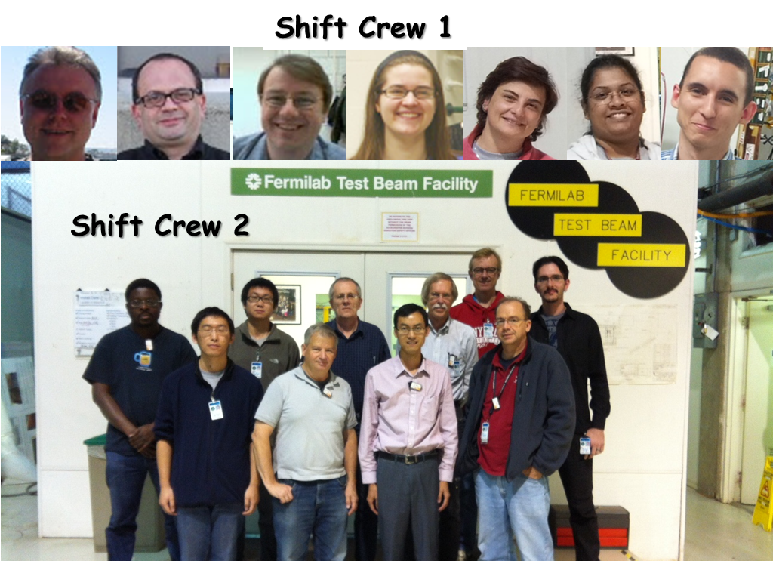
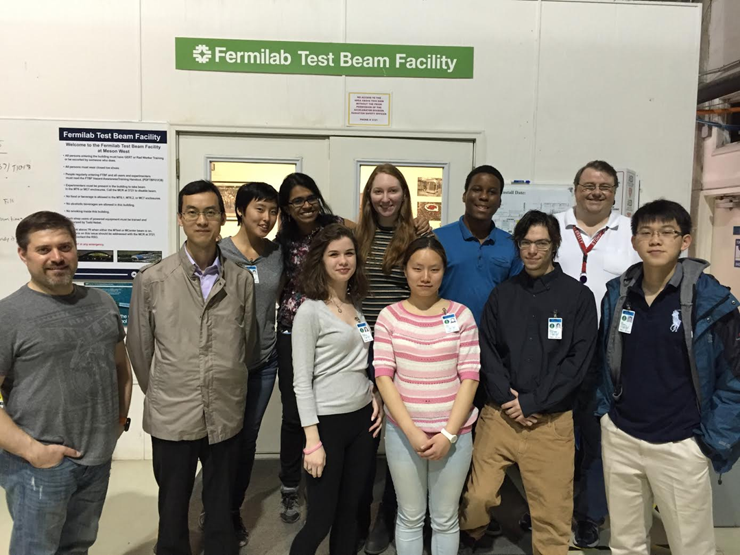
eRD6: Tracking/PID Consortium
Existing Since 1st Round of EIC R&D
Brookhaven National Lab: MiniDrift & TPCC
Florida Institute of Technology: ZigZag Planar GEMs
Stony Brook University: RICH & TPCC
University of Virginia: Stereo-COMPASS Planar GEMs
Yale University: 2Gem+μMEGA
Recent Additions
INFN Trieste: RICH PID
Weizmann Institute of Science: EIC TPC
Largest experiment at Fermilab Test Beam Facility with 19 detector stations in single experiment
Sector Test: October 2013
TPC/Cherenkov: April 2016
BNL, FIT, INFN Trieste, SUNY, UV, WIS, Yale

Slide 21
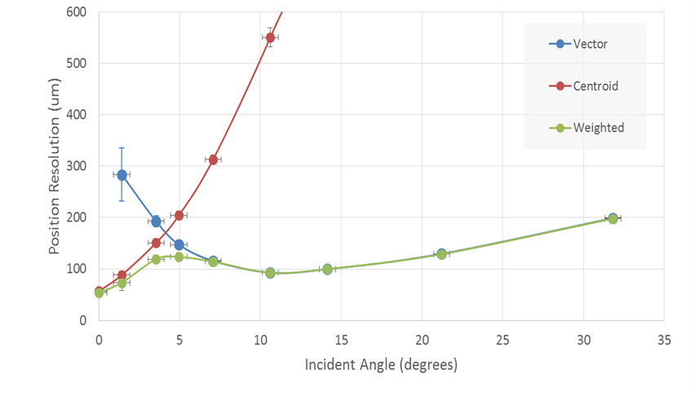
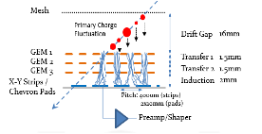
eRD6: Mini-Drift GEM Tracking Detector
Triple GEM stack with a small drift region (mini TPC type configuration)
Position and arrival time of the charge deposited in the drift region were measured on the readout plane allowing reconstruction of track traversing the chamber.
Minidrift overcomes resolution degradation with incident angle for conventional GEM tracking detectors using only charge centroid information.
Compatible with all forms of planar GEM tracker.
Normal Chamber
MiniDrift

Slide 22
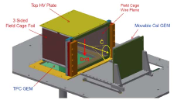
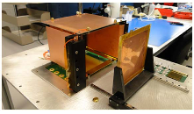
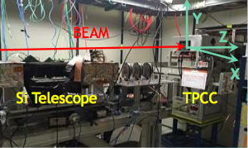
eRD6: Cherenkov TPC
Combines the functions of a TPC for charged particle tracking and a Cherenkov detector for particle identification in same volume
Prototype:
TPC: 10cm drift + 10x10cm2 4GEM
Cherenkov: 3.3x3.3cm2 pad array + 10cmx10cm 4GEM
Common Gas: CF4 (vdrift = 7.5cm/μs & large N0)
Successful demonstration of proof of principle - TPCC works!
Quantified performance specs like track resolution and Cherenkov light yield

Slide 23
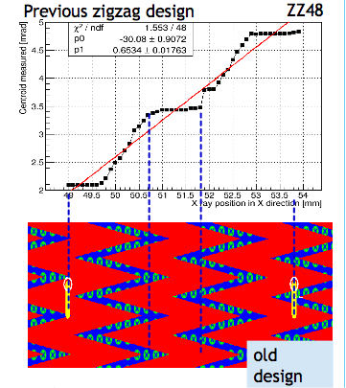
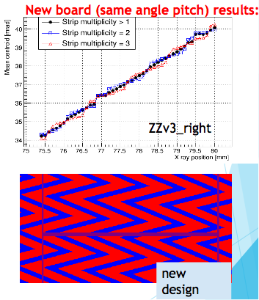
eRD6: ZigZag Strip Readouts
Goal: Improve common readout boards with more complex zigzag design
Test with 3GEM readout and X-ray source
Early results of boards tested at FNAL showed non-linear behavior
Recent: Scans of PCBs with improved zigzag strip design aiming to reduce non-linear response and achieve <100 μm spatial resolution
Vastly improved
Linear response over whole range
> 95% events fire 2 or 3 strips (before mostly 1)
Continue work with company to further improve PCBs

Slide 24
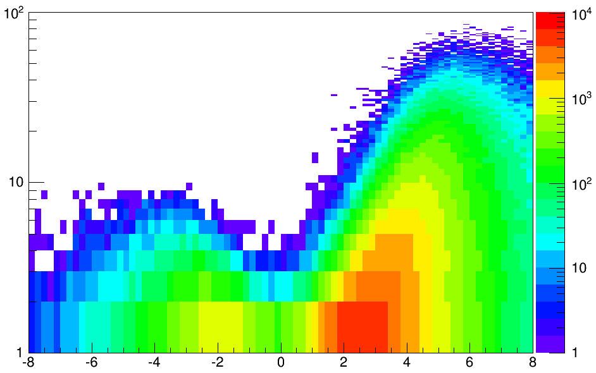
eRD14: PID Consortium
Particle ID is essential for EIC
eRD14 is developing a suite of detector systems covering the full angular- and momentum range required for an EIC
Imaging Cherenkov detectors are the primary technology
Current Projects:
h-side: RICH with two radiators (gas + aerogel) are needed to cover the full momentum range: more than 3 s.d. separation for π/K/p over 3-50 GeV/c
e-side: Compact aerogel RICH covering up to 10 GeV/c (π/K/p) can provide the required PID and allow for an endcap design optimized for EIC physics requirements
Barrel:
DIRC is compact and can cover momenta up to 6-7 GeV/c
ToF under investigation, still issue with determining T0 and related t-resolution
e
p/A
h-endcap
GeV
10x100 GeV
Q² > 1 GeV²
barrel
e-endcap
Dual-radiator RICH
DIRC
Aerogel RICH
rapidity
ACU, ANL, BNL, CUA, William & Mary, Duke, GSU, GSI, Howard, INFN Ferrara, INFN Roma, ISS Rome, JLAB, LANL, ODU, USM, UIC, UNM, SC, Yale

Slide 25
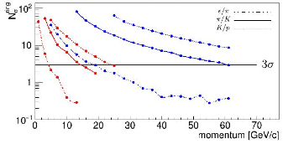
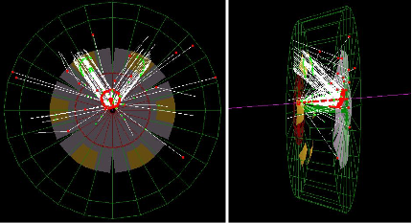
eRD14: Dual Radiator RICH Detectors
First dual-radiator RICH developed for use with a solenoidal detector
Combination of C2F6 gas and n=1.02 aerogel leaves no gaps in coverage
Outward-reflecting mirrors reduce backgrounds and (UV) scattering in aerogel
3D focusing reduces photosensor area
Geant4 simulations show excellent performance for both hadron and lepton ID
Particle separation power for tracks with 15° polar angle

Slide 26
eRD12: Low Q²-Tagger, Luminosity Monitor & e-Beam Polarimeter
Successful conclusion of project:
Initial design and integration into the IR completed
Optimized the IR design to integrate:
Luminosity monitor
Lepton polarimeter
Low Q²-tagger
Developed a Monte Carlo code for Bremsstrahlung taking into account the polarization dependence of the Bremsstrahlung cross section
Integrate a first layout into the EicRoot simulation package
Develop a dedicated e-polarimeter simulation package
Determine detector performance requirements based on physics and machine backgrounds
Targeted Detector R&D which fulfills the determined requirements
BNL

Slide 27
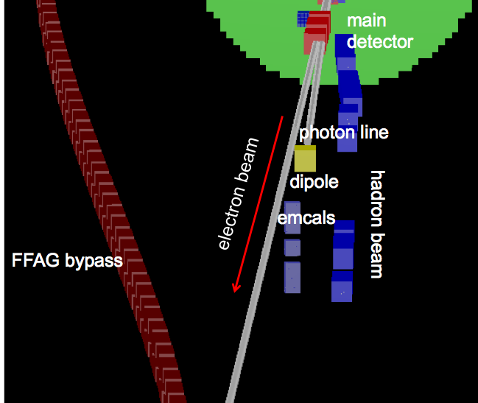
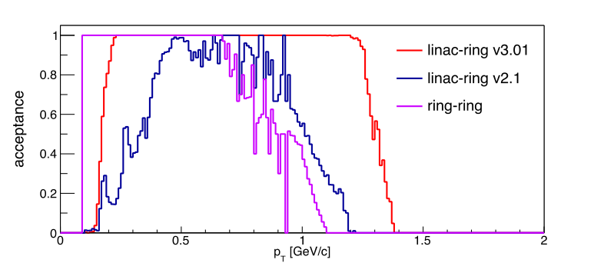
eRD12: Low Q²-Tagger, Luminosity Monitor & e-Beam Polarimeter
hadrons electrons
-45 m
-35 m
-15 m
0 m
18 m
Forward Proton Spectrometer
Important for DVCS
Roman Pot integrated into IR
Studied the acceptance of protons through the lattice
Feedback to machine designers to push for next iteration
Electron polarimetry
Identified the space in the tunnel
Estimated constraints on the laser (cathode by cathode measurement in about 2 minutes)
Low Q²-tagger
Tracking code to calculate scattering angle of electron
Iterate with machine designers to improve IR design
Pythia studies show acceptance down to Q² O(10⁻⁵ GeV²)
Lumi Monitor
Integrated into IR
Includes a pair spectrometer
Effect of beam optics studies
Angular divergence dominates the acceptance, current parameters are ok

Slide 28
General Remarks from the Committee
It is great to see proposals come to a conclusion with a deliverable that is of general value for the EIC development (e.g. eRD12)
Field is getting more crowded and level of funding will not change in the near future. The protocol for proposal submission will be modified and proposals will have to address different funding levels: 100% +/- 25%.
Given the severe financial constraints, a guideline of one year of support per postdoc will be implemented; this hopefully will encourage securing matching support by the proponents.
EIC R&D funding is NOT base funding, but should be considered as supplemental funding to initiate new directions.
There seems to be a tendency of some of collaborations that have been in existence for a longer time to move in the direction of (value) engineering. The committee feels that it is too early for this (R&D versus PED)

Slide 29
General Remarks from the Project Coordinator
It is great and rewarding to see the program grows and mature
Program has participants from 43 institutions (11 non-US)
The number of peer reviewed publication grows steadily
Certainly in the near future funding is not expected to increase stressing the project (and the committee)
We will make some changes to the proposal format (include different funding levels) and apply new rules (e.g. only support for 1 year/postdoc) to mitigate some funding issues
Need to work with DOE to implement LRP recommendation and increase funding.
The program needs to have room (i.e. funds) for further grow

