Slide 1
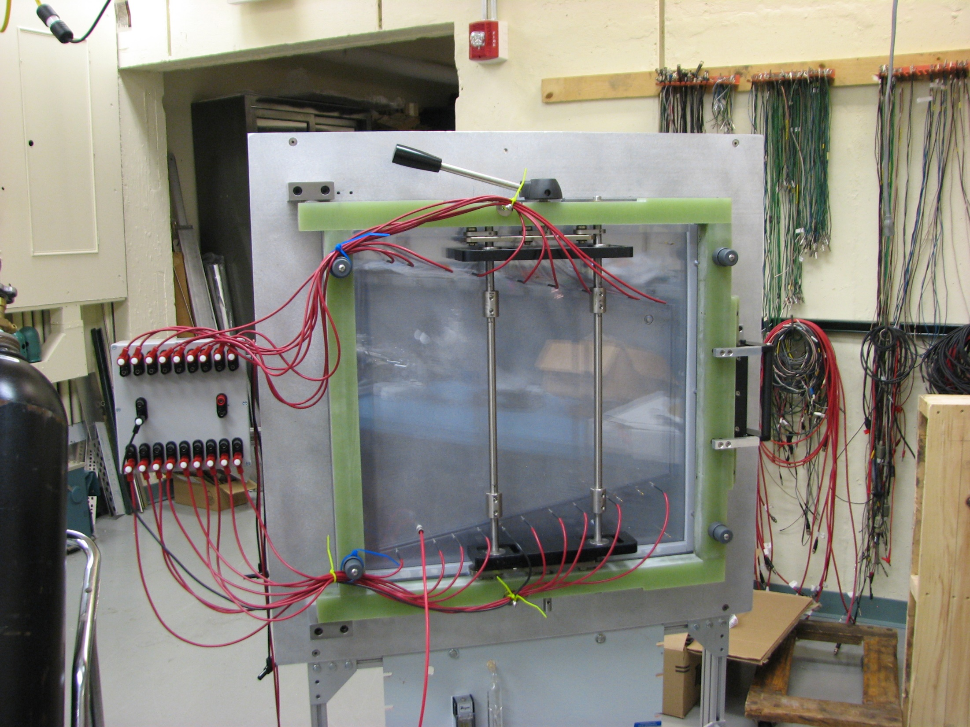
Shrouded Banana cables cut to appropriate length (EZ Hook 9138-60RED)

Slide 2
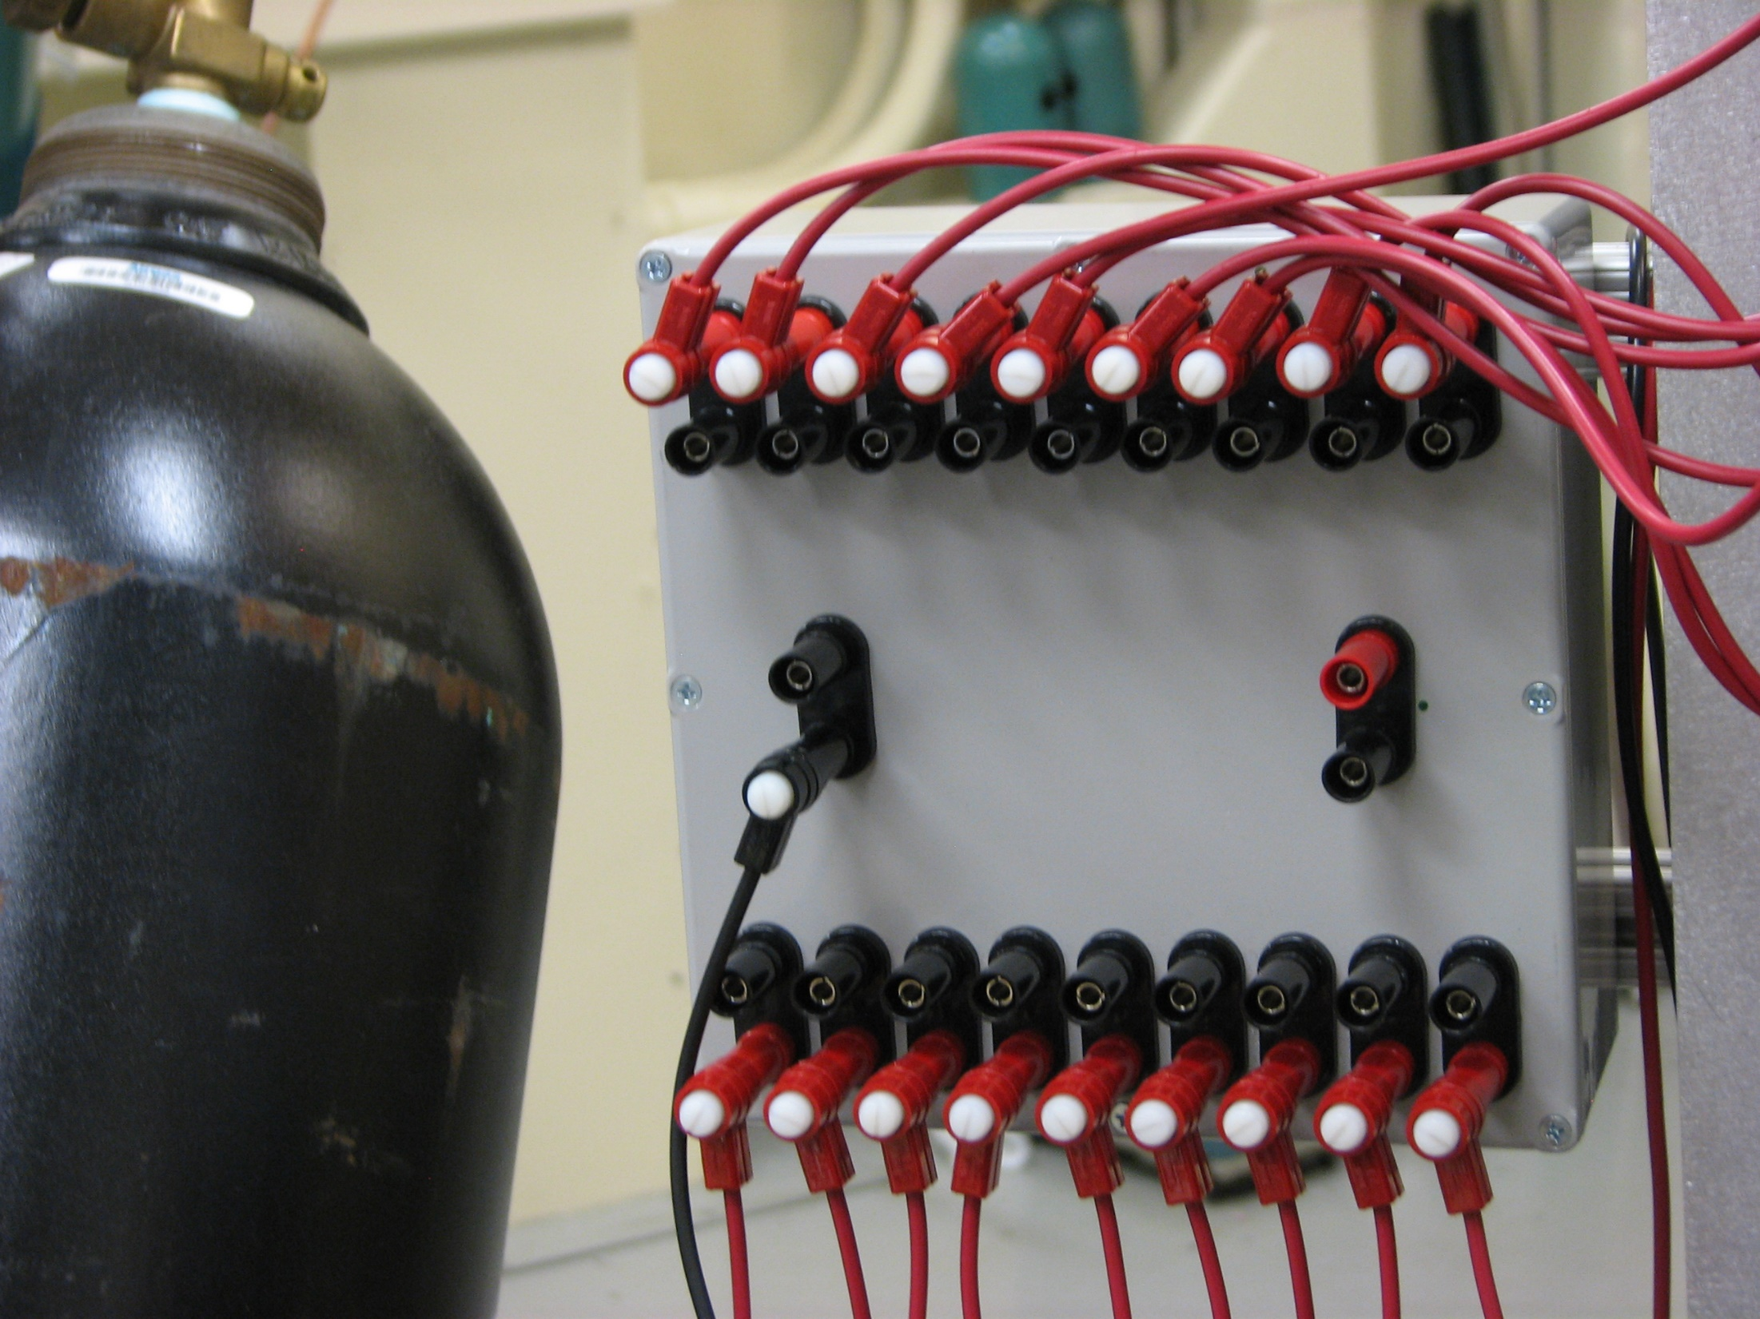
Fluke meter on mV scale move probe to each segemnt
To HV Supply (HV side)
To HV supply (usually Ground side)
To Foil unsegmented side

Slide 3
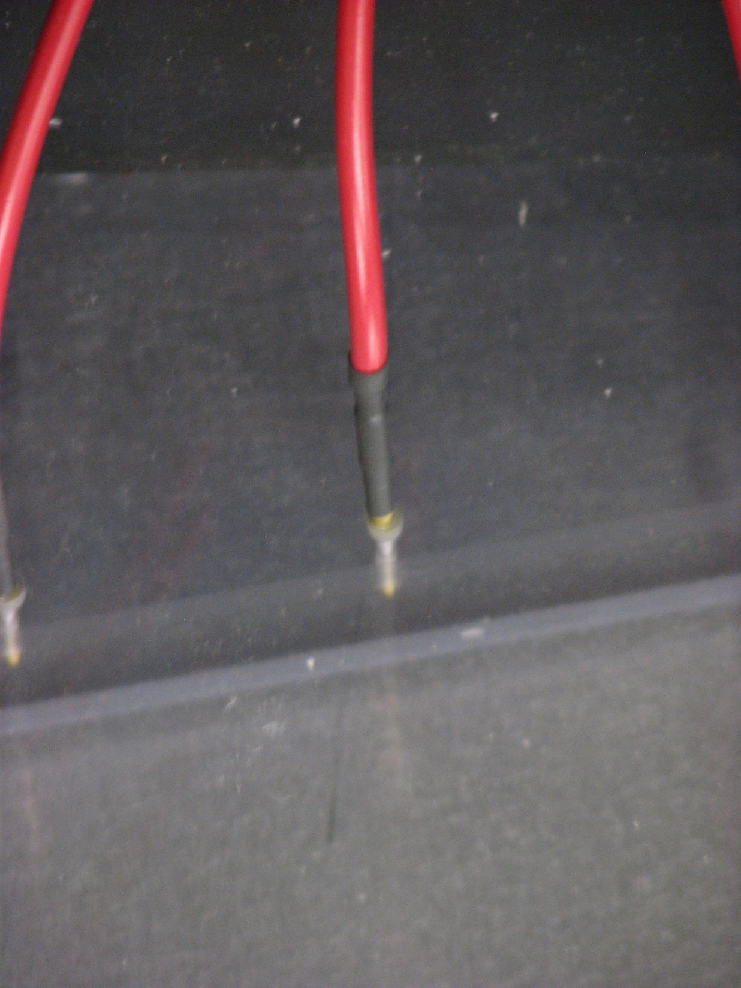
Socket R-3-CR crimped on shrouded banana cable, covered with heat shrink and slipped over spring pin. Spring ping is epoxied through Plexiglas window – makes contact on other side of window.

