Slide 1
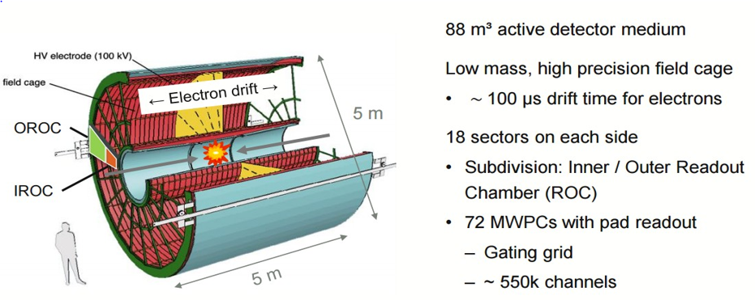
ALICE Time Projection Chamber (TPC) Upgrade
The Large Hadron Collider at CERN will be upgraded to increase the Pb-Pb ion collision rate from 8 kHz to 50 kHz.
The main charged particle tracking detector at ALICE is a large TPC.
Trails of ionization electrons produced by charged particles passing through the TPC volume are drifted to the endcaps where the signal is multiplied by multi-wire proportional chambers (MPWC) and the transverse position is recorded. The drift time gives the third coordinate and the ionization density can be used to determine the type of particle.
The MWPC chambers will not operate at the projected Pb ion collision rates of 50,000/second – each producing thousands of charged particles.
An upgrade to the TPC will replace the MPWC readout chambers with newer technology Gas Electron Multiplier (GEM) chambers.
New readout electronics
will allow recording of every
collision

Slide 2
Gas Electron Multipliers (GEMs) - Solution for High Rate Operation
5 μm Copper
One of several micropattern gas detectors developed over the past ~20 years.
Invented by Fabio Sauli at CERN
Sauli NIM A386(1997)531
Ionization electrons are guided by the electric field into the holes in the GEM foil where the very high field causes an avalanche – thus multiplying the signal.
70 μm
50 μm polyimide
50 μm
5 μm Copper
140
μm
Typical parameters:
50μm Kapton
metal coated
Ø50-70μm holes
• 100-200μm pitch
1e⁻ in
>10³ e⁻s out
Electric field in the holes ~100kV/cm

Slide 3
ALICE TPC end plate readout is divided into 18 20º sectors on each end. Each sector has an inner chamber (IROC) and outer chamber (OROC). To maintain reasonable sizes for the GEM foils the OROCs are divided into 3 sections.
GEM foil sizes
₋ 40 sectors (36 installed + 4 spare)
₋ 4 GEM stacks per sector
₋ 4 GEM foils per stack
GEM foil numbers
46.7 cm
= 640 GEM foils
To accomplish this very large construction effort the project has been divided among several institutions
US Teams with DOE support are building the IROCs
49.7 cm

Slide 4
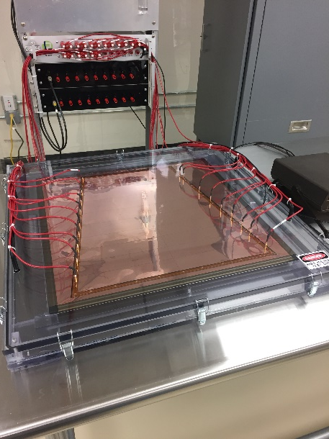
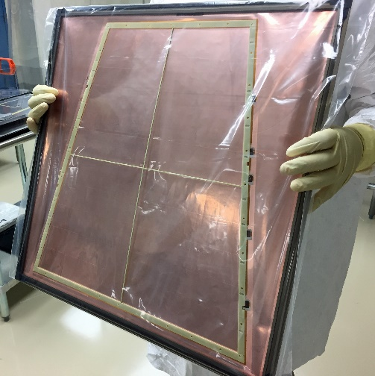
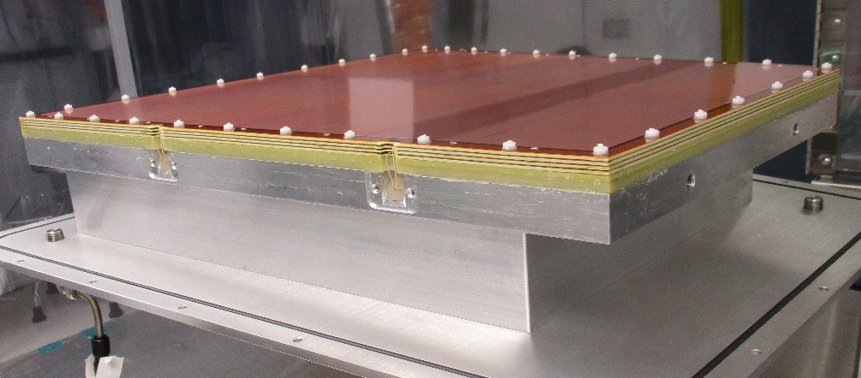
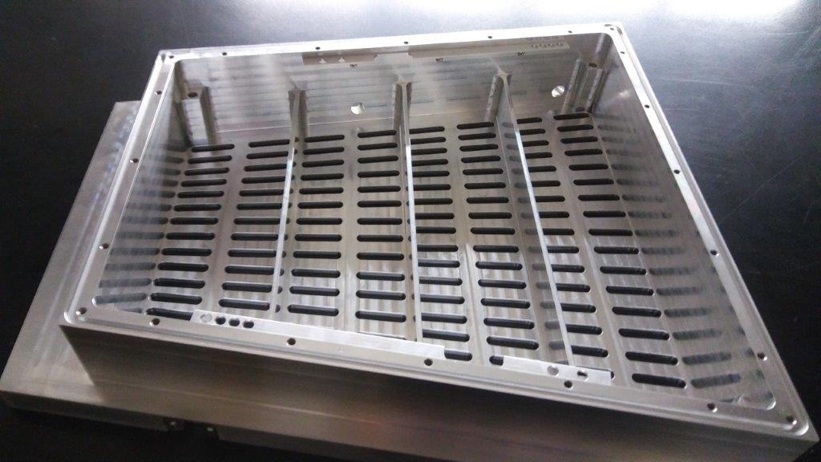
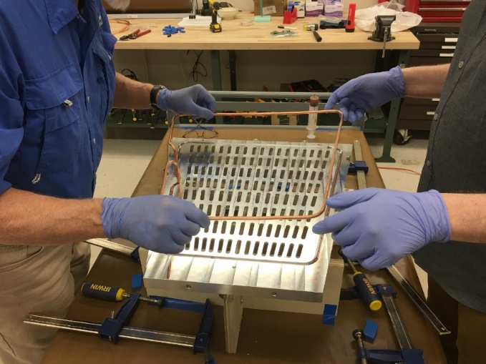
Fiberglass frames to support GEM foils fabricated and glued to foils at Wayne State University. Foils tested at high voltage before and after framing.
Final assembly of GEM foils onto chamber body and QA tests with sources and X-ray generator at Yale University
X-Y Stages
Thin Window
X-ray Generator
Pad plane with readout electrodes, Spacer,
High voltage feedthroughs and cooling tube for electronics assembled on aluminum base and tested at University of Tennessee, Knoxville.
Aluminum base fabricated at University of Texas, Austin
Also, vessels for testing and shipping IROCs to CERN.

