Slide 1
The ALICE TPC Upgrade Project
Richard Majka
R. Majka

Slide 2

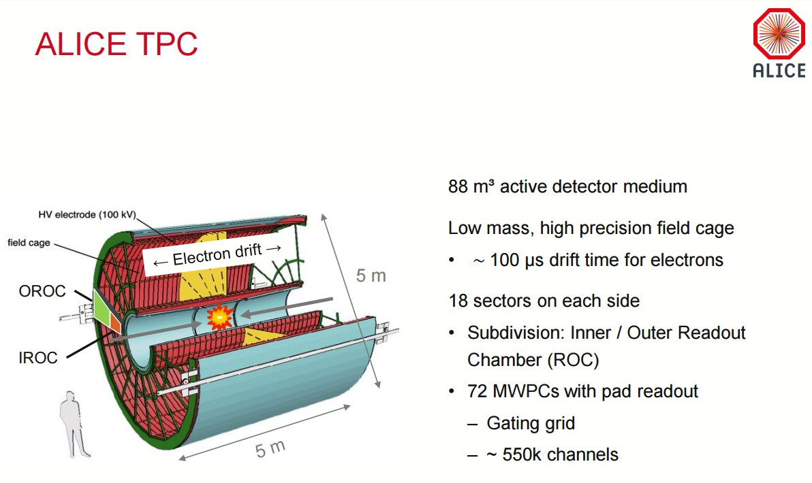
What is a TPC and why is it used in ALICE?*
A large cylindrical gas volume with electric field arranged to drift ionization electrons from charged particles passing through the gas to either end.
A magnetic field parallel to the electric field bends the particles and allows measurement of the particle momentum.
By measuring the number of ionization electrons per unit path length for a charged particle the velocity of the particle is determined and one can determine the particle mass.
Invented by Dave Nygren, ~1975 http://www.slac.stanford.edu/pubs/slacreports/reports04/slac-r-190.pdf, p 126
Physics Today 31, 46 (1978); http://doi.org/10.1063/1.2994775

Slide 3
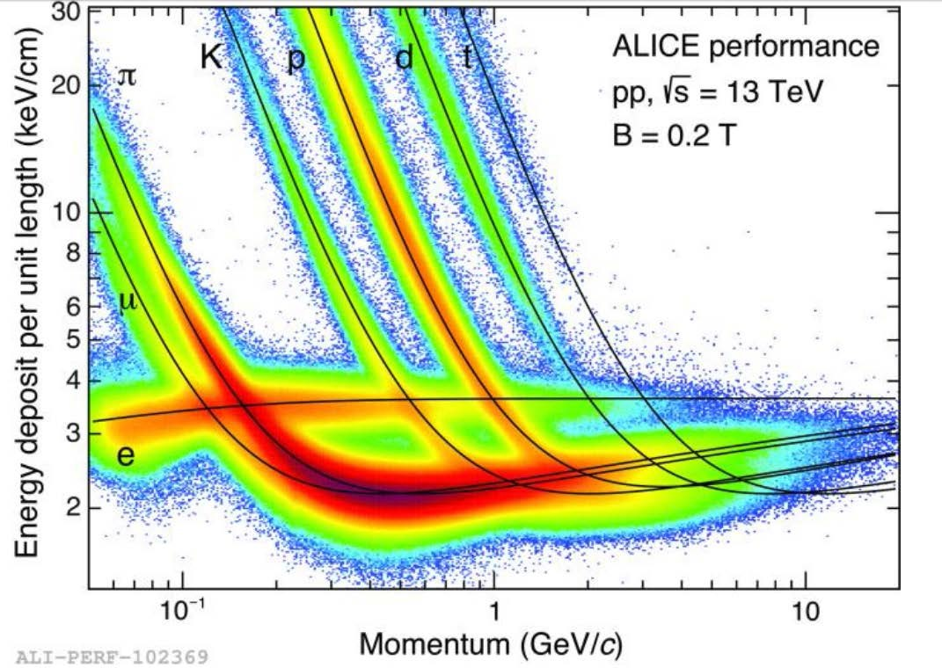
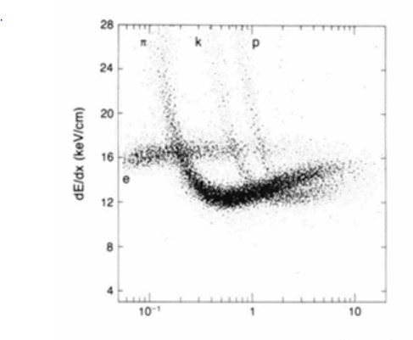
ALICE TPC
PEP4 TPC
At low momentum the ionization cross section falls with increasing momentum, at higher energy relativistic contraction/dilation of the particle’s electric field causes the ionization cross section to increase.

Slide 4











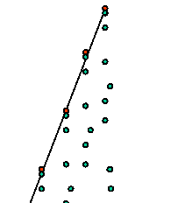














Basic idea of gas detector for ionizing radiation:
Ionizing radiation – such as a charged particle –
passing through a gas (usually a noble gas with “additives”) can knock electrons off the gas atoms.
Under the influence of an electric field the electrons can drift to an electrode to be detected.
But, on average only a few ionization electrons/mm are produced. With modern, low noise, inexpensive preamplifiers you need ~ 10⁴ electrons to be comfortably above the noise level.
A mechanism to multiply the signal is needed.
E field
Multiplier
Collection electrode

Slide 5



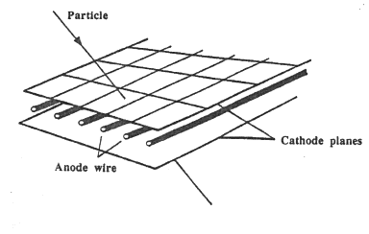








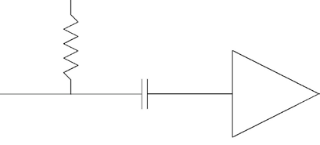







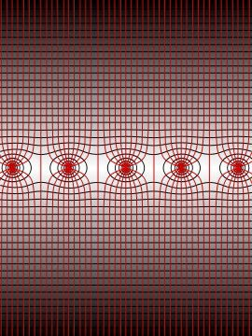


Since its invention in 1968 by Georges Charpak*, the basic “workhorse” of gas detectors for tracking high-energy charged particles has been the Multi- Wire Proportional Chamber and its derivatives.
~2kV – 4kV Many MΩ
φ = 25 - 50 μm
Micro electronics made possible readout for 10⁴ – 10⁵ channels.
Few mm
Field is high enough near wires to accelerate electrons to sufficient energy so they can create further ionization
1 - 2 mm
* G. Charpak, et al., Nucl. Intrum. and Meth., 62, 262, 1968.

Slide 6
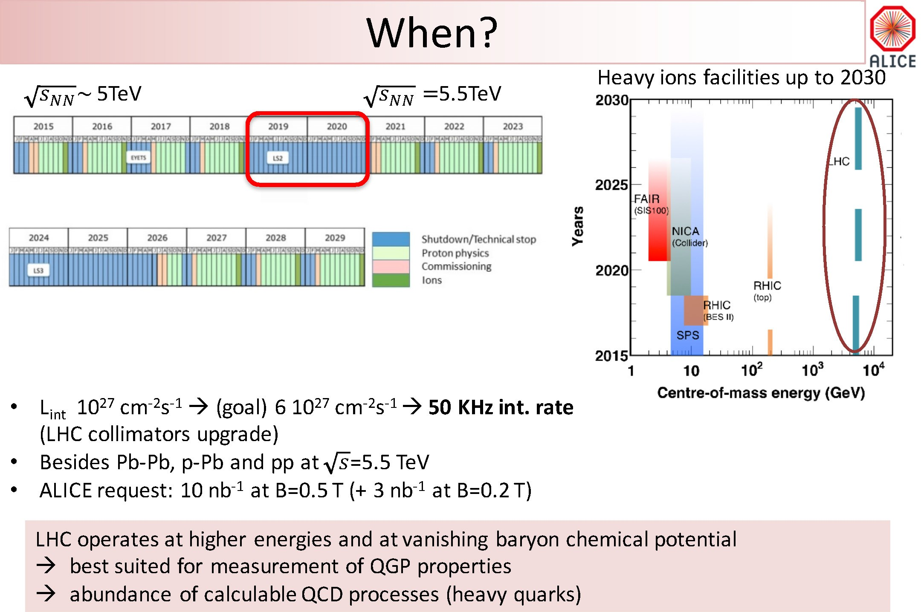

Upgrade of LHC injector chain - What and When
Pb-Pb interaction rate: 8 kHz
50 kHz

Slide 7
LHC Upgrade → New Physics Opportunities for ALICE
Study the thermalization of partons in the QGP, with focus on
charm and beauty quarks at low p_{T}
secondary vertices
Low-momentum charmonia dissociation (and regeneration?) to study deconfinement and medium temperature
Production of thermal photons and low-mass dileptons emitted by QGP to study initial temperature and equation of state of the medium
exploit low p_{T} reach & PID of ALICE
Processes Cannot be selected at trigger level
Move from 1 kHz triggered running in ALICE to 50 kHz Pb-Pb
Record Everything!

Slide 8

Why We Need to Upgrade the TPC
Present TPC: Wire chamber end plates
~
p Resolution: s_{pT}/p_{T} < 3.5% at p_{T} = 50 GeV/c and below 1% at p_{T} = 1 GeV/c.
•
•
dE/dx resolution: 5% (p-p) – 6.5% (central Pb-Pb) (158 max. samples)
Event rate: 1 kHz Pb-Pb minimum bias
Want to be able to record 50 kHz Pb-Pb collision rate and maintain the current performance
BUT
Drift time for ionization electrons from central electrode to end plate is O (100 μs)
Drift time for ions from end plate to central electrode is O (160 ms)
Build up of positive ions in the drift volume → electric field distortion → distortion of the ionization electron tracks as they drift to the end plates
Ions produced by charged particles traversing the detector are unavoidable – this is the signal
Ions from the gain structure - typically a few thousand times the initial ionization -
must be prevented from getting to main drift volume

Slide 9
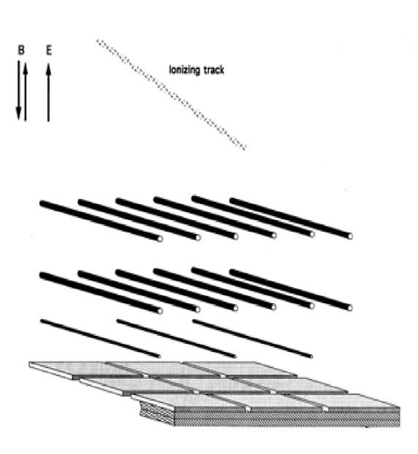
Usual Solution
Use a gating grid between the gain element and the drift volume
Main Drift
Gating grid is normally biased to prevent passage of charged particles (ionization electrons and ions)
Gating Grid
Ground Plane Anode wires (gain)
TPC is run in triggered mode
Read out (pad plane)
When a trigger occurs, gating grid is biased (opened) to allow passage of charged particles
The grid is kept open for the time required to collect the ionization electrons O (100 μs)
In this time, no ions from the gain element (anode wires) can escape the gain region
Grid then must be kept closed long enough to collect all ions O (300 μs)
Intrinsic dead time → rate limitation ~ 3 kHz
Eliminate the gating grid by exploiting the low Ion Back Flow (IBF) of Gas Electron Multipliers (GEMs)*
*B. Ketzer et al., Nucl.Instrum.Meth. A732 (2013) 237-240

Slide 10




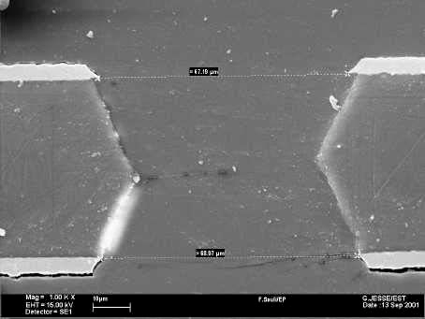













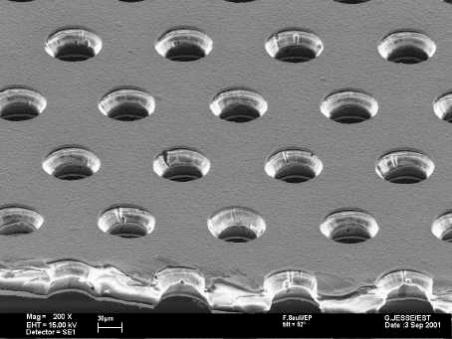






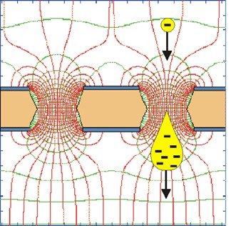
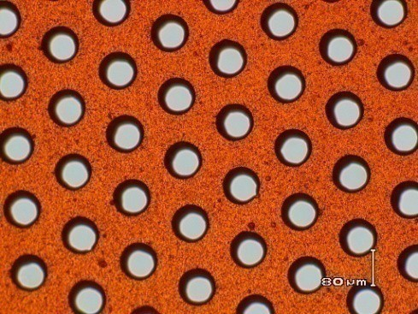
Gas Electron Multipliers (GEMs)
One of several micropattern gas detectors developed over the past ~20 years.
Invented by Fabio Sauli at CERN
Sauli NIM A386(1997)531
5 μm Copper
70 μm
50 μm polyimide
50 μm
Typical parameters:
50μm Kapton
metal coated
Ø50-70μm holes
• 100-200μm pitch
5 μm Copper
140
μm
1e⁻ in
>10³ e⁻s out
Electric field in the holes ~100kV/cm
10

Slide 11
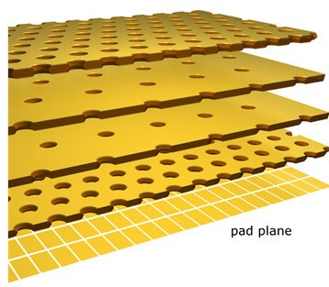

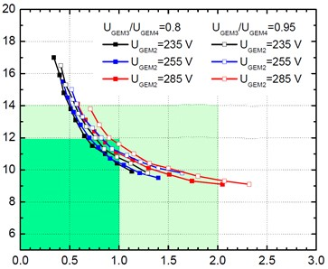


Solution – Technology Choice
Several year R&D program developed a solution with 4-GEM chambers
Different GEM hole patterns on each GEM helps to block ion backflow
Tradeoff between energy resolution (large gain in first foil) and ion back
flow (IBF) (small gain in first foil)
Standard Pitch not rotated
Large Pitch
400 V/cm drift field
DV=270 V
DV=800 V
DV=230 V
⁵⁵Fe peak s/mean (%)
rotated
Large Pitch not rotated
Standard Pitch rotated
DV=800 V
dE/dx res. =8.5%
dE/dx res. =8.0%
DV=288 V
DV=20
DV=359 V
DV=800 V
Ion Backflow current / Anode Current (%)
90-10-5 Ne-CO₂-N₂
Eight voltages (DV on 4 GEMs and DV on 4 gaps) makes huge parameter space to scan
Curves of energy resolution vs ion backflow show a region that meets our design goals and a larger region that gives acceptable performance to meet the physics goals.
Calibration method for correcting space-charge distortions is already in use for the current run and handles variations even larger than we see in prototype chamber.
11

Slide 12
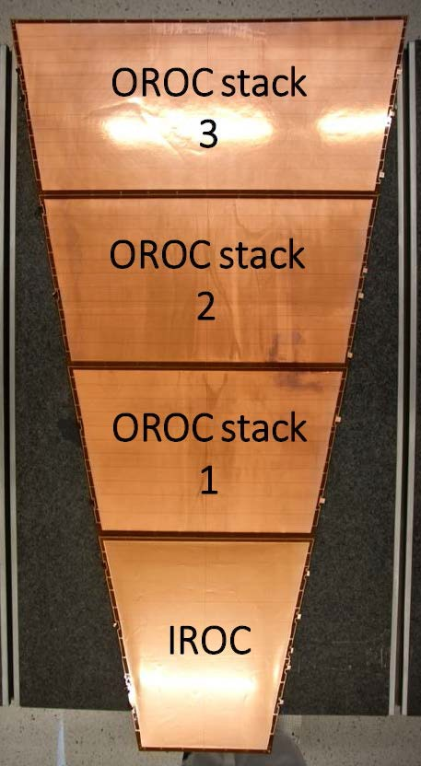
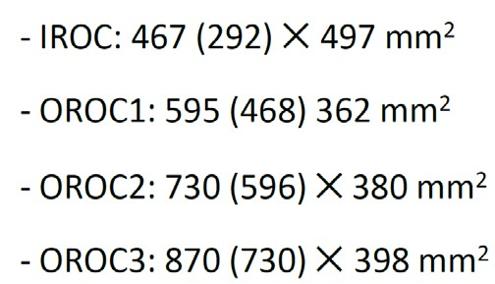
Readout Chamber Design and Construction
ALICE TPC end plate readout is divided into 18 20º sectors on each end. Each sector has an inner chamber (IROC) and outer chamber (OROC). To maintain reasonable sizes for the GEM foils the OROCs are divided into 3 sections.
GEM foil sizes
₋ 40 sectors (36 installed + 4 spare)
₋ 4 GEM stacks per sector
₋ 4 GEM foils per stack
GEM foil numbers
= 640 GEM foils
To accomplish this very large construction effort the project has been divided among several institutions

Slide 13
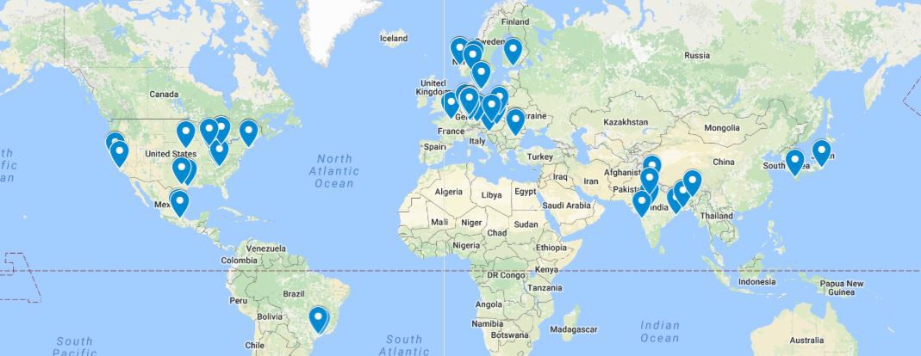
Division of Effort for ROC and Electronics Construction and Testing
45 Institutes
Managing material flow among many institutes is not a small part of the project. For ROC construction Database is used to track material location, status and archive QA+test data.

Slide 14
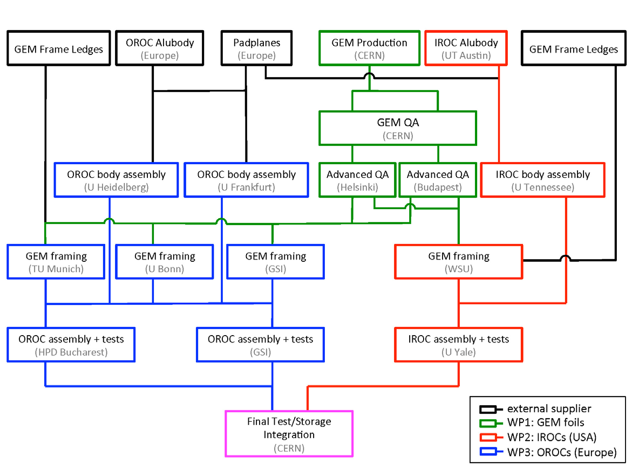
Division of effort and material flow for ROC construction and testing.
Managing material flow is not a small part of the project.
Database is in place and being used to track material location, status and archive QA+test data.

Slide 15
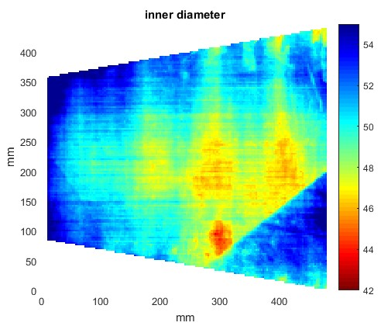
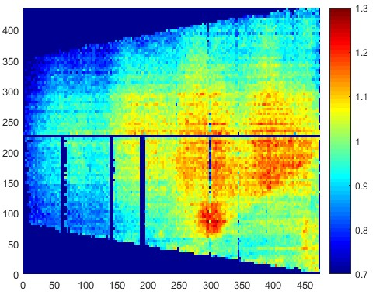
Single Foil Advanced QA
Two institutes have optical scanners and software to measure all inner (polyimide) and outer (copper) hole diameters.
We also can map the gain across single foils.
Training neural net software to predict the gain based on optical measurements.
Clear correlation is seen and the optical scan is faster and easier to do.
Every foil will be optically scanned and acceptance criteria established.
Hole Diameter (mm)
Relative Gain
Scan shown is from “flawed” foil – useful to have larger range of hole sizes for neural net training

Slide 16
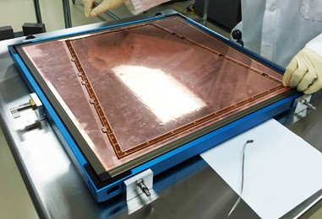
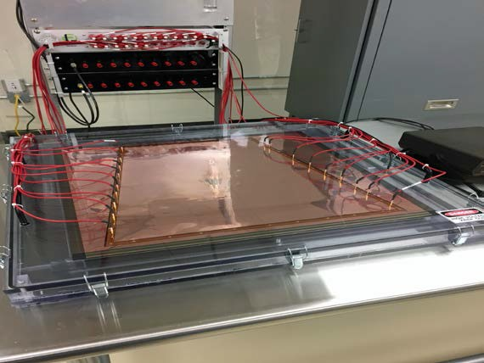


Foil Handling and Testing
Commercial stencil stretching frame used. The inner frame is used for handling foils until they are glued onto fiberglass frame.
HV Testing:
Foil mounted in inner frame as soon as it comes from CERN shop
Stays with foil until foil is finally trimmed to final fiberglass frame
Plexiglass box can be flushed with dry nitrogen.
Spring pins in lid connect to each of the foil HV segments
Multichannel floating pico ammeter developed can measure leakage currents at HV down to a few pA
Foils checked before leaving CERN, at advanced QA site, before and after framing and before mounting in chamber
Outer (blue) frame clamps inner frame and applies calibrated stretching force (Calibrated springs)

Slide 17
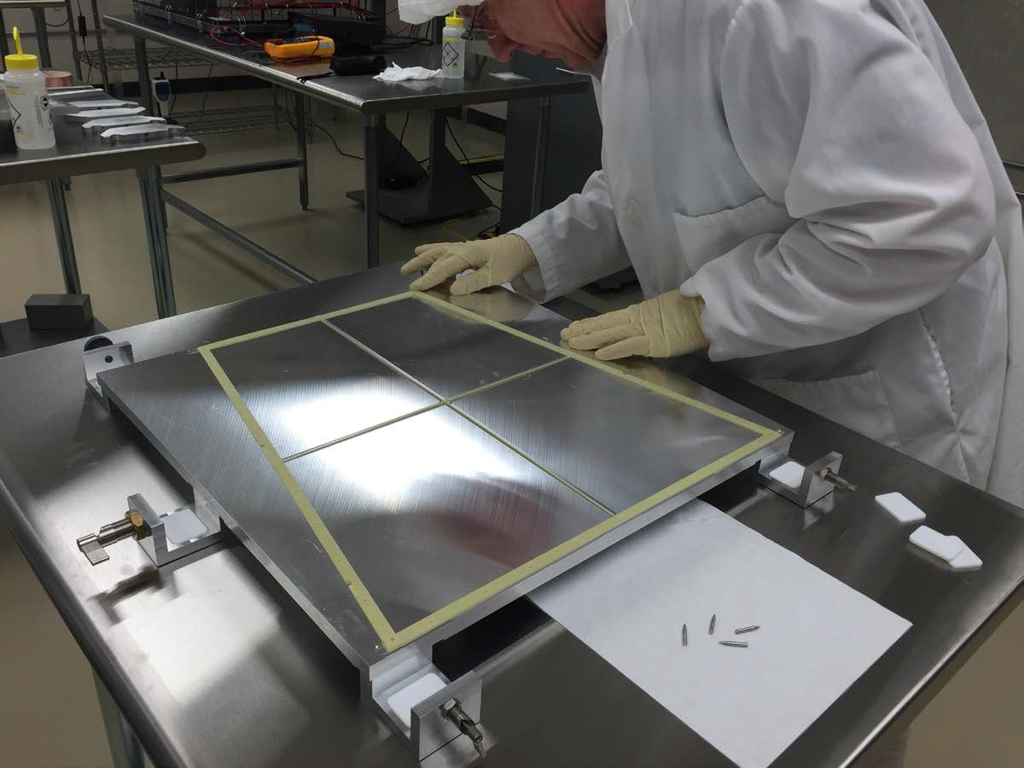
Frame in gluing fixture at Wayne State

Slide 18
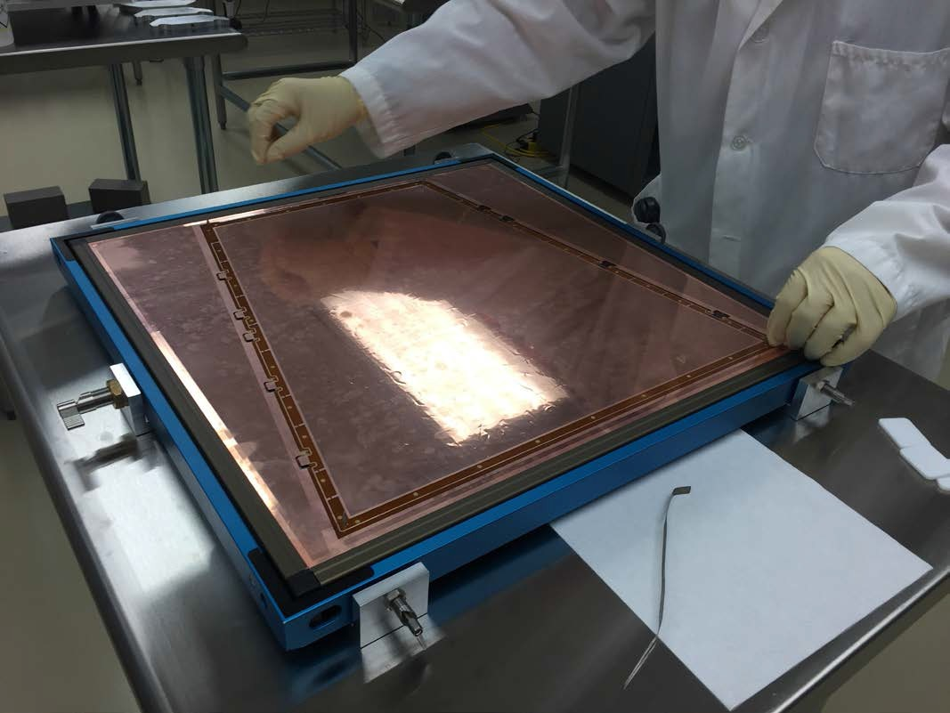
Foil in gluing fixture

Slide 19
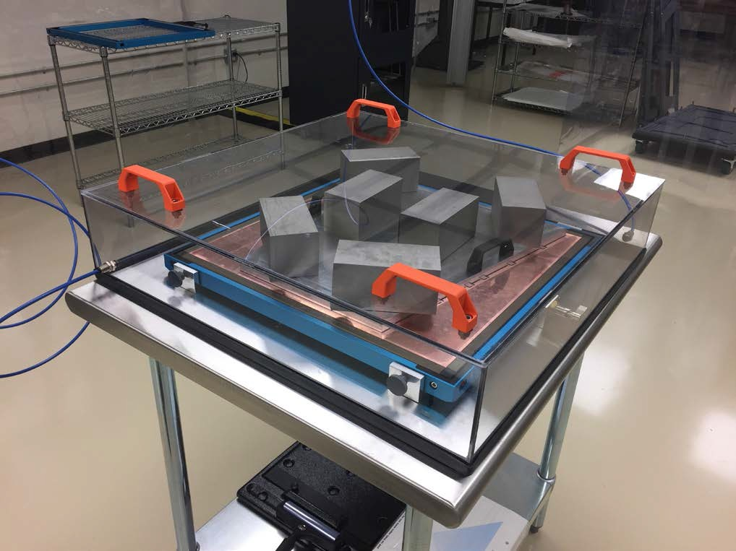
Curing in dry atmosphere

Slide 20
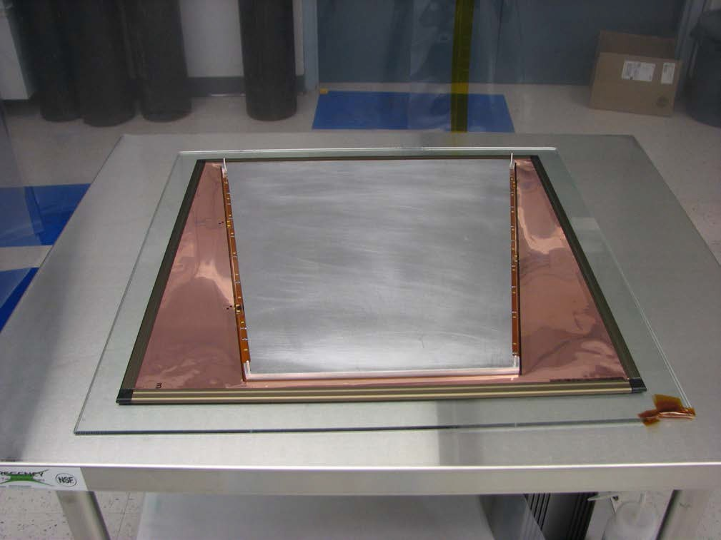
Foil trimming plate
Glass plate with hole matching alignment hole in corner of GEM foil and frame.
Dowel pins keep foil, frame and protective aluminum cover in place during trimming
20

Slide 21
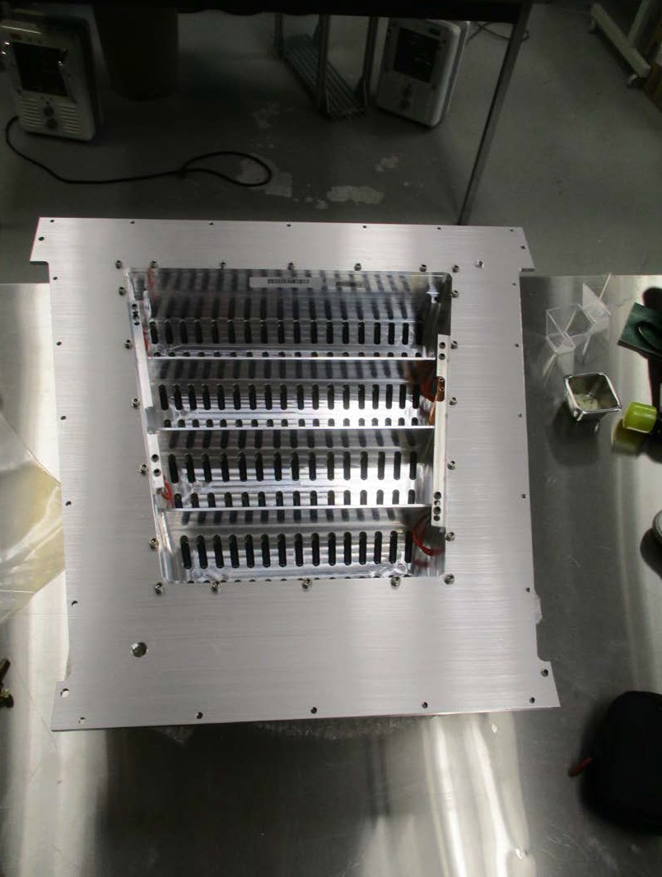
Alubody at Yale, mounted on base plate for test and shipping vessel

Slide 22
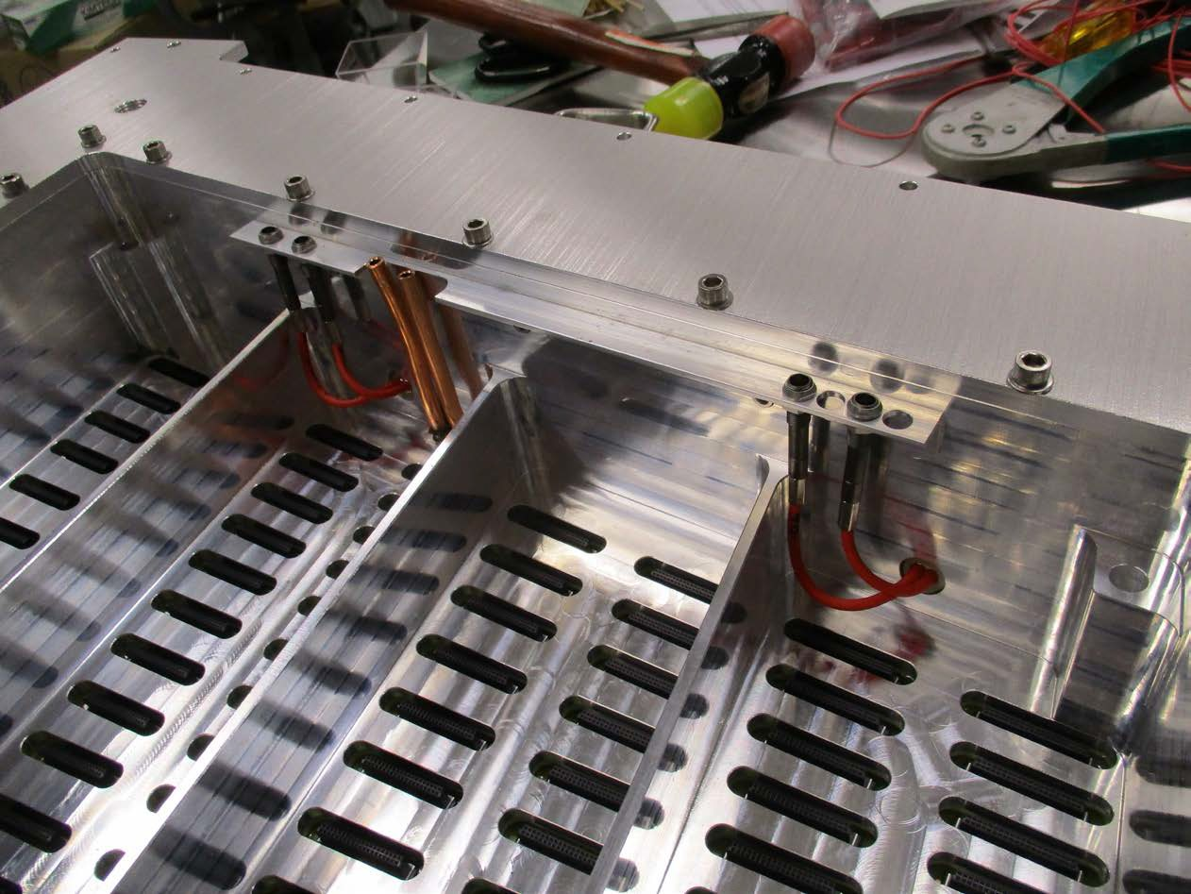
Close up showing high voltage connectors and cooling tubes

Slide 23
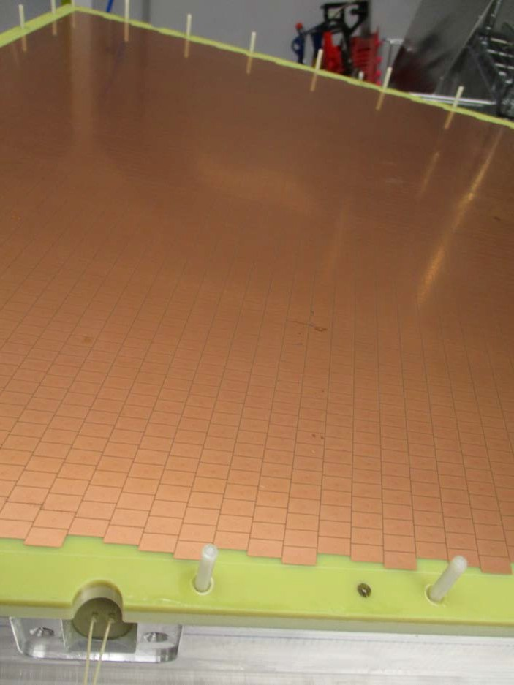

Slide 24
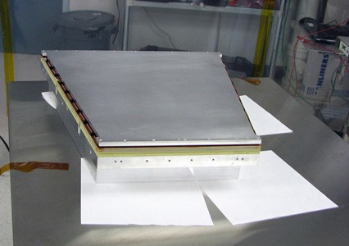
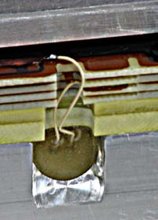


For assembly work, soldering HV leads to GEM’s or when not necessary to have GEM exposed it is always kept covered.

Slide 25
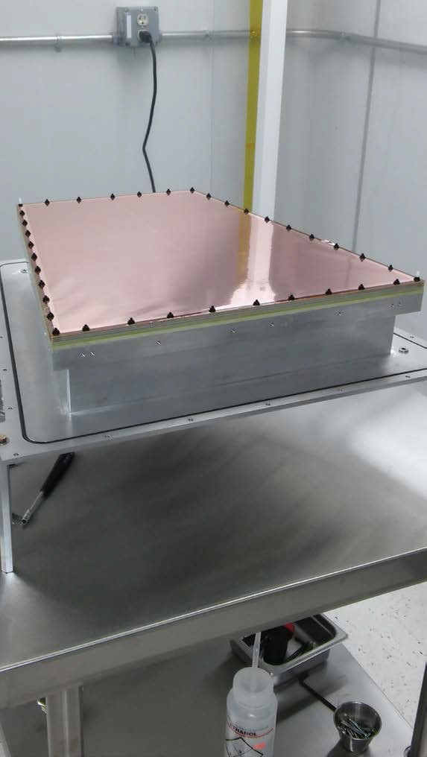
IROC foils assembled on pad plane, alubody, test vessel base plate.
Ready for test vessel cover.

Slide 26
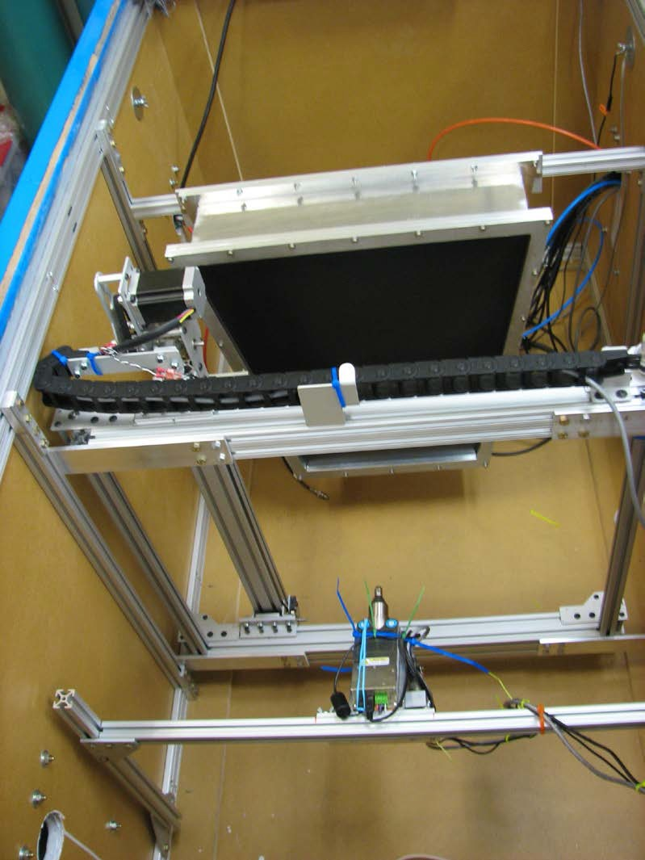
X-ray generator mounted to illuminate full chamber

Slide 27
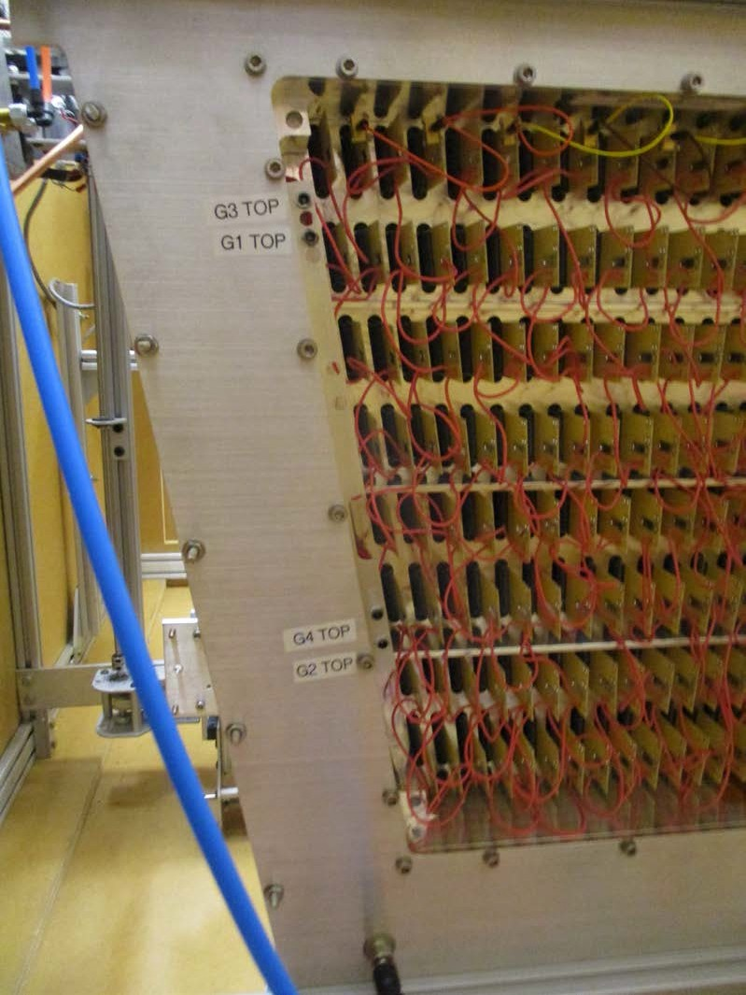
Shorting cards bring current from all read out pads to a current meter.

Slide 28
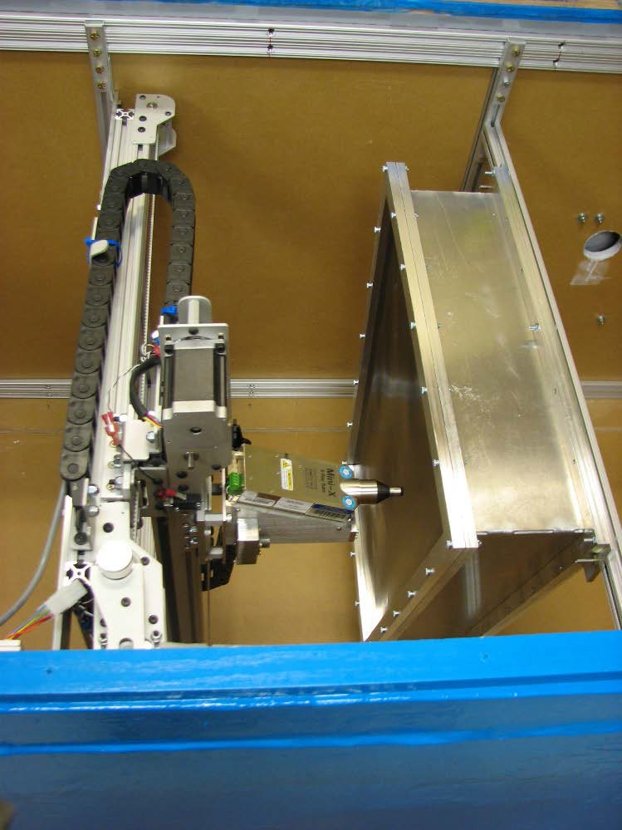



X-ray generator mounted to scan chamber to map gain and ion back flow.
Thin Window
X-Y Stages
X-ray Generator

Slide 29
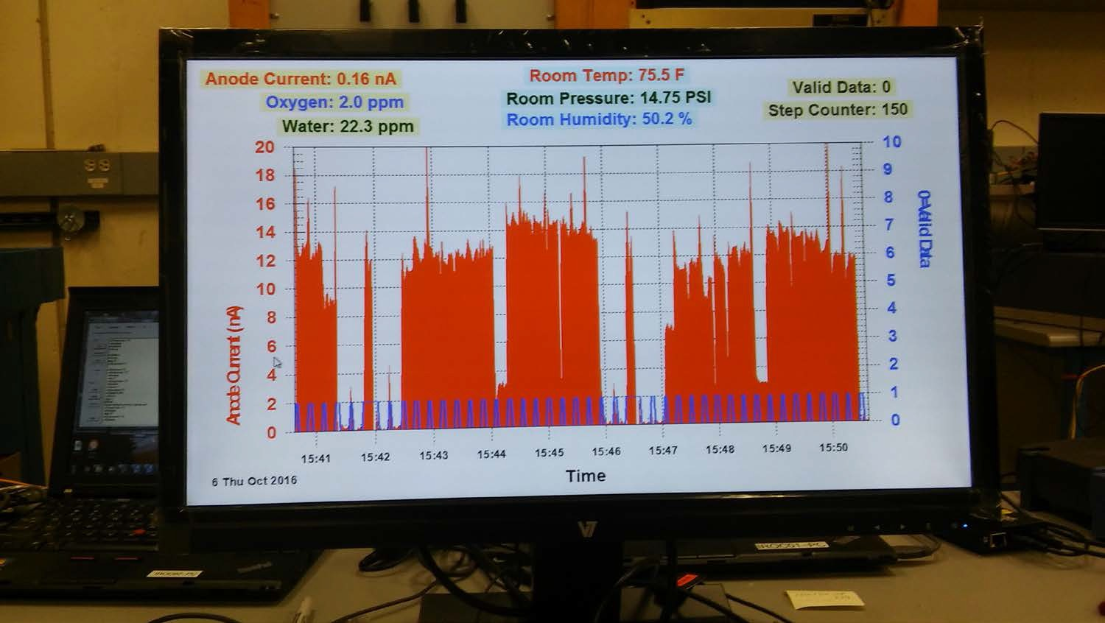
Typical live display while scanning chamber gain vs position

Slide 30
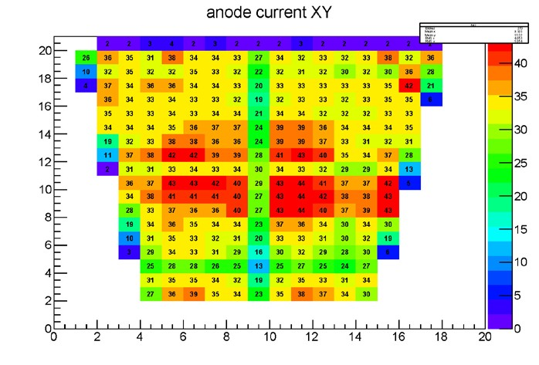
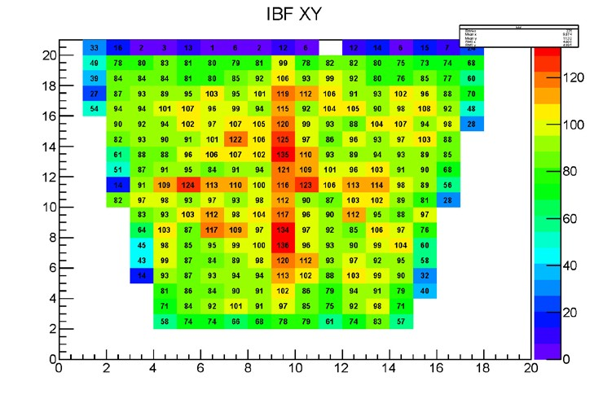
Assembled Chamber Testing and QA
Gas tightness (monitor H₂0, O₂ in gas exit stream)
Gain curve and gain at standard voltages (⁵⁵Fe peak)
Stability – run for 2 days, monitor gain and any discharges
Spatial map of gain and Ion Back Flow (IBF) – scan chamber with collimated X-ray source, measure anode and cathode currents at each location
“Stress” test – illuminate full chamber with X-ray source to give 10 nA/cm² anode current (max. expected in operation at LHC). Monitor for discharges.
Inches
Inches
Inches
Inches
*Local IBF variation can be tolerated if the pattern is stable in time. Tests indicate that it is.
30

Slide 31
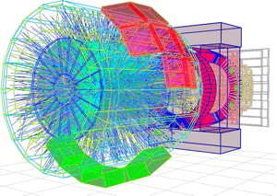
Data Compression
All this data pouring out of the front end has to be further compressed, monitored, used to feed calibrations back into compression, …
3.2 TByte/s into PC farm
O² (Online Offline) System Hardware and software developments ongoing
50 kHz
Reconstruction Compression Monitoring Calibration
Storage
⬅ PEAK OUTPUT
(20 GB/s average)
75 GB/s

Slide 32
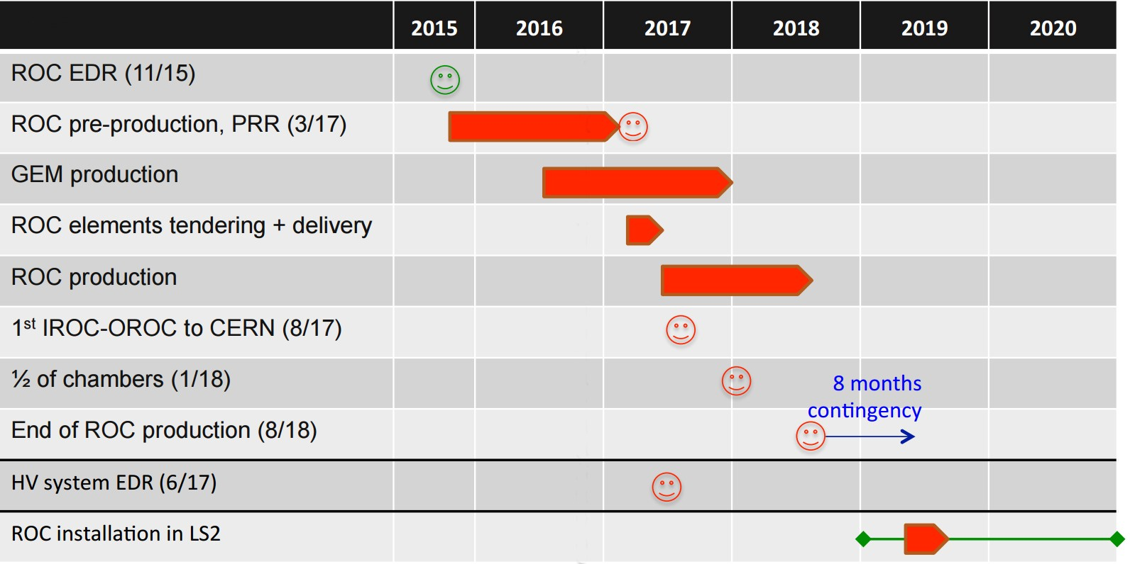
Status and Schedule
Two full prototype IROC and OROC chambers have been built using nearly final design and tested
Changes made to design and to procedures
Final-design parts ordered for 5 IROC and 5 OROC chambers
Gain more experience before starting full production
Final design chamber built and under test now.
→
→
→
→

Slide 33
Backup Slides

Slide 34
New Front End Card (FEC) for TPC Upgrade readout - 5 x 10⁵ Channels
Uses five ALICE custom-designed 32 channel ASICs (SAMPA) providing preamp/shaper/ADC and digital signal processing
3276 FECs will be installed, each with 160 channels using radiation tolerant components (rad tolerant to 5.6 kRad integrated dose)
System continuously digitizes signals at 5 MHz* for 0.5 M TPC channels.
FECs send digitized data over fiber optic links to ALICE Common Readout Units (CRU)
*Detailed simulations show that the TPC sampling rate can be lowered from the present 10 MHz to 5 MHz without compromising the physics performance.
>> Onboard front end zero suppression not required
Baseline correction and zero suppression can be done in a computer – much easier to program and change if needed.

Slide 35
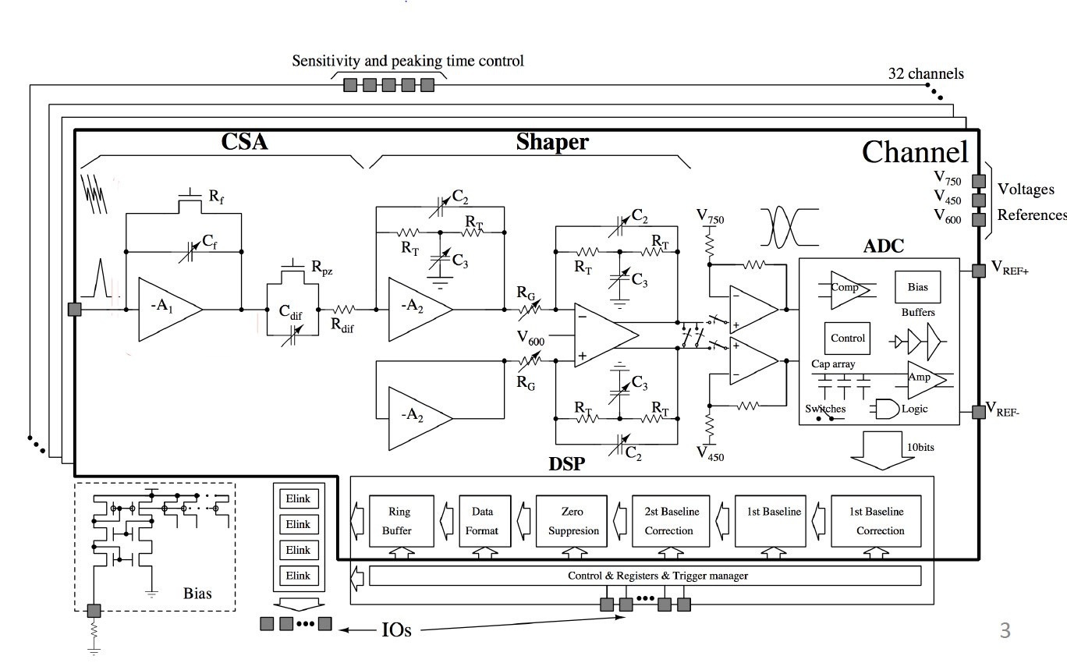
SAMPA – Custom ASIC for TPC and Muon Tracking Chambers
SAMPA = 32 channel chip – mixed analog and digital – also used for muon tracker upgrade Development plan allows 3 cycles
Cycle 1 – functionality divided into 3 chips, lots of test features included
Cycle 2 – all functions integrated into one chip
Delivered and tested. Noise performance looks very good - average 360 electrons on the bench
Some glitches in digital part found but workarounds have allowed functional front end cards (FEC) to be built
Test
Cycle 3 – all fixes incorporated
Submit this Spring
Expect chips in Summer
Work already ongoing for final FEC design
Test fully instrumented chamber

Slide 36
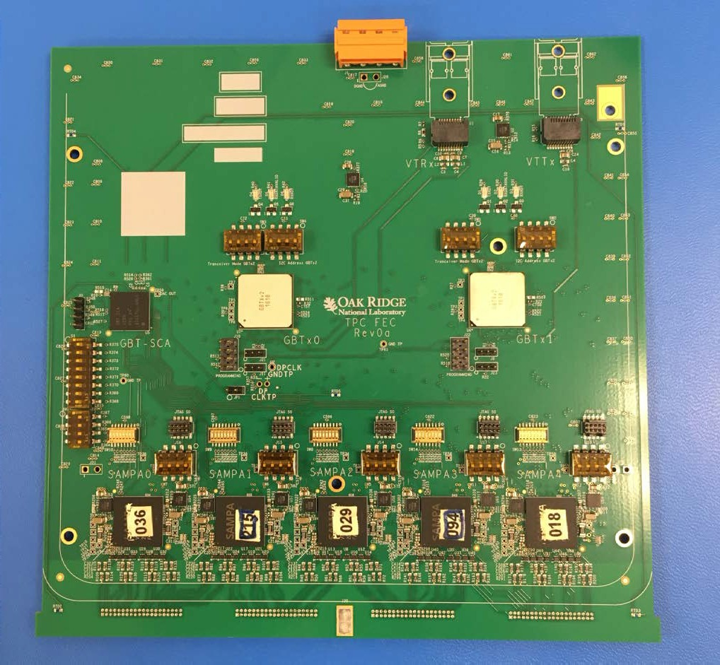





TPC Front End Card Prototype (Rev. 0a)
5 cycle 2 SAMPA chips
4 connectors for flat jumpers to connectors on pad plane
Note: Final FEC will be rigid-flex with a flex layer extending here to plug directly into pad plane connectors – no jumper cables needed
18.4 cm
18.6 cm

Slide 37
Summary
The ALICE collaboration is building a major upgrade for the ALICE TPC to be installed in the LHC Long Shutdown 2 (2019-2020)
This upgrade will allow operation in the high luminosity in LHC runs 3 and 4 (50 kHz Pb-Pb collision rate) while maintaining the current physics performance of the TPC.
The upgrade involves:
Replacing all readout wire chambers with quadruple-GEM chambers.
The GEMs are designed to minimize ion back flow to allow continuous, ungated and untriggered readout.
Replacing the front end electronics with electronics based on a new ASIC (SAMPA) designed to allow continuous readout
Developing software to achieve compression of the 3.2 TB/sec raw data from the TPC
This upgrade will allow ALICE to record the full Pb-Pb luminosity and gather very high statistics data sets even for processes where a trigger is not possible.

Slide 38
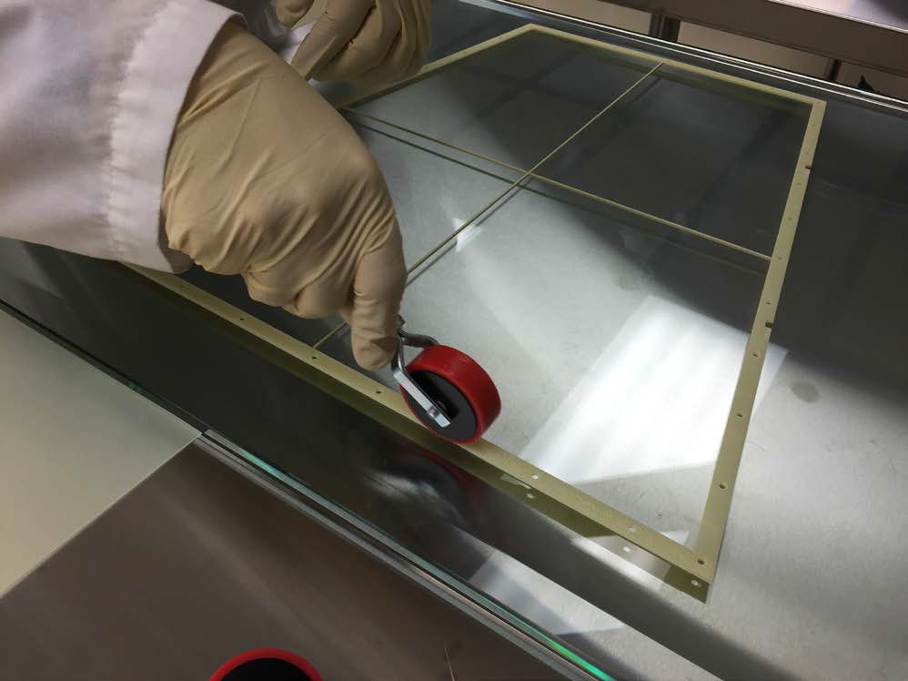
Using roller to apply epoxy

Slide 39
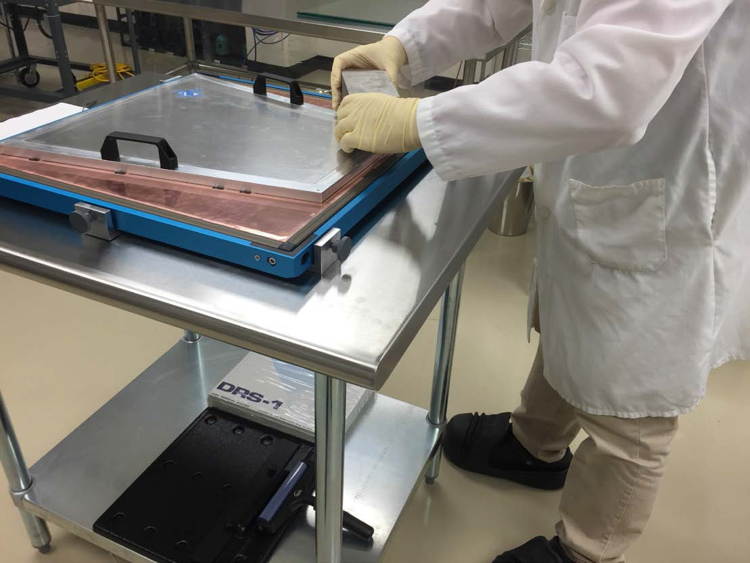
Pressure plate and SS bricks

Slide 40
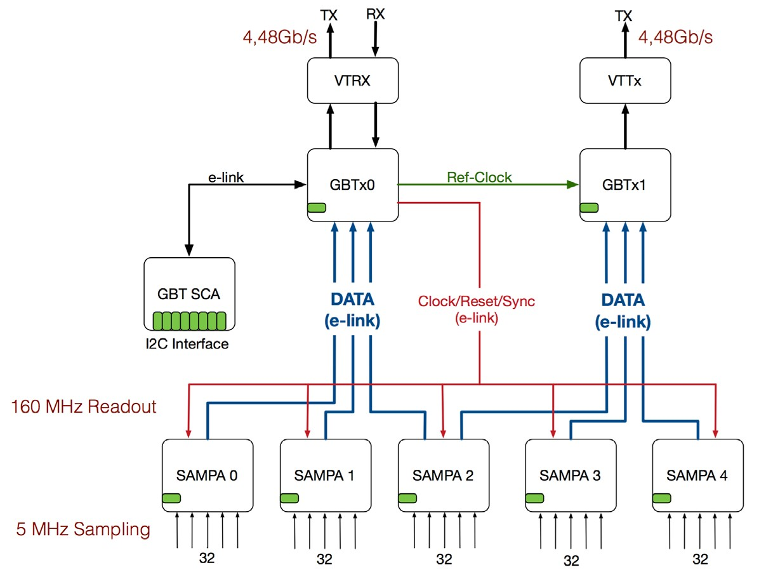
FEC Block diagram
40

Slide 41
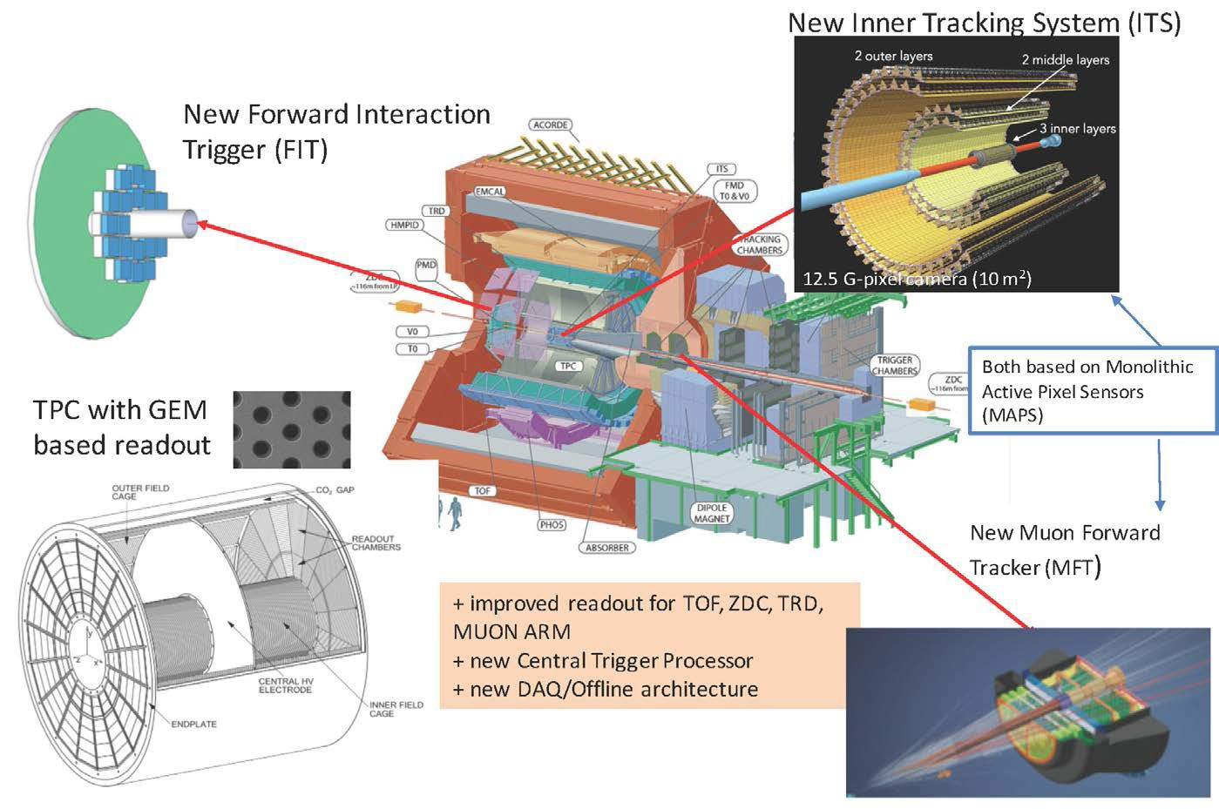
What will ALICE do to exploit these new physics opportunities?
Next Presentation, Paolo Martinengo
The new Fast Interaction Trigger detector for the ALICE Upgrade Wladyslaw Henryk Trzaska, Poster
Detector Control System of the new Muon Forward Tracker at ALICE Kenta Shigaki, Poster
Prospects for ALICE physics with the Muon Spectrometer Upgrade
and the new Muon Forward Tracker
Antonio Uras, Poster
This Presentation

Slide 42
Nygren, http://www.slac.stanford.edu/pubs/slacreport s/reports04/slac-r-190.pdf, p 126

