Slide 1
Status of IROC assembly at University of Tennessee, Knoxville (UTK)
Andrew Castro, Charles Hughes, Soren Sorensen, Will Witt
Functions performed at UTK
  Gluing of alu-body, strongbacks, and pad-planes
  Gluing of HV connectors
  Leak testing of assembled IROCs
Laboratory status
  Lab was setup from scratch in 2016. We have been allocated ~300 sqft in a room next to the office of our postdoc and graduate students.
  The lab consists of a vacuum table on loan from Heidelberg, 3 large tables, 2 rolling tables,. We have also purchased a laptop for DAQ, an oxygen sensor, and miscellaneous workshop tolls.
Production status
  In 2016 we produced 2 pre-production IROCs.
  In 2017 we have produced 5 production IROCs that have been shipped to Yale.
  We estimate we can produce at ~8 IROCs per months once we have the components ready.

Slide 2
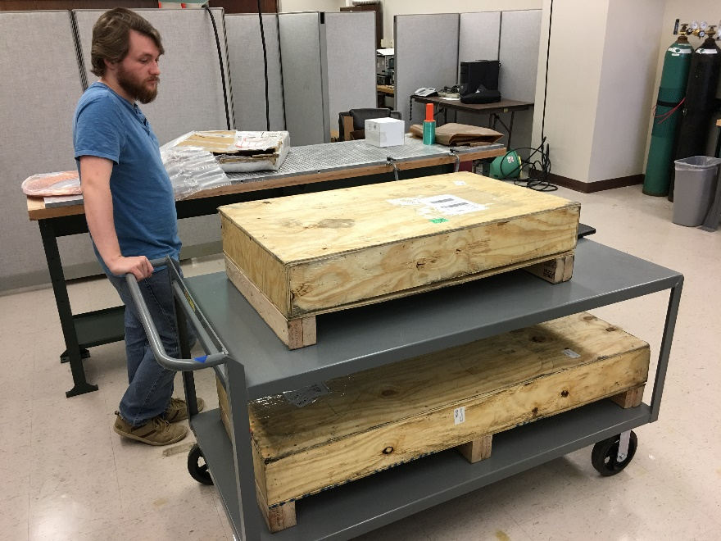
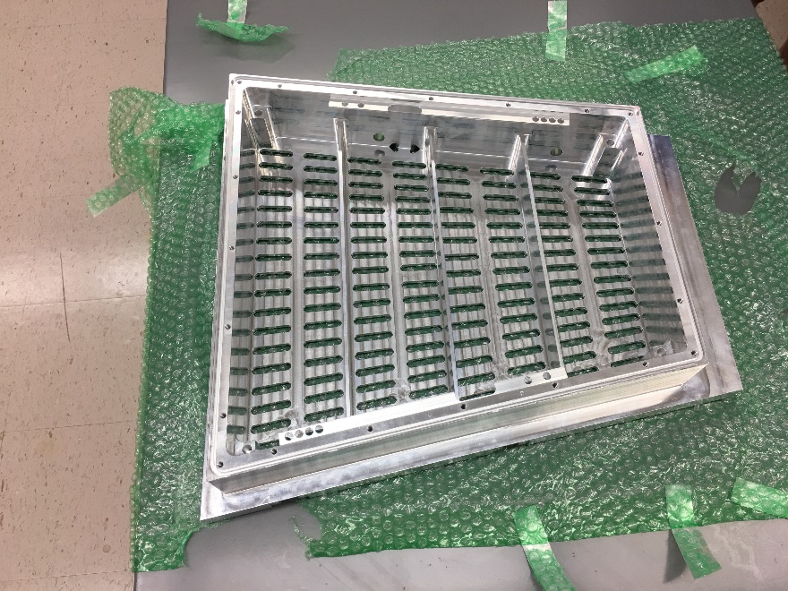
Reception of AluBodies (AB) from Texas
Clean and Organize IROC lab using compressed air. Wipe down all surfaces. Make sure everything is put away correctly
Check for defects in AluBody(AB). Clean all surfaces, especially all holes on AB.
Inspect L-Profiles on inner surface of AB
Inspect protective 3M layer on PP GEM side
Remove barcode sticker on PP and place on underside of AB. Record ID number above.

Slide 3
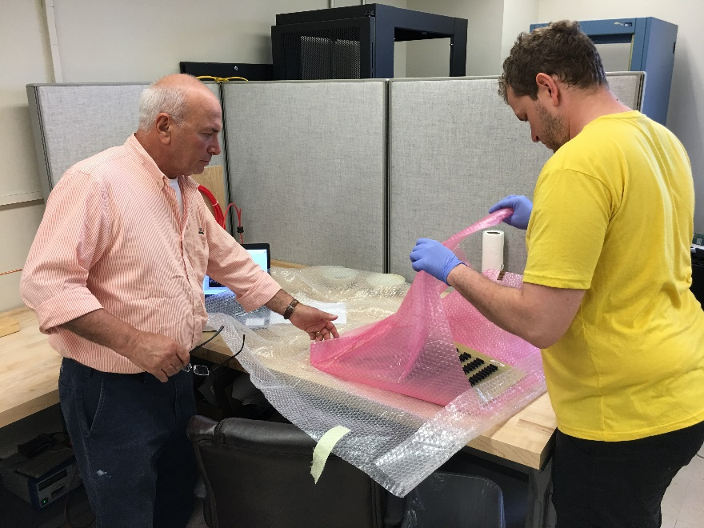
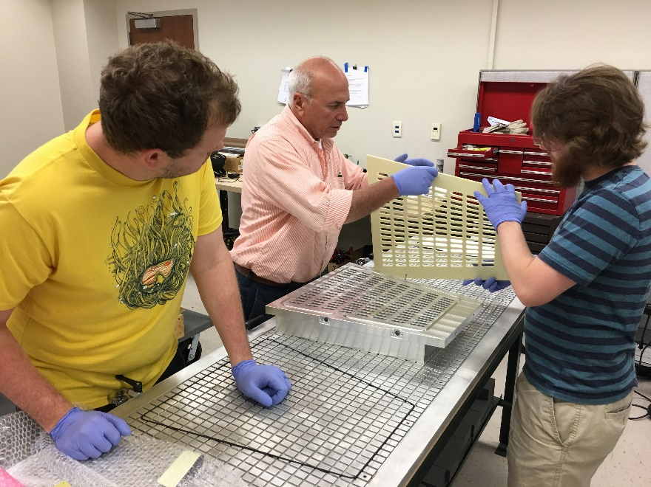
Inspection of AluBodies, Strongbacks and Pad-planes

Slide 4
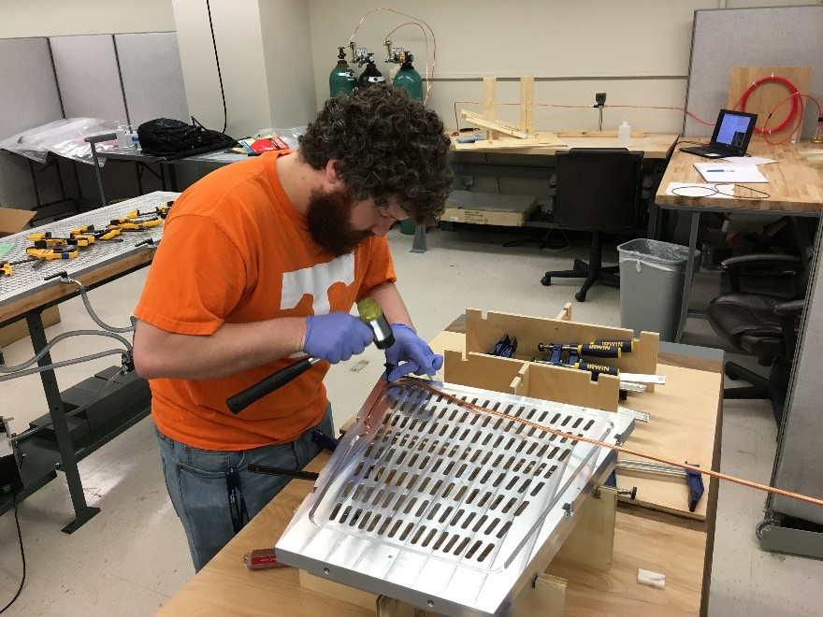
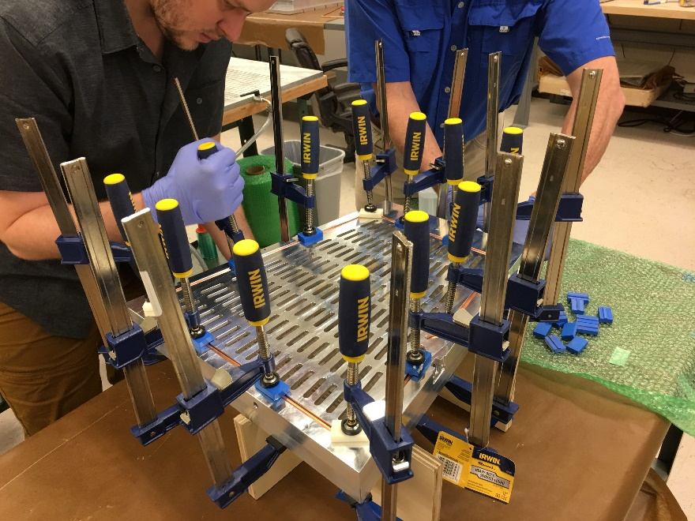
Production of cooling tube
The cooling tube is made of 6.0 mm Cu with a total length of ~65”.
The tube is formed by using the groove in the alubody.

Slide 5
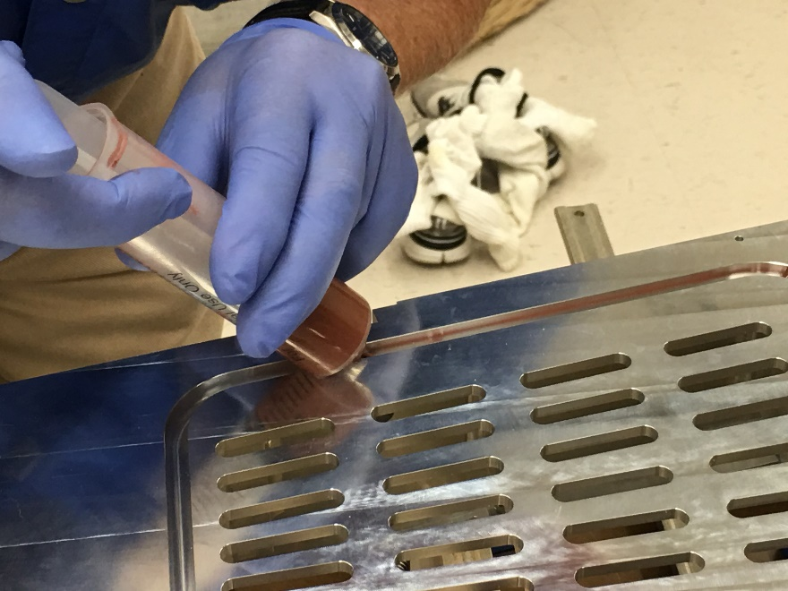
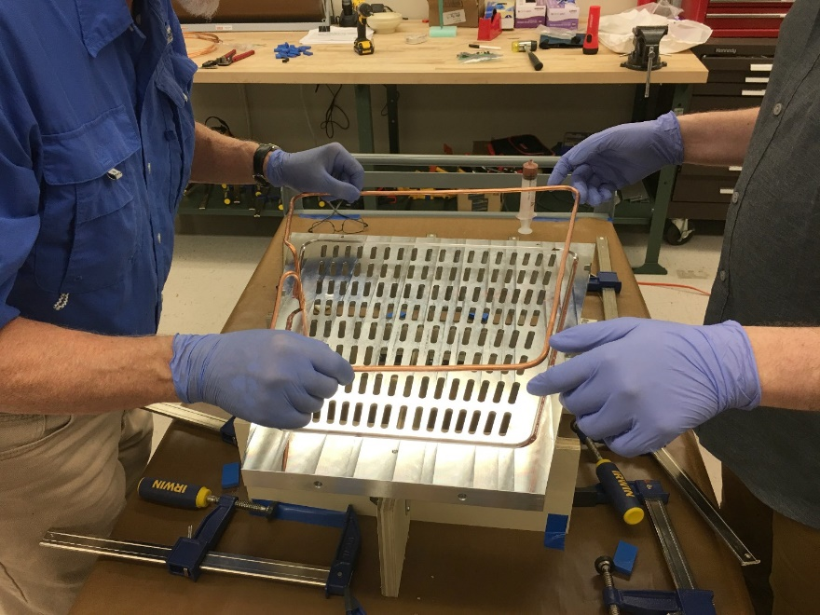
Gluing of cooling tube I
The cooling tube is glued in place using epoxy mixed with Cu powder to optimize the heat transfer.

Slide 6
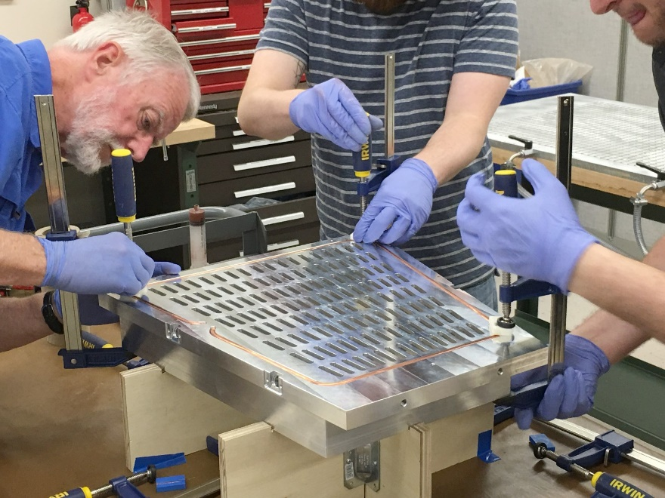
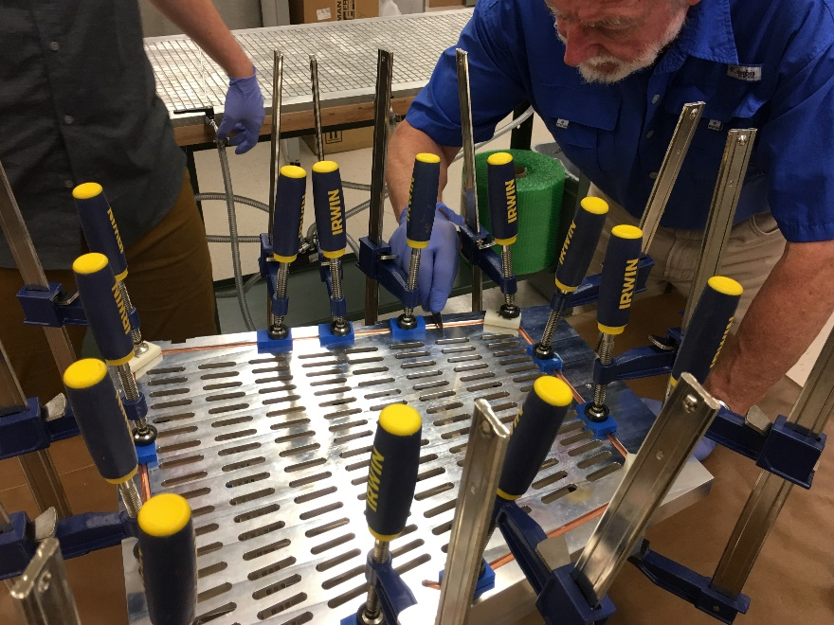
Gluing of cooling tube II
Fastening the cooling tubes while epoxy is hardening
Testing that the cooling tube is situated below the horizontal plane of the Alubody

Slide 7
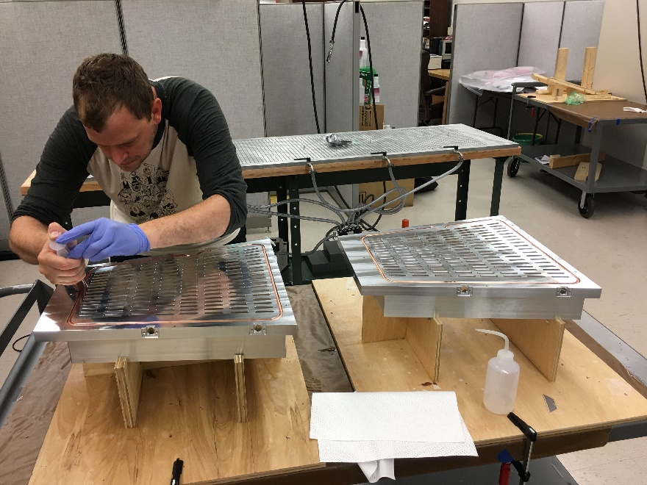
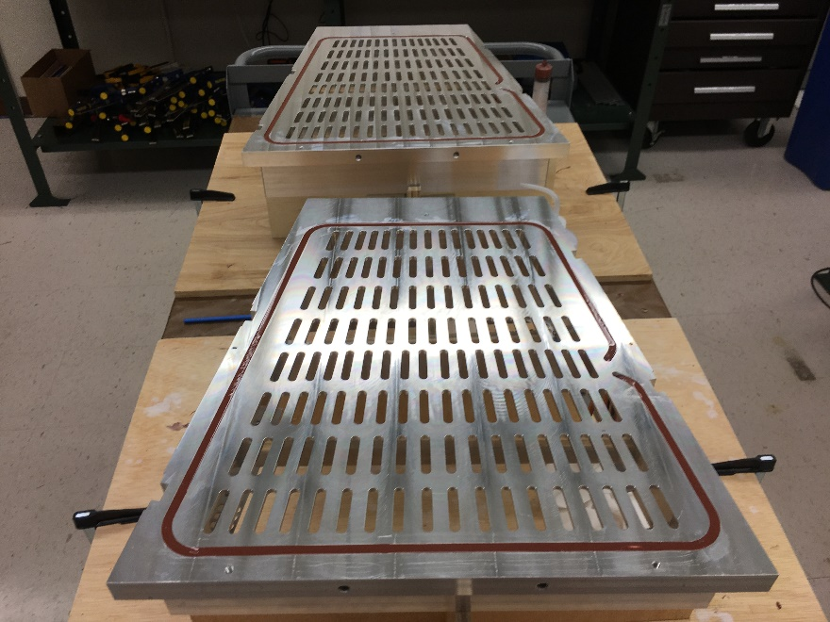
Gluing of cooling tube III
Applying the top layer of epoxy for the cooling tubes.
Please note homemade jigs for holding the alubodies during the gluing process.
For the production stage we are processing 2 IROCs in parallel.

Slide 8
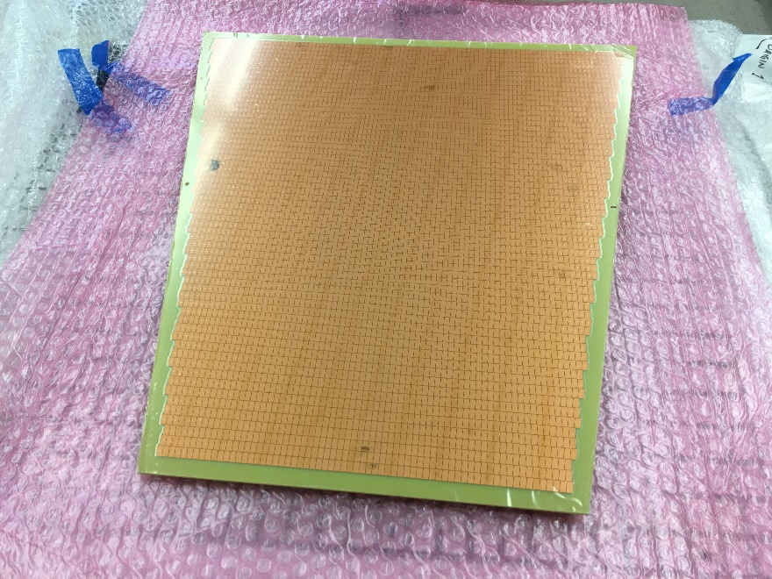
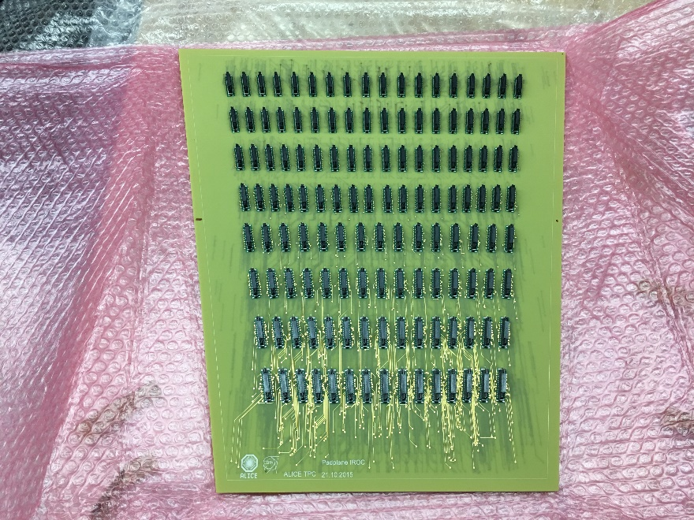
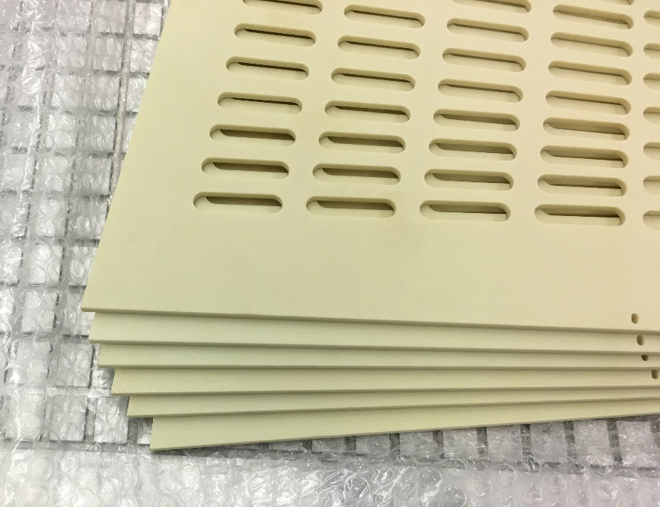
Preparation of Pad Planes and Strongbacks
Inspect and clean pad-planes and strongbacks

Slide 9
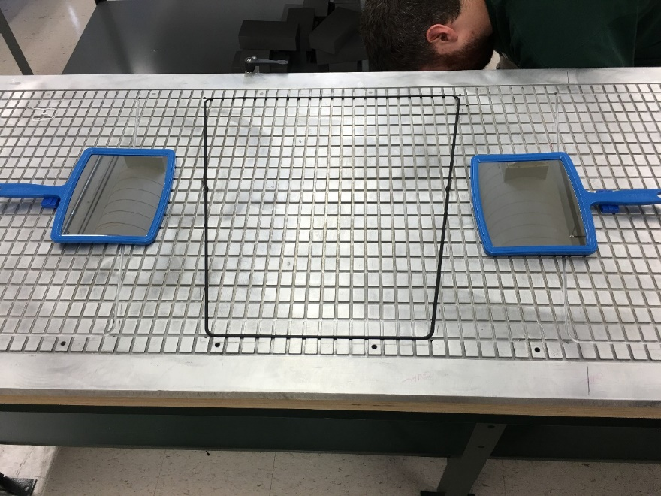
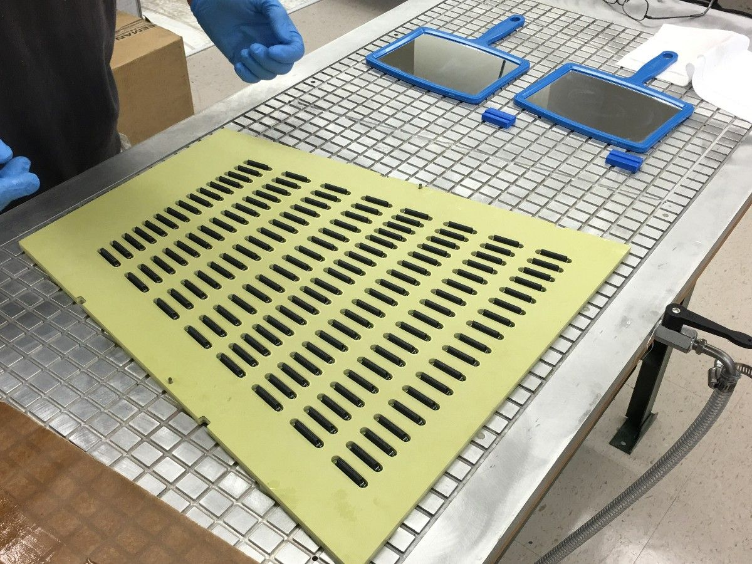
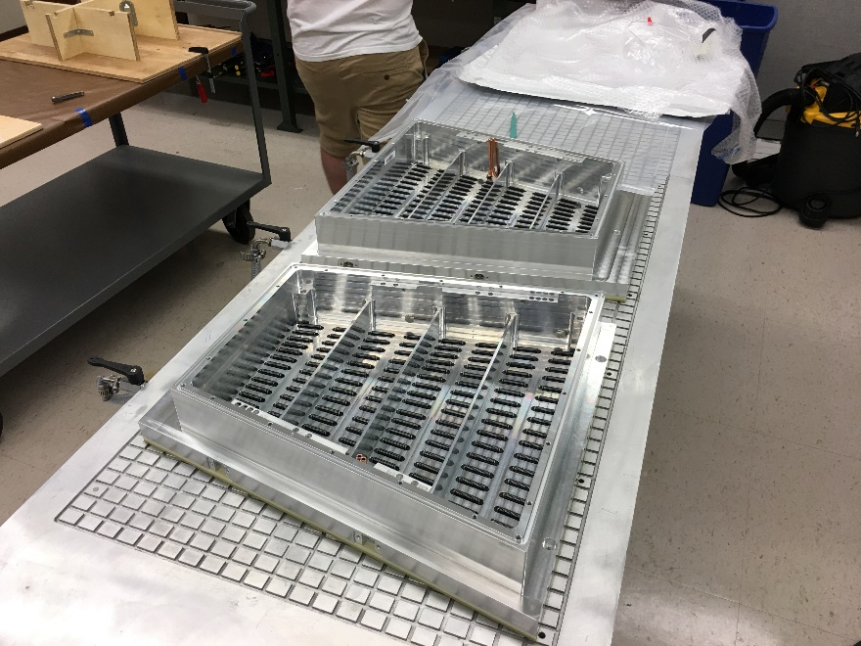
Gluing of components I
Vacuum table from Heidelberg is used for the gluing operation
Initially dry mount pad plane, strongback and alubody to test pinhole alignment and planarity

Slide 10
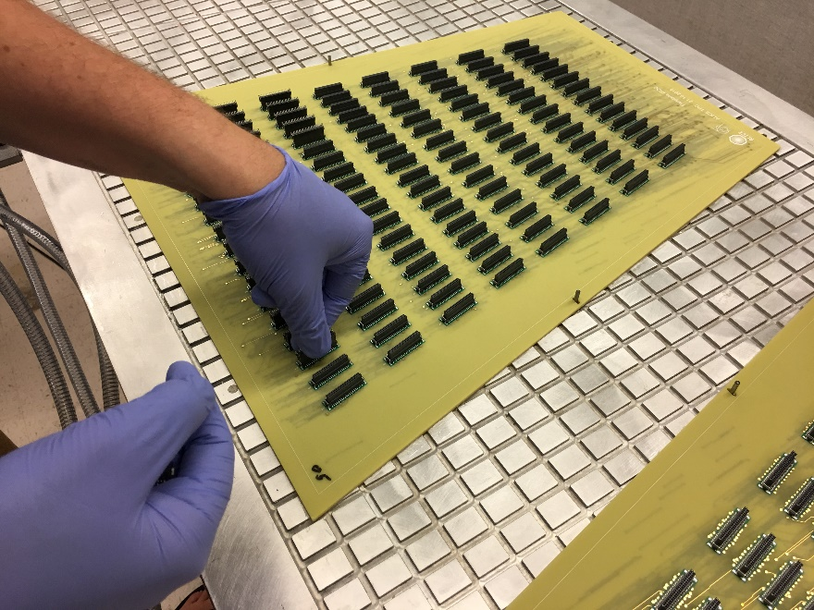
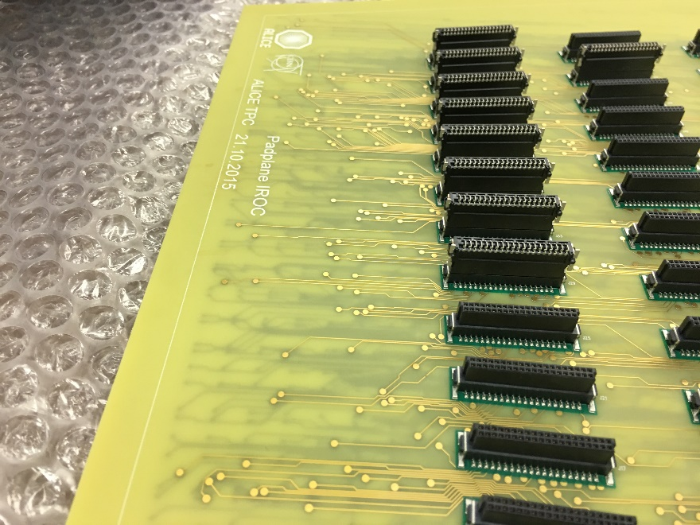
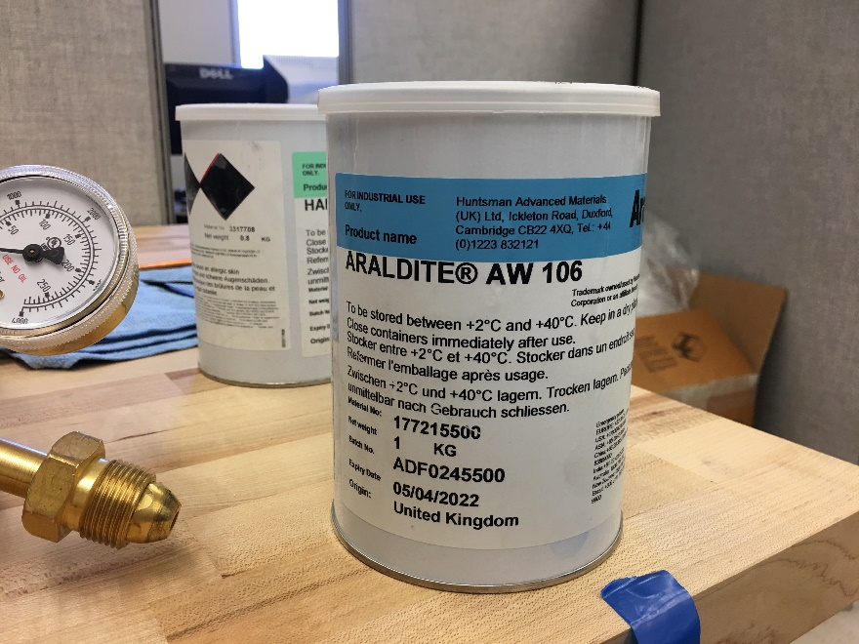
Gluing of components II
Place dummy male connectors on ERNI female connectors to avoid glue contamination.
Apply epoxy (each layer ~200 - 300 um thick using plastic roller) 20 g resin, 16 g hardener per side of IROC

Slide 11
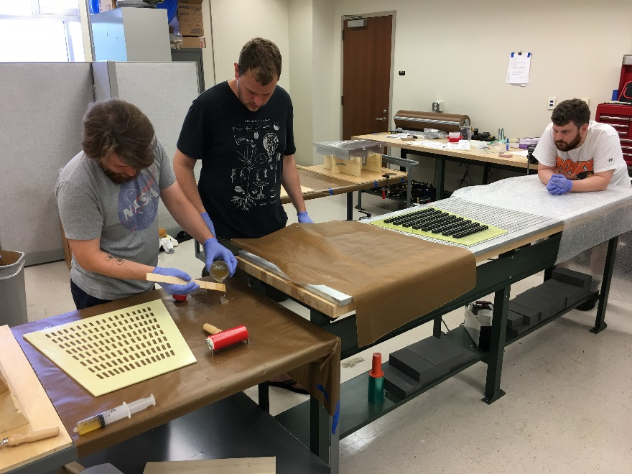
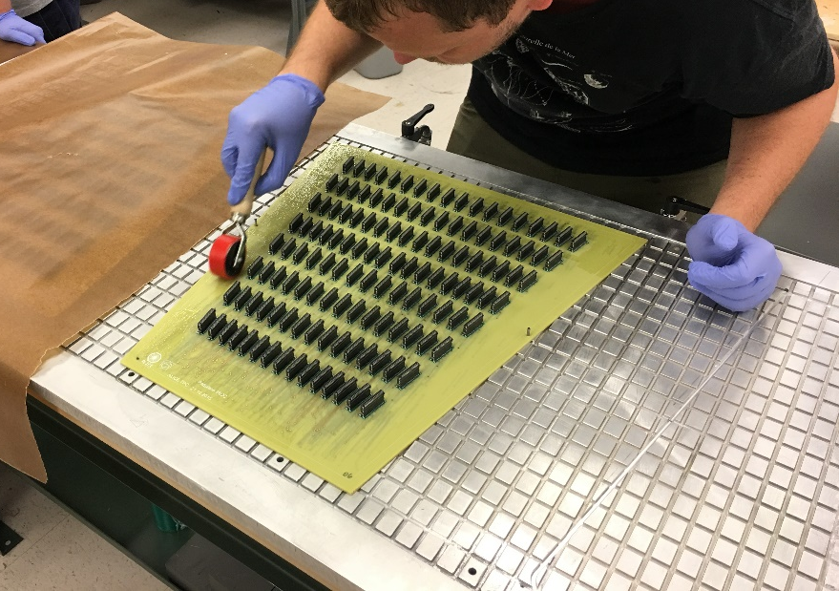
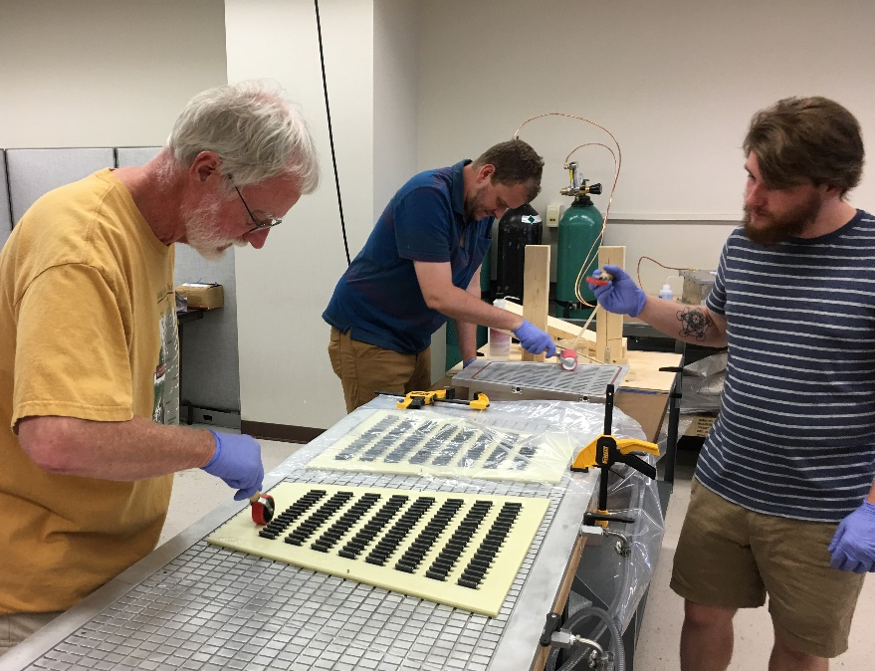
Gluing of components III
Apply epoxy to each of the 4 surfaces (1 pad plane, 2 strong backs and 1 alubody) using rollers of various lengths.
Gluing 2 IROCs at a time.

Slide 12
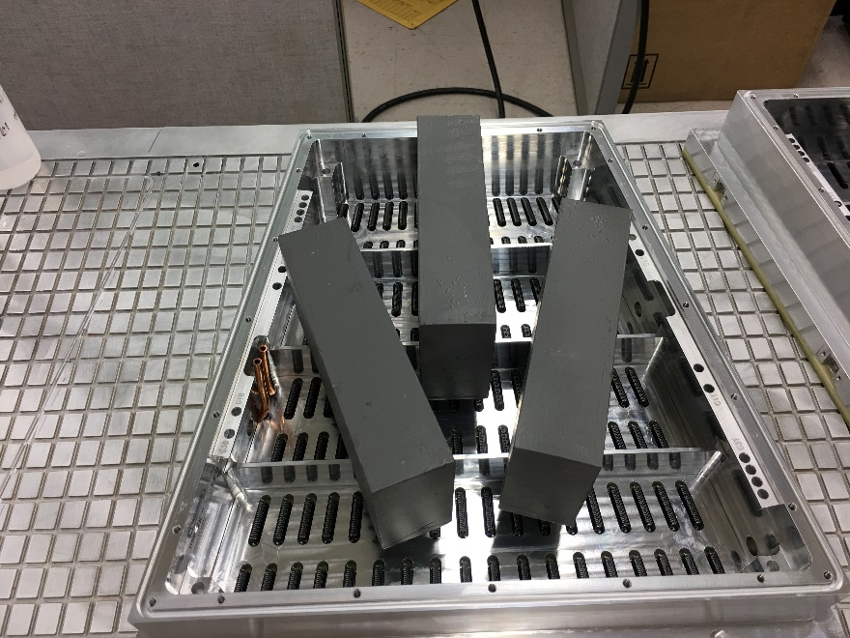
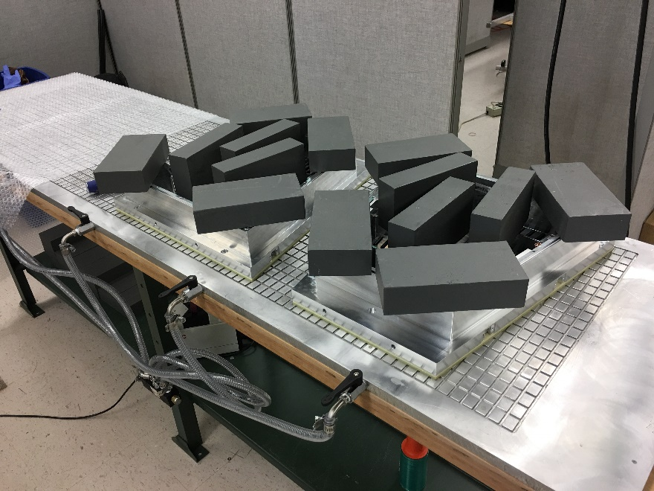
Gluing of components IV
After gluing place lead bricks to apply pressure to glued surfaces.
Place lead bricks in the middle initially to ensure flow of epoxy is towards the edges.
Surplus epoxy oozing from the edges are cut after 1-1.5 hours.
Curing for 16-24 hours under pressure.

Slide 13
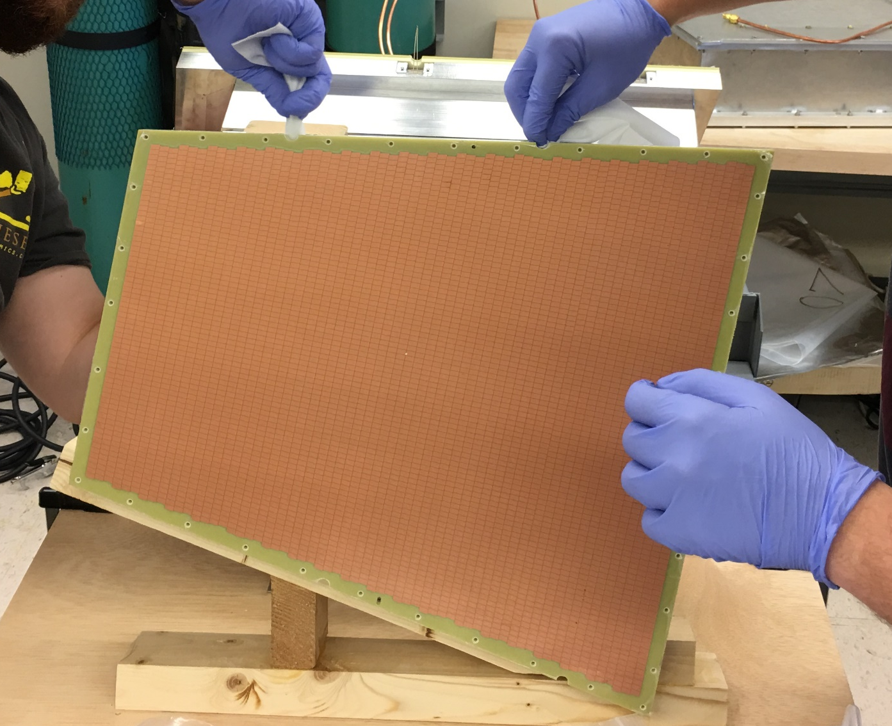
GEM Frame support holes and prep for gluing of HV connectors
After main gluing operation the UTK Mechanical Workshop drills holes for the GEM Frame support and makes cutouts for the HV wires.
Preparation for gluing of HV connectors on homemade jig providing horizontal gluing surfaces.

Slide 14
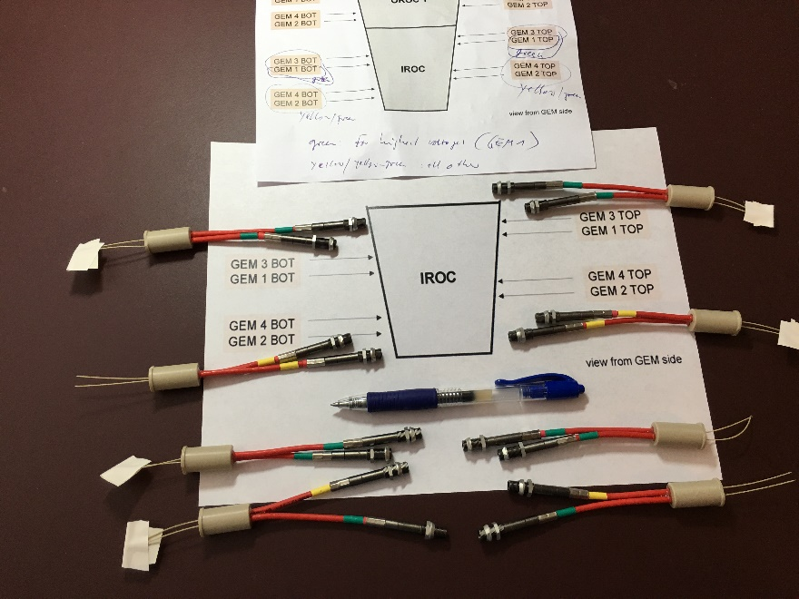
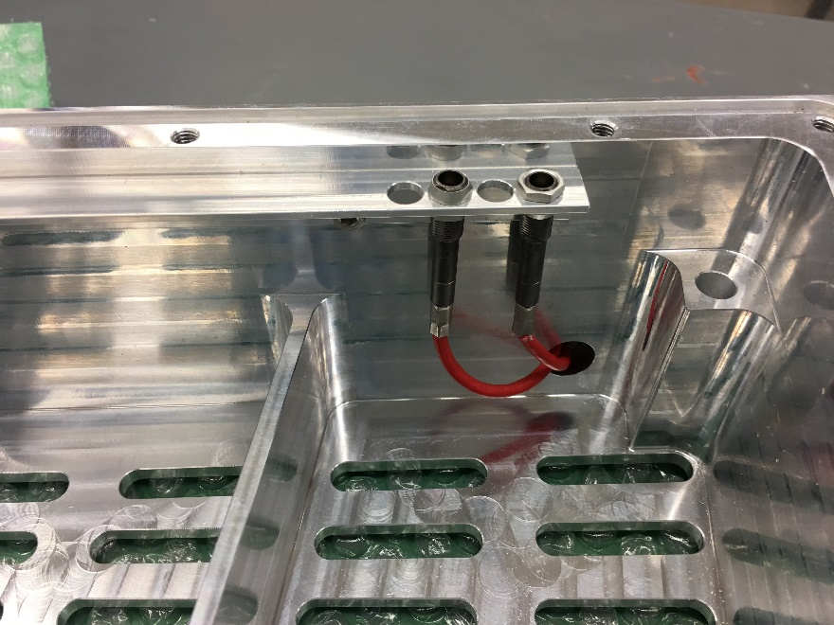
HV Connectors
Layout of HV connectors (photo from pre-production)
Mounting of HV Lemo connectors on the electronics side of IROC (test prior to actual gluing).

Slide 15
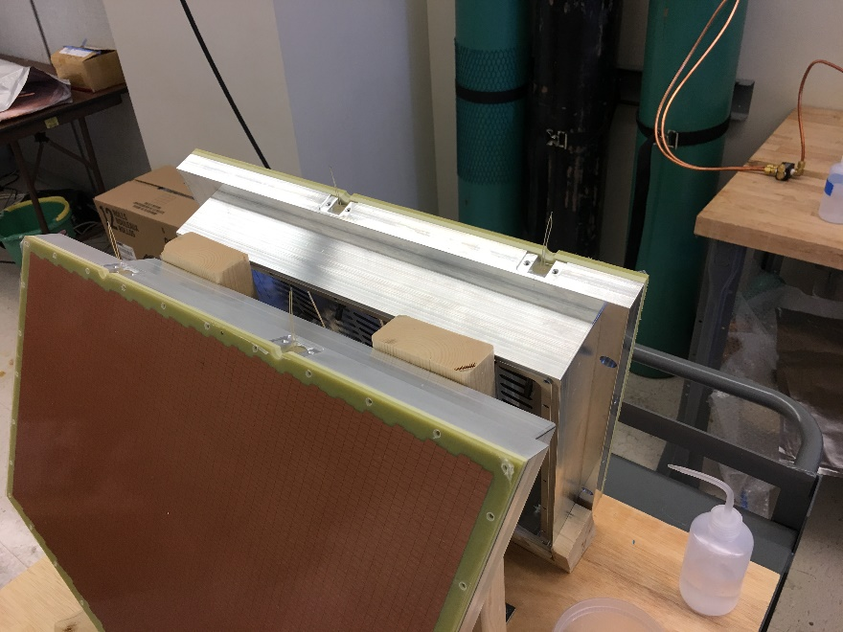
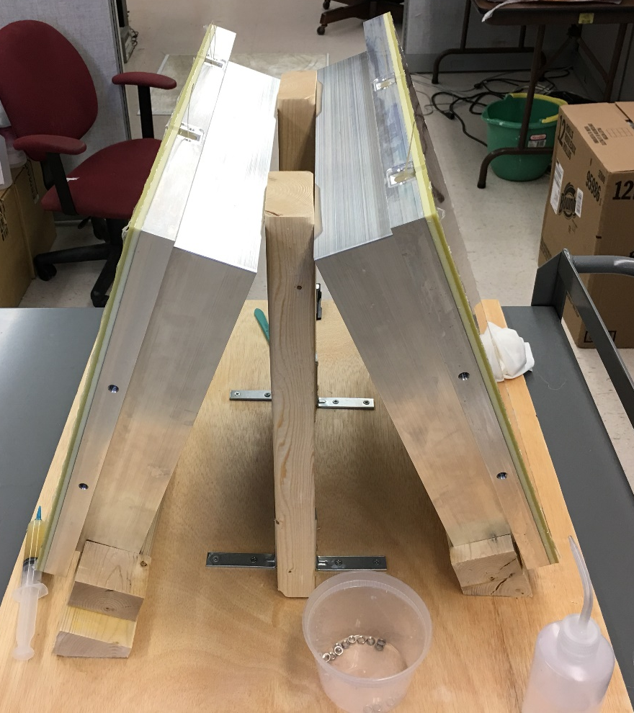
Gluing of HV connectors II
Gluing of HV connectors.
Takes 2 days since each side has to cure prior to moving IROCs

Slide 16
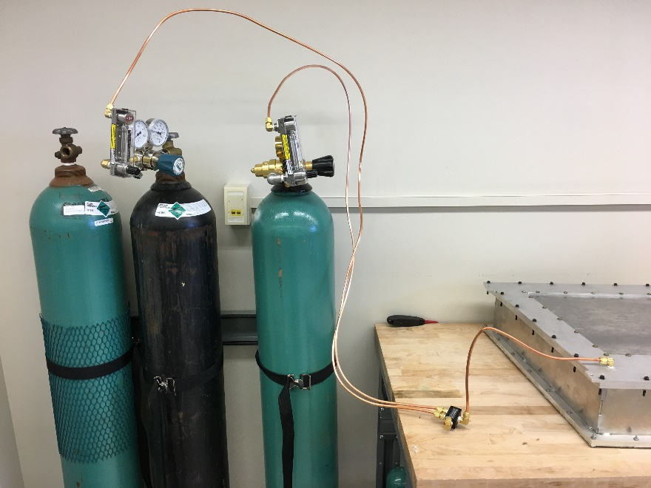
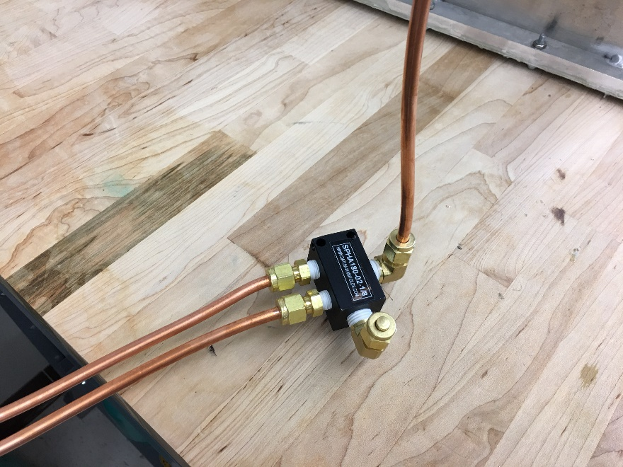
Leak Test Setup I

Slide 17
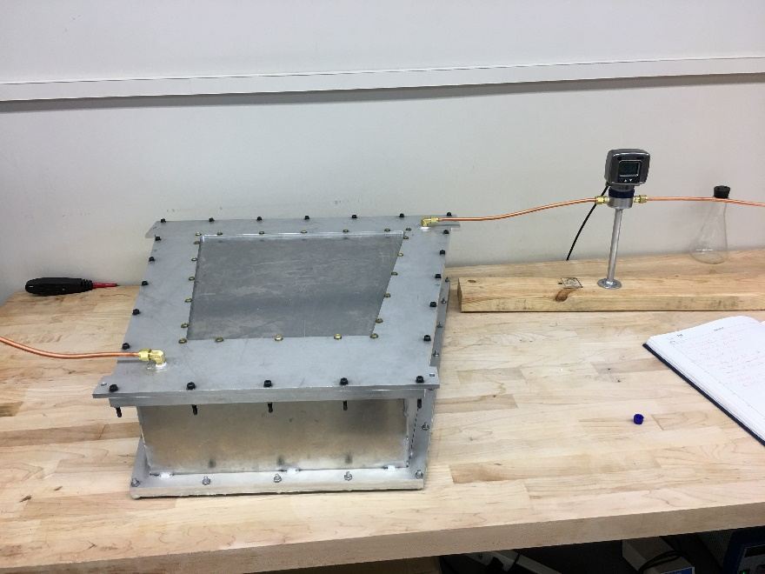
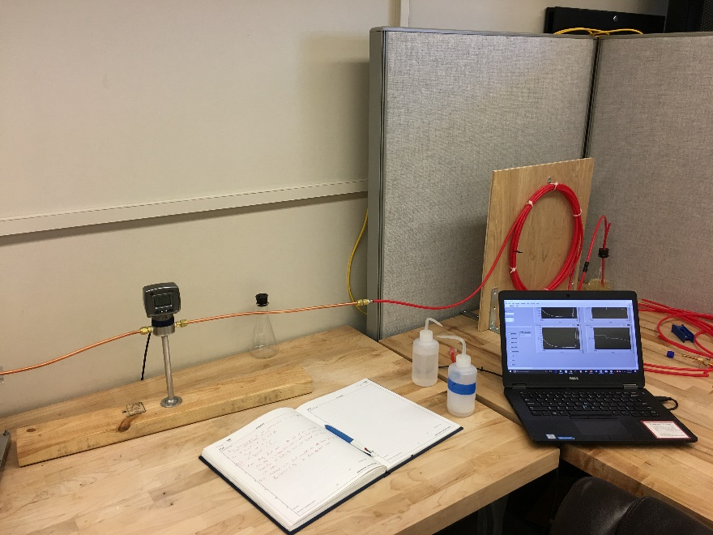
Leak Test Setup II

Slide 19
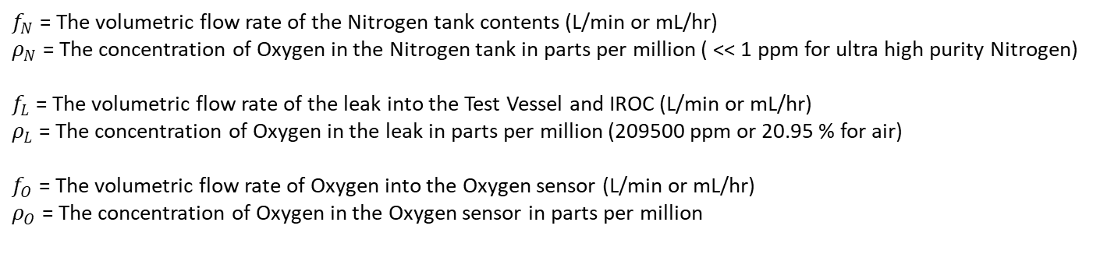
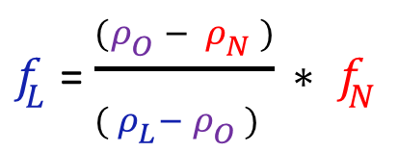
Leak Test Measurements
$f_{N}$ = The volumetric flow rate of the Nitrogen tank contents (L/min or mL/hr)
$ρ_{N}$ = The concentration of Oxygen in the Nitrogen tank in parts per million ( << 1 ppm for ultra high purity Nitrogen)
$f_{L}$ = The volumetric flow rate of the leak into the Test Vessel and IROC (L/min or mL/hr)
$ρ_{L}$ = The concentration of Oxygen in the leak in parts per million (209500 ppm or 20.95 % for air)
$f_{O}$ = The volumetric flow rate of Oxygen into the Oxygen sensor (L/min or mL/hr)
$ρ_{O}$ = The concentration of Oxygen in the Oxygen sensor in parts per million
$f_{L}$ = $\frac{(ρ_{O} − ρ_{N} )}{( ρ_{L}− ρ_{O} ) }∗ f_{N}$

Slide 20
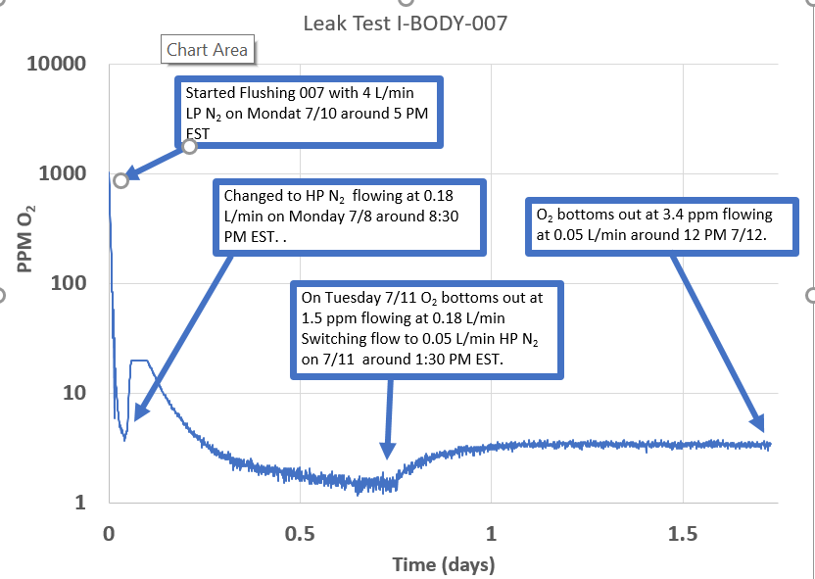
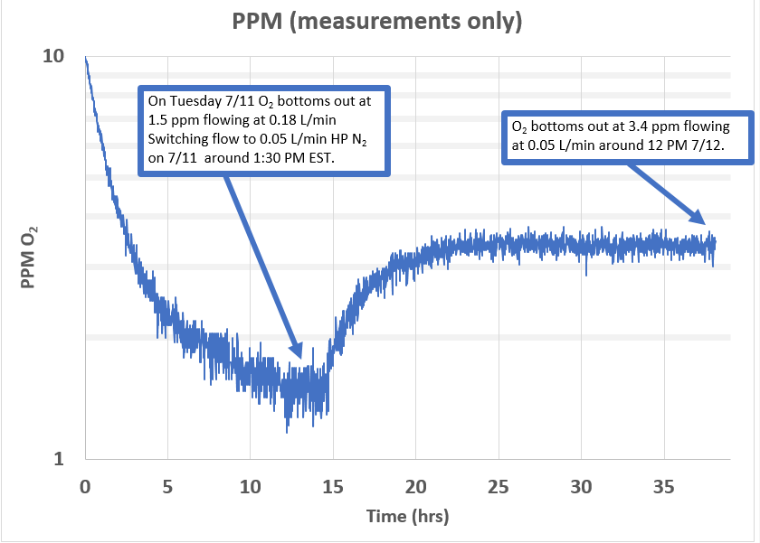
Leak Test Measurements II
Leak test starts by flushing test vessel with low purity (cheap) Nitrogen at a very high rate (4 l/min)
Once O₂ content is below 5 ppm, we perform 2 measurement with high purity nitrogen at a flow of 0.18 l/m and 0.05 l/m

Slide 21
Leak Test Measurements III
Leak test result for the first 5 production IROCs:
The actual leak rate for IROC_003 is much better than shown in table, since the test vessel had a serious leak that was removed after the production of IROC_003 by replacing the original thin bottom plate with a much thicker Al plate with an O-ring.
The conservative estimate assumes the High Purity Nitrogen has no O₂ impurities and the test vessel and the various connectors have no leaks.
The actual estimate takes into account that a) the High Purity Nitrogen has a measured O₂ impurity of ~0.4 ppm and b) subtracting the leak rate for the test vessel without the IROC.

Slide 22
Production time estimates
Very conservative estimate using 21 workdays per month and assume no parallel operations:
3 IROCs per month.
Realistic estimate based on our experience producing the first 5 IROCs using parallel operations and also occationally performing flow rate changes (a 5 minute operation) during weekends:
~8 IROCs per month

